Slide 1
TO-DO
Make to do list
Answer the 2 lingering questions
Figure out what needs to be updated (run file)
Remove age modifier

Slide 2
Research question
How does a car-free inner-ring scenario in Berlin affect person-based accessibility and its distribution across socio-demographic groups using MATSim?
How does the car-free scenario affect person-based accessibility when considering individual transport modes separately?
How does multi-modal accessibility influence the accessibility and equity impacts?
How are accessibility changes distributed across income groups under the car-free scenario? Across age groups? Spatially across districts?
Notes:
Split into methodological research questions and case study ones. Like maybe How location-based vs person-based accessibility compare to each other?

Slide 3
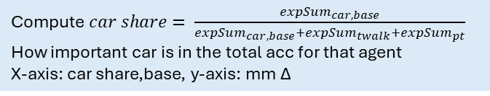
Research question
How does a car-free inner-ring scenario in Berlin affect person-based accessibility using MATSim?
Methodological research questions:
How does person-based accessibility compare to location-based accessibility in evaluating policy impacts?
How does integrating socio-demographic attributes influence accessibility assessment?
How does multimodal accessibility alter the interpretation of accessibility and equity effects?
Case study research questions:
How does the car-free scenario affect accessibility in Berlin?
How are accessibility changes distributed across income groups, age groups and districts?
Who benefits/disadvantaged under the car-free scenario?
Heat map locbased acc
Map pb acc
scatter plot locbased vs pb
Acc by income (into car avail)
Acc by age
Acc by bezirk
Car only Δ by income
Multimodal Δ by income
Plot of car-share vs multimodal Δ
Map of Δ accessibility by district
Bar plot: mean Δ by district
% worsened by district
Compute $car share= \frac{{expSum}_{car,base}}{{expSum}_{car,base}+{expSum}_{twalk}+{expSum}_{pt}}$
How important car is in the total acc for that agent
X-axis: car share,base, y-axis: mm Δ
Boxplot Δ by income, age, district
Table share improved/worsened by group
Outcome table share:
Improved
No change
worsened
Table share by:
Income
Age
Car avail
Scatter:
Base accessibility vs Δ
Notes:
Split into methodological research questions and case study ones. Like maybe How location-based vs person-based accessibility compare to each other?

Slide 4
MATSim framework
Why MATSim is suitable?
Agent-based simulation framework
Assign individual agents with socio-demographic attributes
Modularity of networks
Including public transport
Simulation output
Implement policy measures

Slide 5
Scenario
Base
Represents a default Berlin network
Full car access across Berlin
Distribution across (income groups, age groups, Bezirke):
Policy
Car access restricted within inner ring (refer to policy proposal)
List ruleset on how car travel is restricted specific to the policy scenario
Pt and walking remain unchanged
No new infrastructure improvements
Read xml in R for 6.4 person file

Slide 6
Person-based accessibility
Why?
Before: - Location based
- Ignores socio-demographic heterogeneity
- Aggregate
After: - Computes at an individual level
- Uses agent attributes (income, age etc.)
What?
Mode-specific accessibility (walk, car, pt)
Multi-modal accessibility (logsum over (available) modes)
Accessibility differences by:
Income
Age
Car ownership
Home location
Notes:
Use hospitals/rathaus

Slide 7
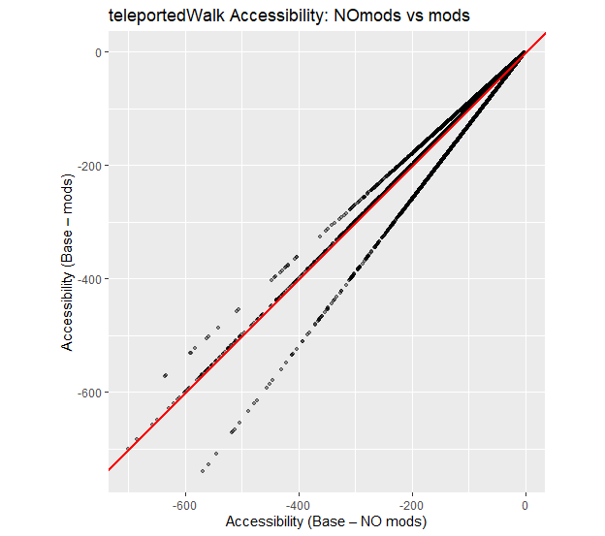
teleportedWalk
Outdated plot
Age modifier:
Age >= 60, then 30% penalty to walk time
Age 15-29, then 10% bonus to walk time
*linear modifier for more detailed distribution
*restricted_mobility modifier
Notes:
Plot labels font size 14

Slide 8
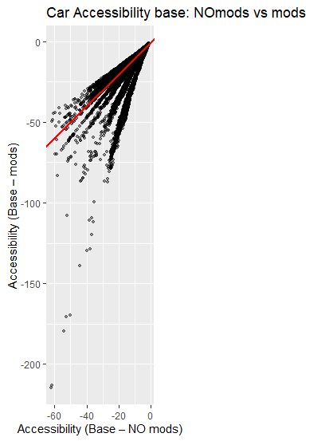
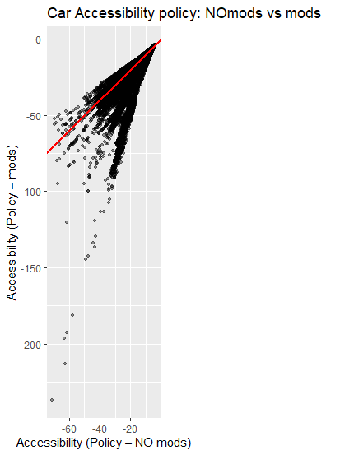
car
Outdated plot
Takes into account the global avg income and then each agents’ income factor is then determined with
double incomeFactor = this.globalAverageIncome / PersonUtils.getIncome((Person) origin.getAttributes().getAttribute("person"));
And then multiplied to the marginal utility of money:
double utilityDistCarMonetary = distCar * betaCarDistMonetary_m * marginalUtilityOfMoney * incomeFactor;

Slide 9
Multimodal accessibility
Why?
Reflects realistic behavioural choice set
Measures system-level accessibility
What results show?
Multimodal accessibility losses are smaller than car-only losses
Substitution of modes mitigates impacts
Distribution of impacts changes significantly
Vulnerable groups are not necessarily worst affected
Notes:
Why logsum and not best score? *add references to plots here maybe

Slide 10
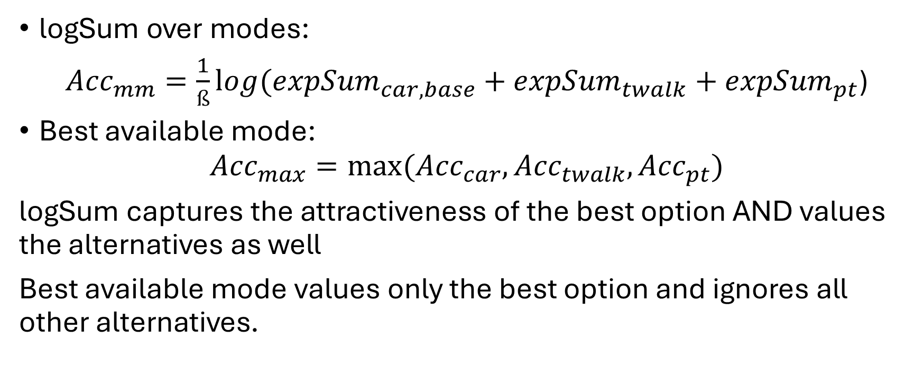
Why logSum and not best mode score?
logSum over modes:
${Acc}_{mm}=\frac{1}{ß}{log⁡(expSum}_{car,base}+{expSum}_{twalk}+{expSum}_{pt}$)
Best available mode:
$${Acc}_{max}=max⁡({Acc}_{car}, {Acc}_{twalk}, {Acc}_{pt})$$
logSum captures the attractiveness of the best option AND values the alternatives as well
Best available mode values only the best option and ignores all other alternatives.
Notes:
Most cases theyre similar, can add simple math example (to know)

Slide 11
(preliminary) results
wip

Slide 12
Base scenario
Preliminary results:
How are the person-based acc scores distributed across socio-demographic groups (by income, age etc.)?
Map of average accessibility by bezirk (show spatial distribution of accessibility)
Notes:
Histogram of mm acc (base)
Boxplot by income (base)

Slide 13
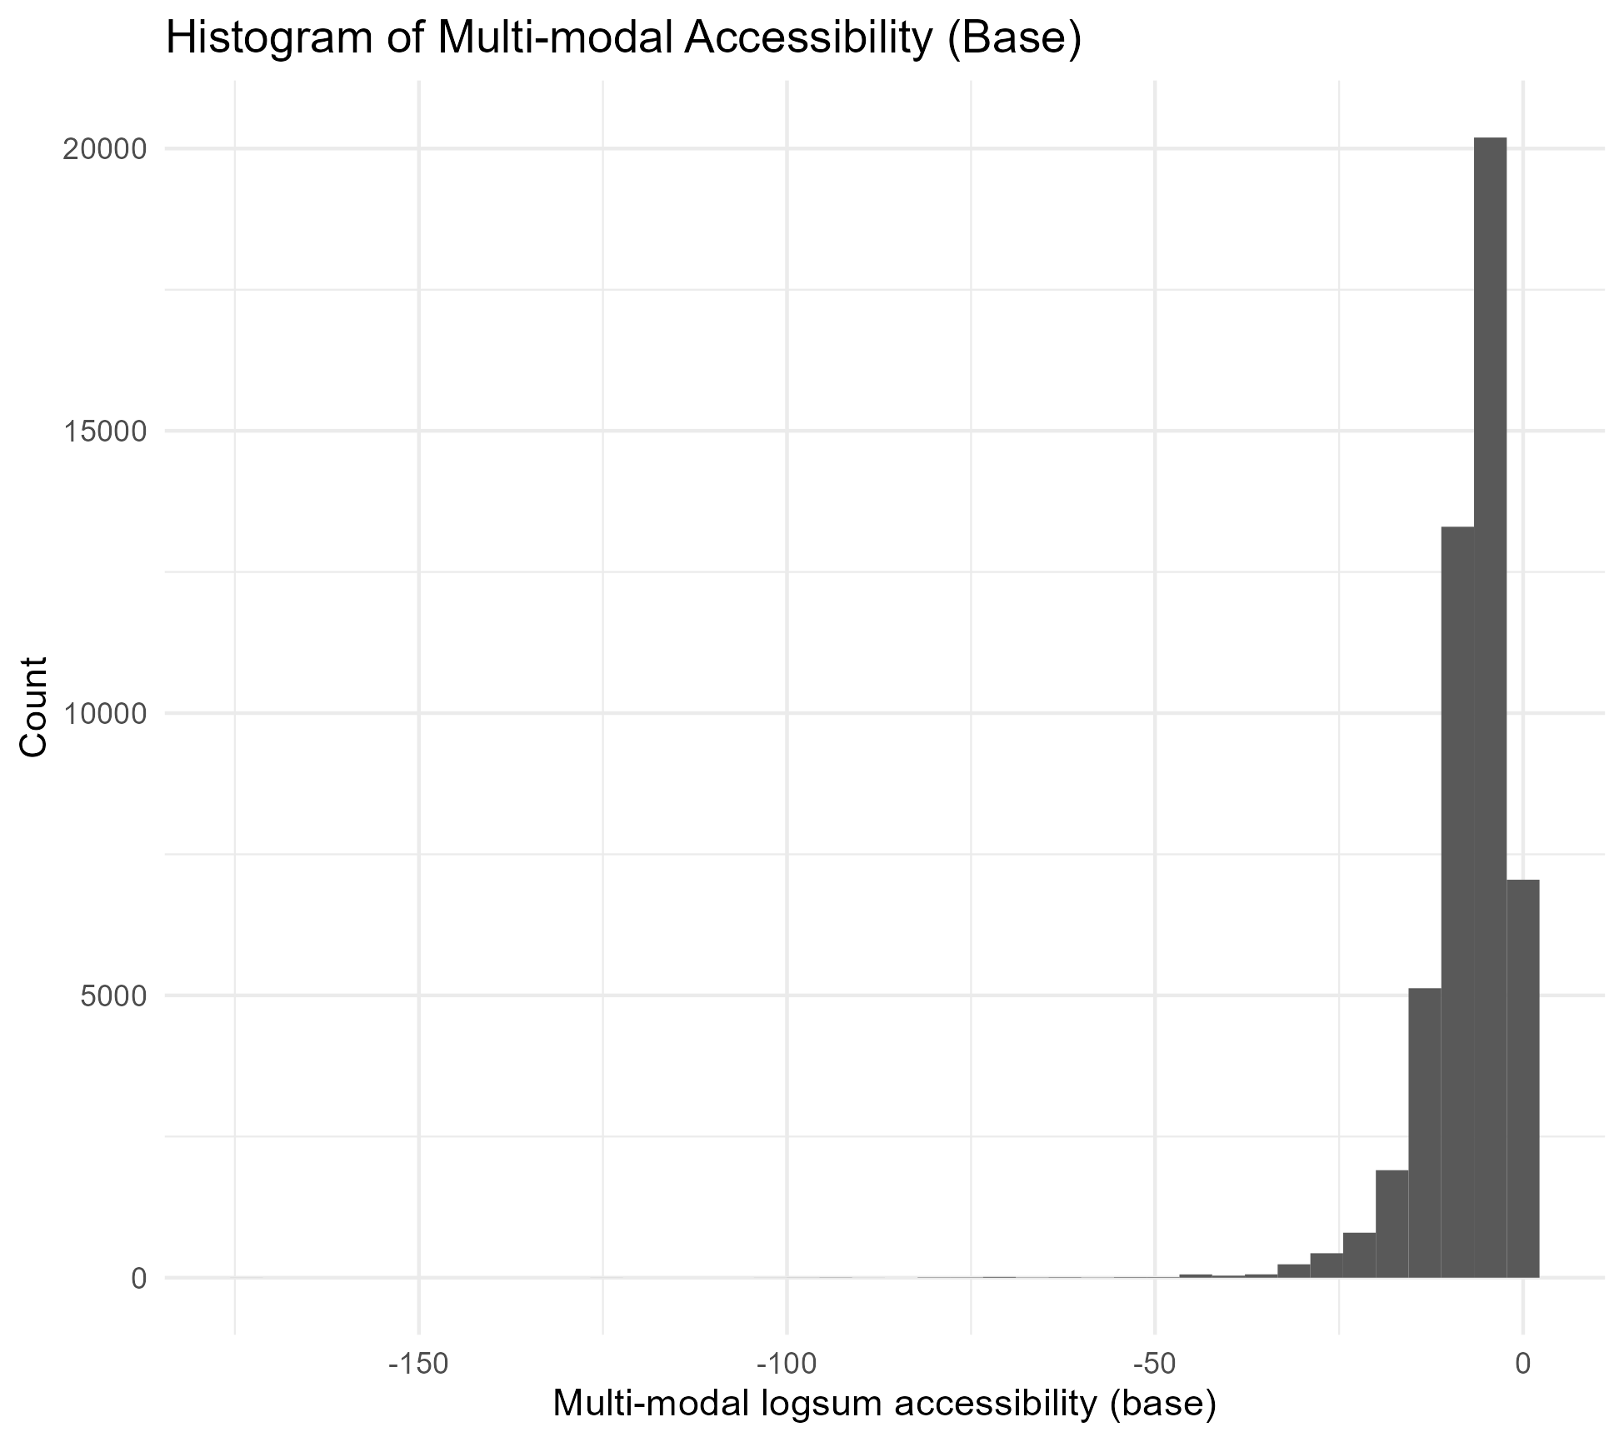
Base scenario
Initial # distribution of mm Acc Even before the policy, accessibility is not uniform.
Differences reflect spatial location, income scaling, age, mode availability.
Notes:
Ignore outliers, better see clearly the distribution add comparison histogram that shows both base+policy but different color(shadow) with same bins + count on the plot

Slide 14
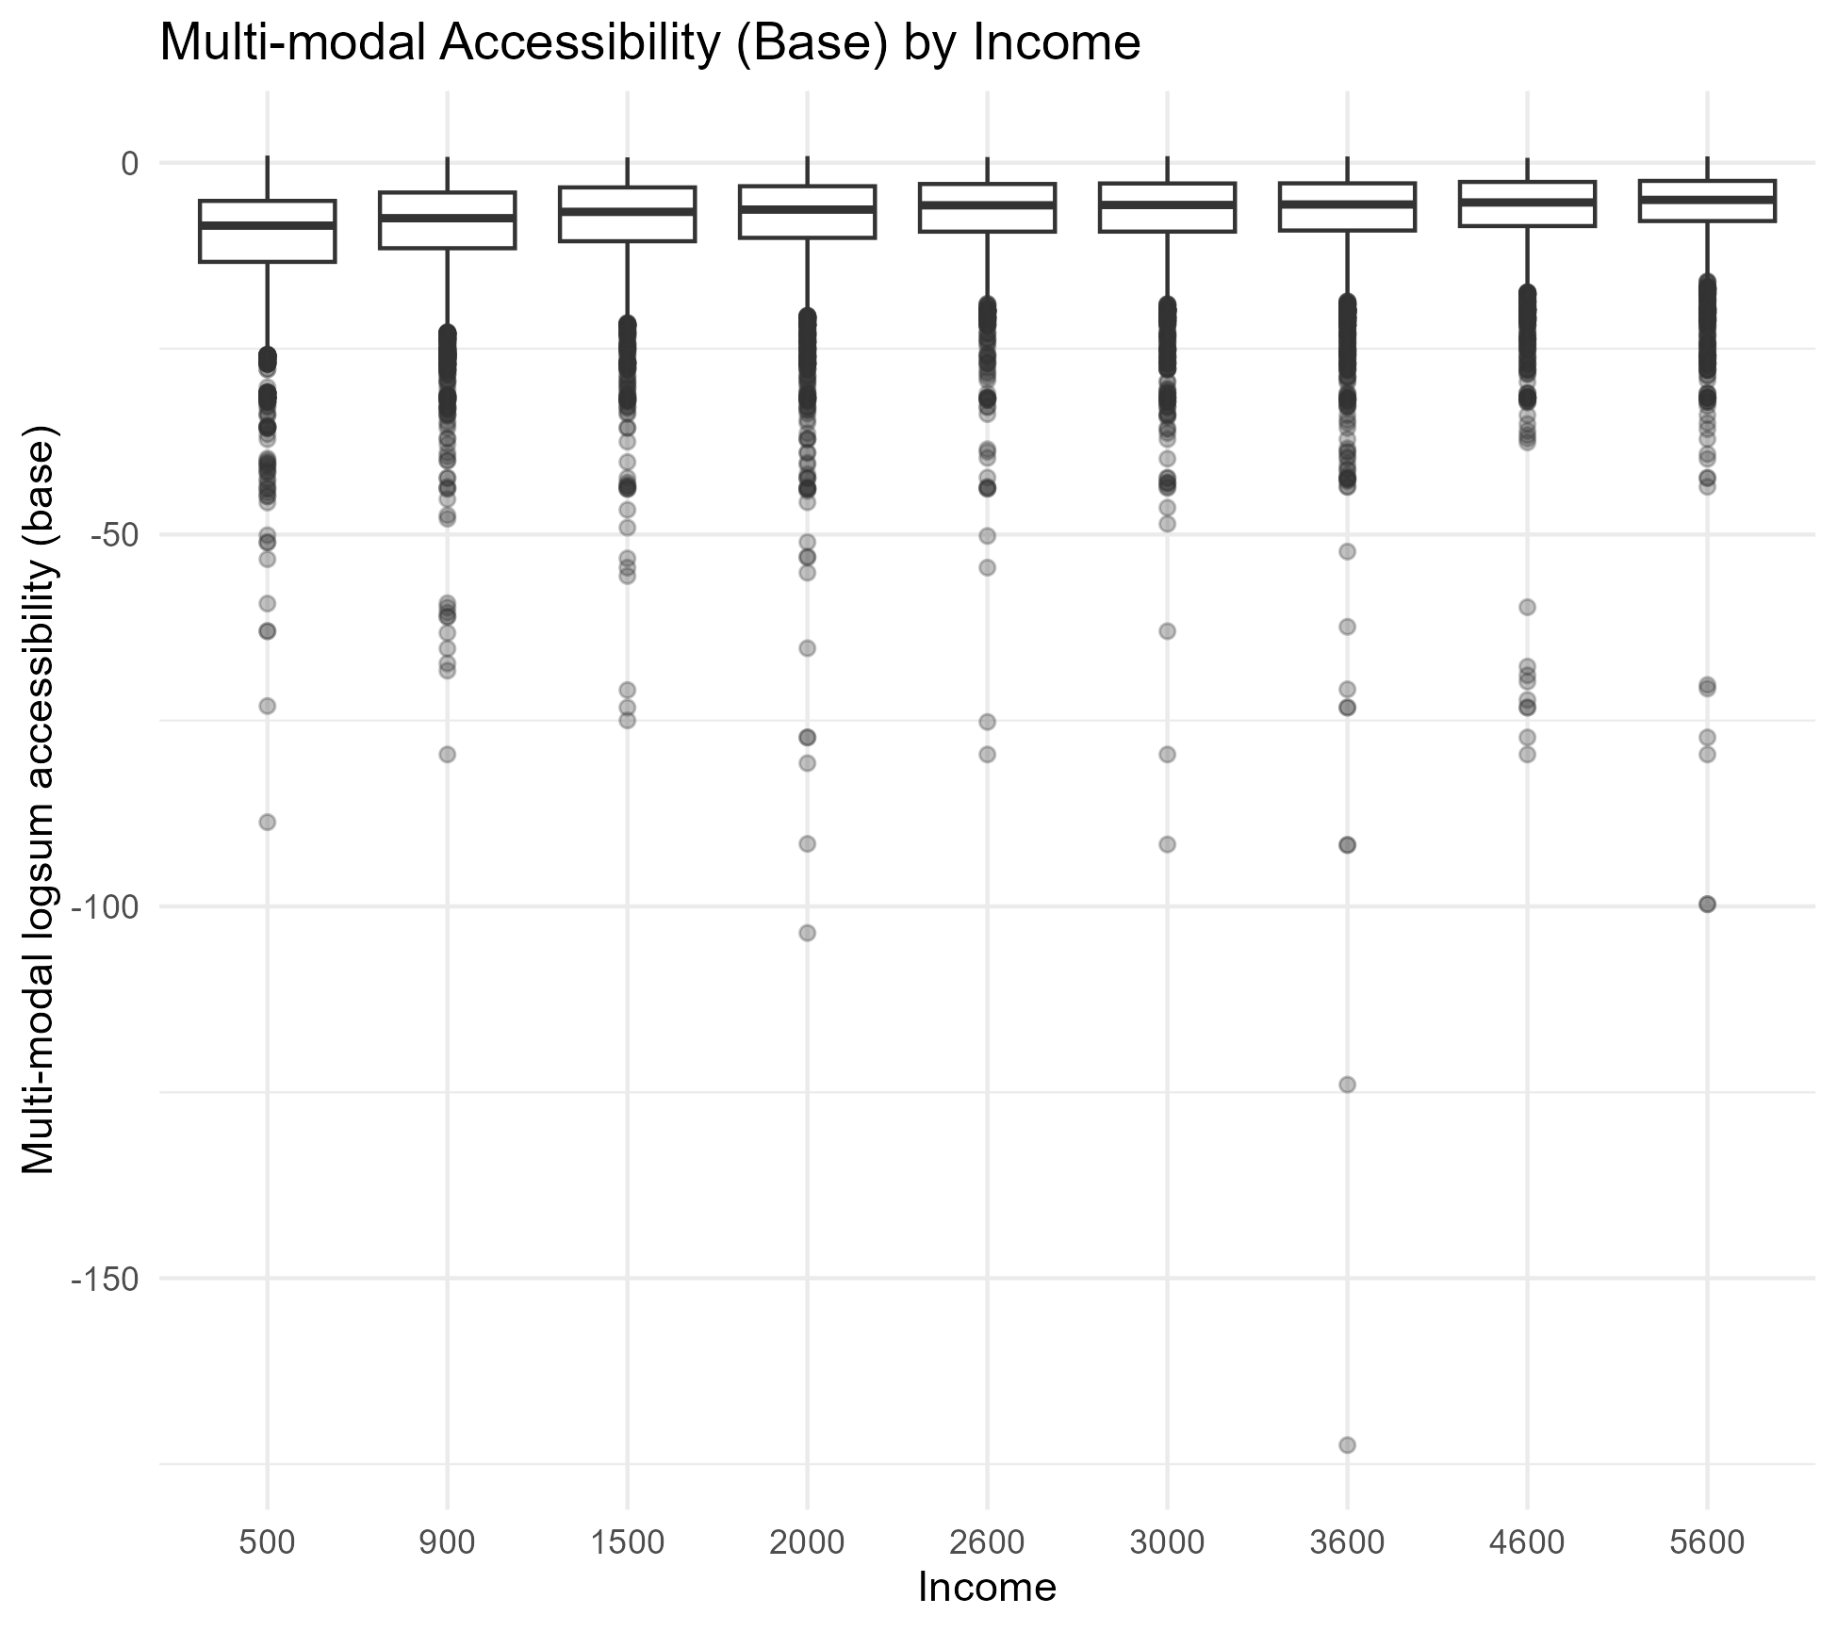
Base scenario
Initial income distribution of mm Acc
*more context*

Slide 15
Policy scenario
Preliminary results:
Specific mode accessibility scores
highlight car deterrence (middle income groups)
Agents who gain accessibility (spatial patterns)
Income distribution of policy effects (car dependence)
Notes:
Mean Δ + median Δ
% worsened/improved

Slide 16
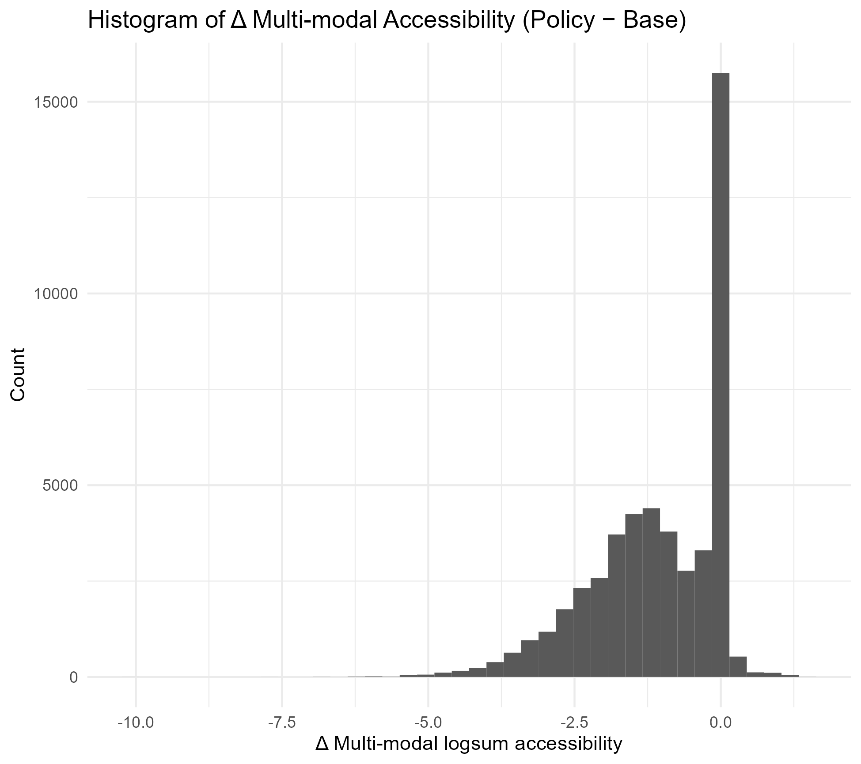
Policy scenario
Majority experience small accessibility changes (from base)

Slide 17
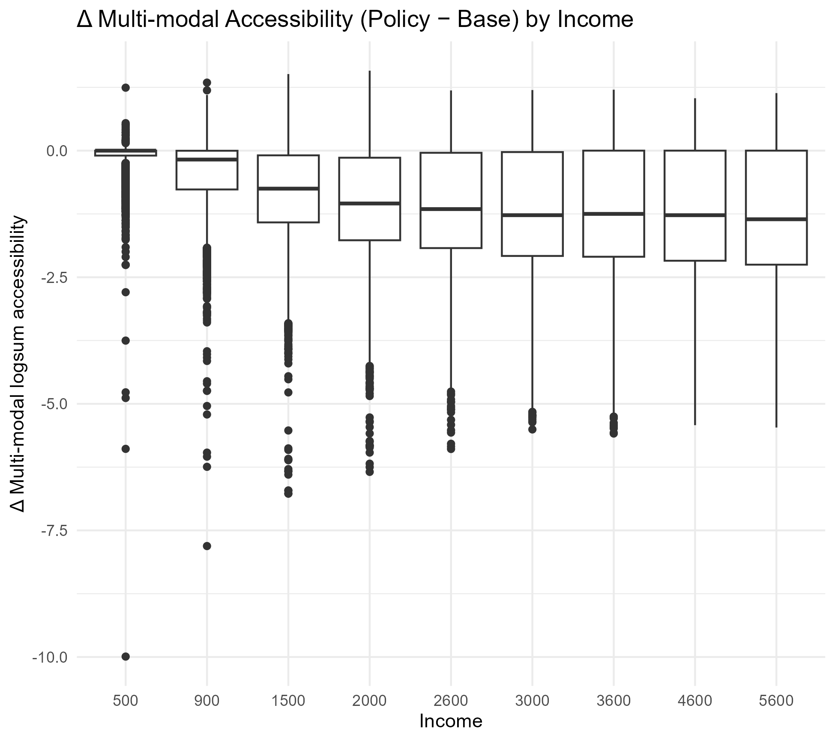
Low income groups not most negatively affected
middle/high income experience bigger losses

Slide 18
Distribution across income
Car only Δ + mm Δ (by income)
Car share (base) vs mm Δ
Spatial distribution
Bar plot / map Δ by bezirk
Improves/worsened/nochange %

Slide 19
Multimodal accessibility
Preliminary results:
Car only delta vs multimodal delta (visual)
Boxplot of distribution

Slide 20
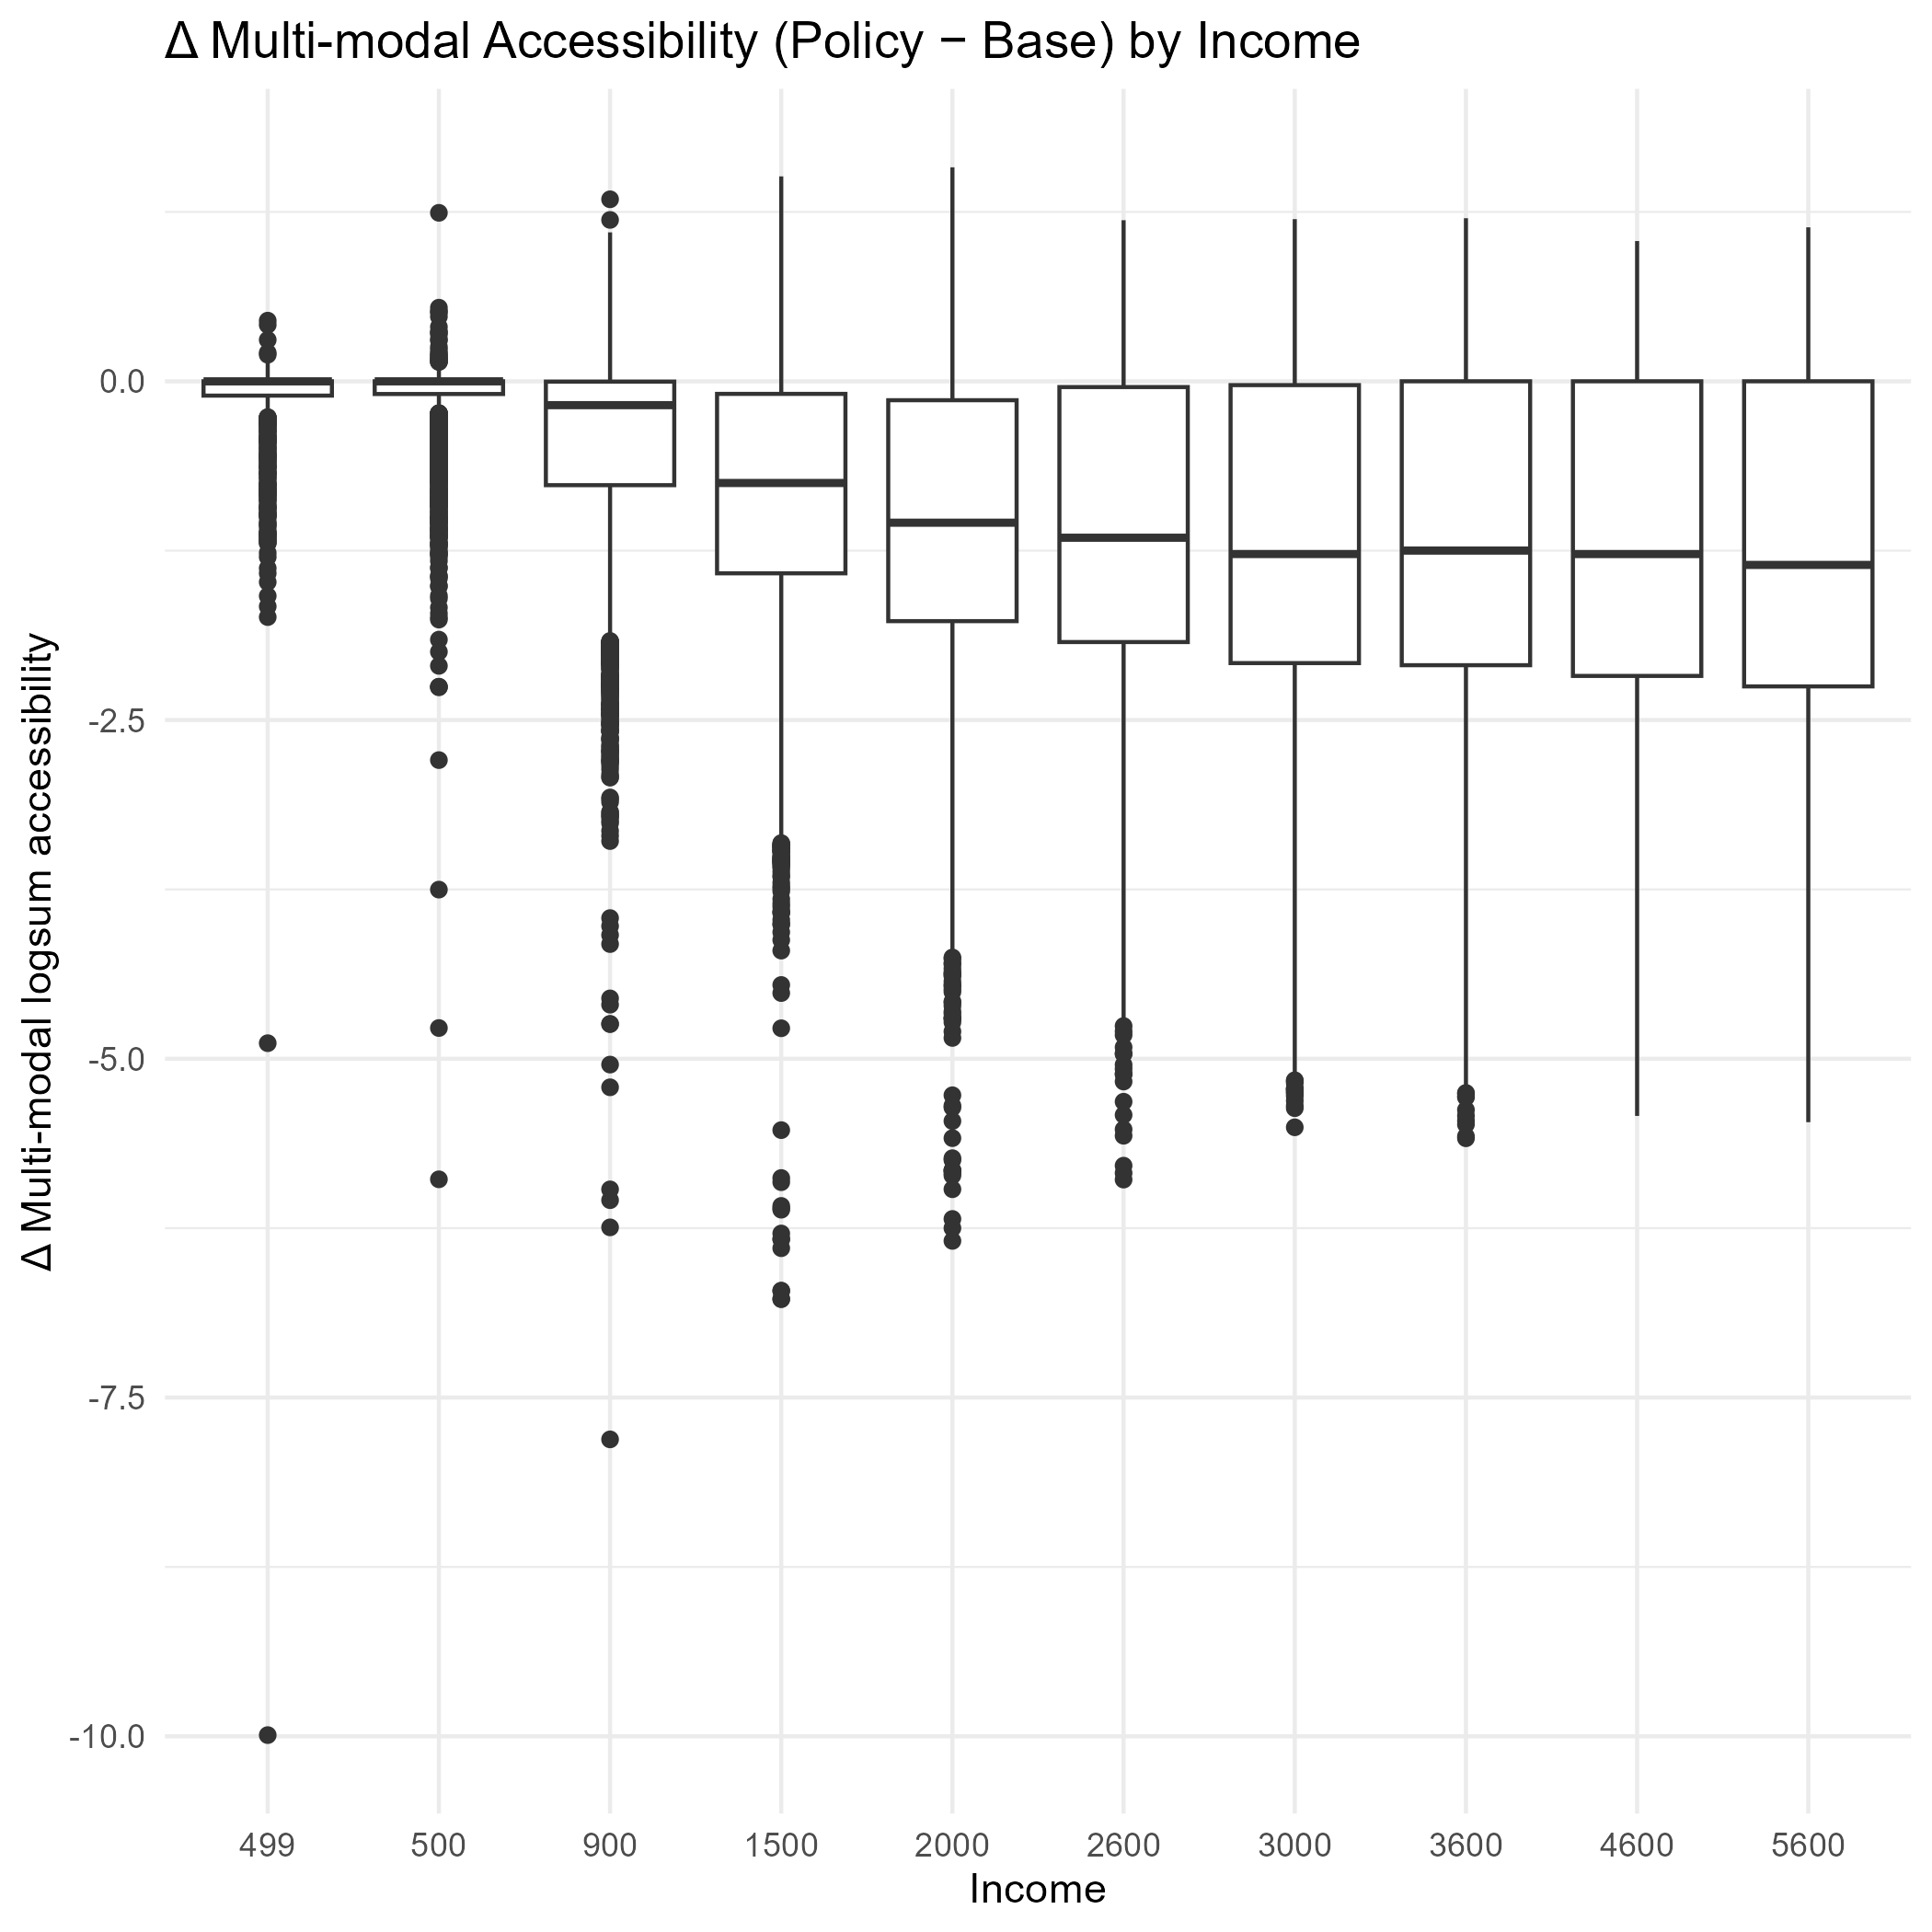
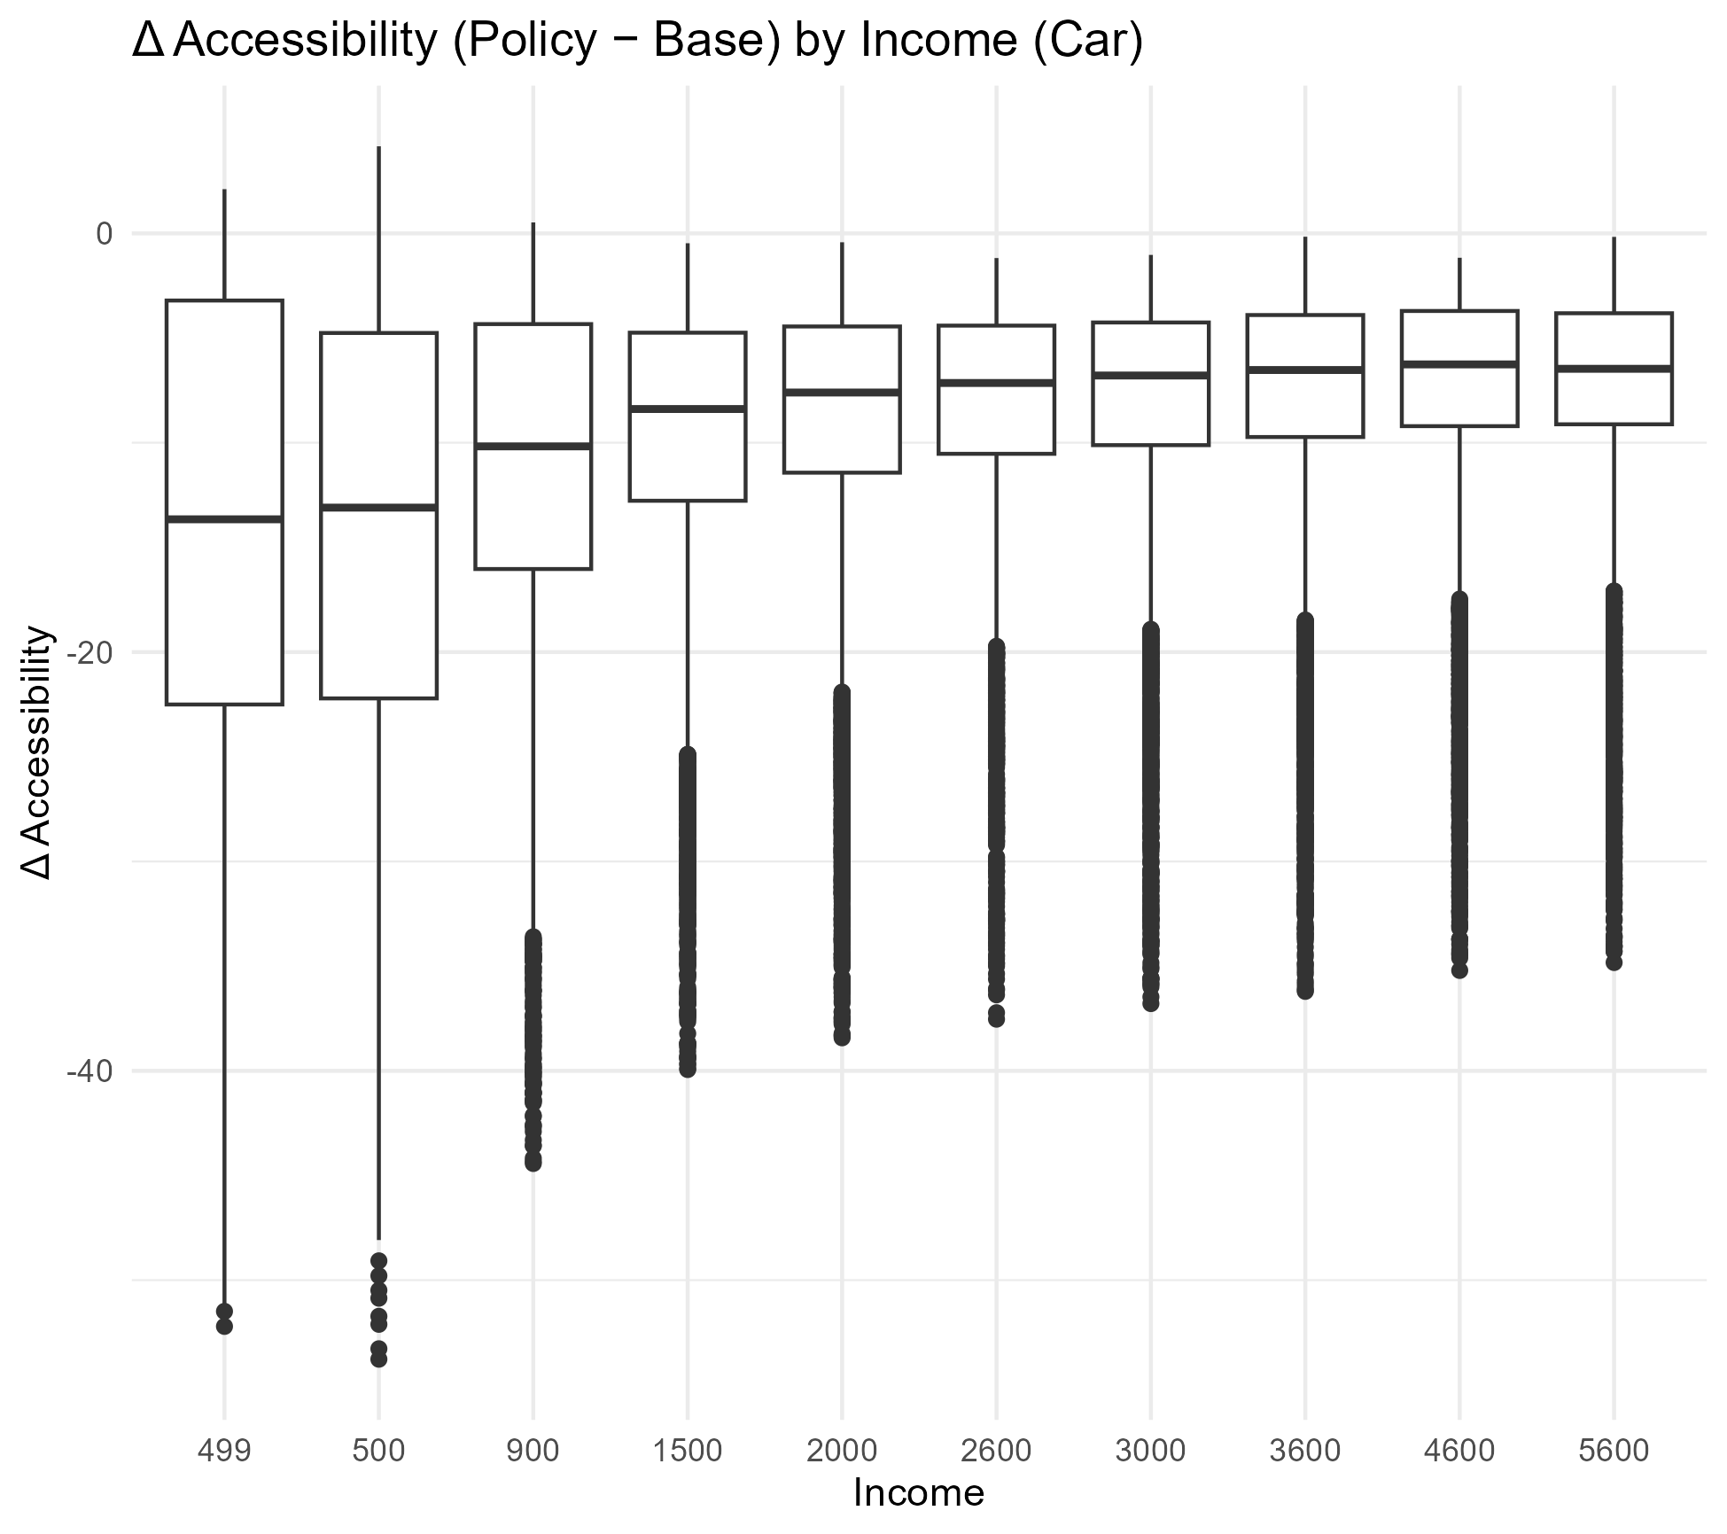
Multimodal accessibility
Outdated plot

Slide 21
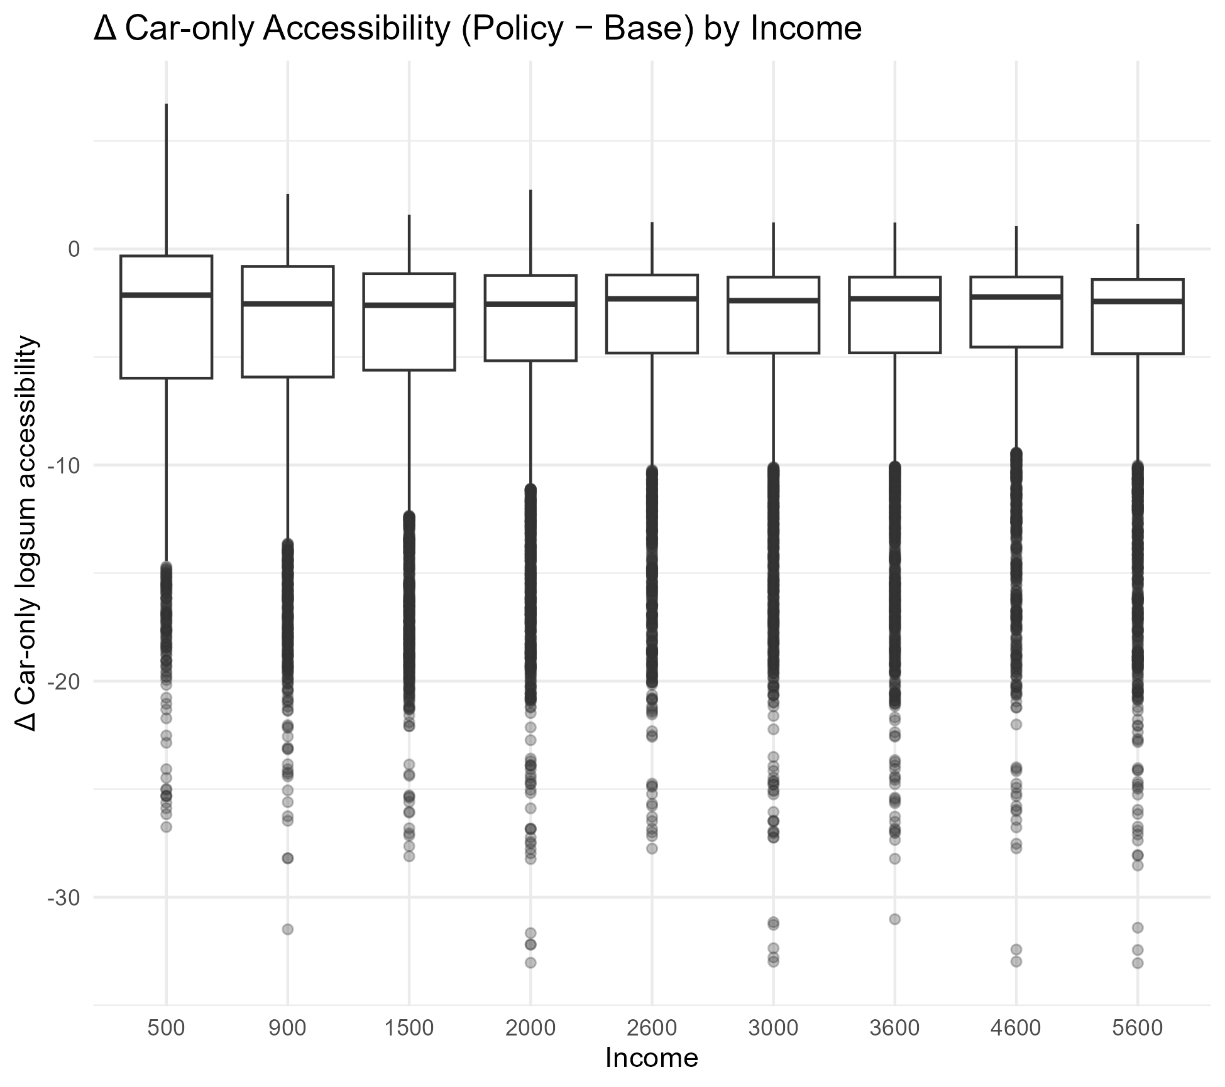
Values of car acc Δ excluding carAvail = “never”
Need to recreate car acc Δ for ALL agents to double check
*more context*

Slide 22
*more context*

Slide 23
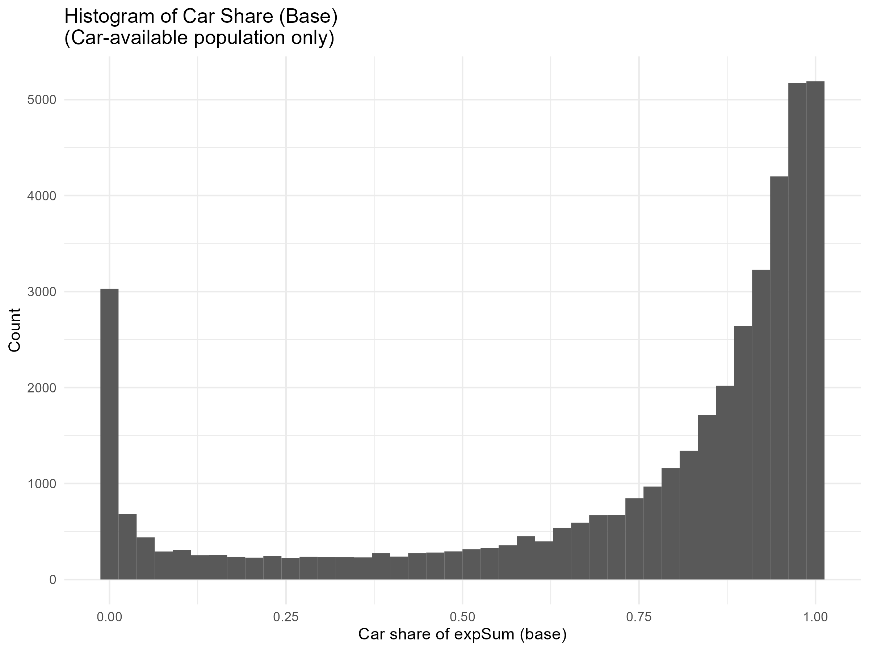
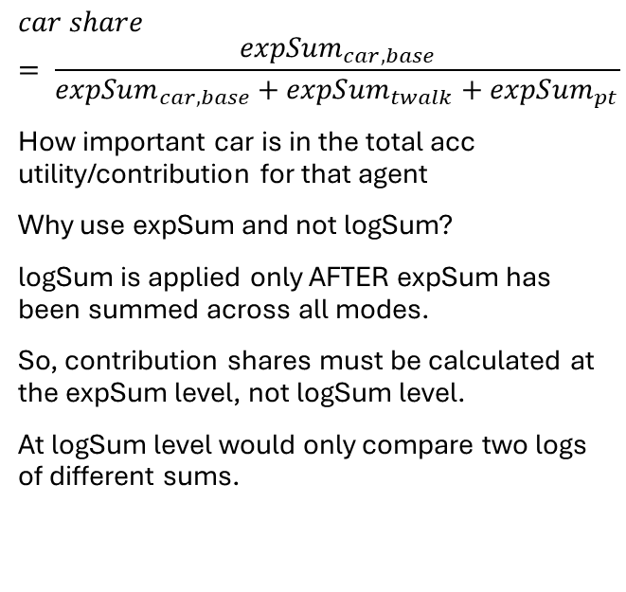
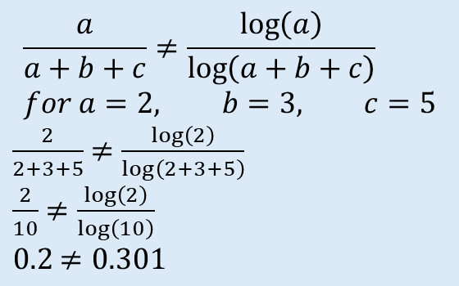
Car share (base)
$$car share= \frac{{expSum}_{car,base}}{{expSum}_{car,base}+{expSum}_{twalk}+{expSum}_{pt}}$$
How important car is in the total acc utility/contribution for that agent
Why use expSum and not logSum?
logSum is applied only AFTER expSum has been summed across all modes.
So, contribution shares must be calculated at the expSum level, not logSum level.
At logSum level would only compare two logs of different sums.
$$\frac{a}{a+b+c}≠\frac{\log\left(a\right)}{\log\left(a+b+c\right)} \\ for a=2, b=3, c=5$$ $\frac{2}{2+3+5}$ $≠\frac{\log\left(2\right)}{\log\left(2+3+5\right)}$
$\frac{2}{10}$ $≠\frac{\log\left(2\right)}{\log\left(10\right)}$ $0.2$ $≠0.301$

Slide 24
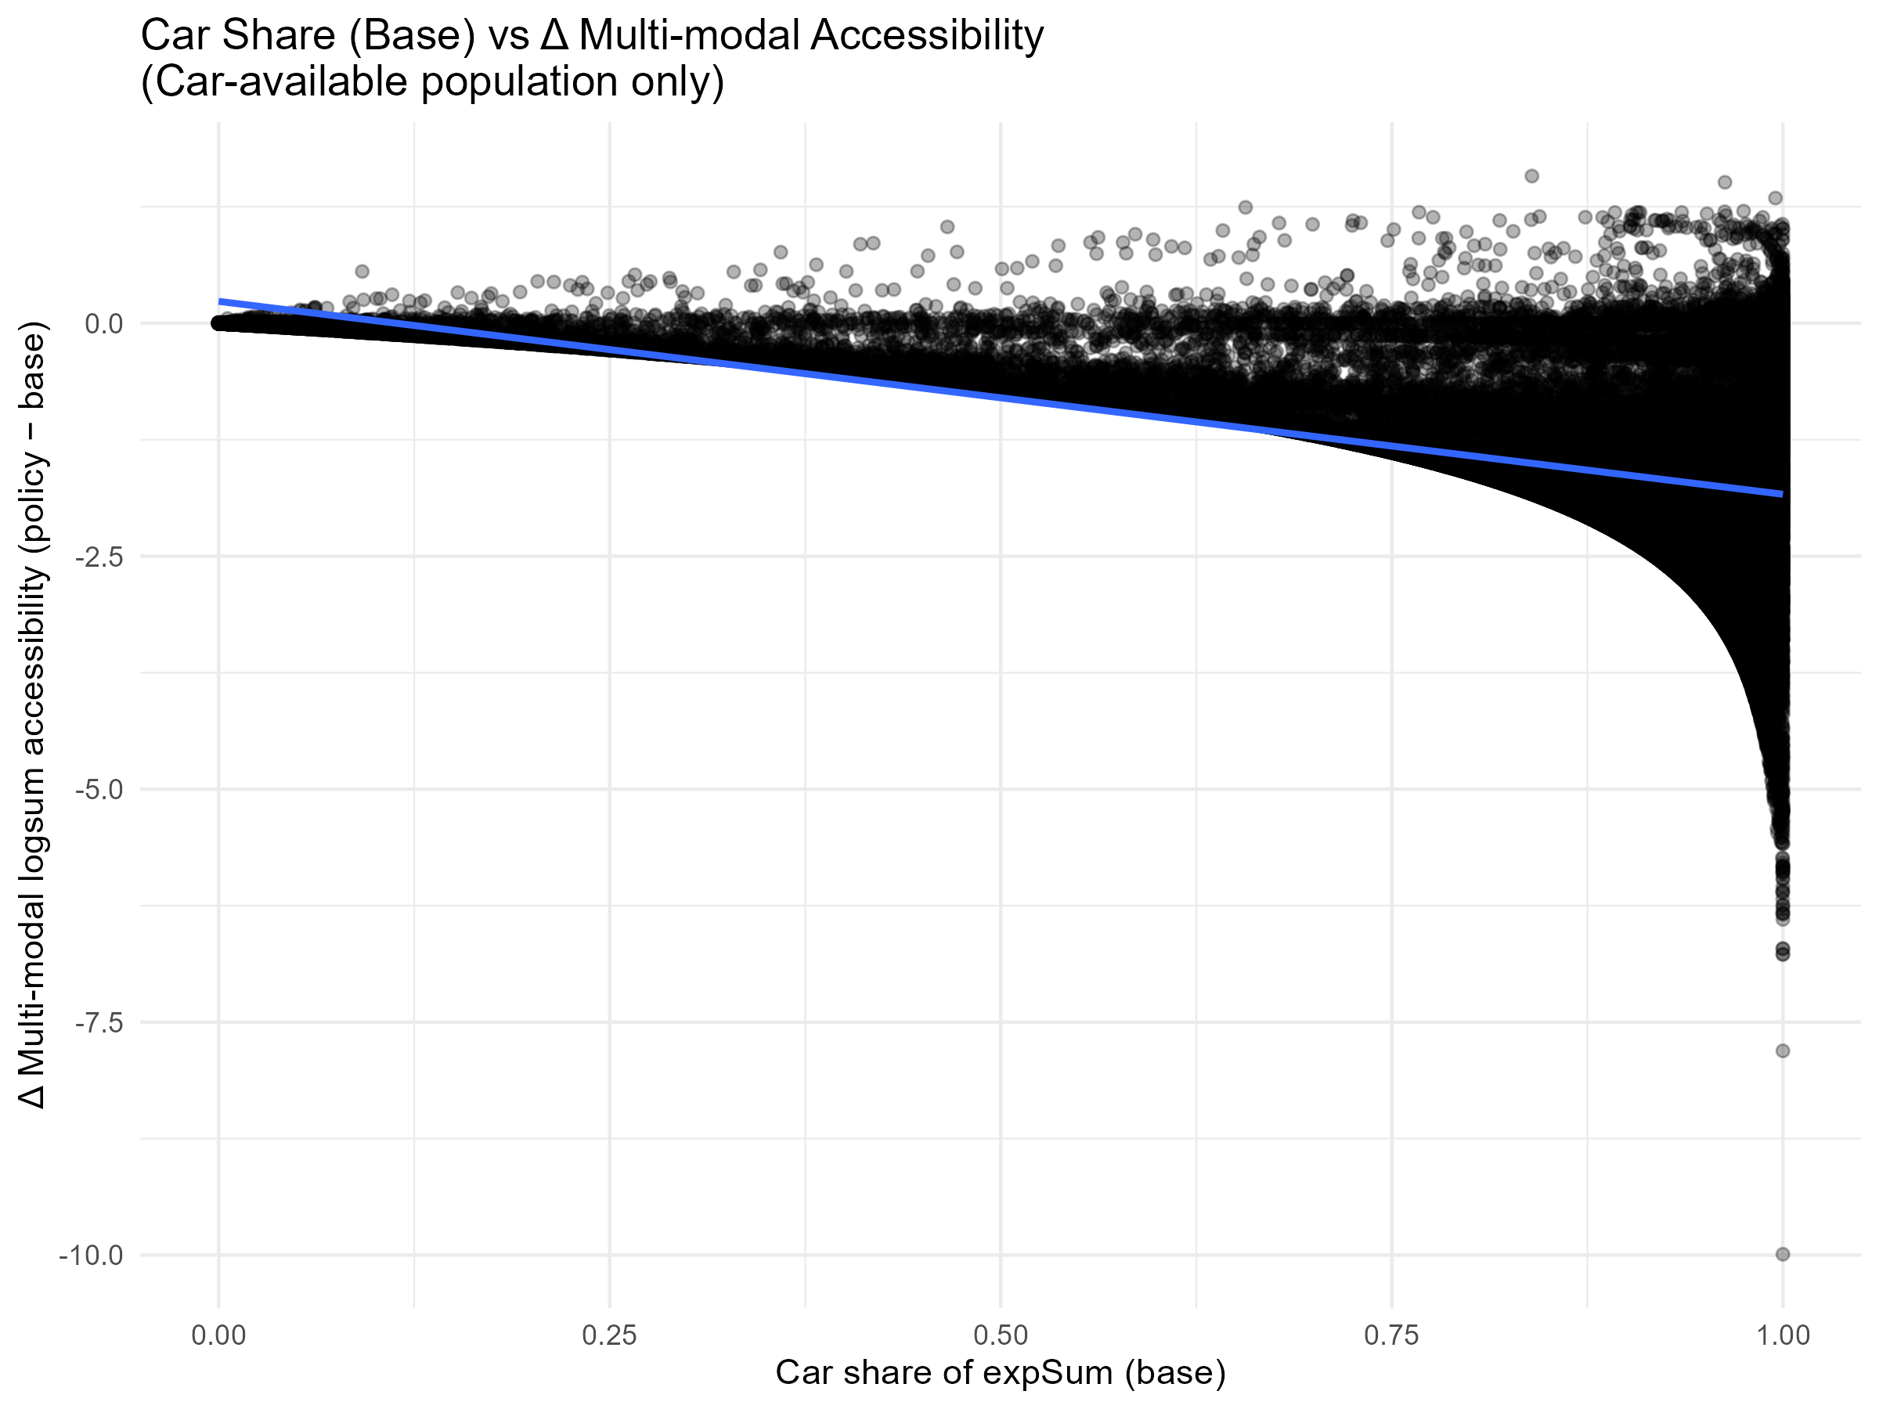
Car share = dependence on car -> which reflects policy vulnerability
Higher car share -> larger mm acc loss
Multimodal accessibility losses scale with car dependance, not directly by income.
Why car share (base) instead of policy/ Δ?
The goal is to explain why some agents experience larger multimodal acc losses than others. Car share is meant to measure how dependent were agents on car acc before the policy.
-> Baseline dependence (car share (base)) of an agent determines the vulnerability to the policy (ΔmmAcc).
Notes:
Agents whose acc is dependent by car in the base scenario experience larger losses under the policy. This plot demonstrates that multimodal accessibility losses are determined by the relative contribution of car to total accessibility, as opposed directly by income, which explains why car-only and multimodal analyses yield different distributional patterns.

Slide 25
Spatial distribution
Bar plot Δ by bezirk / map Δ by bezirk
Show how policy effects are spatially structured in the city
Notes:
See which agent has the highest acc for single opportunity low income agent (that car

Slide 26
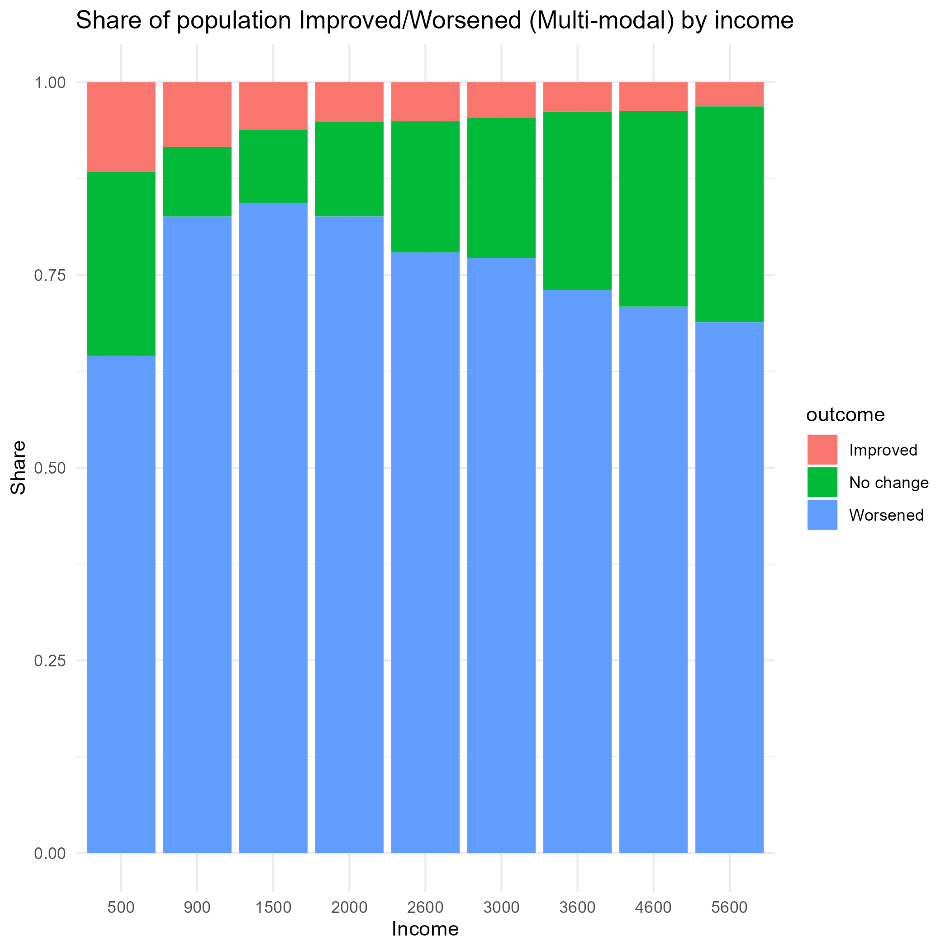
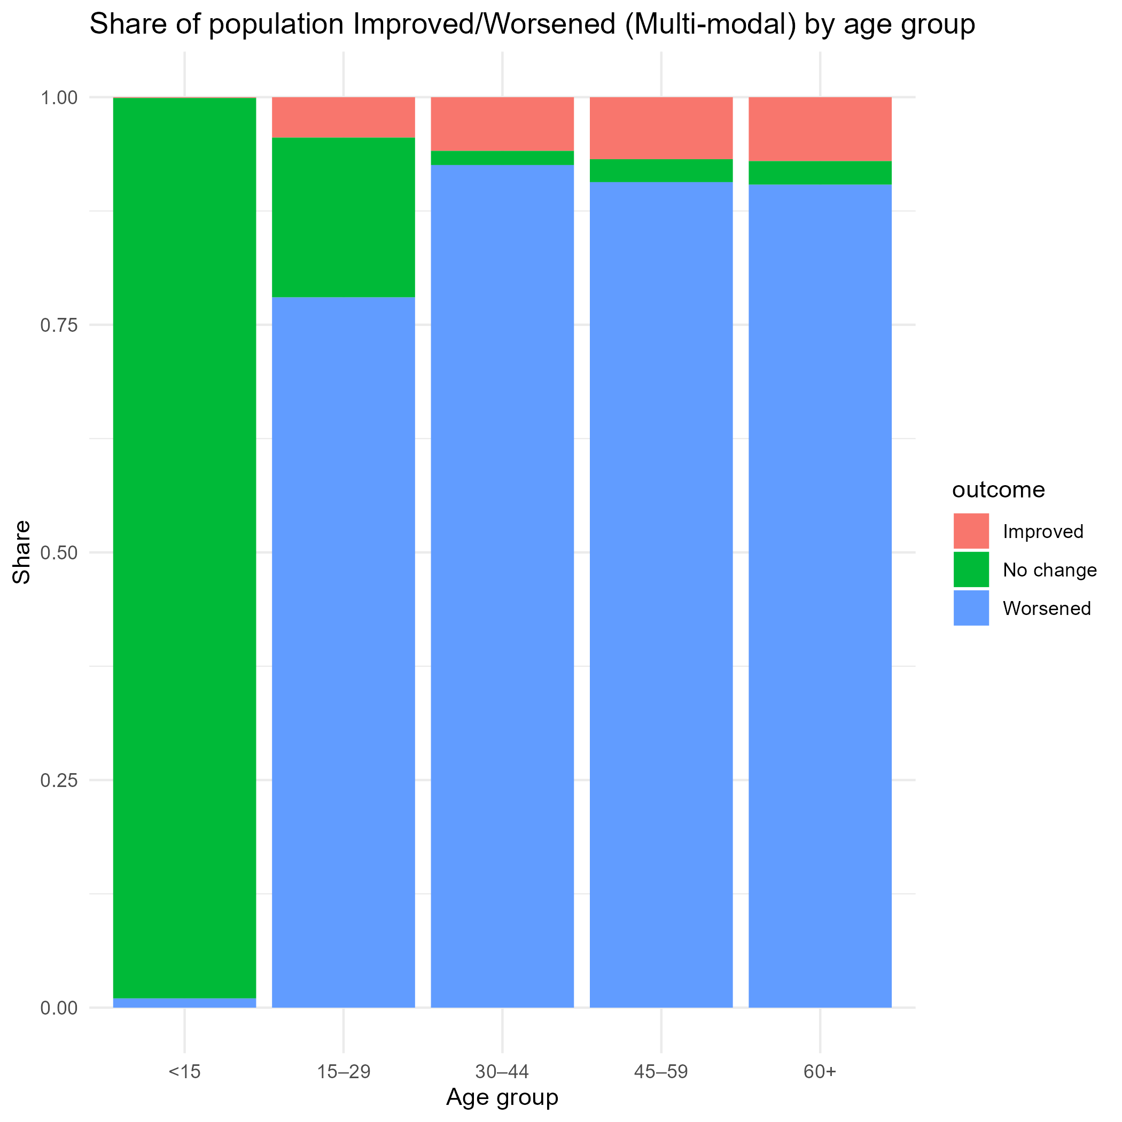
Benefits/loses?
Add age+bezirk
*more context*

Slide 27
Interim conclusions
Accessibility impacts of the policy are heterogeneous
Socio-demographic attributes on agents influence their accessibility scores
The policy affects different areas in different ways (spatially structured)
Multimodal framework changes how equity is interpretated
Accessibility changes scale with transport mode dependence

Slide 28
Q&A
Why/how agents score improve after multimodalAcc?
Is the acc delta income based?
Why high income are more affected within the spread?
> is car ownership income dependent?
How would results change if reinvestments into pt accompanied the car-free policy?
> what policy recommendations follow from the previous question?

Slide 29
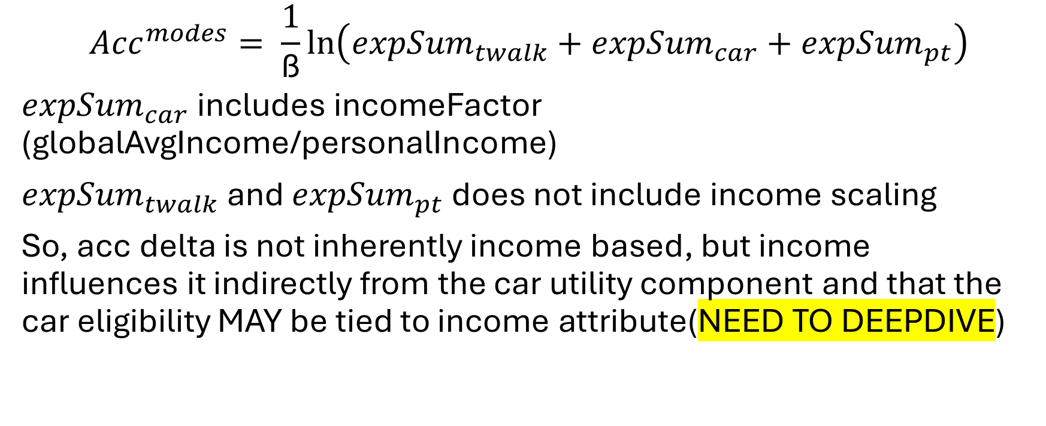
$${Acc}^{modes}= \frac{1}{\text{ß}}\ln\left({expSum}_{twalk}+{expSum}_{car}+{expSum}_{pt}\right)$$
${expSum}_{car}$ includes incomeFactor (globalAvgIncome/personalIncome)
${expSum}_{twalk}$ and ${expSum}_{pt}$ does not include income scaling
So, acc delta is not inherently income based, but income influences it indirectly from the car utility component and that the car eligibility MAY be tied to income attribute(NEED TO DEEPDIVE)

Slide 30
More q&a
Why pbAcc instead of locationbasedAcc?
Why only car experience change after policy and twalk&pt remain?
How much does brainExpBeta affect results?
Why use logsum for multimodalAcc instead of best mode? Try out
How sensitive are results to facility locations? (what would happen if more facilities were included?)
With the policy, equality/inequality? Who are the winners/losers?
Are vulnerable groups protected? Socially just?
For multimodalAcc, what if only car owners are evaluated?

Slide 31
Why/how agents score improve after multimodalAcc in car free berlin (policy)?
Why is there negative relationship between income and mm acc delta despite car avail not income dependant (from persons file)
30min getting through slides (prio more important topics to explain)
How do we even define who has car/car availability based on input files (inaccurate)

