Slide 1
Person-based accessibility analysis of a car-free Berlin using MATSim
Zwischenpräsentation
Ardias Tumiwa (396966)
Supervisor: Jakob Rehmann

Slide 2
Structure
Part I: Introduction
1.1 Research question
Part II: Methodology
2.1 MATSim framework 2.2 Scenarios 2.3 Accessibility 2.4 Person-based accessibility 2.5 Multimodal accessibility
Part III: Results
3.1 Base vs policy scenario 3.2 Multimodal accessibility by income 3.3 Multimodal accessibility by district
Part IV: Summary
4.1 Conclusion 4.2 Remaining work and timeline 4.3 Questions

Slide 3
1.1 Research question
How does a car-free scenario in Berlin affect person-based accessibility using MATSim?
Methodological research questions:
How does person-based accessibility compare to location-based accessibility in evaluating policy impacts? (1)
How does multimodal accessibility alter the interpretation of accessibility and equity effects? (2)
Case study research questions:
How are the accessibility effects distributed across income groups and districts in Berlin? (3)
Which socio-demographic groups experience gains/losses in accessibility under the car-free scenario? (4)

Slide 4
Research questions
How does a car-free zone in Berlin affect person-based accessibility, and how are these effects influenced by income?
Methodological research questions:
How does person-based accessibility differ from location/grid-based accessibility in evaluation transport policy impacts?
How does factoring income into the utility function influence individual accessibility outcomes?
How does multi-modal accessibility alter the interpretation of policy impacts compared to person-based accessibility?
Case study research questions:
What is the overall impact of the car-free zone on accessibility in Berlin?
How are accessibility changes distributed across different income groups?
Which individuals or groups benefit from or are disadvantaged by the car-free zone policy?
How are accessibility impacts distributed spatially across Berlin districts?
To what extent are accessibility changes driven by differences in mode dependence rather than income alone? (one of the hypotheses)

Slide 5
2.1 MATSim framework
Why MATSim?
Agent-based simulation framework
Agents are assigned individual socio-demographic attributes
Modularity of networks (including public transport)
Existing framework for accessibility module
Ability to implement policy measures
Accessibility: Location/grid-based
Notes:
It’s the logsum of the utility of the grid to all opportunities

Slide 6
2.2 Scenarios
Base
Represents a default Berlin network
Full car access including inner ring
Based using the v6.3 1% files
Policy
Car access restricted within inner ring of Berlin
Walking and pt remain the same as base scenario because no new infrastructure improvements implemented for these modes in the policy scenario
Notes:
What does it mean then if there are no new infrastructure improvements for walk+pt in the policy scenario? Explicitly show normal congestion patterns (base), here is car-free congestion patterns (policy)

Slide 7
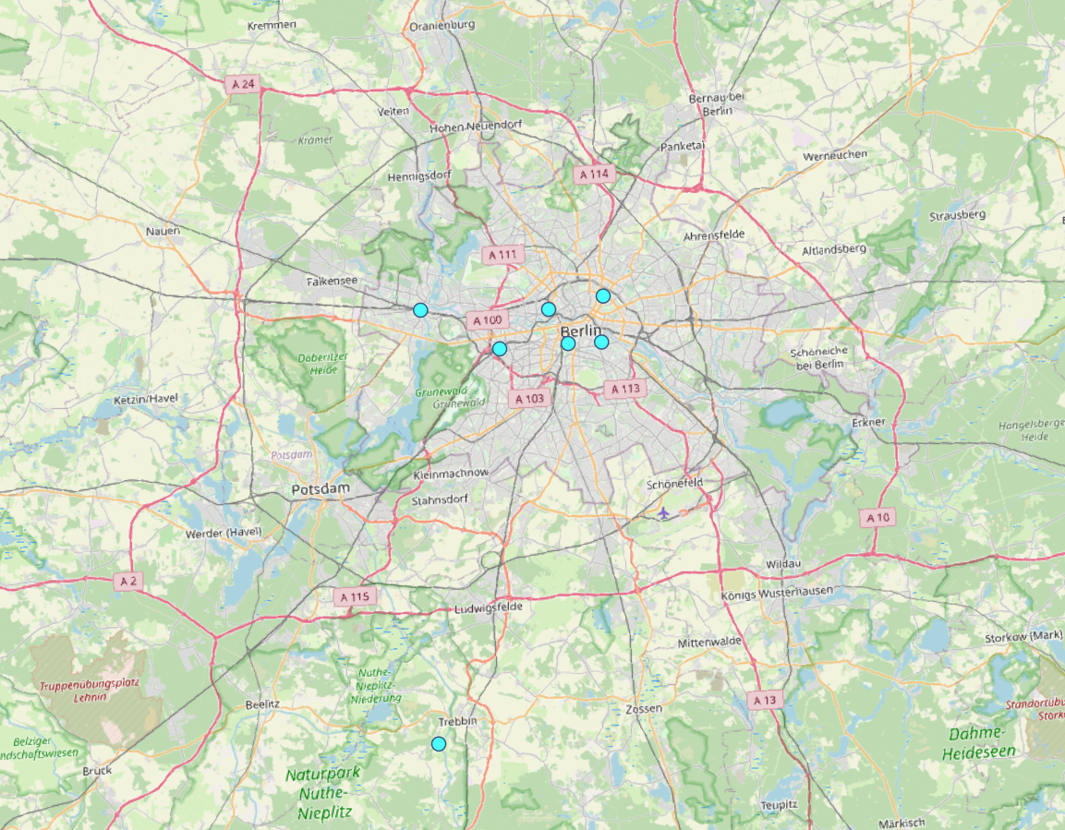
Facilities
Map of facilities
So currently still using berlin spas as the facilities to run everything the accessibility computation.
Reason being that it has been used in the start of this whole process and still being used and added upon ever since and already have existing tables/graphs/plots for it.
However, switch to other facilities can simply be done in the java code.
Notes:
Relation of berlin ring and how the facilities are scattered (slightly uneven) + facilities outside the ring (ludwigsfelde) understand how trips are then executed (outside ring to facility outside the zone instead of inside) filter for poor agents and do detailed analysis deep dive into individual values/steps car acc loss plot (once for poor/ rich) find more details in telling story of agents more detailed case study on individual agents run 6.3> congestion patterns accessibility as a potential anyways

Slide 8

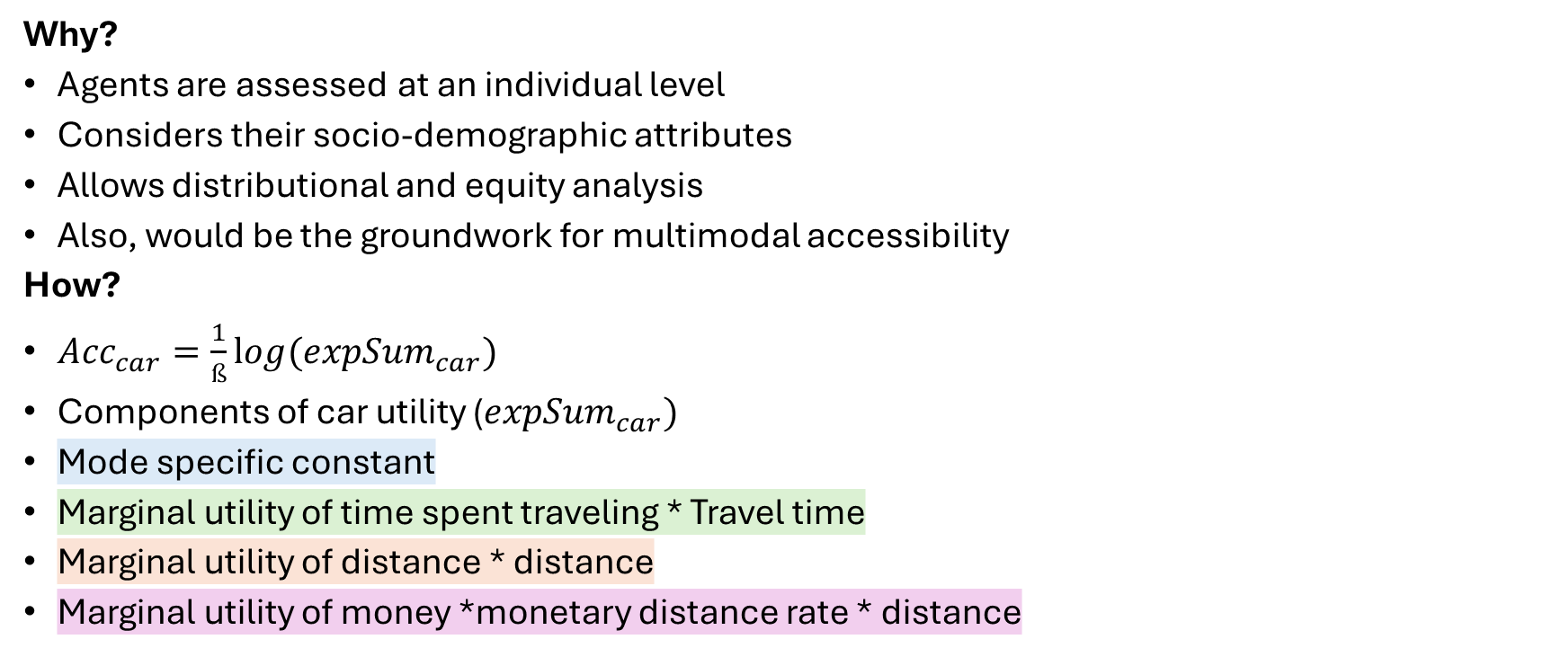
2.3 Person-based accessibility
Why?
Agents are assessed at an individual level
Considers their socio-demographic attributes
Allows distributional and equity analysis
Also, would be the groundwork for multimodal accessibility
How?
${Acc}_{car}=\frac{1}{ß}{log⁡(expSum}_{car})$
Components of car utility (${expSum}_{car})$
Mode specific constant
Marginal utility of time spent traveling * Travel time
Marginal utility of distance * distance
Marginal utility of money *monetary distance rate * distance
Notes:
Logsum = represents the total expected utility of all available options in a choice model. To calculate the overall attractiveness of transportation options.
pbAcc is the logsum of the aggregated utility to all opportunities/facilities

Slide 9
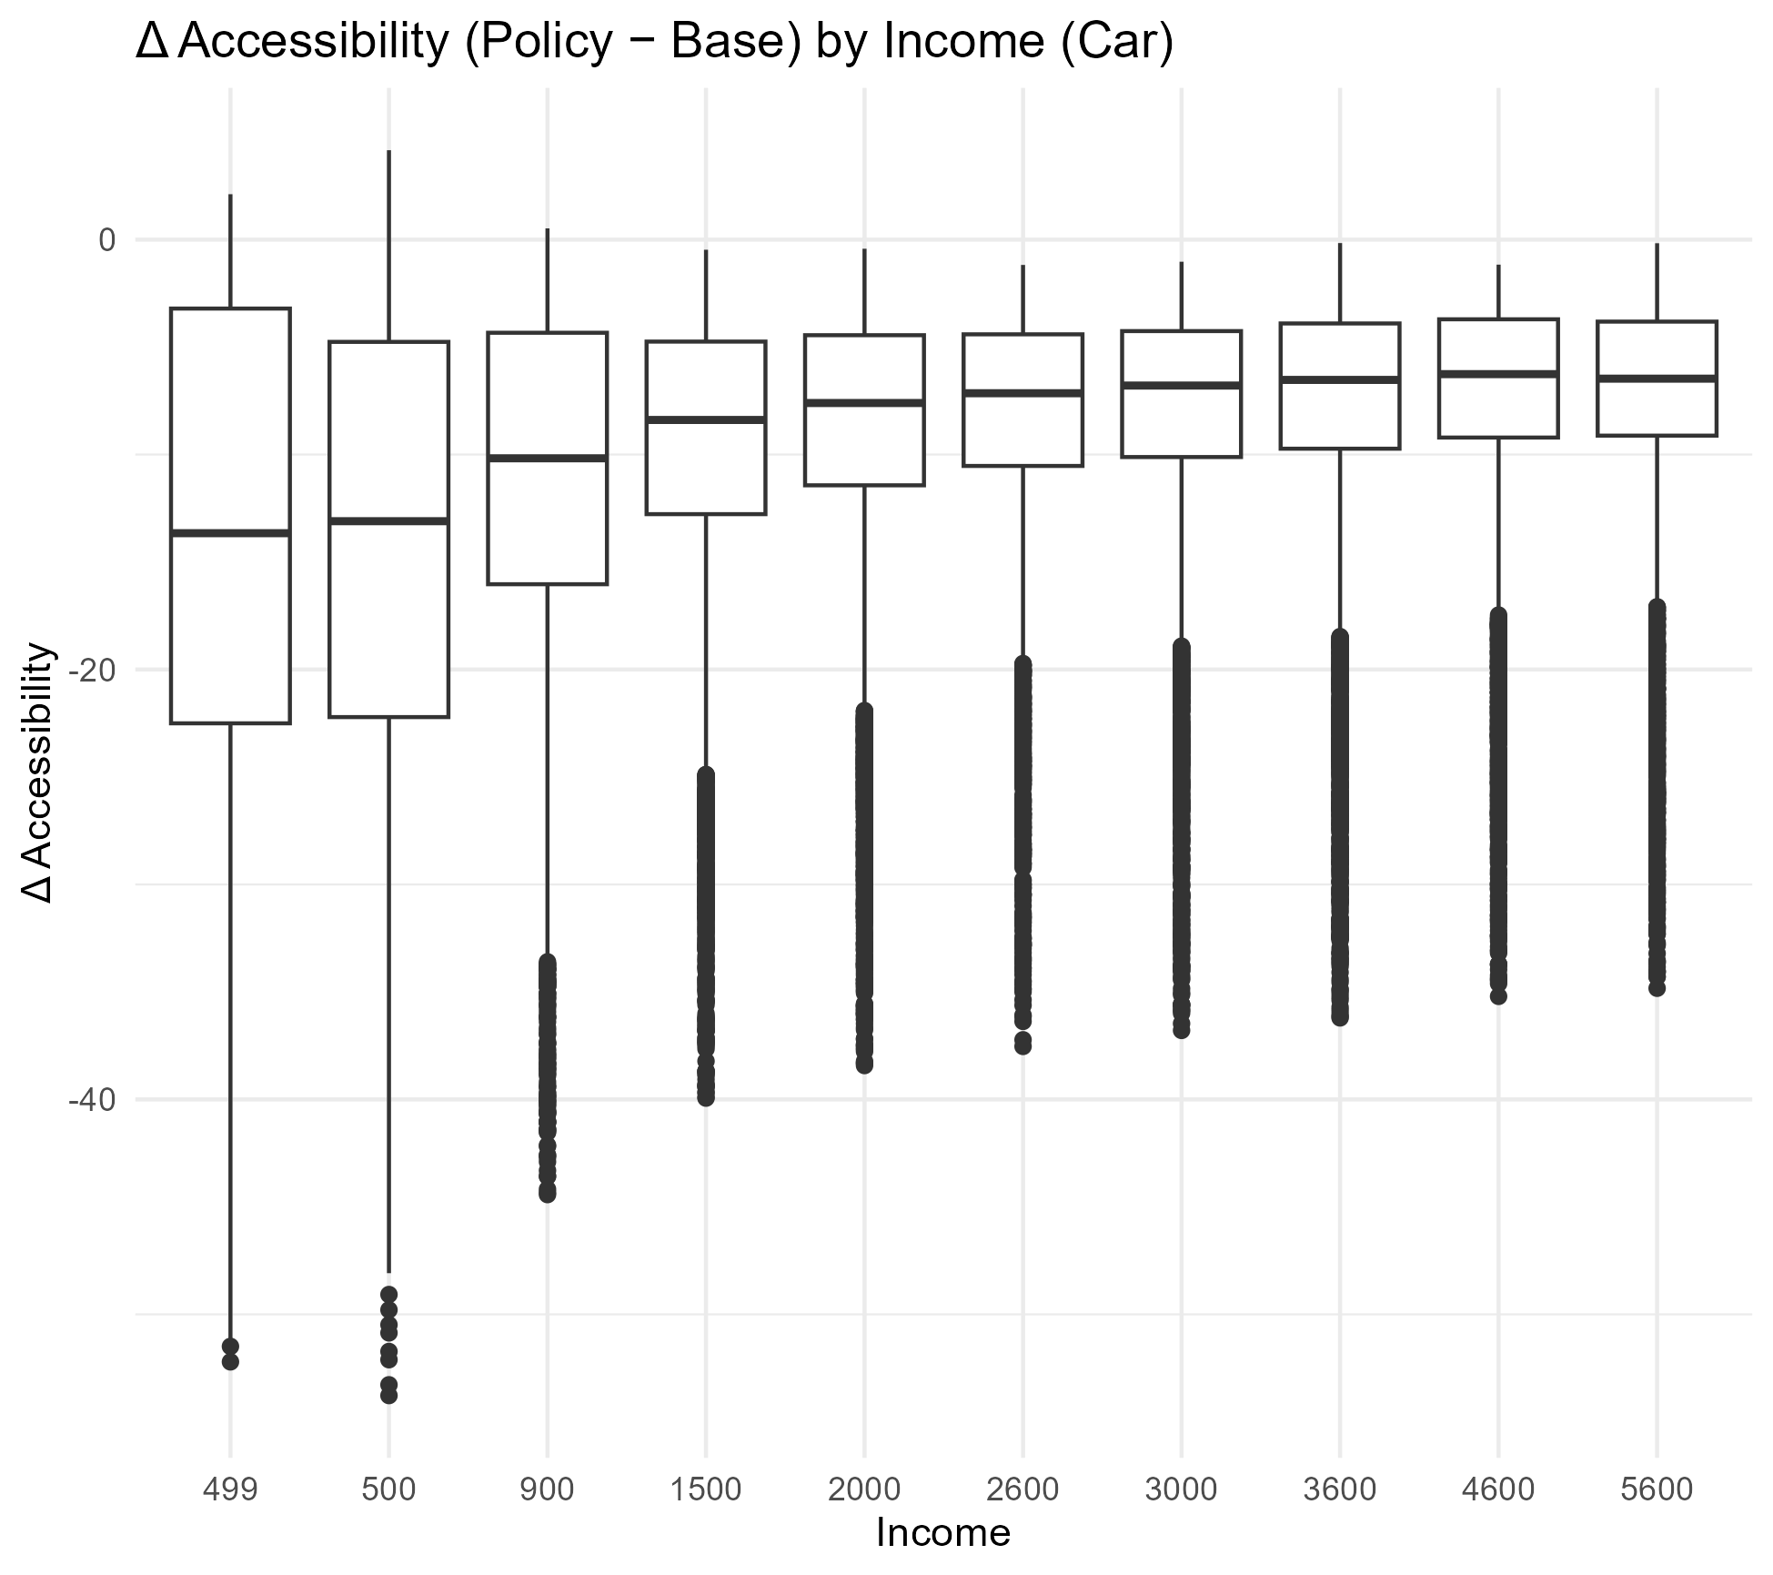
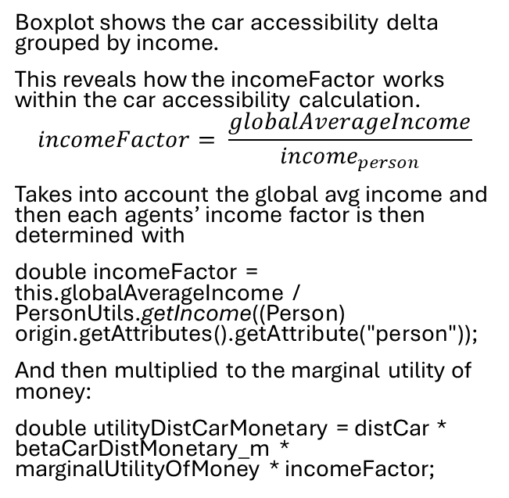
2.3 Person-based accessibility
Boxplot shows the car accessibility delta grouped by income.
This reveals how the incomeFactor works within the car accessibility calculation.
$$incomeFactor= \frac{globalAverageIncome}{{income}_{person}}$$
Takes into account the global avg income and then each agents’ income factor is then determined with
double incomeFactor = this.globalAverageIncome / PersonUtils.getIncome((Person) origin.getAttributes().getAttribute("person"));
And then multiplied to the marginal utility of money:
double utilityDistCarMonetary = distCar * betaCarDistMonetary_m * marginalUtilityOfMoney * incomeFactor;
Notes:
Which type of people are driving these results

Slide 10
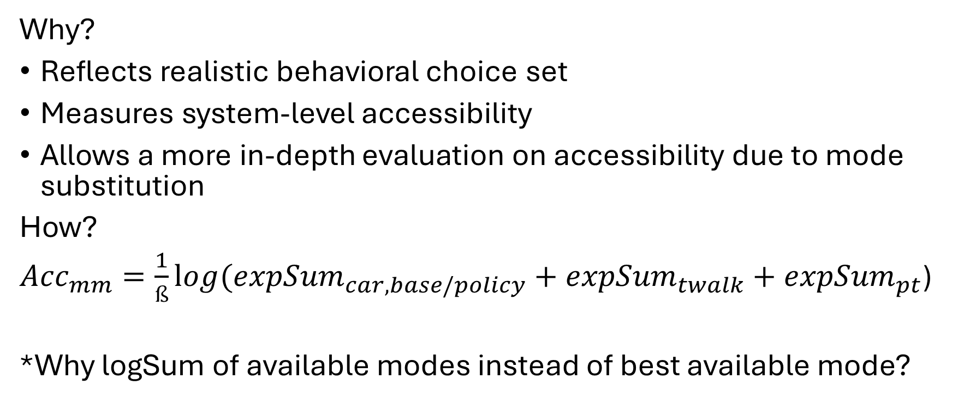
2.4 Multimodal accessibility
Why?
Reflects realistic behavioral choice set
Measures system-level accessibility
Allows a more in-depth evaluation on accessibility due to mode substitution
How?
${Acc}_{mm}=\frac{1}{ß}{log⁡(expSum}_{car,base/policy}+{expSum}_{twalk}+{expSum}_{pt}$)
*Why logSum of available modes instead of best available mode?
Notes:
Value that represents the total expected utility of all available modes to an agent

Slide 11
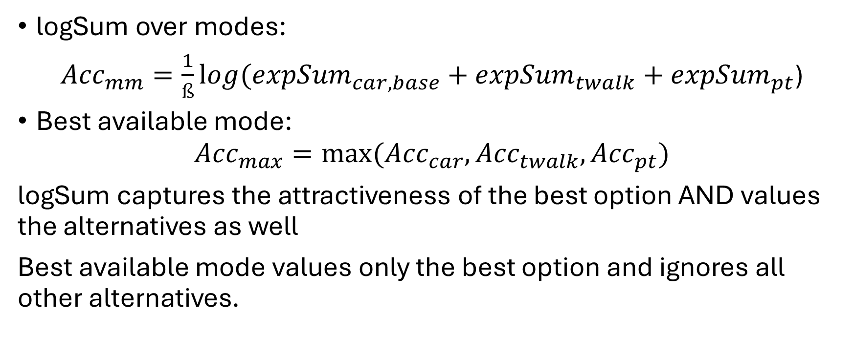
Why logSum and not best mode score?
logSum over modes:
${Acc}_{mm}=\frac{1}{ß}{log⁡(expSum}_{car,base}+{expSum}_{twalk}+{expSum}_{pt}$)
Best available mode:
$${Acc}_{max}=max⁡({Acc}_{car}, {Acc}_{twalk}, {Acc}_{pt})$$
logSum captures the attractiveness of the best option AND values the alternatives as well
Best available mode values only the best option and ignores all other alternatives.
Notes:
Most cases theyre similar, can add simple math example (to know)

Slide 12
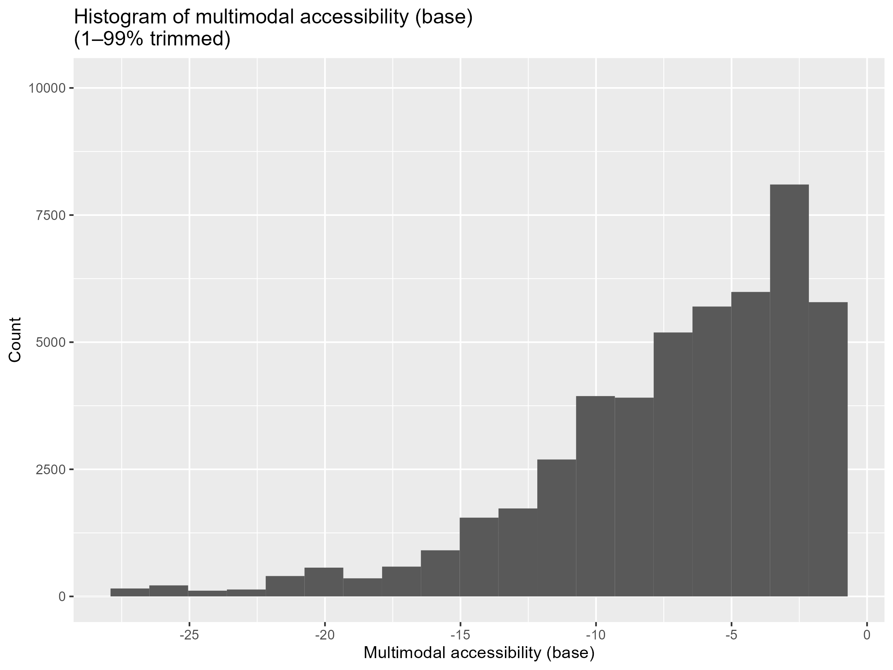
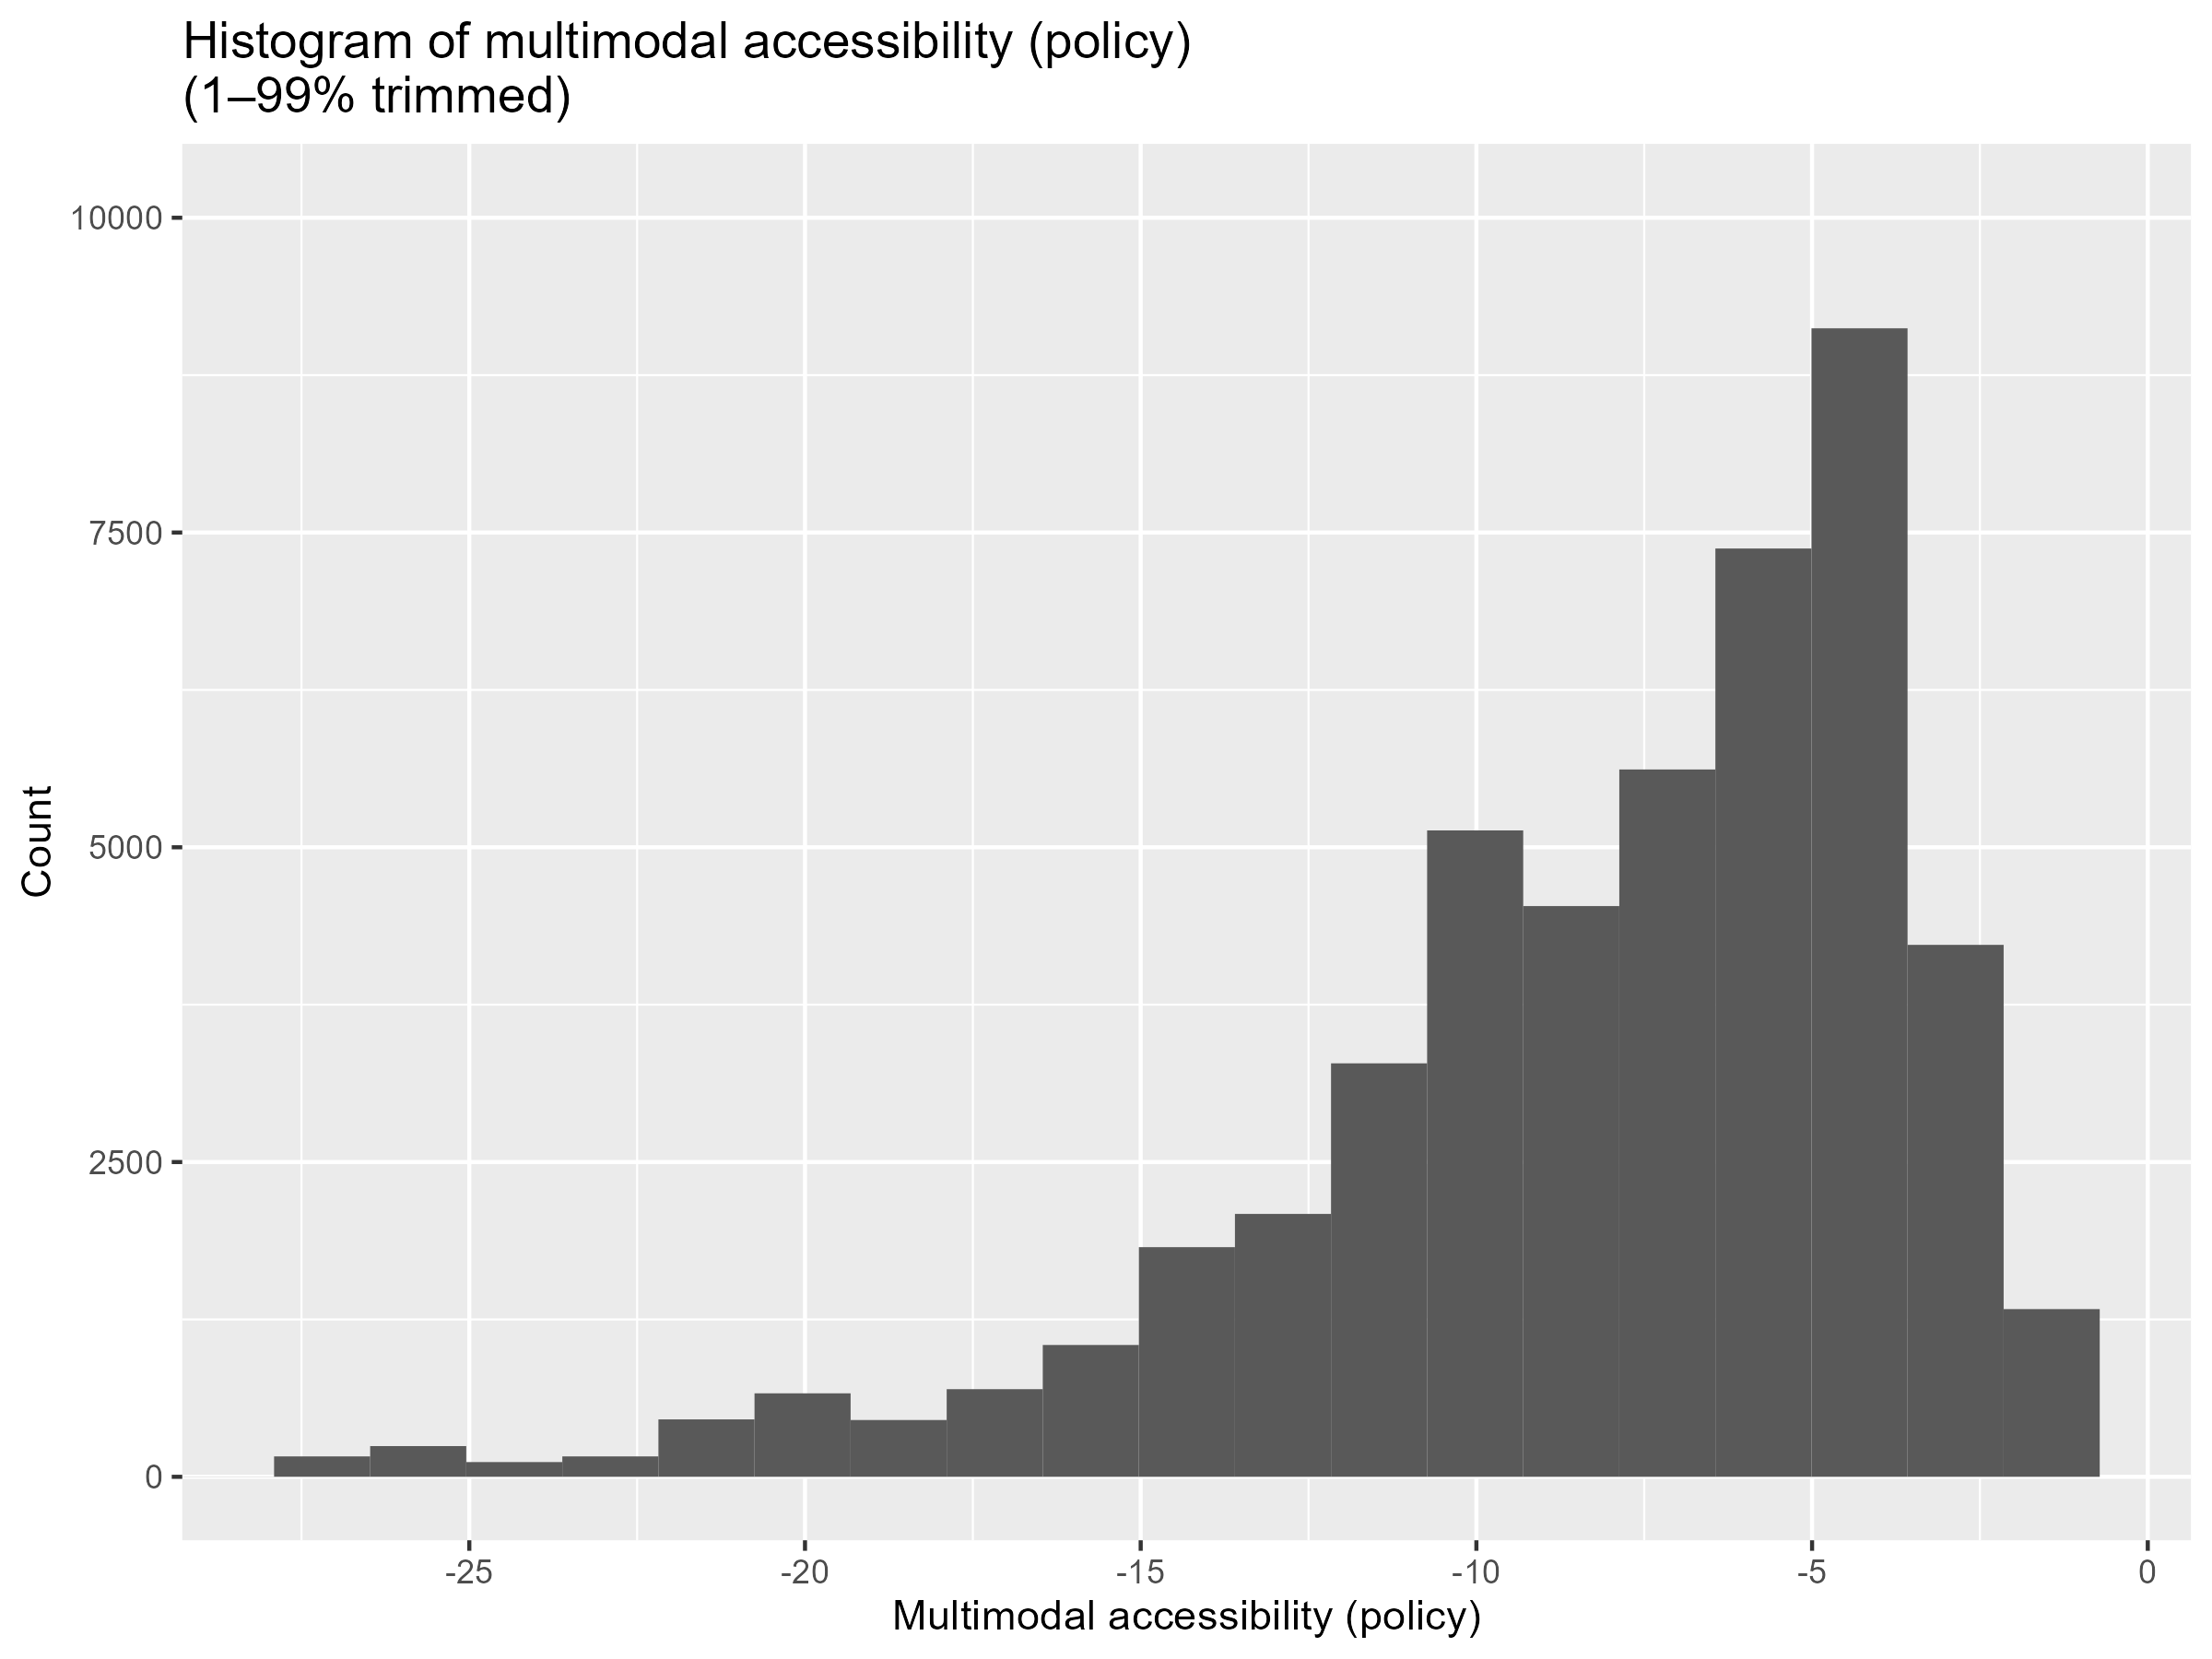
3.1 Base vs policy scenario
Notes:
Here are the results of the multimodal accessibility computation. Distribution of the multimodal accessibility scores in the base scenario and also the policy scenario. Differences are very minor and in this view aren’t very visible.

Slide 13
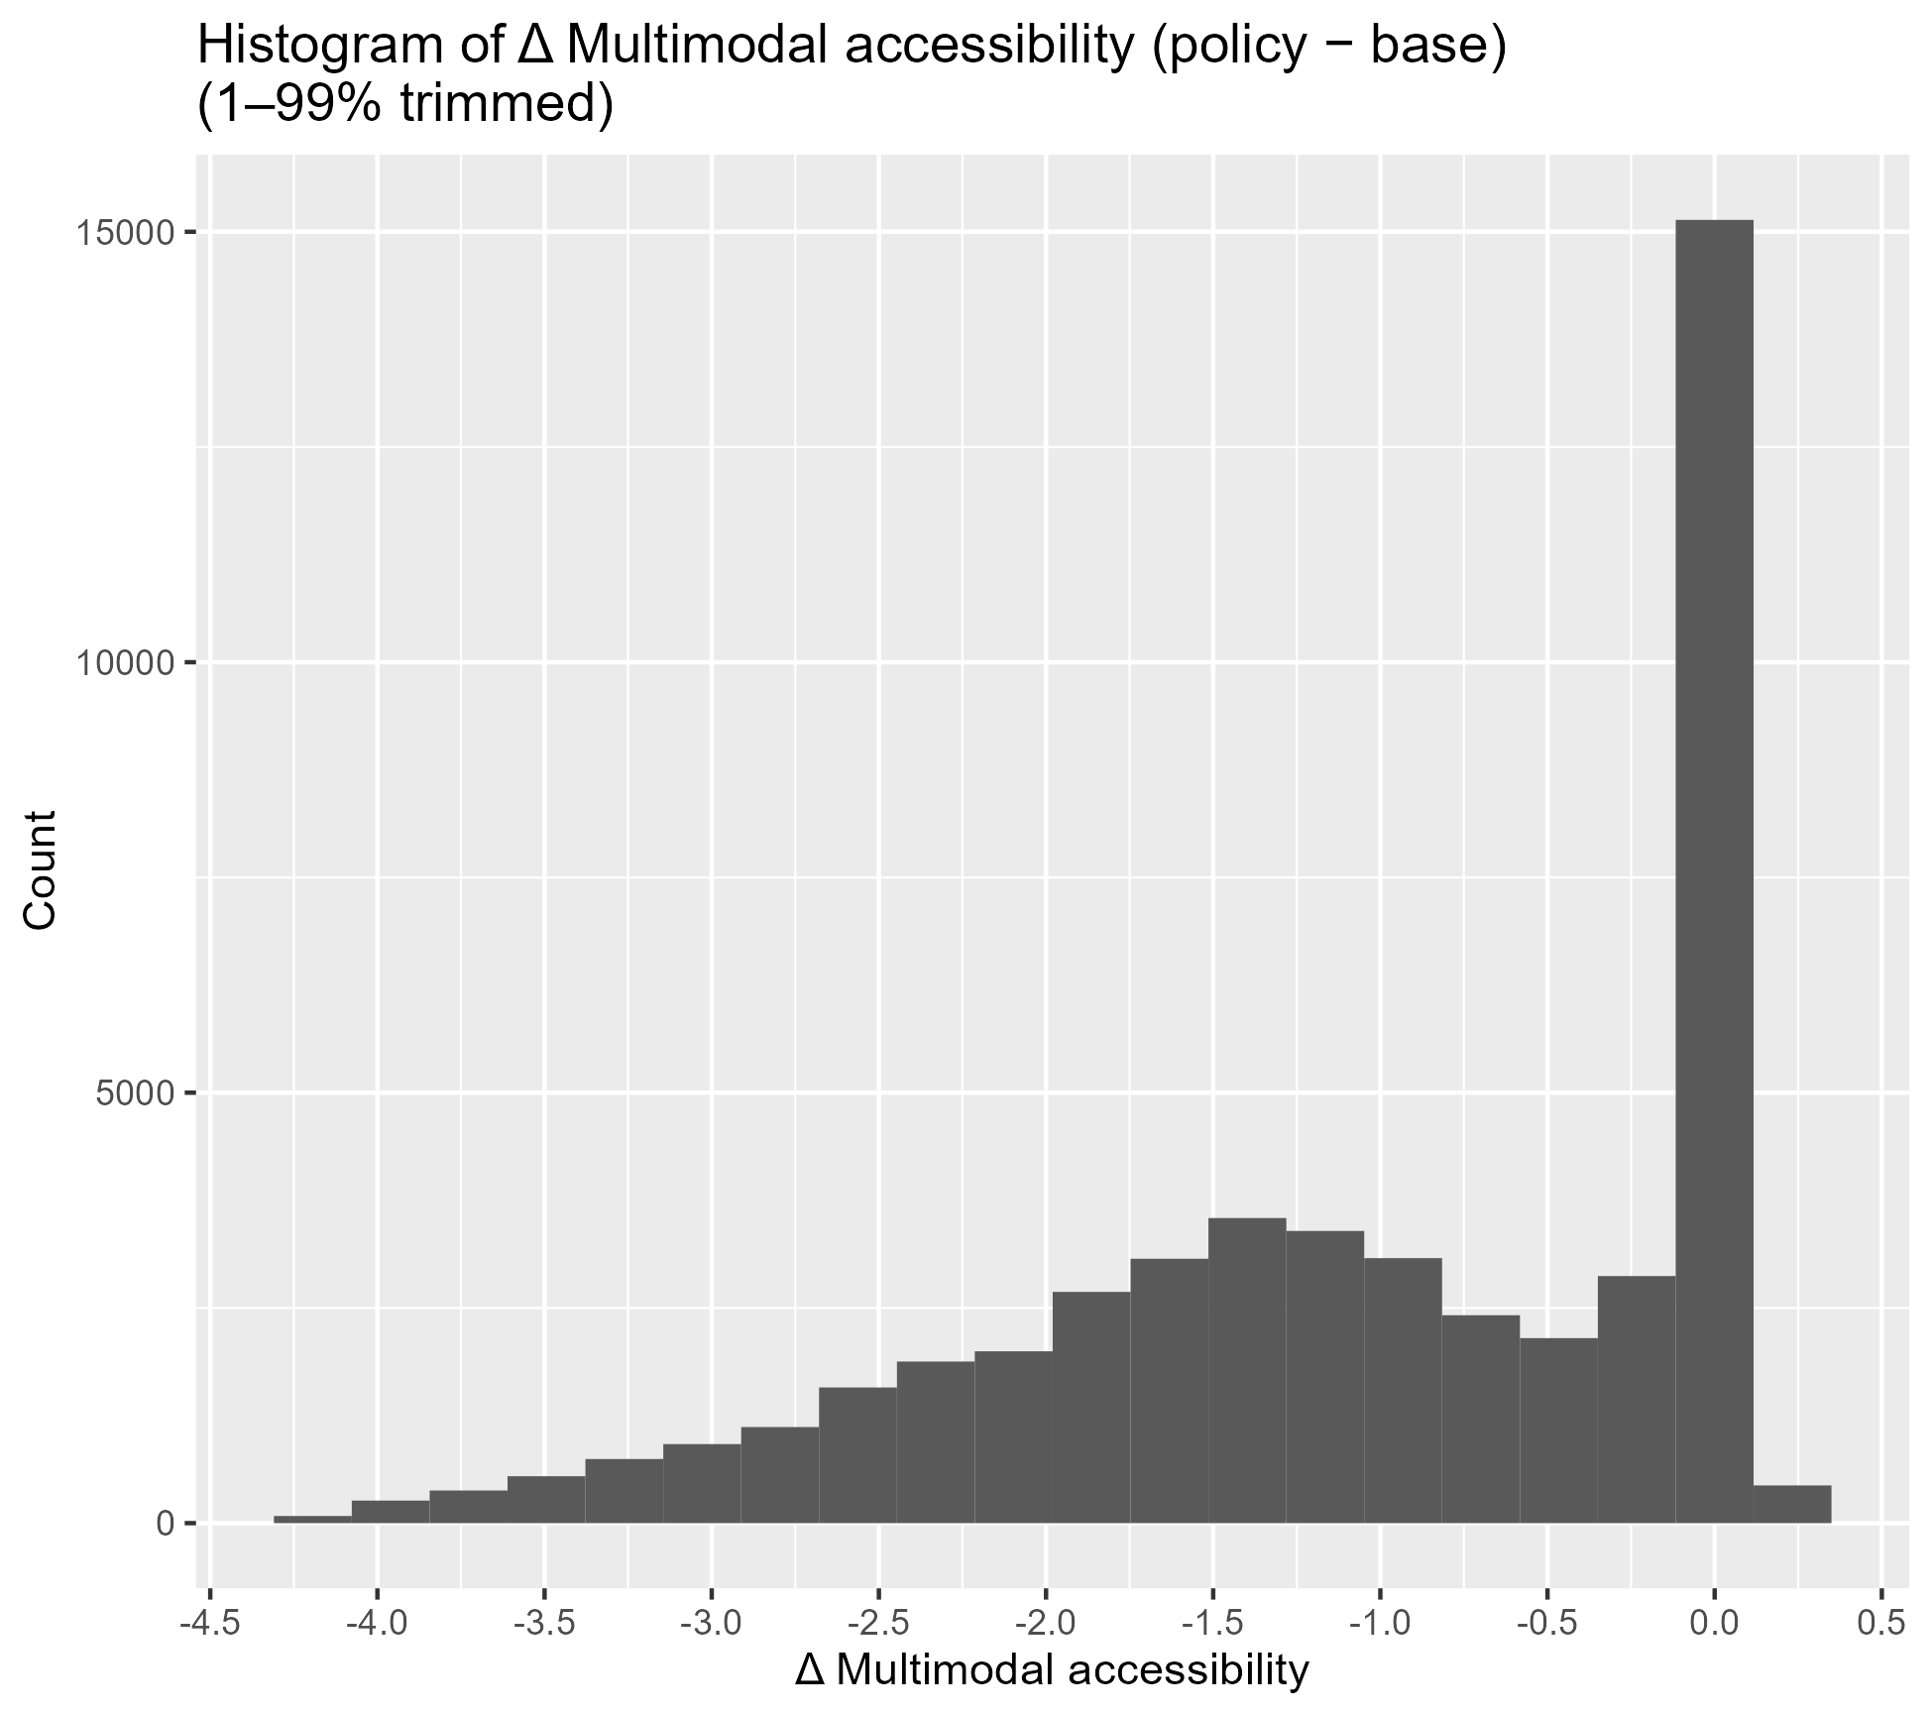
3.1 Base vs policy scenario
Multimodal accessibility delta (policy – base) has quite a broad distribution meaning car dependant agents are affected to varying degrees.
The large spike at the 0 value due to agent that don’t have car availability (carAvail = “never”). Car accessibility is excluded for these agents.
Accessibility impact of the policy is heterogenous and depends on individual attributes and spatial context.

Slide 14
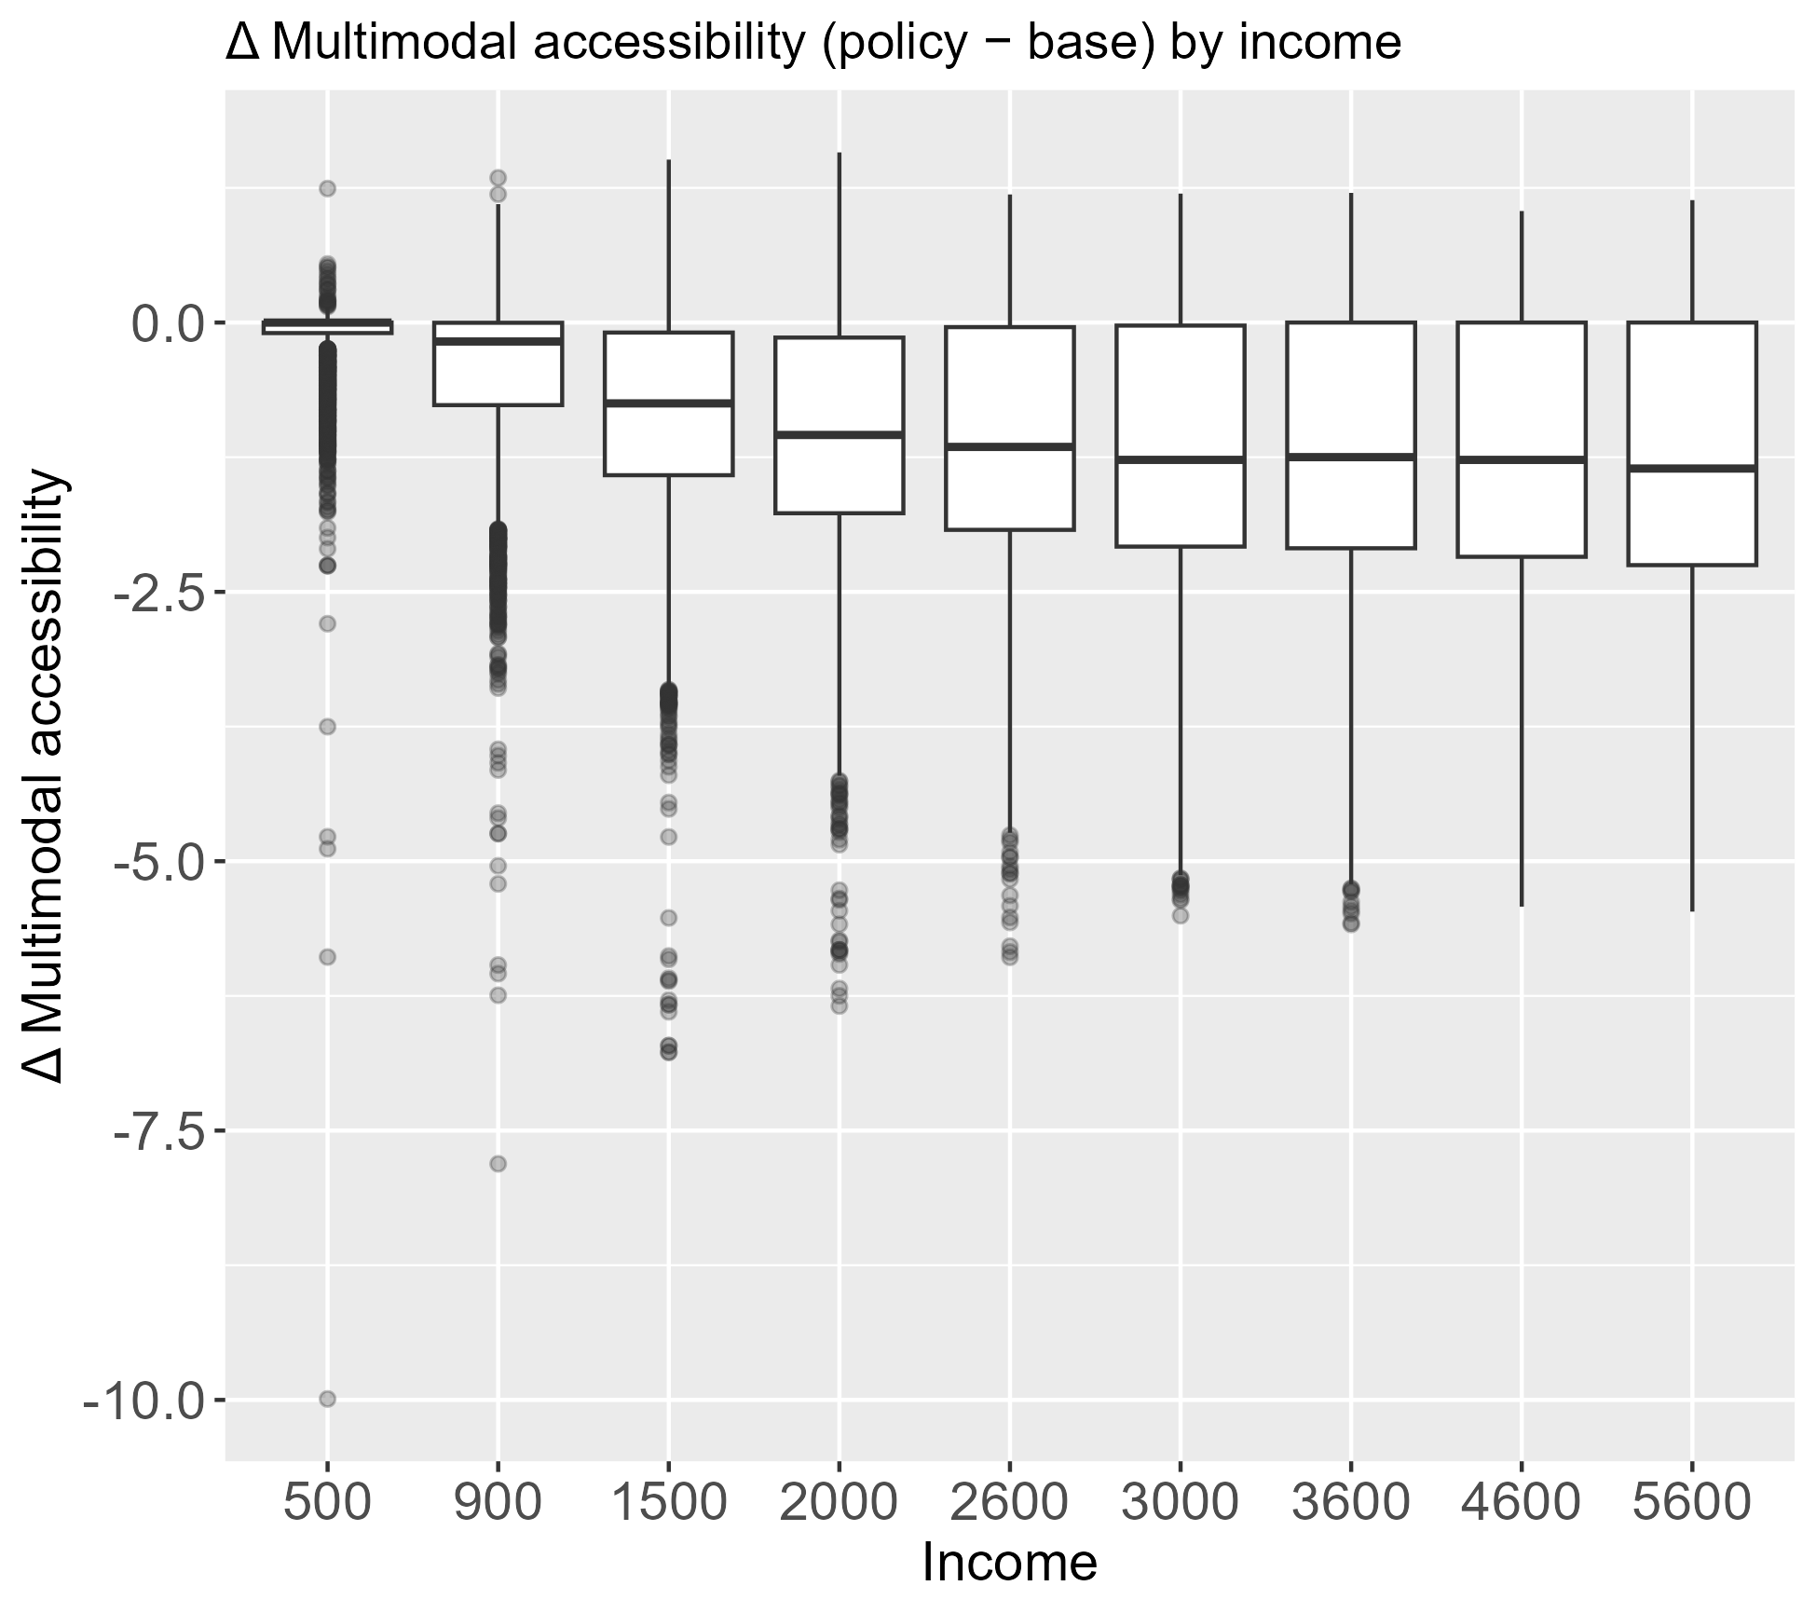
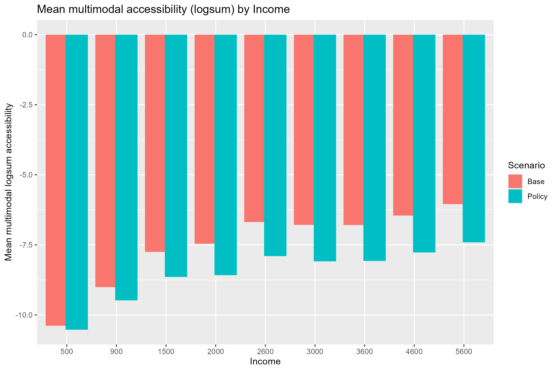
3.2 Multimodal accessibility by income
Notes:
So sure, higher income groups suffer on average higher losses, however their general accessibility loss is still less (linearly) compared to lower income group counterparts which suffer more in terms of absolute value. instead of thinking who wins from this policy, it should be looked instead at who bears the cost of this policy, and in this case the higher income groups (which is what we expect in terms of equity)

Slide 15
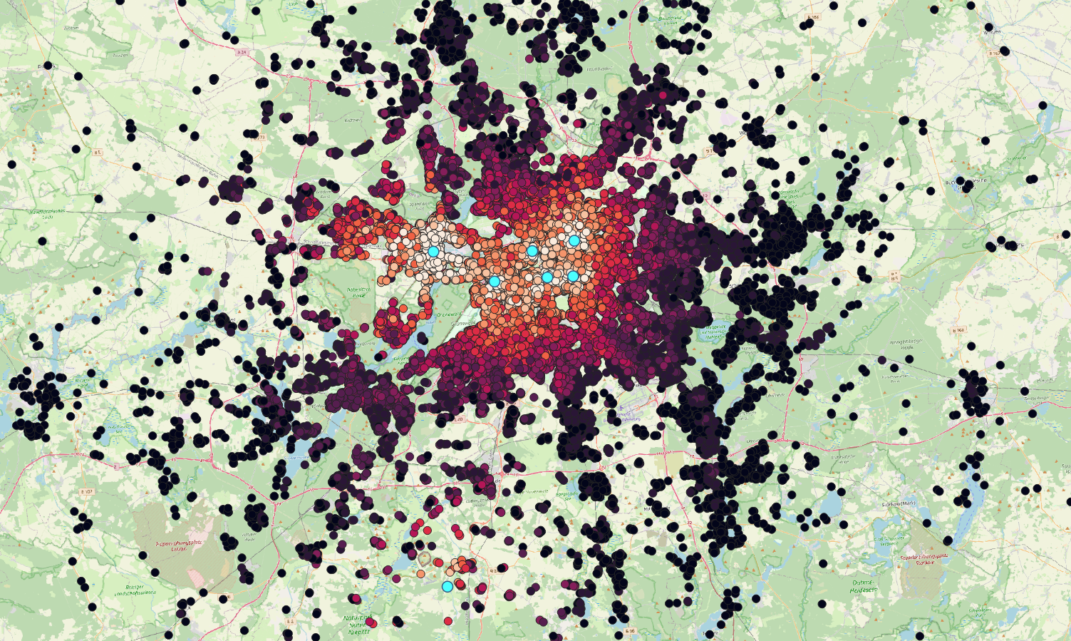
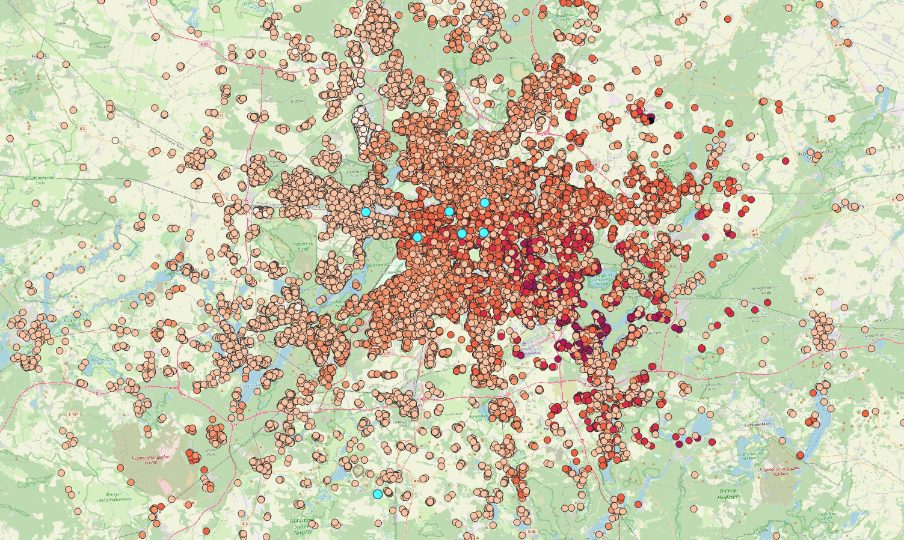
3.3 Multimodal accessibility by district
Top is a heat map of the agents and their multimodal accessibility in the policy scenario to showcase how policy affects are spatially distributed (exaggerated color gradient).
Bottom is a heatmap of the multimodal accessibility delta (policy – base).

Slide 18
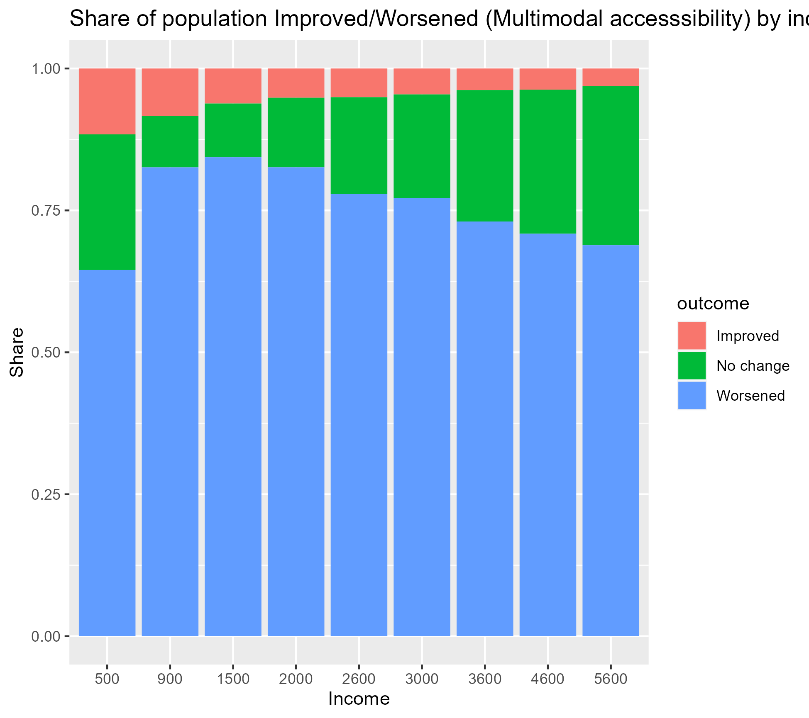
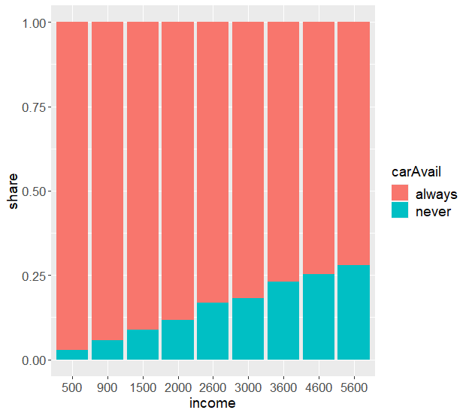
3.4 Accessibility gains/losses
*issue regarding relation of carAvail to income
Share of improved/worsened/no change mirrors the share of carAvail. However, carAvail share reduces the higher income the agent has (also the case with v6.4)

Slide 19
4.1 Conclusion (preliminary)
Effects of policy towards accessibility are heterogeneous
Multimodal evaluation changes the interpretation of policy impacts compared to single-mode analysis
Accessibility losses scale with the relative contribution of car to total utility (all modes), not just car availability
Policy affects are also spatially structured (on facilities) and not evenly distributed

Slide 20
4.2 Remaining work and timeline
Computation in java
Compute using 10% v6.4 files using math clusters (already have account)
Implement actual facilities (hospitals, Bürgeramt etc.)
Analysis in R
Clean up scripts (currently spaghetti code)
Add more relevant plots/graphs
More %change data
Literature
Thesis writing

Slide 21
4.3 Questions

Slide 22
Why/how agents score improve after multimodalAcc in car free berlin (policy)?
Why is there negative relationship between income and mm acc delta despite car avail not income dependant (from persons file)
New zwp file
Structure for new zwp
Remove age modifier (for now?)
Get new raw outputs
Get new plots+graphs
Map heat maps+plots
Map of facilities in berlin (+agent denisity)
Words in slidezzzz

Slide 23
Why is there negative relationship between income and mm acc delta despite car avail not income dependant (from persons file)
Make table to show all the values grouped by incomebins
Add expSum (twalk, pt, car_base, car_policy) + mm_logSum (base, policy, delta), car (logSum_base, logSum_policy, car_delta)
%delta as well + colored cells
Even if low income groups have more carAvail (as per persons file), and that car utility (expSum_car) is penalized more (because of income factor) and therefore smaller.
Why do high income groups experience big mm_acc loss?
They experience big mm_acc loss due to incomeFactor. Their logSum scores in the base scenario are heavily influenced by their high scoring car utility (because of incomefactor).

Slide 24
Why/how agents score improve after multimodalAcc in car free berlin (policy)?
Take all improved scores
Only thing that can improve is car
See spatially where they are located
Extract the individual facilities and see where they get very high score
Have to see before vs after for all facilities, so manually extract them(?)
Lastly, for simpler is to just check with less facilities, and all of them inside ring for result consistency

Slide 25
R
Population distribution (income, district)
tWalk_accessibility histogram
Pt_accessibility histogram
income effects on car_accessibility plot☑️
carAvail effects on car_accessibility plot
mmAcc (base+policy overlap) histogram
Mm_delta histogram☑️
Table of values☑️
Mm_acc by income bar graph
mm_delta by income boxplot☑️
Mm_acc by district bar graph
Mm_delta by district boxplot☑️
Improves/worsened/nochange % bar graph (by income, age, district, car avail) ☑️

Slide 26
QGIS
Accessibility heatmap
Map of facilities
Mm_acc by district
Map Δ by district

Slide 27
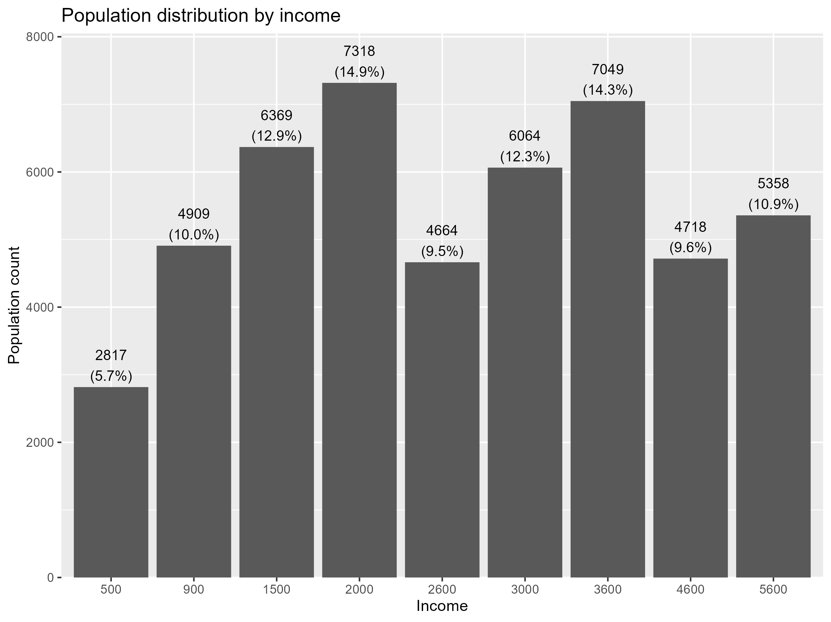
Population distribution
Table shows distribution of the population by income from the v6.3 1% files.
Switch over to using v6.4 10% files is already in the pipeline.

Slide 28
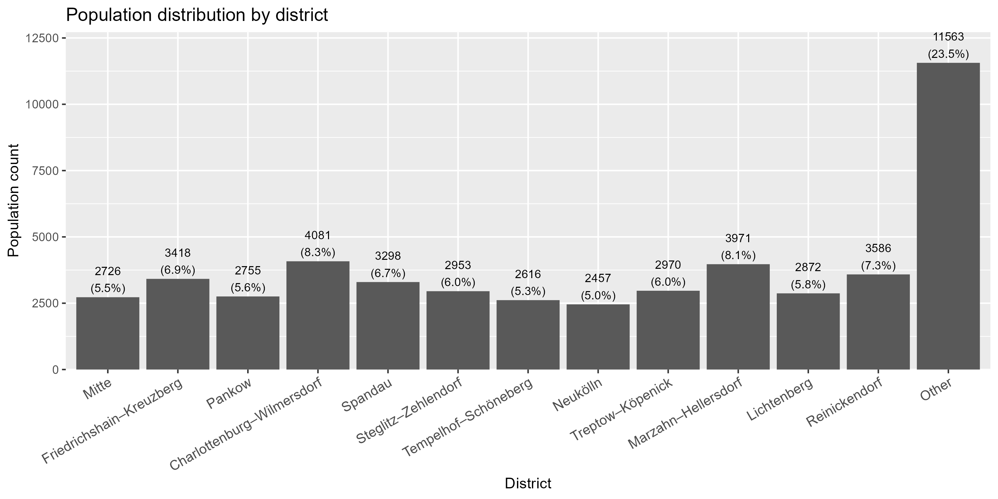
Population distribution
By district

