Slide 1

Project Title – Netflix Data Analysis
[ADITYA ROSHAN DASH]
[STU6632350cdae131714566412]

Slide 2

PROBLEM STATEMENT
Netflix Dataset Analysis

Slide 3
Project Description The specific problem to be addressed in this project is 'Content Trends Analysis for Strategic Recommendations'. The aim is to uncover how Netflix’s content distribution (Movies vs. TV Shows, genres, and country contributions) has evolved over the years. This will enable the identification of key genres, audience preferences, and strategic insights into global content expansion.

Slide 4

WHO ARE THE END USERS?
The Netflix crew team
Enthusiasts and stake holders who want to analyze Netflix content

Slide 5

Technology Used
Python
Pandas
Numpy
Matplotlib
seaborn

Slide 6
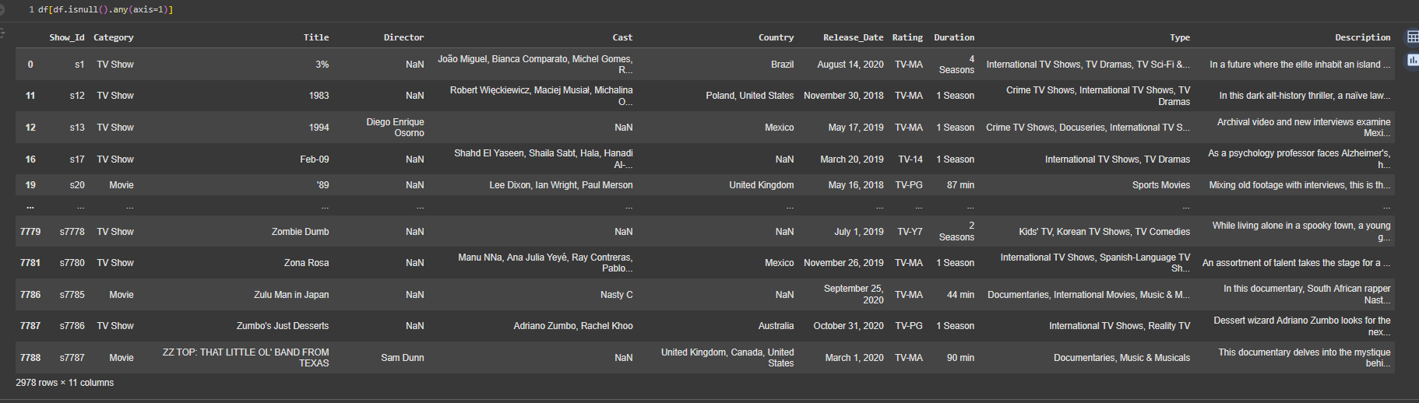
RESULTS 1

Slide 7
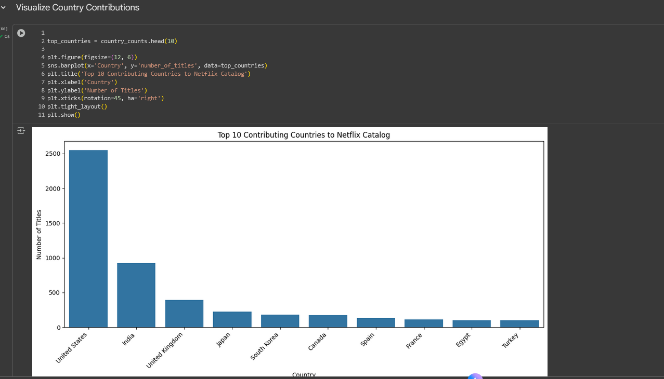
RESULTS 2

Slide 8
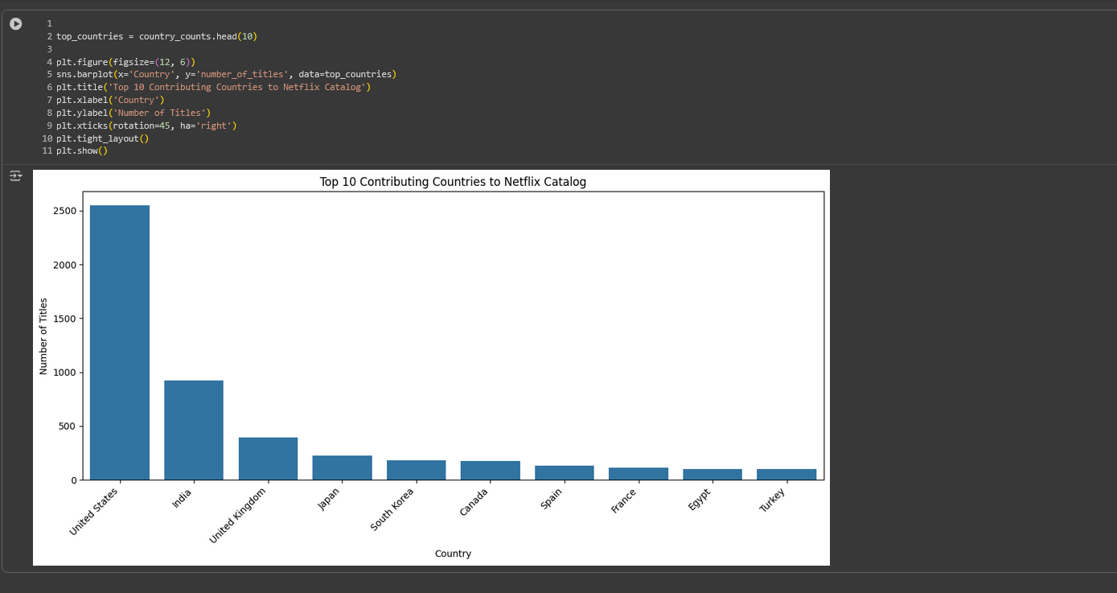
RESULTS 3

Slide 9
GitHub repository
https://github.com/ard2004/VOIS_AICTE_Oct2025_MajorProject_AdityaRoshanDash.git

Slide 10
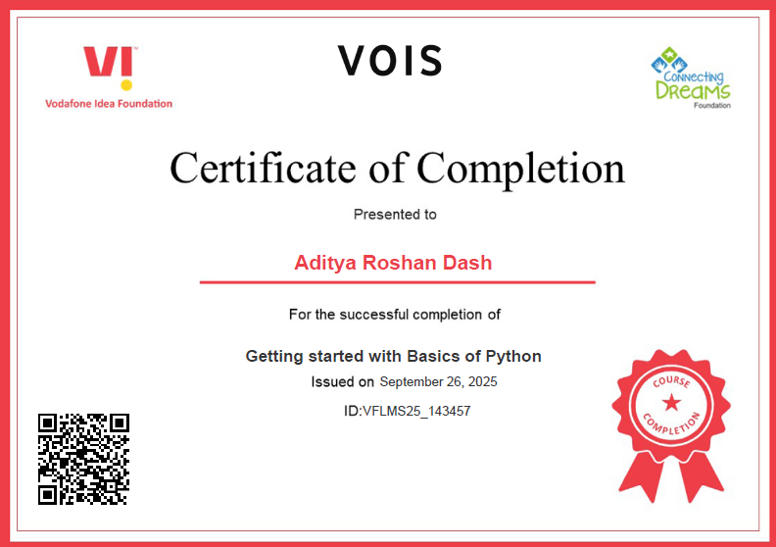
Getting started with Basics of Python Certificate

Slide 11
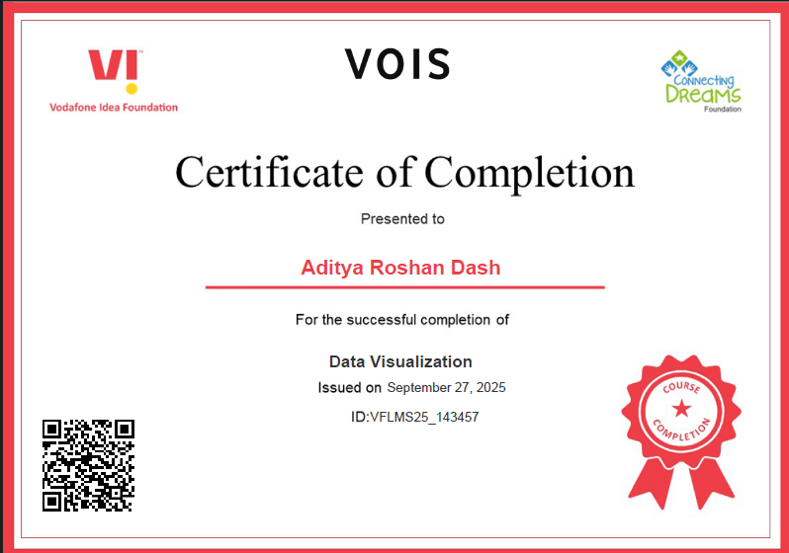
Data Visualization Certificate

Slide 12
Thank you
.
.

