Slide 1
Coaching Models
Copyrights and credit belong to the respective authors and thought leaders

Slide 2
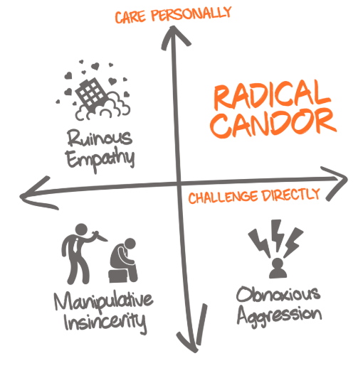
https://www.radicalcandor.com/

Slide 3
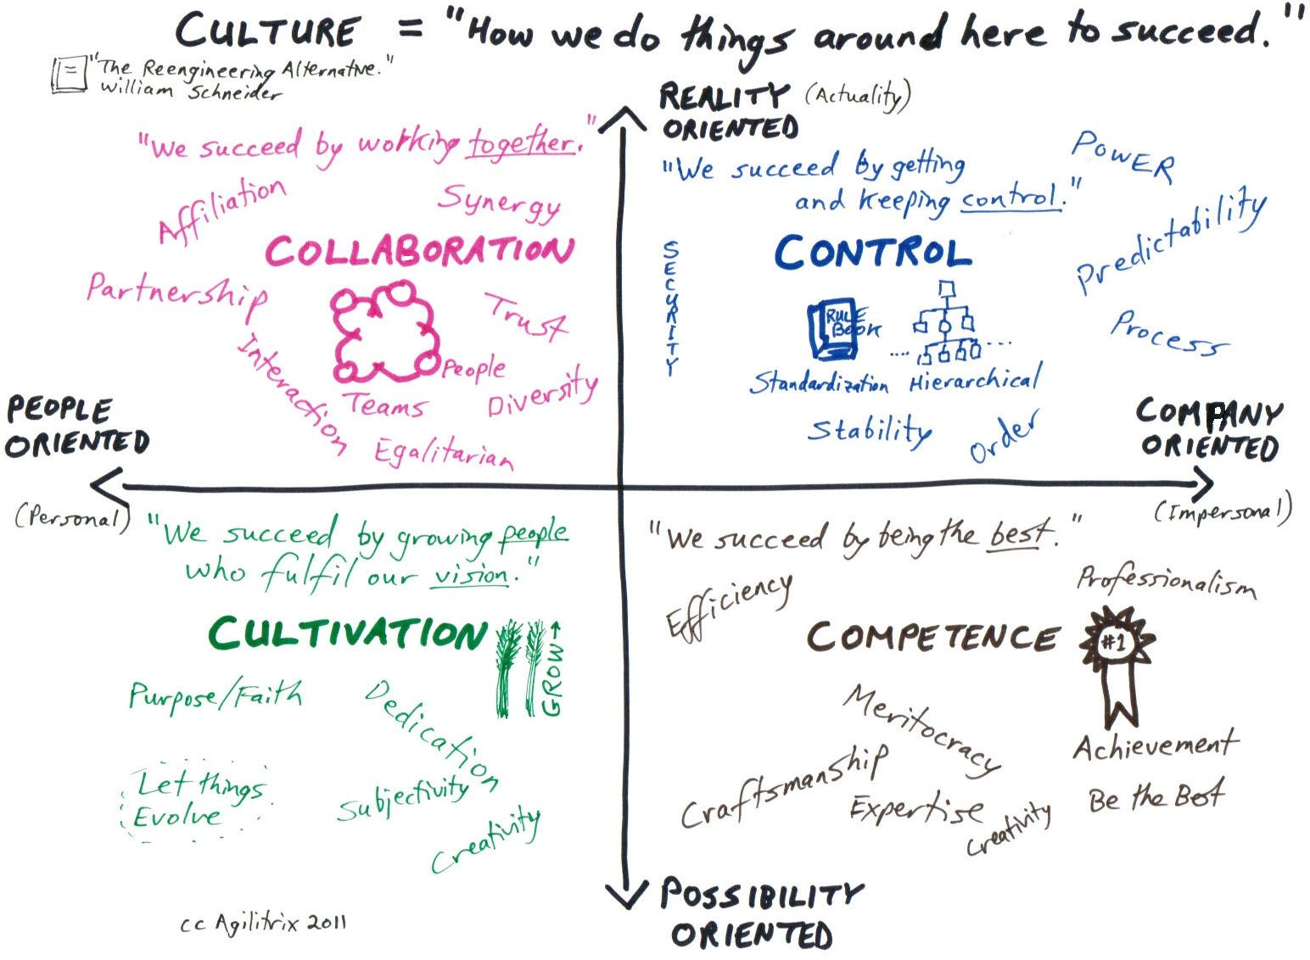
Schneider Culture Model
http://agilitrix.com/2011/03/how-to-make-your-culture-work/

Slide 4
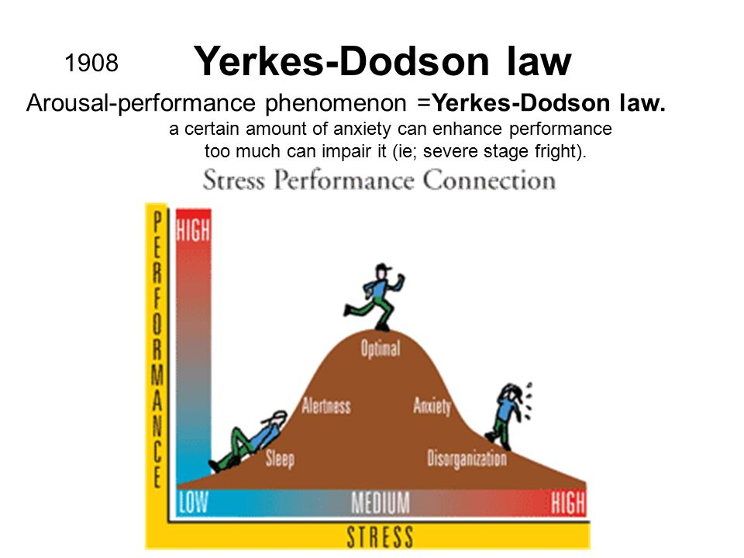
http://slideplayer.com/slide/9238010/

Slide 5
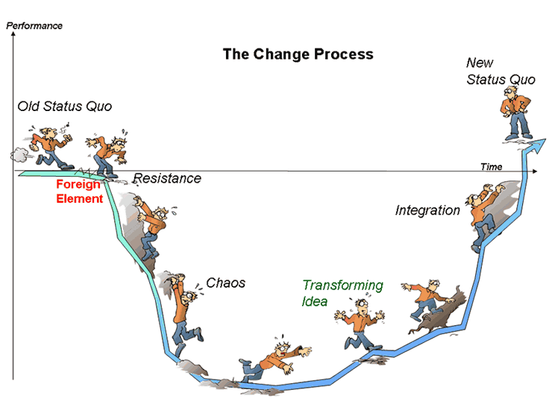
Satir Change Model
http://10minutehr.com/2013/11/11/chaos-in-the-organisational-change-process-dont-try-to-avoid-it-manage-it/
Notes:
http://10minutehr.com/wp-content/uploads/2013/09/Virginia-Satir-change_process-by-Michael-Erickson.gif

Slide 6
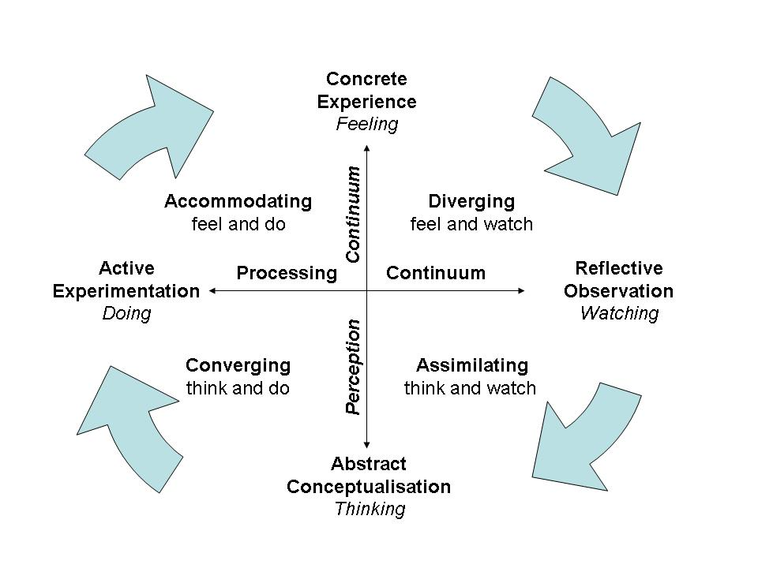
Kolb's Learning Styles
http://nwlink.com/~donclark/hrd/styles/learning_styles.jpg

Slide 7
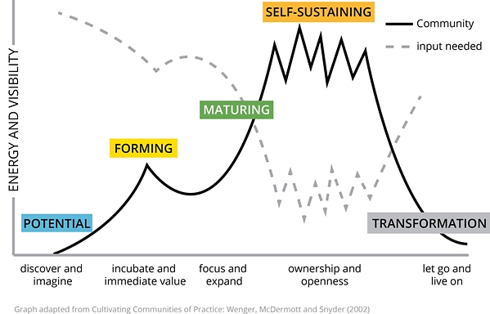
Community maturity stages
https://www.infoq.com/articles/communities-of-practice-agile-organisation

Slide 8
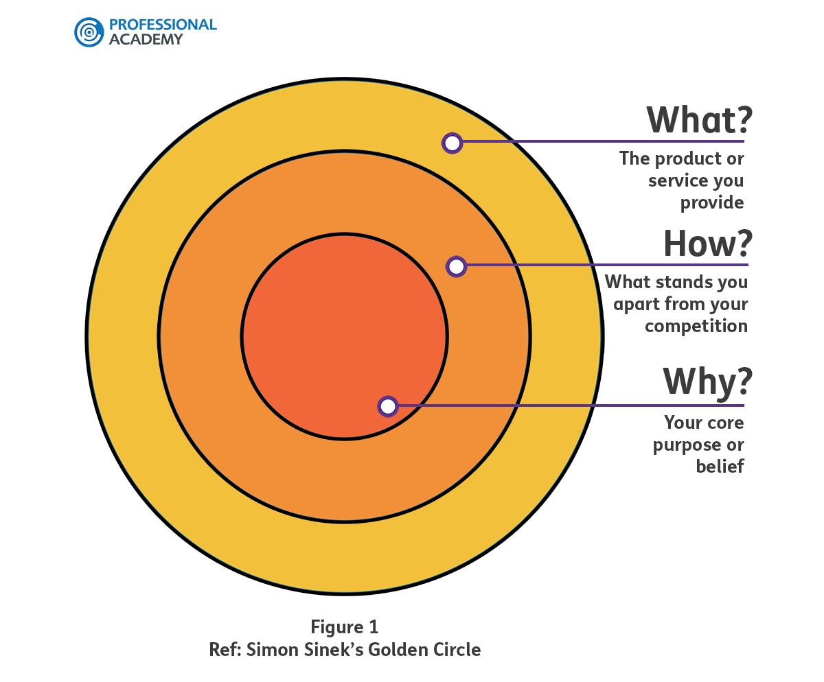
Simon Sinek’s Golden Circle
https://www.professionalacademy.com/blogs-and-advice/inspiration-and-influence--what-s-the-difference

Slide 9
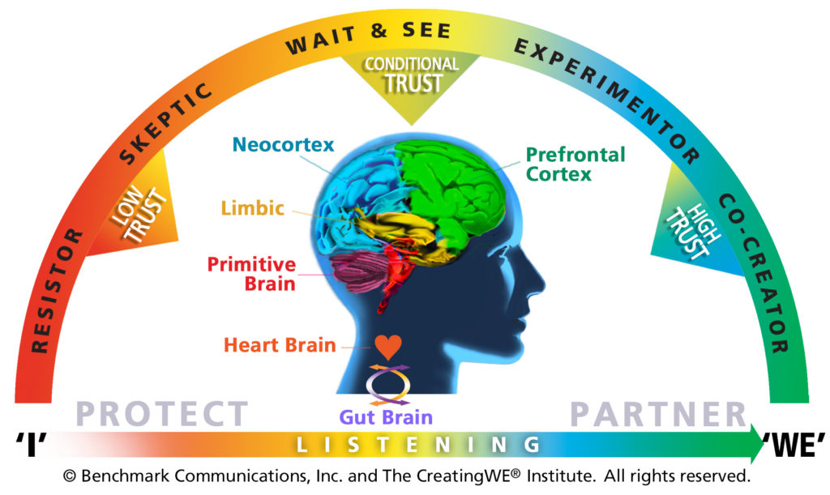
Arc of Engagement
https://creatingwe.com

Slide 10
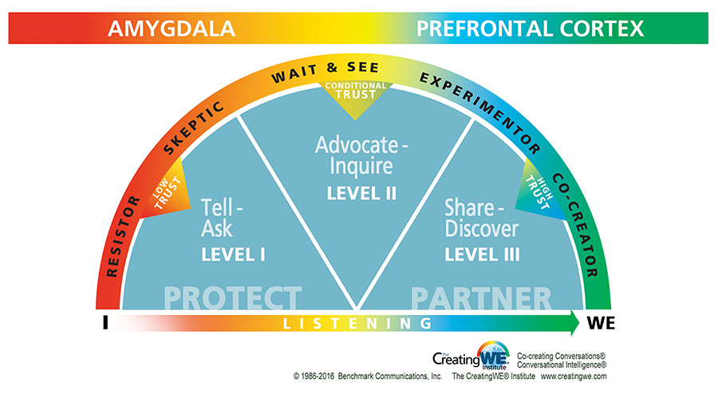
Conversational Dashboard
https://creatingwe.com

Slide 11
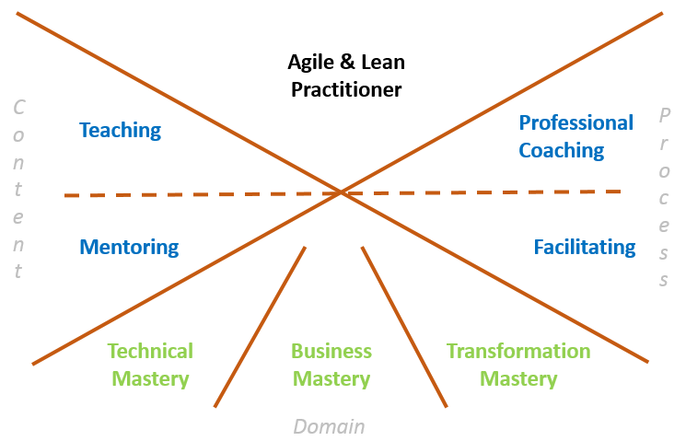
Agile Coaching Competency Framework
http://agilecoachinginstitute.com

