Slide 1
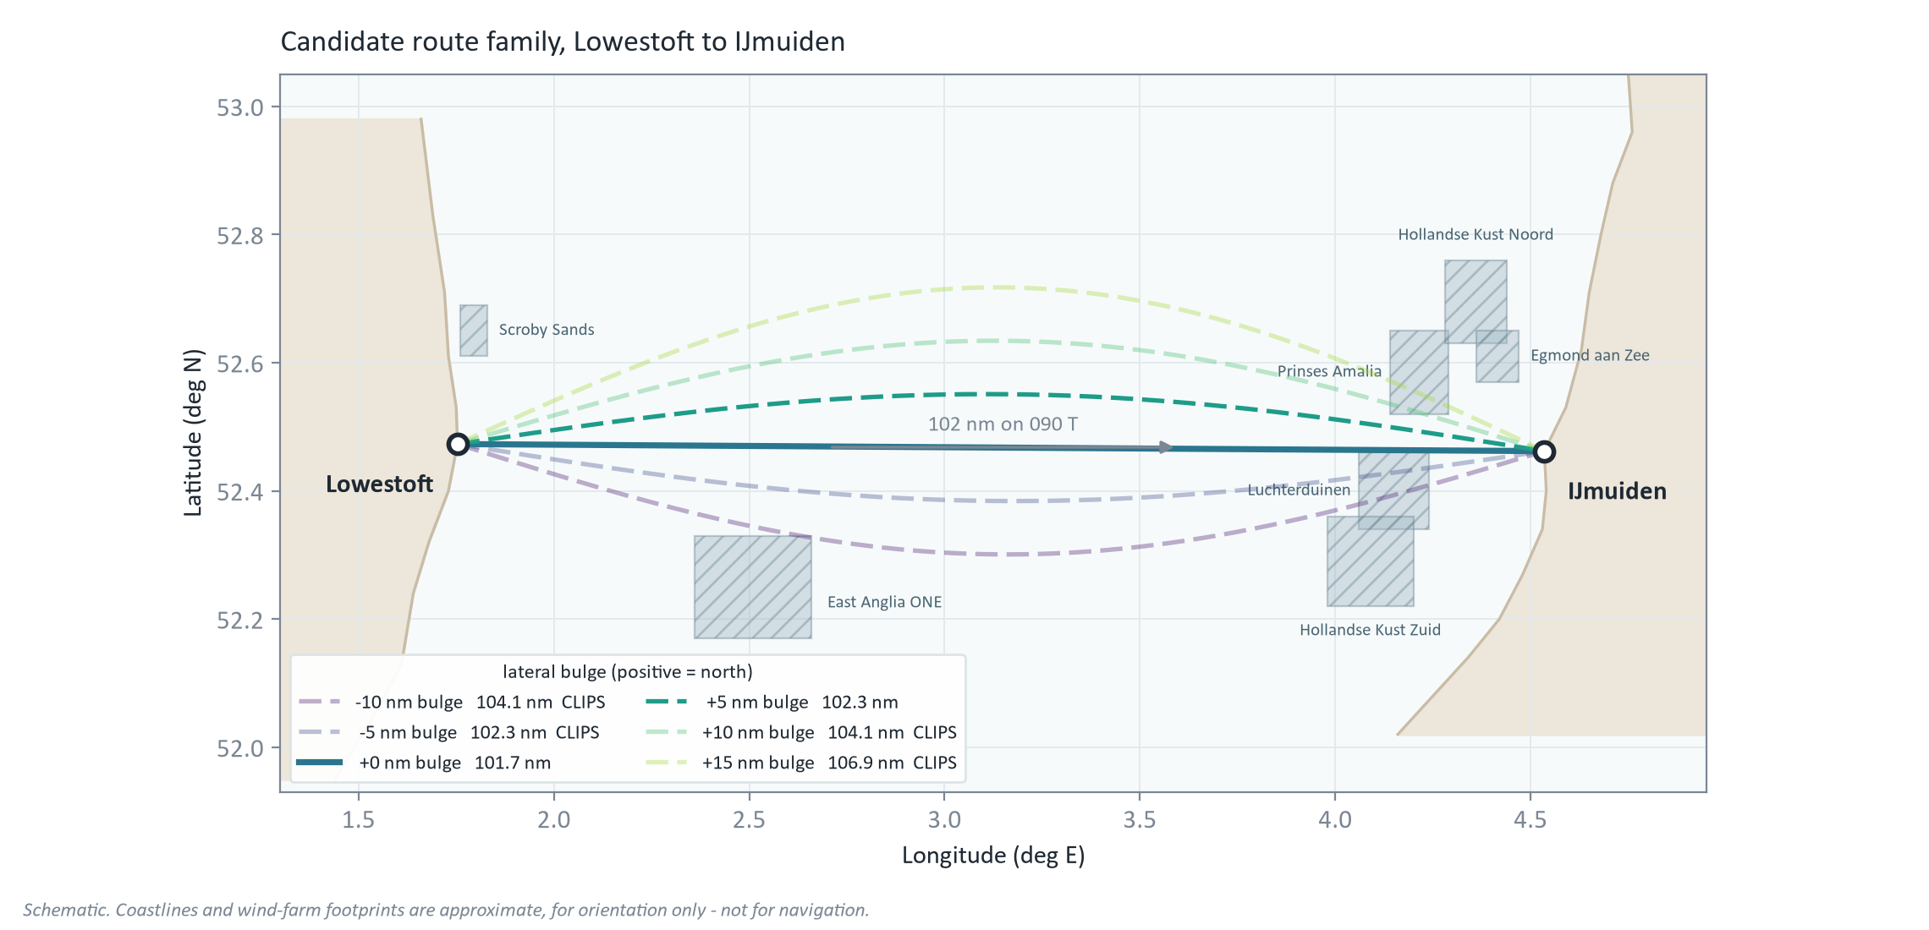
THE PROBLEM | ~45 s
102 miles due east, and an eight-mile corridor
101.7 nm on 090 T. 18 knots average to take it. The wind farms leave us about 8 nm of corridor, north only.
Notes:
[~45 s] Lowestoft to IJmuiden: 101.7 nautical miles, almost exactly due east. To take the record we have to average 18 knots, five hours thirty-nine. On a reach this short there is no clever detour: every candidate is the same reach, and they differ only in how far north we bow out. And the sea room is tighter than it looks. The wind farms off the Dutch coast pinch us into a corridor roughly eight miles wide, and it is north-only: bulge south and we are inside Luchterduinen. So the question is not which of a thousand routes. It is: inside a narrow corridor, which line still works when the forecast turns out wrong?

Slide 2
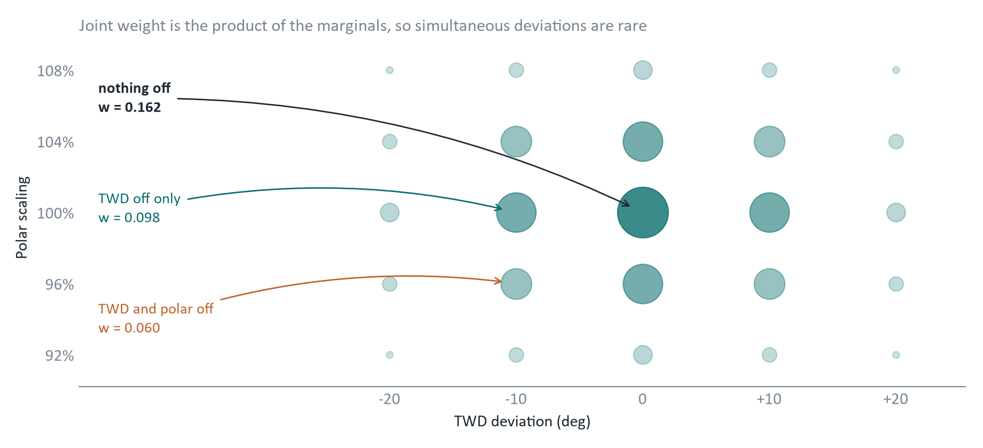
THE INPUT SPACE | ~45 s
We don't trust one forecast, we weight many
One thing being off is likely. Everything being off at once is not. Weight accordingly.
Notes:
[~45 s] We do not trust a single forecast. We perturb everything that matters, the polar, wind speed, wind direction, current, and give every level a likelihood. The joint weight is the product of the marginals, so being wrong about one thing far outranks being wrong about everything at once: across four axes, a single one-sigma deviation is about three times as likely as three simultaneous ones. That matters. A naive worst-case study assumes every input fails together, and then tells you to sail defensively for a day that will essentially never happen. Weighting by likelihood is what keeps the pessimism honest.

Slide 3
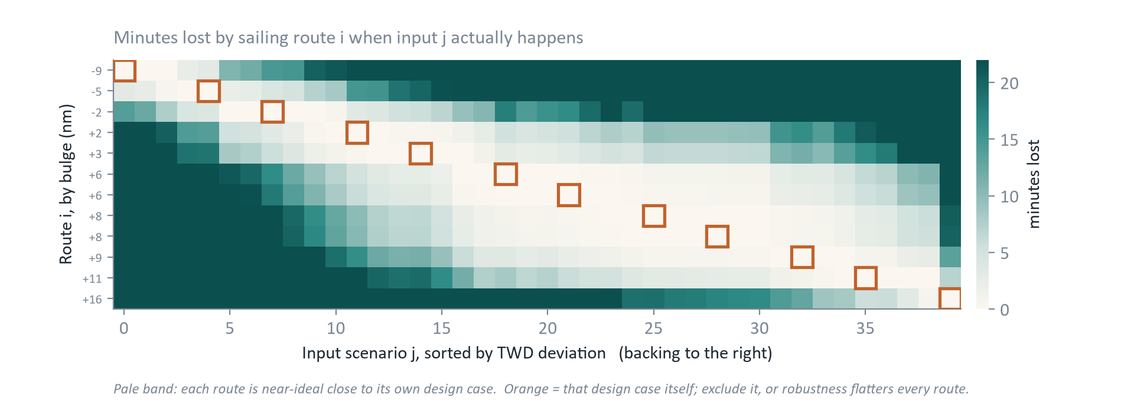
THE TEST | ~45 s
Optimise per forecast, then sail every route in every forecast
A route's honest robustness is its row with its own design case removed.
Notes:
[~45 s] For each weighted input we run the optimiser once and get one optimal route. That is the easy half. Robustness comes from the other half: we take every route and sail it through all forty inputs. This chart is minutes lost against the ideal line for that particular day. Each route is excellent near its own design case and decays away from it, and notice the pale band widens for the larger northward bulges. Those are the forgiving ones. One discipline point: we exclude each route's own design case, because otherwise every route gets one flattering result and robustness looks better than it really is.

Slide 4
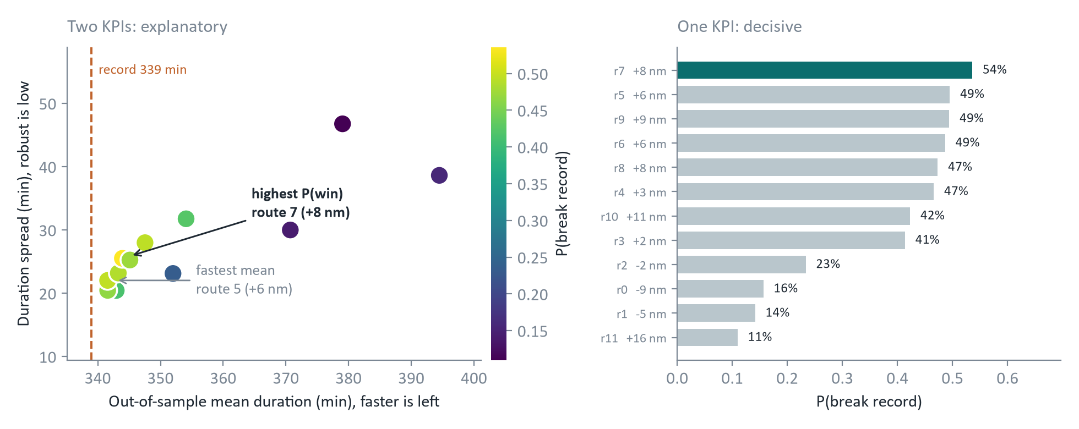
THE ANSWER | ~45 s
One number: probability of taking the record
The record time is the exchange rate. One ranked number, and the binding constraint named.
Notes:
[~45 s] Duration and robustness are two KPIs and you can draw a Pareto front, but you do not have to trade them off by hand, because the record time is the exchange rate. Weight every cell by its likelihood, count the ones under 339 minutes, and you get one ranked number: probability of taking the record. The fastest-mean route comes second. And the winner sits at plus seven and a half miles, right against the Prinses Amalia boundary. That tells us the binding constraint is the wind farm, not the weather. So the instruction to the skipper is simple: bulge as far north as the farm allows.

