Slide 1
Clojure way, Clojure-clr & C# interop
Examples from ChineseWriter
RJB

Slide 2
Clojure
Dialect of Lisp
Code-as-data philosophy, simple syntax
Mainly a functional programming language
Rich set of immutable, persistent data structures (Lists, Vectors, Maps)
Software Transactional Memory (STM) for thread-safe mutable state

Slide 3
Clojure-clr
Dotnet version of Clojure
https://github.com/clojure/clojure-clr
Good level of maintenance
Good Performance
Good C# / IronRuby interop

Slide 4
ChineseWriter
RJB Hobby project for writing Chinese Hanzi characters using pinyin phonetic writing
Uses English hints for Hanzi-conversion
Allows person who can speak Chinese to write Chinese without knowing Hanzi
Originally with XAML + WPF + C#
Now XAML + WPF + C# + Clojure-clr
https://github.com/rbrother/ChineseWriter/wiki

Slide 5
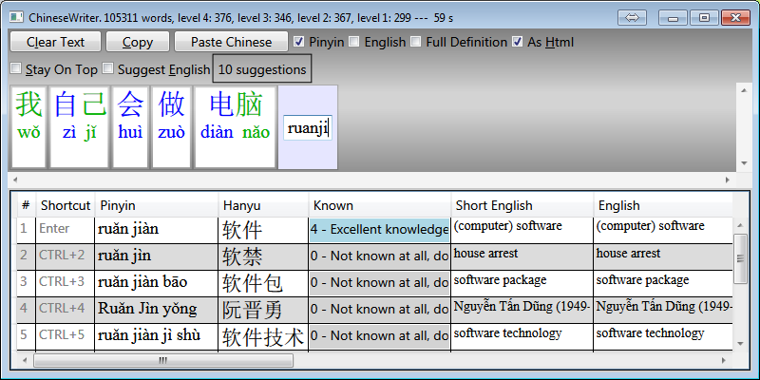
ChineseWriter UI parts

Slide 6
Dictionary conversion
Uses CC-DICT 100 000+ word dictionary
Converting to Clojure-form with stand-alone Clojure script
Done once for each new version of CC-DICT to improve software startup time
Reading and writing files
Pretty-printing

Slide 7
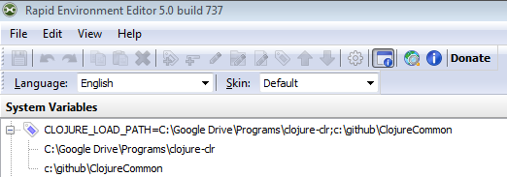
Using Clojure-clr from C#
Define CLOJURE_LOAD_PATH env variable to contain clojure-clr path and any shared clojure code paths

Slide 8
Data first philosophy
Data - maps and lists – for everything!
No classes!
Allows powerful reuse:
No need for custom getters and setters
Easy debugging, easy understanding
Easy access to data, no hiding
No hiding needed since data immutable
Word is a map
Dictionary is a list of maps / map of maps

Slide 9
Merging custom dictionary
Often custom words needed
Also additional properties to existing words: Knowledge level, source, short english, finnish, …
Using separate words.clj
(merge-with merge a b)

Slide 10
Handling state with atoms

