Slide 1
CS102 – GUI
AWT & Swing
  Components & Containers,
  Layout Managers,
  Events & Listeners
  MVC design pattern.
David Davenport

Slide 2
IMPORTANT…
Students…
  This presentation is designed to be used in class as part of a guided discovery sequence. It is not self-explanatory! Please use it only for revision purposes after having taken the class. Simply flicking through the slides will teach you nothing. You must be actively thinking, doing and questioning to learn!
Instructors…
  You are free to use this presentation in your classes and to make any modifications to it that you wish. All I ask is an email saying where and when it is/was used. I would also appreciate any suggestions you may have for improving it.
thank you, David.

Slide 3
Programming forms
Conventional/Procedural programming
  code is always executed in same sequence.
  characterised by input/process/output
Event-driven programming
  code is executed upon activation of events.
  sequence changes depending on order of events
method 1
method 2
method 3
--------
--------
method n
Do
method 2
then
method 1
then
method 3
method 1
method 2
method 3
--------
--------
method n
Do
method 1
then
method 3
Do
method 2
every
second

Slide 4
GUI using AWT

Slide 5
GUI using AWT
AWT - Abstract Window Toolkit
Must base
  desktop programs on Frame
    constructor, paint, …
  browser programs on Applet
    init, start, paint, stop, destroy, …
Can convert, but
  better to base code on Panel
  then it add to Frame or Applet

Slide 6
Implementing GUIs
Two steps
  (1) Create the interface
    By add components & containers
    & using layout managers
  (2) Add interaction
    Create event listeners
    & “Wire-up” events

Slide 7
(1) Create the interface…

Slide 8
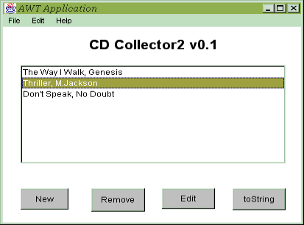
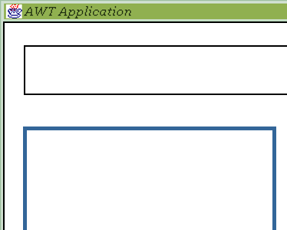
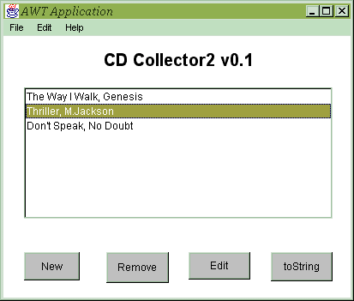
UI Component Layout…
x
0,0
50,350
1
y
2
1
Moral…
use automated Layout!
OK
2
OK
See also
LayoutManager Visual Guide
1250,950
LayoutManager demo…

Slide 9
AWT Applications - Frame
Frame is a container for components
Frame with normal window controls
Optional Menu
Three containers in Frame with Border Layout
UI-components inside containers each with own layout

Slide 10
AWT classes
AWTEvent
Container
Panel
Applet
Font
Button
Window
Frame
FontMetrics
Label
Dialog
FileDialog
TextField
Object
Color
TextComponent
TextArea
Graphics
List
Component
Choice
CheckBox
LayoutManager
CheckBoxGroup
Canvas
MenuComponent
MenuItem
Menu
Scrollbar
MenuBar

Slide 11
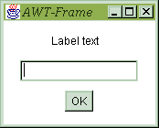
Understanding the GUI
UI-containers
  have list of
  UI-components
Each UI-component
  is a class
  with paint method
  & lists of
  Event listeners
{label}
{Frame}
components
{textfield}
{button}

Slide 12
Setting up the GUI
Extend Frame class
  In constructor
    Create instances of containers
    & add them to Frame
    Create instances of components
    & add them to containers or Frame
  Possibly override paint method
Hint: Employ layout managers to arrange components in containers
UI-components added to components list
Painting Frame
  paints Frame borders
  calls Frame paint method
  calls paint method of each object in component list

Slide 13
Junk…
1
2
OK
OK

