Slide 1
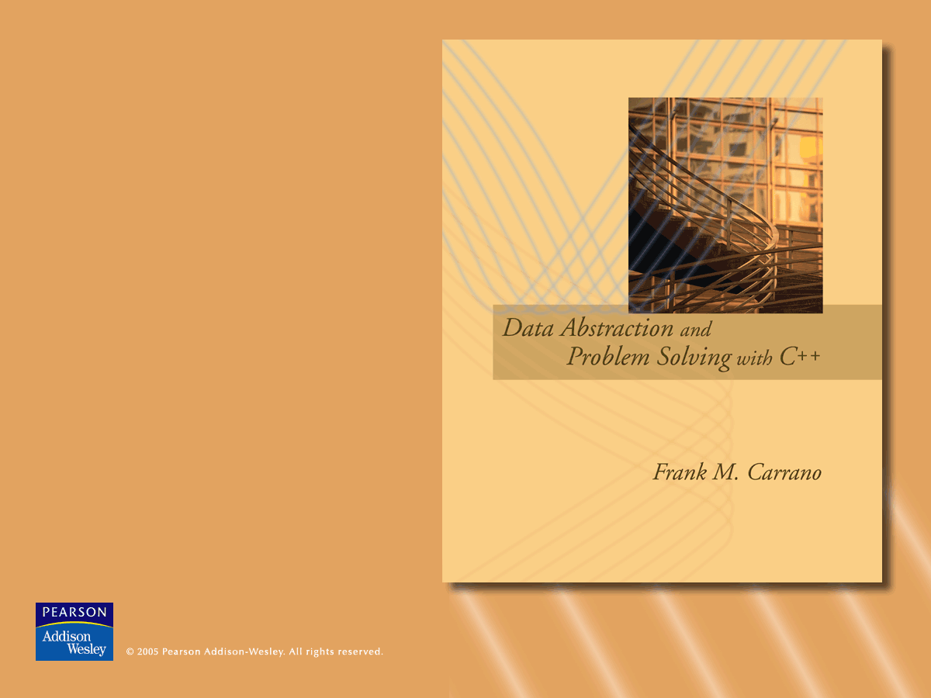
Chapters 6 and 7
Stacks

Slide 2
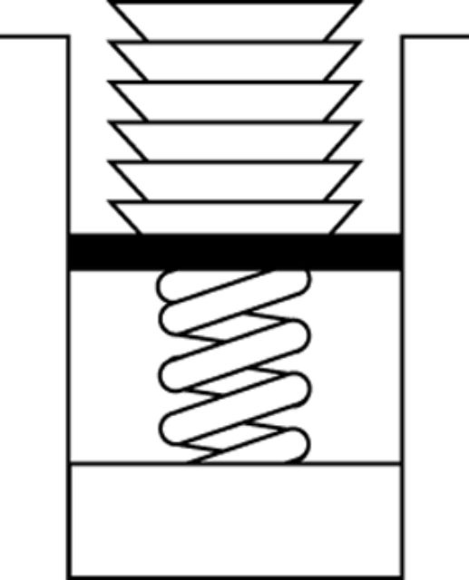
ADT Stack
A stack
  Last-in, first-out (LIFO) property
    The last item placed on the stack will be the first item removed
  Analogy
    A stack of dishes in a cafeteria
Figure 6.1
Stack of cafeteria dishes
© 2005 Pearson Addison-Wesley. All rights reserved
6-<number>

Slide 3
ADT Stack
ADT stack operations
  Create an empty stack
  Destroy a stack
  Determine whether a stack is empty
  Add a new item
  Remove the item that was added most recently
  Retrieve the item that was added most recently
A program can use a stack independently of the stack’s implementation
© 2005 Pearson Addison-Wesley. All rights reserved
6-<number>

Slide 4
ADT Stack
// stack operations:
bool isEmpty() const;
// Determines whether a stack is empty.
// Precondition: None.
// Postcondition: Returns true if the
// stack is empty; otherwise returns false.
© 2005 Pearson Addison-Wesley. All rights reserved
6-<number>

Slide 5
ADT Stack
bool push(StackItemType newItem);
// Adds an item to the top of a stack.
// Precondition: newItem is the item to
// be added.
// Postcondition: If the insertion is
// successful, newItem is on the top of
// the stack.
© 2005 Pearson Addison-Wesley. All rights reserved
6-<number>

Slide 6
ADT Stack
bool pop();
// Removes the top of a stack.
// Precondition: None.
// Postcondition: If the stack is not
// empty, the item that was added most
// recently is removed. However, if the
// stack is empty, deletion is impossible.
© 2005 Pearson Addison-Wesley. All rights reserved
6-<number>

Slide 7
ADT Stack
bool pop(StackItemType& stackTop);
// Retrieves and removes the top of a stack
// Precondition: None.
// Postcondition: If the stack is not empty,
// stackTop contains the item that was added
// most recently and the item is removed.
// However, if the stack is empty, deletion
// is impossible and stackTop is unchanged.
© 2005 Pearson Addison-Wesley. All rights reserved
6-<number>

Slide 8
ADT Stack
bool getTop(StackItemType& stackTop) const;
// Retrieves the top of a stack.
// Precondition: None.
// Postcondition: If the stack is not empty,
// stackTop contains the item that was added
// most recently. However, if the stack is
// empty, the operation fails and stackTop
// is unchanged. The stack is unchanged.
© 2005 Pearson Addison-Wesley. All rights reserved
6-<number>

Slide 9
Checking for Balanced Braces
A stack can be used to verify whether a program contains balanced braces
  An example of balanced braces
  abc{defg{ijk}{l{mn}}op}qr
  An example of unbalanced braces
  abc{def}}{ghij{kl}m
Requirements for balanced braces
  Each time you encounter a “}”, it should match an already encountered “{”
  When you reach the end, you should match every “{”
© 2005 Pearson Addison-Wesley. All rights reserved
6-<number>

Slide 10
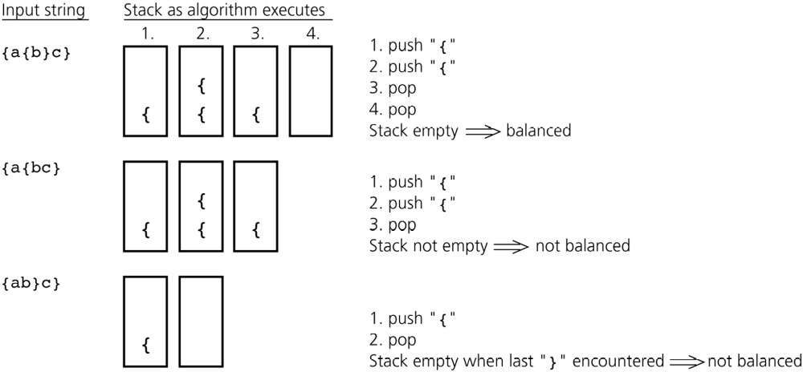
Checking for Balanced Braces
Figure 6.3
Traces of the algorithm that checks for balanced braces
© 2005 Pearson Addison-Wesley. All rights reserved
6-<number>

Slide 11
Checking for Balanced Braces
aStack.createStack()
balancedSoFar = true
i = 0
while ( balancedSoFar and i < length of aString ){
ch = character at position i in aString
++i
if ( ch is '{' ) // push an open brace
aStack.push( '{' )
else if ( ch is '}' ) // close brace
if ( !aStack.isEmpty() )
aStack.pop() // pop a matching open brace
else // no matching open brace
balancedSoFar = false
// ignore all characters other than braces
}
if ( balancedSoFar and aStack.isEmpty() )
aString has balanced braces
else
aString does not have balanced braces
© 2005 Pearson Addison-Wesley. All rights reserved
6-<number>

Slide 12
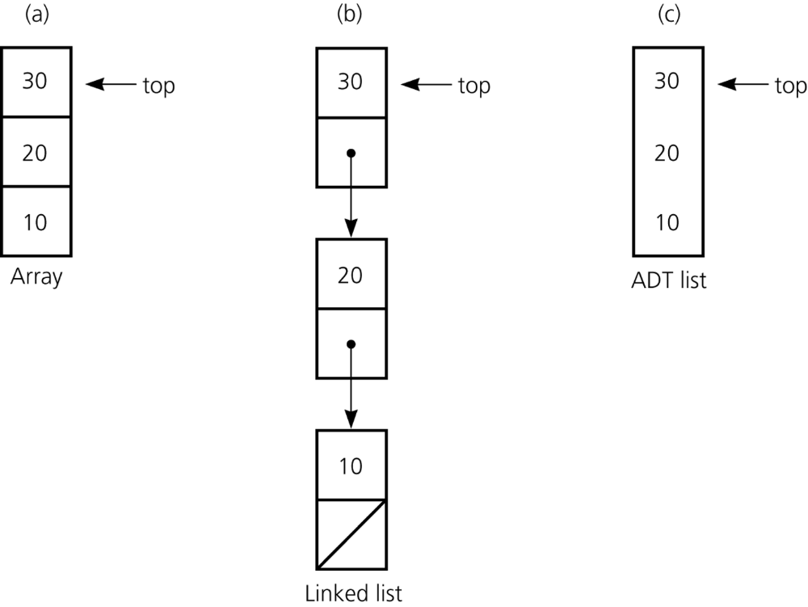
Implementations of the ADT Stack
The ADT stack can be implemented using
  An array
  A linked list
  The ADT list
Figure 6.4
Implementation of the ADT stack that use
a) an array
b) a linked list
c) an ADT list
© 2005 Pearson Addison-Wesley. All rights reserved
6-<number>

Slide 13
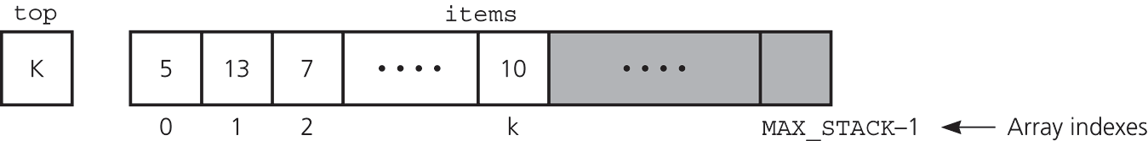
An Array-Based Implementation of the ADT Stack
Private data fields
  An array of items of type StackItemType
  The index top
Compiler-generated destructor and copy constructor
Figure 6.5
An array-based implementation
© 2005 Pearson Addison-Wesley. All rights reserved
6-<number>

Slide 14
An Array-Based Implementation of the ADT Stack
const int MAX_STACK = maximum-size-of-stack;
typedef desired-type-of-stack-item StackItemType;
class Stack{
public:
Stack();
bool isEmpty() const;
bool push(StackItemType newItem);
bool pop();
bool pop(StackItemType& stackTop);
bool getTop(StackItemType& stackTop) const;
private:
// array of stack items
StackItemType items[MAX_STACK];
// index to top of stack
int top;
};
© 2005 Pearson Addison-Wesley. All rights reserved
6-<number>

Slide 15
An Array-Based Implementation of the ADT Stack
// default constructor
Stack::Stack(): top(-1){
}
bool Stack::isEmpty() const{
return top < 0;
}
© 2005 Pearson Addison-Wesley. All rights reserved
6-<number>

Slide 16
An Array-Based Implementation of the ADT Stack
bool Stack::push(StackItemType newItem){
// if stack has no more room for
// another item
if (top >= MAX_STACK-1)
return false;
else{
++top;
items[top] = newItem;
return true;
}
}
© 2005 Pearson Addison-Wesley. All rights reserved
6-<number>

Slide 17
An Array-Based Implementation of the ADT Stack
bool Stack::pop(){
if (isEmpty())
return false;
// stack is not empty; pop top
else {
--top;
return true;
}
}
© 2005 Pearson Addison-Wesley. All rights reserved
6-<number>

Slide 18
An Array-Based Implementation of the ADT Stack
bool Stack::pop(StackItemType& stackTop){
if (isEmpty())
return false;
// stack is not empty; retrieve top
else {
stackTop = items[top];
--top;
return true;
}
}
© 2005 Pearson Addison-Wesley. All rights reserved
6-<number>

Slide 19
An Array-Based Implementation of the ADT Stack
bool Stack::getTop(StackItemType& stackTop)
const{
if (isEmpty())
return false;
// stack is not empty; retrieve top
else {
stackTop = items[top];
return true;
}
}
© 2005 Pearson Addison-Wesley. All rights reserved
6-<number>

Slide 20
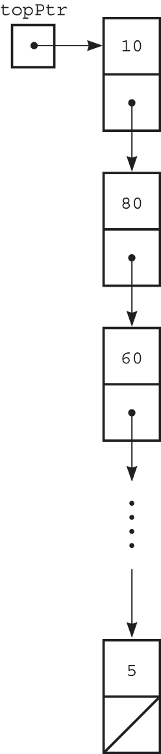
A Pointer-Based Implementation of the ADT Stack
A pointer-based implementation
  Required when the stack needs to grow and shrink dynamically
top is a reference to the head of a linked list of items
A copy constructor and destructor must be supplied
Figure 6.6 A pointer-based implementation
© 2005 Pearson Addison-Wesley. All rights reserved
6-<number>

Slide 21
A Pointer-Based Implementation of the ADT Stack
typedef desired-type-of-stack-item StackItemType;
class Stack{
public:
Stack();
Stack(const Stack& aStack);
~Stack();
bool isEmpty() const;
bool push(StackItemType newItem);
bool pop();
bool pop(StackItemType& stackTop);
bool getTop(StackItemType& stackTop) const;
private:
struct StackNode { // a node on the stack
StackItemType item; // a data item on the stack
StackNode *next; // pointer to next node
};
StackNode *topPtr; // pointer to first node in the stack
};
© 2005 Pearson Addison-Wesley. All rights reserved
6-<number>

Slide 22
A Pointer-Based Implementation of the ADT Stack
// default constructor
Stack::Stack() : topPtr(NULL){
}
© 2005 Pearson Addison-Wesley. All rights reserved
6-<number>

Slide 23
A Pointer-Based Implementation of the ADT Stack
// copy constructor
Stack::Stack(const Stack& aStack){
if (aStack.topPtr == NULL)
topPtr = NULL; // original stack is empty
else {
// copy first node
topPtr = new StackNode;
topPtr->item = aStack.topPtr->item;
// copy rest of stack
StackNode *newPtr = topPtr;
for (StackNode *origPtr = aStack.topPtr->next;
origPtr != NULL;
origPtr = origPtr->next){
newPtr->next = new StackNode;
newPtr = newPtr->next;
newPtr->item = origPtr->item;
}
newPtr->next = NULL;
}
}
© 2005 Pearson Addison-Wesley. All rights reserved
6-<number>

Slide 24
A Pointer-Based Implementation of the ADT Stack
// destructor
Stack::~Stack(){
// pop until stack is empty
while (!isEmpty())
pop();
}
© 2005 Pearson Addison-Wesley. All rights reserved
6-<number>

Slide 25
A Pointer-Based Implementation of the ADT Stack
bool Stack::isEmpty() const {
return topPtr == NULL;
}
© 2005 Pearson Addison-Wesley. All rights reserved
6-<number>

Slide 26
A Pointer-Based Implementation of the ADT Stack
bool Stack::push(StackItemType newItem) {
// create a new node
StackNode *newPtr = new StackNode;
// set data portion of new node
newPtr->item = newItem;
// insert the new node
newPtr->next = topPtr;
topPtr = newPtr;
return true;
}
© 2005 Pearson Addison-Wesley. All rights reserved
6-<number>

Slide 27
A Pointer-Based Implementation of the ADT Stack
bool Stack::pop() {
if (isEmpty())
return false;
// stack is not empty; delete top
else{
StackNode *temp = topPtr;
topPtr = topPtr->next;
// return deleted node to system
temp->next = NULL; // safeguard
delete temp;
return true;
}
}
© 2005 Pearson Addison-Wesley. All rights reserved
6-<number>

Slide 28
A Pointer-Based Implementation of the ADT Stack
bool Stack::pop(StackItemType& stackTop) {
if (isEmpty())
return false;
// not empty; retrieve and delete top
else{
stackTop = topPtr->item;
StackNode *temp = topPtr;
topPtr = topPtr->next;
// return deleted node to system
temp->next = NULL; // safeguard
delete temp;
return true;
}
}
© 2005 Pearson Addison-Wesley. All rights reserved
6-<number>

Slide 29
A Pointer-Based Implementation of the ADT Stack
bool Stack::getTop(StackItemType& stackTop)
const {
if (isEmpty())
return false;
// stack is not empty; retrieve top
else {
stackTop = topPtr->item;
return true;
}
}
© 2005 Pearson Addison-Wesley. All rights reserved
6-<number>

Slide 30
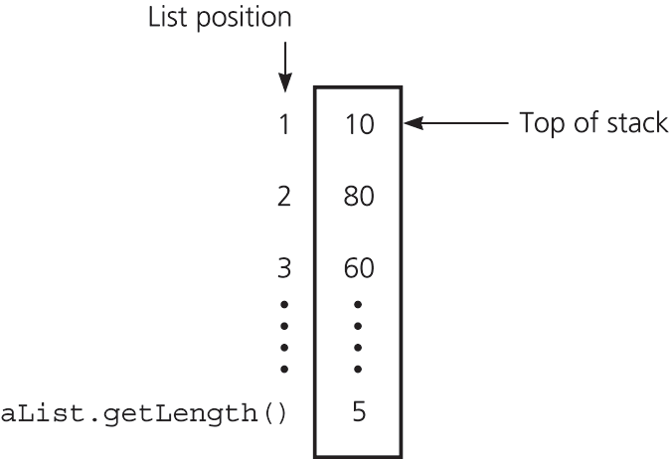
An Implementation That Uses the ADT List
The ADT list can be used to represent items in a stack
If the item in position 1 is the top
push(newItem)
  insert(1, newItem)
pop()
  remove(1)
getTop(stackTop)
  retrieve(1, stackTop)
© 2005 Pearson Addison-Wesley. All rights reserved
6-<number>

Slide 31
An Implementation That Uses the ADT List
#include "ListP.h" // list operations
typedef ListItemType StackItemType;
class Stack {
public:
Stack();
Stack(const Stack& aStack);
~Stack();
bool isEmpty() const;
bool push(StackItemType newItem);
bool pop();
bool pop(StackItemType& stackTop);
bool getTop(StackItemType& stackTop) const;
private:
List aList; // list of stack items
};
© 2005 Pearson Addison-Wesley. All rights reserved
6-<number>

Slide 32
An Implementation That Uses the ADT List
// default constructor
Stack::Stack(){
}
// copy constructor
Stack::Stack(const Stack& aStack)
: aList(aStack.aList){
}
// destructor
Stack::~Stack() {
}
© 2005 Pearson Addison-Wesley. All rights reserved
6-<number>

Slide 33
An Implementation That Uses the ADT List
bool Stack::isEmpty() const {
return aList.isEmpty();
}
bool Stack::getTop(StackItemType& stackTop)
const {
return aList.retrieve(1, stackTop);
}
bool Stack::push(StackItemType newItem){
return aList.insert(1, newItem);
}
© 2005 Pearson Addison-Wesley. All rights reserved
6-<number>

Slide 34
An Implementation That Uses the ADT List
bool Stack::pop() {
return aList.remove(1);
}
bool Stack::pop(StackItemType& stackTop) {
if (aList.retrieve(1, stackTop))
return aList.remove(1);
else
return false;
}
© 2005 Pearson Addison-Wesley. All rights reserved
6-<number>

Slide 35
Comparing Implementations
Fixed size versus dynamic size
  An array-based implementation
    Prevents the push operation from adding an item to the stack if the stack’s size limit has been reached
  A pointer-based implementation
    Does not put a limit on the size of the stack
© 2005 Pearson Addison-Wesley. All rights reserved
6-<number>

Slide 36
Comparing Implementations
An implementation that uses a linked list versus one that uses a pointer-based implementation of the ADT list
  ADT list approach reuses an already implemented class
    Much simpler to write
    Saves time
© 2005 Pearson Addison-Wesley. All rights reserved
6-<number>

Slide 37
Applications
Chapter 6
© 2005 Pearson Addison-Wesley. All rights reserved
6-<number>

Slide 38
Defining Languages
A language
  A set of strings of symbols
  Examples: English, C++
  If a C++ program is one long string of characters, the language C++Programs is defined as
  C++Programs = {strings w : w is a syntactically correct
  C++ program}
© 2005 Pearson Addison-Wesley. All rights reserved
6-<number>

Slide 39
Defining Languages
A language does not have to be a programming or a communication language
  Example: AlgebraicExpressions =
  {w : w is an algebraic expression}
  The grammar defines the rules for forming the strings in a language
A recognition algorithm determines whether a given string is in the language
  A recognition algorithm for a language is written more easily with a recursive grammar
© 2005 Pearson Addison-Wesley. All rights reserved
6-<number>

Slide 40
The Basics of Grammars
Symbols used in grammars
  x | y means x or y
  x y means x followed by y
  < word > means any instance of word that the definition defines
© 2005 Pearson Addison-Wesley. All rights reserved
6-<number>

Slide 41
Example: C++ Identifiers
A C++ identifier begins with a letter and is followed by zero or more letters and digits
Language
C++Ids = {w : w is a legal C++ identifier}
Grammar
  < identifier > = < letter > |
  < identifier > < letter > | < identifier > < digit>
  < letter > = a | b | … | z | A | B | …| Z | _ | $
  < digit > = 0 | 1 | … | 9
© 2005 Pearson Addison-Wesley. All rights reserved
6-<number>

Slide 42
Algebraic Expressions
Infix expressions: an operator appears between its operands
    a + b
    a + b * c + ( d * e + f ) * g
Prefix expressions: an operator appears before its operands
    + a b
    ++a*bc*+*defg
Postfix expressions: an operator appears after its operands
    a b +
    abc*+de*f+g*+
© 2005 Pearson Addison-Wesley. All rights reserved
6-<number>

Slide 43
Algebraic Expressions
To convert a fully parenthesized infix expression to a prefix form
  Move each operator to the position marked by its corresponding open parenthesis
  Remove the parentheses
  Example
    Infix expression: ( ( a + b ) * c )
    Prefix expression: * + a b c
© 2005 Pearson Addison-Wesley. All rights reserved
6-<number>

Slide 44
Algebraic Expressions
To convert a fully parenthesized infix expression to a postfix form
  Move each operator to the position marked by its corresponding closing parenthesis
  Remove the parentheses
  Example
    Infix form: ( ( a + b ) * c )
    Postfix form: a b + c *
© 2005 Pearson Addison-Wesley. All rights reserved
6-<number>

Slide 45
Algebraic Expressions
Prefix and postfix expressions
  Never need
    Precedence rules
    Association rules
    Parentheses
  Have
    Simple grammar expressions
    Straightforward recognition and evaluation algorithms
© 2005 Pearson Addison-Wesley. All rights reserved
6-<number>

Slide 46
Prefix Expressions
Grammar
  < prefix > = < identifier > | < operator >
  < prefix > < prefix >
  < operator > = + | - | * | /
  < identifier > = a | b | … | z
© 2005 Pearson Addison-Wesley. All rights reserved
6-<number>

Slide 47
Postfix Expressions
Grammar
  < postfix > = < identifier > |
  < postfix > < postfix > < operator>
  < operator > = + | - | * | /
  < identifier > = a | b | … | z
The recursive case for prefix form to postfix form conversion
    postfix(exp)= postfix(prefix1) +
    postfix(prefix2) + <operator>
© 2005 Pearson Addison-Wesley. All rights reserved
6-<number>

Slide 48
Fully Parenthesized Infix Expressions
Grammar
  < infix > = < identifier > |
  (< infix > < operator > < infix > )
  < operator > = + | - | * | /
  < identifier > = a | b | … | z
Fully parenthesized expressions
  Do not require precedence rules or rules for association
  Are inconvenient for programmers
© 2005 Pearson Addison-Wesley. All rights reserved
6-<number>

Slide 49
Evaluating Prefix Expressions
A recursive algorithm that evaluates a prefix expression
  evaluatePrefix(inout strExp:string):float
  ch = first character of expression strExp
  Delete first character from strExp
  if (ch is an identifier)
  return value of the identifier
  else if (ch is an operator named op) {
  operand1 = evaluatePrefix(strExp)
  operand2 = evaluatePrefix(strExp)
  return operand1 op operand2
  }
© 2005 Pearson Addison-Wesley. All rights reserved
6-<number>

Slide 50
Converting Prefix Expressions to Equivalent Postfix Expressions
A recursive algorithm that converts a prefix expression to postfix form
  convert(inout pre:string, out post:string)
  ch = first character of pre
  Delete first character of pre
  if (ch is a lowercase letter)
  post = post + ch
  else {
  convert(pre, post)
  convert(pre, post)
  post = post + ch
  }
© 2005 Pearson Addison-Wesley. All rights reserved
6-<number>

Slide 51
Algebraic Expression Operations using Stacks
When the ADT stack is used to solve a problem, the use of the ADT’s operations should not depend on its implementation
To evaluate an infix expression
  Convert the infix expression to postfix form
  Evaluate the postfix expression
© 2005 Pearson Addison-Wesley. All rights reserved
6-<number>

Slide 52
Converting Infix Expressions to Equivalent Postfix Expressions
Facts about converting from infix to postfix
  Operands always stay in the same order with respect to one another
  An operator will move only “to the right” with respect to the operands
  All parentheses are removed
© 2005 Pearson Addison-Wesley. All rights reserved
6-<number>

Slide 53
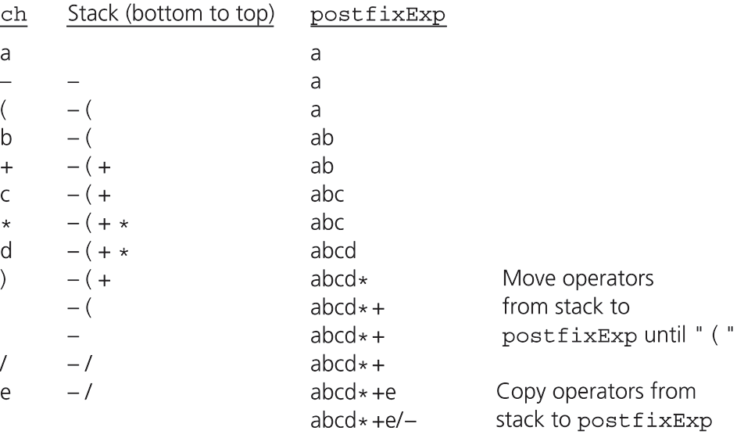
Converting Infix Expressions to Equivalent Postfix Expressions
Figure 6.9
A trace of the algorithm that converts the infix expression a - (b + c * d)/e to postfix form
© 2005 Pearson Addison-Wesley. All rights reserved
6-<number>

Slide 54
Converting Infix Expressions to Equivalent Postfix Expressions
First draft of an algorithm
initialize postfixExp to the null string
for (each character ch in the infix expression){
switch (ch){
case ch is an operand:
append ch to the end of postfixExp
break
case ch is an operator:
store ch until you know where to place it
break
case ch is '(' or ')':
discard ch
break
}
}
© 2005 Pearson Addison-Wesley. All rights reserved
6-<number>

Slide 55
Converting Infix Expressions to Equivalent Postfix Expressions
A pseudocode algorithm
for (each character ch in the infix expression){
switch (ch){
case operand: // append operand to end of PE
postFixExp += ch
break
case '(': // save '(' on stack
aStack.push(ch)
break
case ')': // pop stack until matching '('
while (top of aStack is not '('){
postFixExp += (top of aStack)
aStack.pop()
}
aStack.pop() // remove the open parenthesis
break
© 2005 Pearson Addison-Wesley. All rights reserved
6-<number>

Slide 56
Converting Infix Expressions to Equivalent Postfix Expressions
A pseudocode algorithm
case operator: // process stack operators of
// greater precedence
while (!aStack.isEmpty() and
top of aStack is not '(' and
precedence(ch) <=
precedence(top of aStack)){
postfixExp += (top of aStack)
aStack.pop()
}
aStack.push(ch) // save new operator
break
}
}
© 2005 Pearson Addison-Wesley. All rights reserved
6-<number>

Slide 57
Evaluating Postfix Expressions
A postfix calculator
  When an operand is entered, the calculator
    Pushes it onto a stack
  When an operator is entered, the calculator
    Applies it to the top two operands of the stack
    Pops the operands from the stack
    Pushes the result of the operation on the stack
© 2005 Pearson Addison-Wesley. All rights reserved
6-<number>

Slide 58
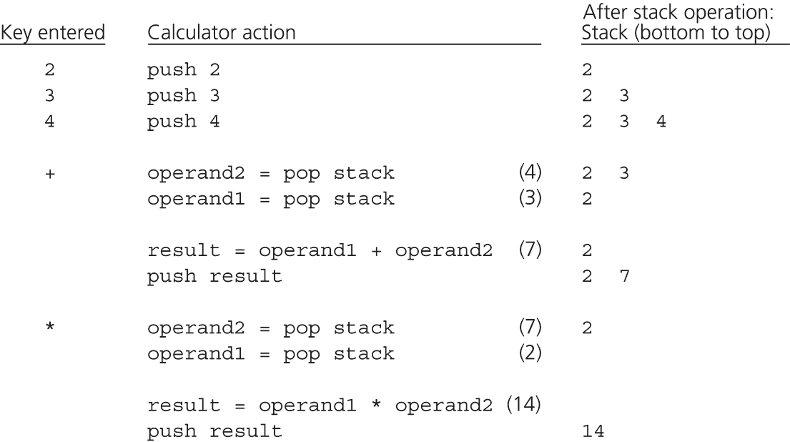
Evaluating Postfix Expressions
Figure 6.8
The action of a postfix calculator when evaluating the expression 2 * (3 + 4)
© 2005 Pearson Addison-Wesley. All rights reserved
6-<number>

Slide 59
Evaluating Postfix Expressions
A pseudocode algorithm
for (each character ch in the string){
if (ch is an operand)
push value that operand ch represents onto stack
else{ // ch is an operator named op
// evaluate and push the result
operand2 = top of stack
pop the stack
operand1 = top of stack
pop the stack
result = operand1 op operand2
push result onto stack
}
}
© 2005 Pearson Addison-Wesley. All rights reserved
6-<number>

Slide 60
Section 6.5: A Search Problem
High Planes Airline Company (HPAir)
  For each customer request, indicate whether a sequence of HPAir flights exists from the origin city to the destination city
The flight map for HPAir is a graph
  Adjacent vertices are two vertices that are joined by an edge
  A directed path is a sequence of directed edges
© 2005 Pearson Addison-Wesley. All rights reserved
6-<number>

Slide 61
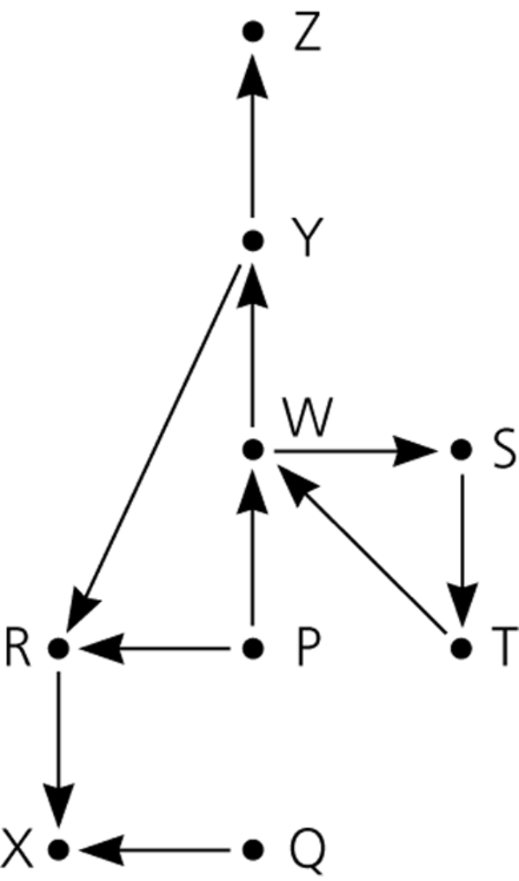
Application: A Search Problem
Figure 6.10
Flight map for HPAir
© 2005 Pearson Addison-Wesley. All rights reserved
6-<number>

Slide 62
A Nonrecursive Solution That Uses a Stack
The solution performs an exhaustive search
  Beginning at the origin city, the solution will try every possible sequence of flights until either
    It finds a sequence that gets to the destination city
    It determines that no such sequence exists
Backtracking can be used to recover from a wrong choice of a city
© 2005 Pearson Addison-Wesley. All rights reserved
6-<number>

Slide 63
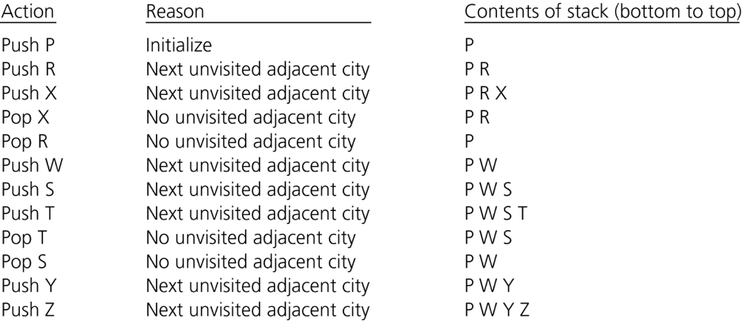
A Nonrecursive Solution That Uses a Stack
Figure 6.13
A trace of the search algorithm, given the flight map in Figure 6-10
© 2005 Pearson Addison-Wesley. All rights reserved
6-<number>

Slide 64
A Nonrecursive Solution That Uses a Stack
Draft of the search algorithm
aStack.createStack()
clear marks on all cities
aStack.push(originCity) // push origin city onto aStack
mark the origin as visited
while (a sequence of flights from the origin to the destination
has not been found){
// loop invariant: the stack contains a directed path from
// the origin city at the bottom of the stack to the city
// at the top of the stack
if (no flights exist from the city on the top of the stack
to unvisited cities)
aStack.pop() // backtrack
else{
select an unvisited destination city C for a flight from
the city on the top of the stack
aStack.push(C)
mark C as visited
}
}
© 2005 Pearson Addison-Wesley. All rights reserved
6-<number>

Slide 65
A Nonrecursive Solution That Uses a Stack
Final version of the search algorithm
boolean searchS(originCity, destinationCity)
// searches for a sequence of flights
// from originCity to destinationCity
aStack.createStack()
clear marks on all cities
aStack.push(originCity) // push origin onto aStack
mark the origin as visited
while (!aStack.isEmpty() and
destinationCity is not at the top of the stack){
// loop invariant: the stack contains a directed path
// from the origin city at the bottom of the stack to
// the city at the top of the stack
© 2005 Pearson Addison-Wesley. All rights reserved
6-<number>

Slide 66
A Nonrecursive Solution That Uses a Stack
Final version of the search algorithm
// originCity to destinationCity
if (no flights exist from the city on the top of the
stack to unvisited cities)
aStack.pop() // backtrack
else {
select an unvisited destination city C for a
flight from the city on the top of the stack
aStack.push(C)
mark C as visited
}
}
if ( aStack.isEmpty() )
return false // no path exists
else
return true // path exists
© 2005 Pearson Addison-Wesley. All rights reserved
6-<number>

Slide 67
A Recursive Solution
Possible outcomes of the recursive search strategy
  You eventually reach the destination city and can conclude that it is possible to fly from the origin to the destination
  You reach a city C from which there are no departing flights
  You go around in circles
© 2005 Pearson Addison-Wesley. All rights reserved
6-<number>

Slide 68
A Recursive Solution
A refined recursive search strategy
  +searchR(in originCity:City,
  in destinationCity:City):boolean
  Mark originCity as visited
  if (originCity is destinationCity)
  Terminate -- the destination is reached
  else
  for (each unvisited city C
  adjacent to originCity)
  searchR(C, destinationCity)
© 2005 Pearson Addison-Wesley. All rights reserved
6-<number>

Slide 69
The Relationship Between Stacks and Recursion
Typically, stacks are used by compilers to implement recursive methods
  During execution, each recursive call generates an activation record that is pushed onto a stack
Stacks can be used to implement a nonrecursive version of a recursive algorithm
© 2005 Pearson Addison-Wesley. All rights reserved
6-<number>

Slide 70
Summary
ADT stack operations have a last-in, first-out (LIFO) behavior
Stack applications
  Algorithms that operate on algebraic expressions
  Flight maps
A strong relationship exists between recursion and stacks
© 2005 Pearson Addison-Wesley. All rights reserved
6-<number>

