Slide 1

Chapters 8 and 9
ADT List:
Linked Lists

Slide 2
Preliminaries
Options for implementing an ADT List
  Array has a fixed size
    Data must be shifted during insertions and deletions
  Linked list is able to grow in size as needed
    Does not require the shifting of items during insertions and deletions
© 2005 Pearson Addison-Wesley. All rights reserved
4-<number>

Slide 3
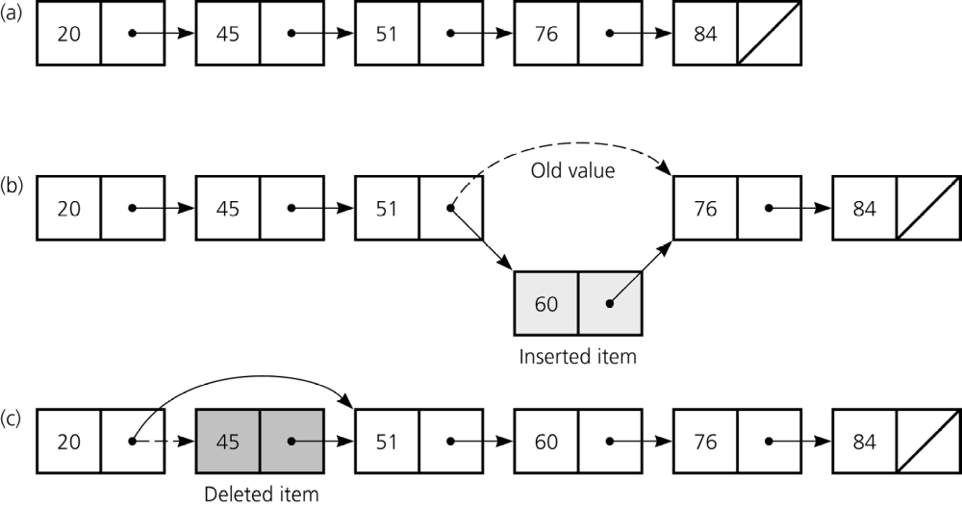
Preliminaries
Figure 4.1 a) A linked list of integers; b) insertion; c) deletion
© 2005 Pearson Addison-Wesley. All rights reserved
4-<number>

Slide 4
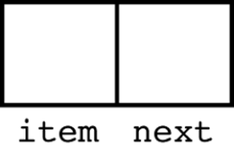
Pointer-Based Linked Lists
A node in a linked list is usually a struct
  struct Node{
  int item;
  Node *next;
  };
A node is dynamically allocated
  Node *p;
  p = new Node;
Figure 4.6 A node
© 2005 Pearson Addison-Wesley. All rights reserved
4-<number>

Slide 5
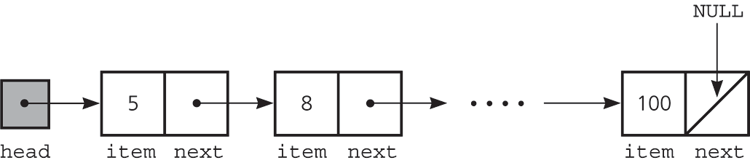
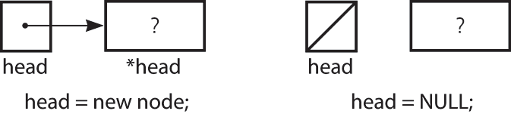
Pointer-Based Linked Lists
The head pointer points to the first node in a linked list
If head is NULL, the linked list is empty
Figure 4.7 A head pointer to a list
Figure 4.8 A lost cell
© 2005 Pearson Addison-Wesley. All rights reserved
4-<number>

Slide 6
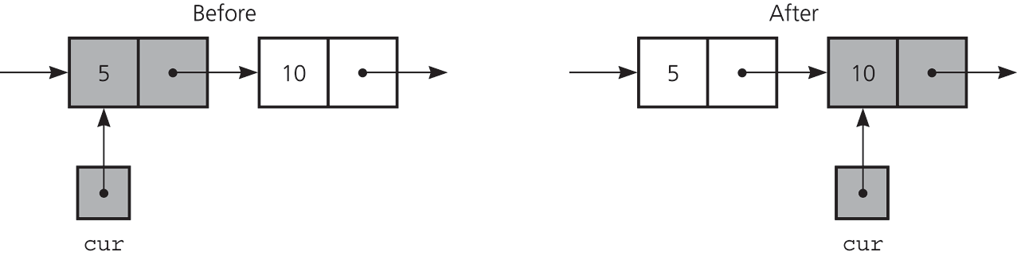
Displaying the Contents of a Linked List
Reference a node member with the -> operator
Traverse operation visits each node in the linked list
  A pointer variable cur keeps track of the current node
for (Node *cur = head; cur != NULL; cur = cur->next)
    cout << cur->item << endl;
Figure 4.9 The effect of the assignment cur = cur->next
© 2005 Pearson Addison-Wesley. All rights reserved
4-<number>

Slide 7
A Linked List Implementation of the ADT List
Public methods
  isEmpty
  getLength
  insert
  remove
  retrieve
Private method
  find
Private data members
  head
  size
Local variables to member functions
  cur
  prev
© 2005 Pearson Addison-Wesley. All rights reserved
4-<number>

Slide 8
Constructors and Destructors
Default constructor initializes size and head
Copy constructor allows a deep copy
  Copies the list items and the number of items
A destructor is required for dynamically allocated memory
© 2005 Pearson Addison-Wesley. All rights reserved
4-<number>

Slide 9
A Linked List Implementation of the ADT List
// ****************************************
// Header file ListP.h for the ADT list.
// Pointer-based implementation.
//*****************************************
typedef desired-type-of-list-item ListItemType;
class List{
// constructors and destructor:
public:
List(); // default constructor
List(const List& aList); // copy constructor
~List(); // destructor
© 2005 Pearson Addison-Wesley. All rights reserved
4-<number>

Slide 10
A Linked List Implementation of the ADT List
// list operations:
bool isEmpty() const;
int getLength() const;
bool retrieve(int index,
ListItemType& dataItem) const;
bool insert(int index, ListItemType newItem);
bool remove(int index);
© 2005 Pearson Addison-Wesley. All rights reserved
4-<number>

Slide 11
A Linked List Implementation of the ADT List
private:
struct ListNode{ // a node on the list
ListItemType item; // a data item on the list
ListNode *next; // pointer to next node
};
int size; // number of items in list
ListNode *head; // pointer to linked list
// of items
ListNode *find(int index) const;
// Returns a pointer to the index-th node
// in the linked list
};
© 2005 Pearson Addison-Wesley. All rights reserved
4-<number>

Slide 12
A Linked List Implementation of the ADT List
// **********************************************
// Implementation file ListP.cpp for the ADT list
// Pointer-based implementation.
// **********************************************
#include "ListP.h" // header file
#include <cstddef> // for NULL
List::List(): size(0), head(NULL){
}
© 2005 Pearson Addison-Wesley. All rights reserved
4-<number>

Slide 13
A Linked List Implementation of the ADT List
List::List(const List& aList): size(aList.size){
if (aList.head == NULL)
head = NULL; // original list is empty
else {
// copy first node
head = new ListNode;
head->item = aList.head->item;
// copy rest of list
ListNode *newPtr = head; // new list ptr
for (ListNode *origPtr = aList.head->next;
origPtr != NULL;
origPtr = origPtr->next){
newPtr->next = new ListNode;
newPtr = newPtr->next;
newPtr->item = origPtr->item;
}
newPtr->next = NULL;
}
} // end copy constructor
© 2005 Pearson Addison-Wesley. All rights reserved
4-<number>

Slide 14
A Linked List Implementation of the ADT List
List::~List(){
while (!isEmpty())
remove(1);
} // end destructor
© 2005 Pearson Addison-Wesley. All rights reserved
4-<number>

Slide 15
A Linked List Implementation of the ADT List
bool List::isEmpty() const{
return size == 0;
} // end isEmpty
© 2005 Pearson Addison-Wesley. All rights reserved
4-<number>

Slide 16
A Linked List Implementation of the ADT List
int List::getLength() const{
return size;
} // end getLength
© 2005 Pearson Addison-Wesley. All rights reserved
4-<number>

Slide 17
A Linked List Implementation of the ADT List
List::ListNode *List::find(int index) const{
// Locates a specified node in a linked list.
// Precondition: index is the number of the
// desired node.
// Postcondition: Returns a pointer to the
// desired node. If index < 1 or index > the
// number of nodes in the list, returns NULL.
if ( (index < 1) || (index > getLength()) )
return NULL;
else{ // count from the beginning of the list
ListNode *cur = head;
for (int skip = 1; skip < index; ++skip)
cur = cur->next;
return cur;
}
} // end find
© 2005 Pearson Addison-Wesley. All rights reserved
4-<number>

Slide 18
A Linked List Implementation of the ADT List
bool List::retrieve(int index,
ListItemType& dataItem) const {
if ((index < 1) || (index > getLength()))
return false;
// get pointer to node, then data in node
ListNode *cur = find(index);
dataItem = cur->item;
return true;
} // end retrieve
© 2005 Pearson Addison-Wesley. All rights reserved
4-<number>

Slide 19
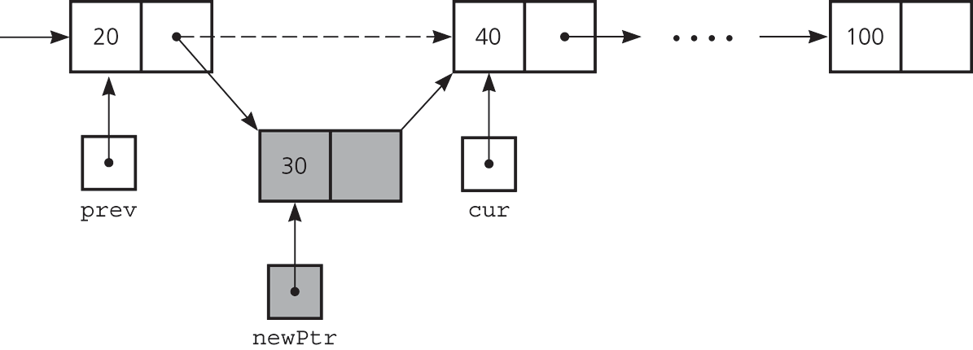
Inserting a Node into a Specified Position of a Linked List
To insert a node between two nodes
    newPtr->next = cur;
    prev->next = newPtr;
Figure 4.12
Inserting a new node into a linked list
© 2005 Pearson Addison-Wesley. All rights reserved
4-<number>

Slide 20
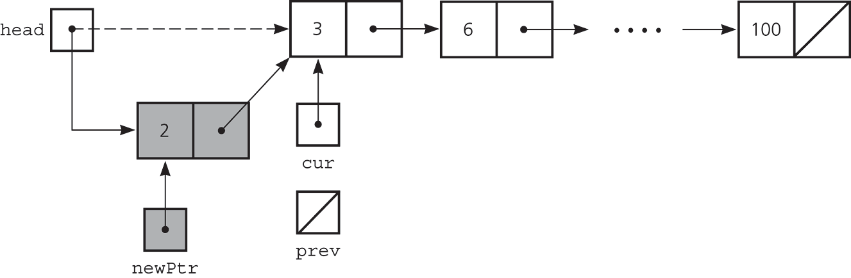
Inserting a Node into a Specified Position of a Linked List
To insert a node at the beginning of a linked list
    newPtr->next = head;
    head = newPtr;
Figure 4.13
Inserting at the beginning of a linked list
© 2005 Pearson Addison-Wesley. All rights reserved
4-<number>

Slide 21
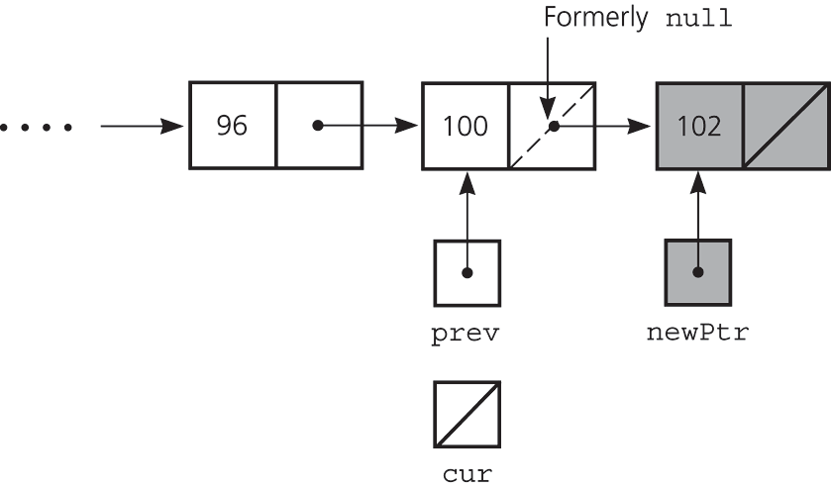
Inserting a Node into a Specified Position of a Linked List
Inserting at the end of a linked list is not a special case if cur is NULL
  newPtr->next = cur;
  prev->next = newPtr;
Figure 4.14
Inserting at the end of a linked list
© 2005 Pearson Addison-Wesley. All rights reserved
4-<number>

Slide 22
A Linked List Implementation of the ADT List
bool List::insert(int index, ListItemType newItem) {
int newLength = getLength() + 1;
if ((index < 1) || (index > newLength))
return false;
ListNode *newPtr = new ListNode;
size = newLength;
newPtr->item = newItem;
if (index == 1){
newPtr->next = head;
head = newPtr;
}
else{
ListNode *prev = find(index-1);
newPtr->next = prev->next;
prev->next = newPtr;
}
return true;
} // end insert
© 2005 Pearson Addison-Wesley. All rights reserved
4-<number>

Slide 23
Inserting a Node into a Specified Position of a Linked List
Determining the point of insertion or deletion for a sorted linked list of objects
  for(prev = NULL, cur= head;
  (cur != NULL)&&
  (newValue > cur->item);
  prev = cur, cur = cur->next);
© 2005 Pearson Addison-Wesley. All rights reserved
4-<number>

Slide 24
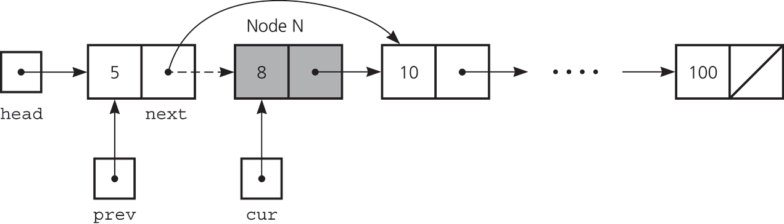
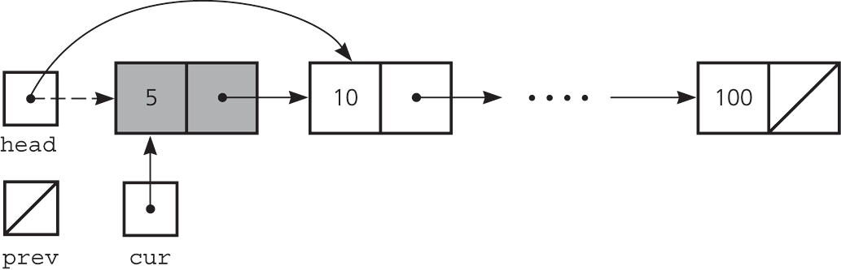
Deleting a Specified Node from a Linked List
Deleting an interior node
  prev->next=cur->next;
Deleting the first node
  head=head->next;
Return deleted node to system
  cur->next = NULL;
  delete cur;
  cur = NULL;
Figure 4.10 Deleting a node from a linked list
Figure 4.11 Deleting the first node
4-<number>

Slide 25
A Linked List Implementation of the ADT List
bool List::remove(int index) {
ListNode *cur;
if ((index < 1) || (index > getLength()))
return false;
--size;
if (index == 1){
cur = head;
head = head->next;
}
else{
ListNode *prev = find(index-1);
cur = prev->next;
prev->next = cur->next;
}
cur->next = NULL;
delete cur;
cur = NULL;
return true;
} // end remove
© 2005 Pearson Addison-Wesley. All rights reserved
4-<number>

Slide 26
Comparing Array-Based and Linked List Implementations
Size
  Increasing the size of a resizable array can waste storage and time
Storage requirements
  Array-based implementations require less memory than a linked list implementation
© 2005 Pearson Addison-Wesley. All rights reserved
4-<number>

Slide 27
Comparing Array-Based and Linked List Implementations
Access time
  Array-based: constant access time
  Linked list: the time to access the i^{th} node depends on i
Insertion and deletions
  Array-based: require shifting of data
  Linked list: require a list traversal
© 2005 Pearson Addison-Wesley. All rights reserved
4-<number>

Slide 28
Saving and Restoring a Linked List by Using a File
Use an external file to preserve the list between runs
Do not write pointers to a file, only data
Recreate the list from the file by placing each item at the end of the list
  Use a tail pointer to facilitate adding nodes to the end of the list
  Treat the first insertion as a special case by setting the tail to head
© 2005 Pearson Addison-Wesley. All rights reserved
4-<number>

Slide 29
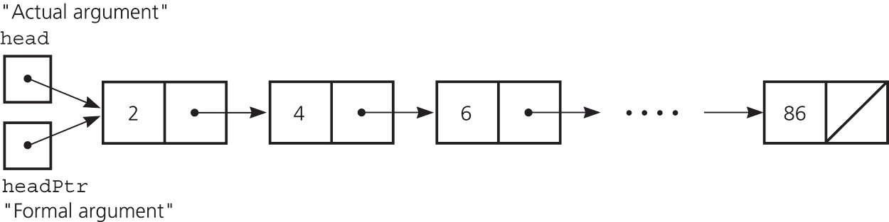
Passing a Linked List to a Function
A function with access to a linked list’s head pointer has access to the entire list
© 2005 Pearson Addison-Wesley. All rights reserved
4-<number>

Slide 30
Processing a Linked List Recursively
Display the contents of a linked list in reverse order
void displayReverseOrder(Node *headPtr){
if (headPtr != NULL){
// display the linked list minus
// its first item in reverse order
displayReverseOrder(headPtr->next);
// display the first item
cout << headPtr->item;
}
}
What is the time complexity of this function?
© 2005 Pearson Addison-Wesley. All rights reserved
4-<number>

Slide 31
Processing a Linked List Recursively
Determine whether or not a linked list is sorted
  The linked list to which head points is sorted if
    head is NULL or
    head->next is NULL or
    head->item < head->next->item, and
    head->next points to a sorted linked list
© 2005 Pearson Addison-Wesley. All rights reserved
4-<number>

Slide 32
Processing a Linked List Recursively
Insert an item into a sorted linked list
void linkedListInsert(Node *&headPtr,
ListItemType newItem){
if ((headPtr == NULL) ||
(newItem < headPtr->item)){
Node *newPtr = new Node;
newPtr->item = newItem;
newPtr->next = headPtr;
headPtr = newPtr;
}
else
linkedListInsert(headPtr->next,newItem);
}
© 2005 Pearson Addison-Wesley. All rights reserved
4-<number>

Slide 33
Objects as Linked List Data
Data in a linked list node can be an instance of a class
  typedef ClassName ItemType;
  struct Node{
  ItemType item;
  Node *next;
  };
  Node *head;
© 2005 Pearson Addison-Wesley. All rights reserved
4-<number>

Slide 34
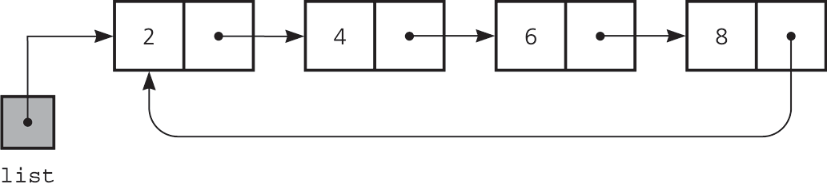
Circular Linked Lists
Last node references the first node
Every node has a successor
No node in a circular linked list contains NULL
Figure 4.25 A circular linked list
© 2005 Pearson Addison-Wesley. All rights reserved
4-<number>

Slide 35
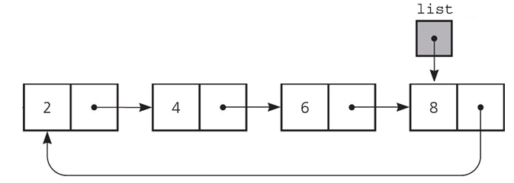
Circular Linked Lists
Figure 4.26 A circular linked list with an external pointer to the last node
© 2005 Pearson Addison-Wesley. All rights reserved
4-<number>

Slide 36
Circular Linked Lists
// display the data in a circular linked list;
// list points to its last node
if (list != NULL){
// list is not empty
Node *first = list->next; // point to first node
Node *cur = first; // start at first node
// Loop invariant: cur points to next node to
// display
do{
display(cur->item); // write data portion
cur = cur->next; // point to next node
} while (cur != first); // list traversed?
}
© 2005 Pearson Addison-Wesley. All rights reserved
4-<number>

Slide 37
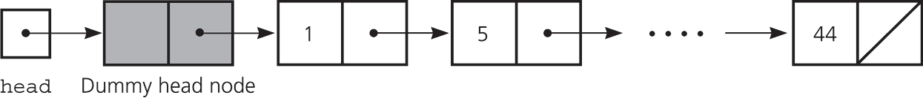
Dummy Head Nodes
Dummy head node
  Always present, even when the linked list is empty
  Insertion and deletion algorithms initialize prev to reference the dummy head node, rather than NULL
Figure 4.27 A dummy head node
© 2005 Pearson Addison-Wesley. All rights reserved
4-<number>

Slide 38
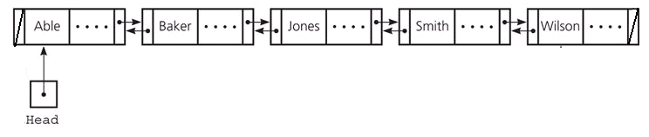
Doubly Linked Lists
Each node points to both its predecessor and its successor
  struct DNode{
  ItemType item;
  DNode *next, *precede;
  };
  DNode *head;
Figure 4.28 A doubly linked list
© 2005 Pearson Addison-Wesley. All rights reserved
4-<number>

Slide 39
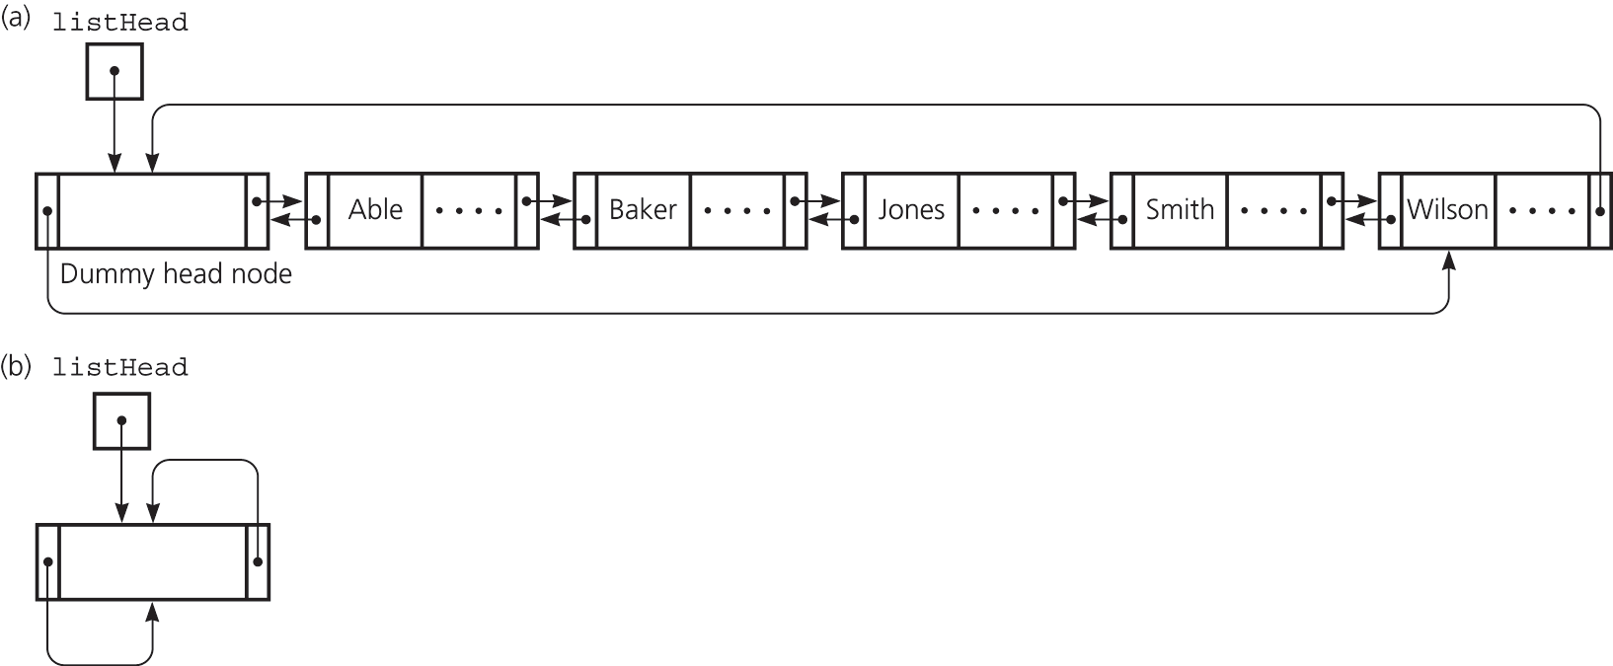
A Circular Doubly Linked List with a Dummy Head Node
precede pointer of the dummy head node points to the last node
next pointer of the last node points to the dummy head node
No special cases for insertions and deletions
Figure 4.29 (a) A circular doubly linked list with a dummy head node
(b) An empty list with a dummy head node
© 2005 Pearson Addison-Wesley. All rights reserved
4-<number>

Slide 40
Doubly Linked Lists
To delete the node to which cur points
  (cur->precede)->next = cur->next;
  (cur->next)->precede = cur->precede;
To insert a new node pointed to by newPtr before the node pointed to by cur
  newPtr->next = cur;
  newPtr->precede = cur->precede;
  cur->precede = newPtr;
  newPtr->precede->next = newPtr;
© 2005 Pearson Addison-Wesley. All rights reserved
4-<number>

Slide 41
Summary
Each pointer in a linked list is a pointer to the next node in the list
Algorithms for insertions and deletions in a linked list involve traversing the list and performing pointer changes
  Inserting a node at the beginning of a list and deleting the first node of a list are special cases
© 2005 Pearson Addison-Wesley. All rights reserved
4-<number>

Slide 42
Summary
Recursion can be used to perform operations on a linked list
In a circular linked list, the last node points to the first node
Dummy head nodes eliminate the special cases for insertion into and deletion from the beginning of a linked list
© 2005 Pearson Addison-Wesley. All rights reserved
4-<number>

