Slide 1
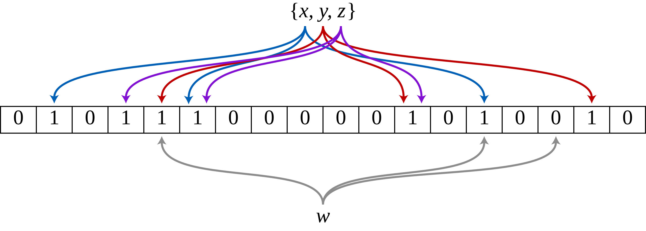
Fast Learnıng Management wıth Bloom Fılters
Arda Durmaz 23070001009

Slide 2
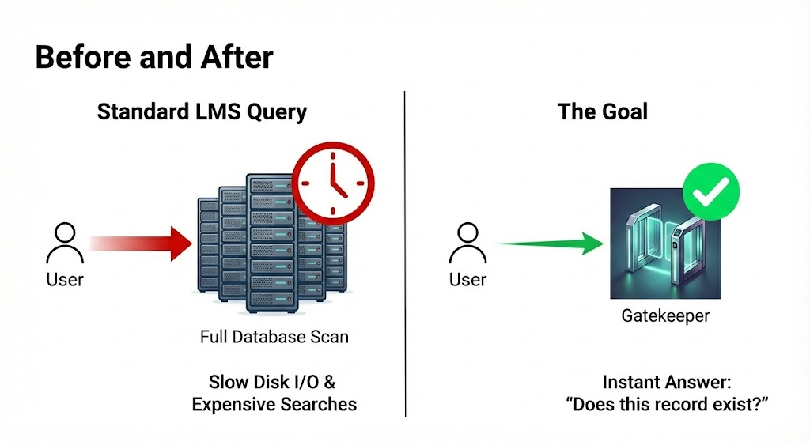
The Problem:
Database Bottleneck

Slide 3
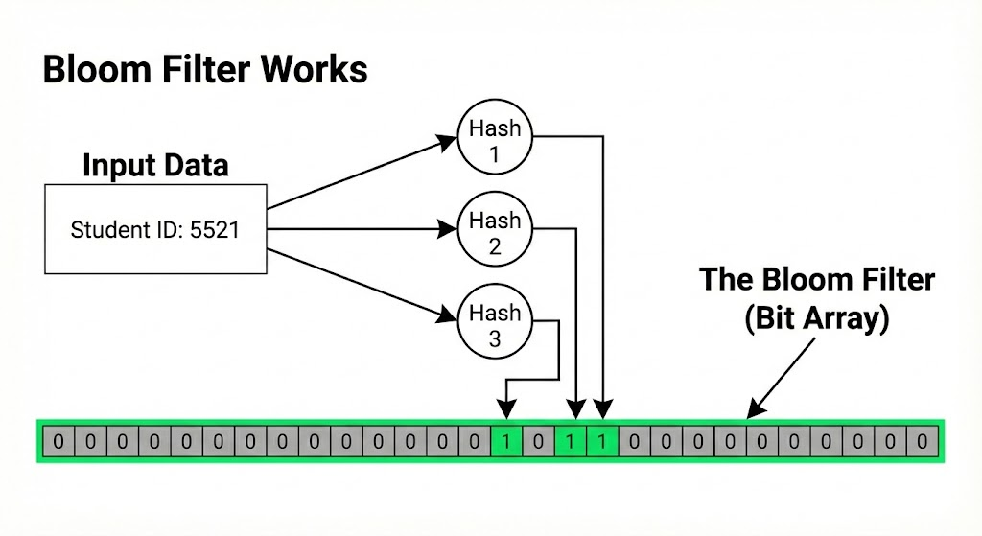
The solutıon:Bloom fılter

Slide 4
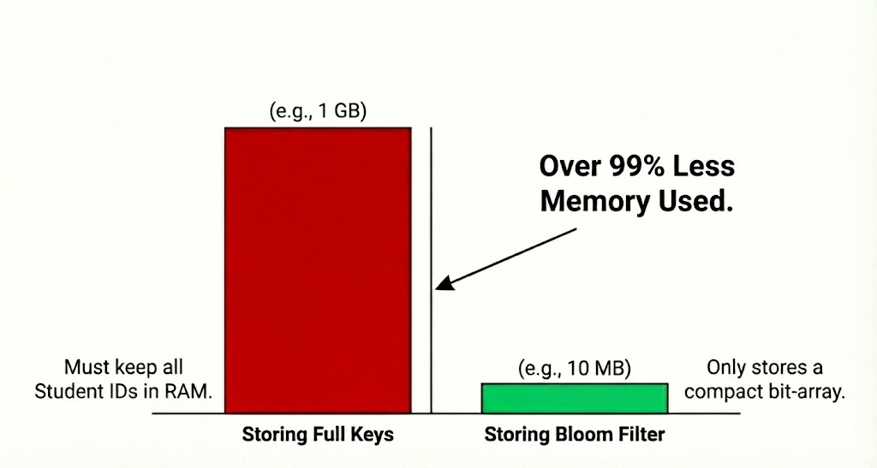
comparıson

Slide 5
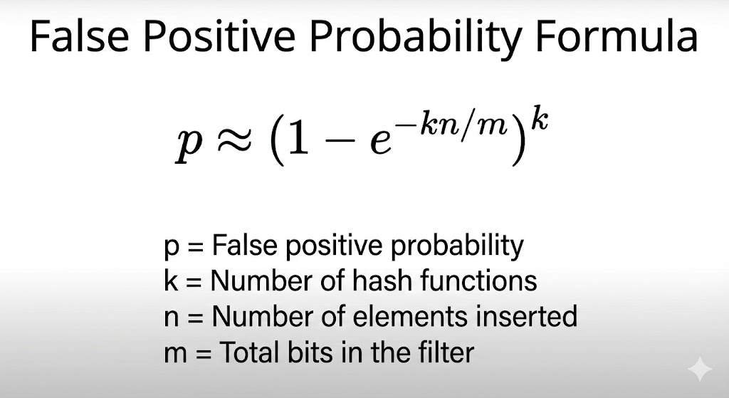
False posıtıve probabılıty

Slide 6
THANk you
REFERENCES:
MurmurHash - Wikipedia
Bloom filter - Wikipedia
Jenkins hash function - Wikipedia

