Slide 1
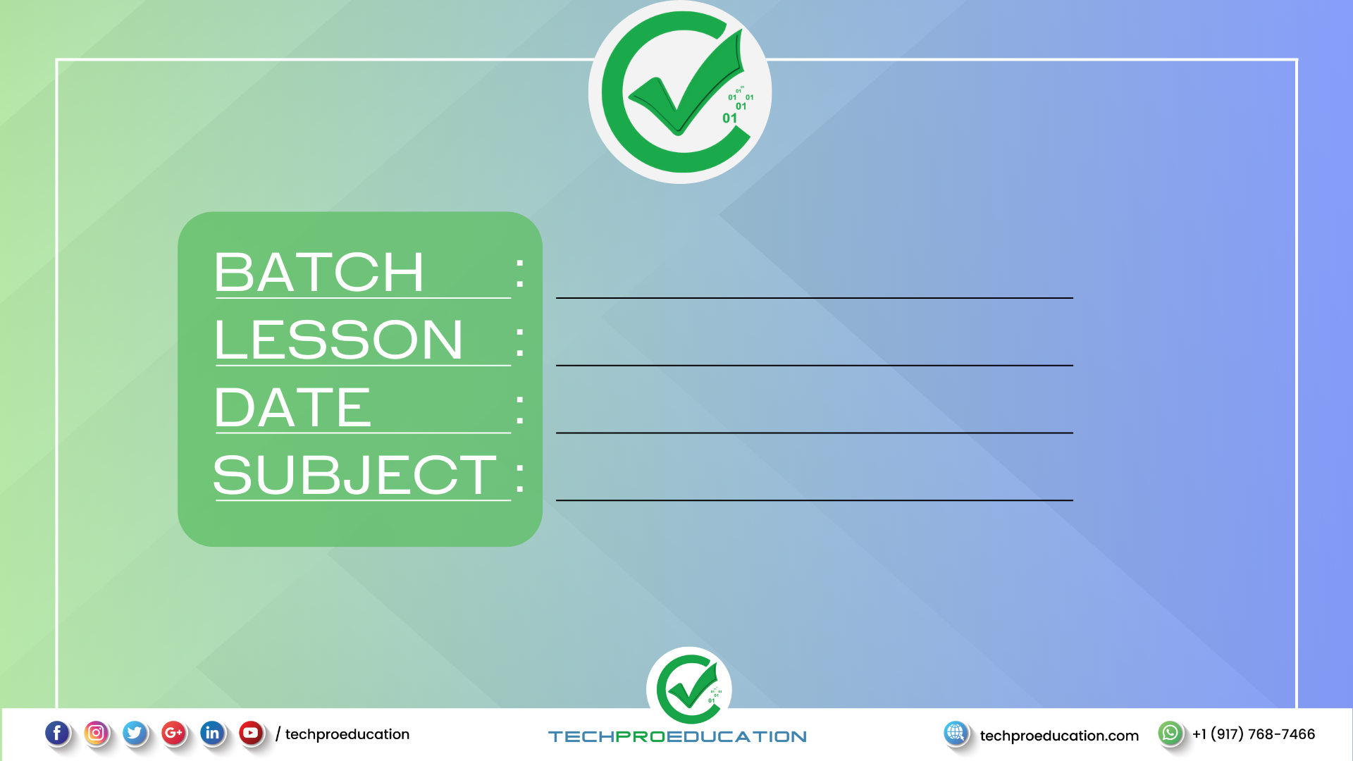
B107 AWS-DevOps
Kubernetes
30.05.2023
Ingress
ZOOM GİRİŞLERİNİZİ LÜTFEN LMS SİSTEMİ ÜZERİNDEN YAPINIZ
Caption

Slide 2
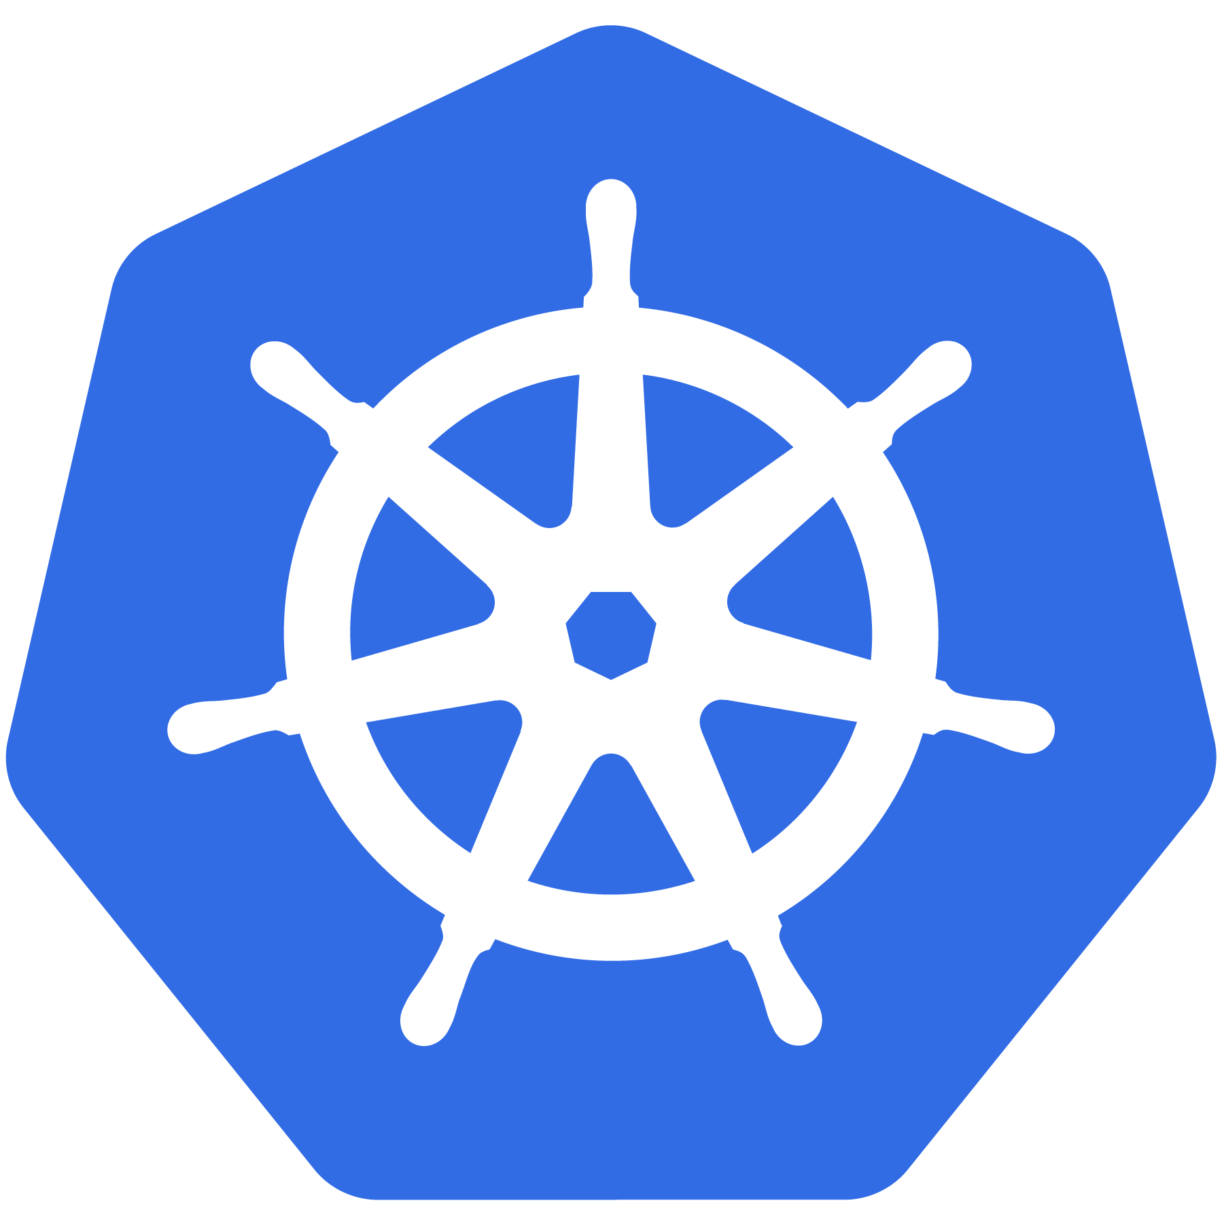
Kubernetes

Slide 3
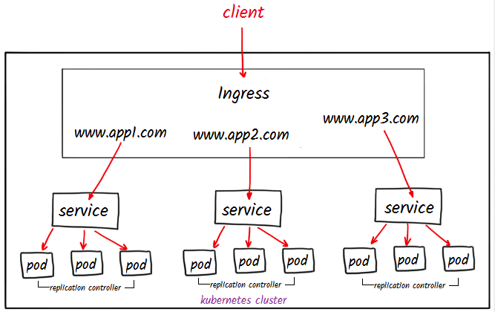
Ingress
Ingress is an object that provides routing rules to manage access to the services within a Kubernetes cluster.
Uses HTTPS and HTTP protocols to facilitate the routing.
Ingress is the ideal choice for a production environment.
You must have and Ingress controller to satisfy an Ingress.
Kubernetes as a project supports and maintains AWS, GCE, and nginx ingress controllers.
Name based routing, advanced load balancing

Slide 4


