Slide 1
Chapter 9
Records (structs)

Slide 2
Objectives (1 of 2)
In this chapter, you will:
  Learn about records (structs)
  Examine various operations on a struct
  Explore ways to manipulate data using a struct
  Learn about the relationship between a struct and functions
  Examine the difference between arrays and structs

Slide 3
Objectives (2 of 2)
  Discover how arrays are used in a struct
  Learn how to create an array of struct items
  Learn how to create structs within a structs

Slide 4
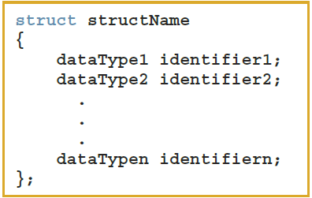
Records (structs) (1 of 3)
struct: a collection of a fixed number of components in which the components are accessed by name
  The components may be of different types and are called the members of the struct
Syntax

Slide 5
Records (structs) (2 of 3)
A struct is a definition, not a declaration
  Must declare a variable of that type to use it
  struct houseType
  {
  string style;
  int numOfBedrooms;
  int numOfBathrooms;
  int numOfCarsGarage;
  int yearBuilt;
  int finishedSquareFootage;
  double price;
  double tax;
  };
  //variable declaration
  houseType newHouse;

Slide 6
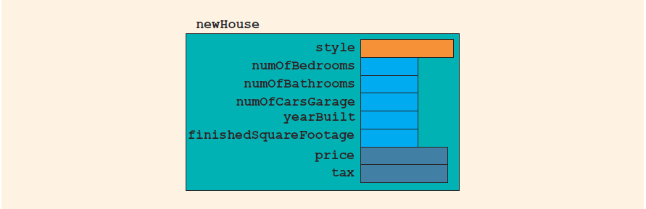
Records (structs) (3 of 3)
FIGURE 9-1 struct newHouse

Slide 7

Accessing struct Members (1 of 2)
Syntax to access a struct member:
The dot (.) is called the member access operator

Slide 8
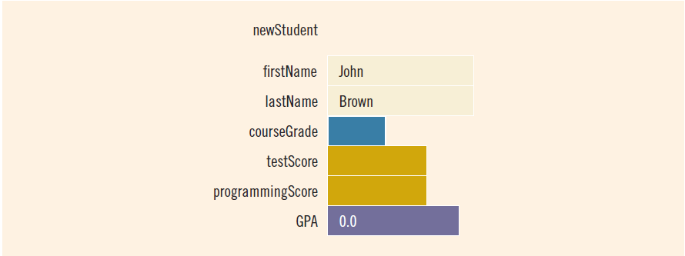
Accessing struct Members (2 of 2)
To initialize the members of newStudent:
  newStudent.GPA = 0.0;
  newStudent.firstName = "John";
  newStudent.lastName = "Brown";
FIGURE 9-2 struct newStudent

Slide 9
Assignment (1 of 2)
Value of one struct variable can be assigned to another struct variable of the same type using an assignment statement
The statement:
student = newStudent;
copies the contents of newStudent into student

Slide 10
Assignment (2 of 2)
The assignment statement:
  student = newStudent;
is equivalent to the following statements:
  student.firstName = newStudent.firstName;
  student.lastName = newStudent.lastName;
  student.courseGrade = newStudent.courseGrade;
  student.testScore = newStudent.testScore;
  student.programmingScore = newStudent.programmingScore;
  student.GPA = newStudent.GPA;

Slide 11
Comparison (Relational Operators)
Compare struct variables member-wise
  No aggregate relational operations are allowed
To compare the values of student and newStudent:
  if (student.firstName == newStudent.firstName &&
  student.lastName == newStudent.lastName)
  .
  .
  .

Slide 12
Input/Output
No aggregate input/output operations are allowed on a struct variable
Data in a struct variable must be read or written one member at a time
The following code would output newStudent contents:
  cout << newStudent.firstName << " " << newStudent.lastName
  << " " << newStudent.courseGrade
  << " " << newStudent.testScore
  << " " << newStudent.programmingScore
  << " " << newStudent.GPA << endl;

Slide 13
struct Variables and Functions
A struct variable can be passed as a parameter by value or by reference
A function can return a value of type struct
The following function displays the contents a struct variable of type studentType:
  void printStudent(studentType student)
  {
  cout << student.firstName << " " << student.lastName
  << " " << student.courseGrade
  << " " << student.testScore
  << " " << student.programmingScore
  << " " << student.GPA << endl;
  }

Slide 14
Arrays versus structs
TABLE 9-1 Arrays vs. structs
Data Type | Array | struct
Arithmetic | No | No
Assignment | No | Yes
Input/output | No (except strings) | No
Comparison | No | No
Parameter passing | By reference only | By value or by reference
Function returning a value | No | Yes

Slide 15
Arrays in structs (1 of 3)
Two items are associated with a list:
  Values (elements)
  Length of the list
Define a struct containing both items:
  const int ARRAY_SIZE = 1000;
  struct listType
  {
  int listElem[ARRAY_SIZE]; //array containing the list
  int listLength; //length of the list
  };

Slide 16
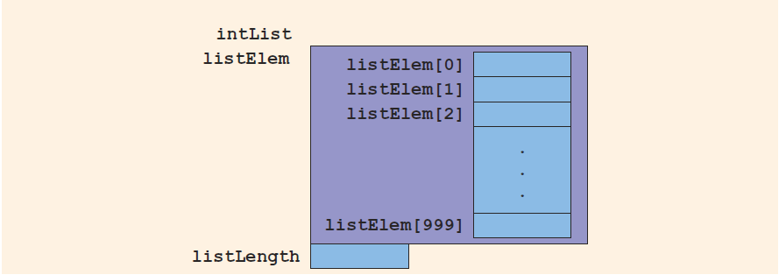
Arrays in structs (2 of 3)
FIGURE 9-5 struct variable intList

Slide 17
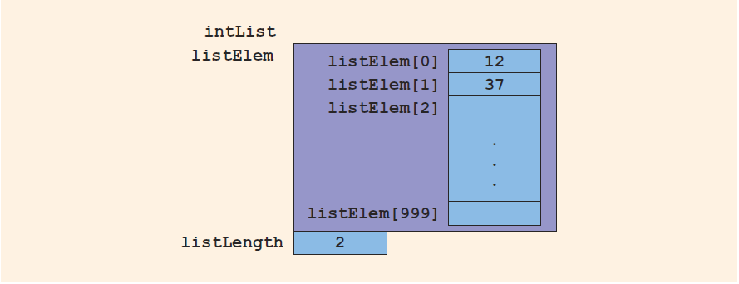
Arrays in structs (3 of 3)
Consider these statements and refer to the figure below showing the results following execution of the statements:
  intList.listLength = 0; //Line 1
  intList.listElem[0] = 12; //Line 2
  intList.listLength++; //Line 3
  intList.listElem[1] = 37; //Line 4
  intList.listLength++; //Line 5
FIGURE 9-6 intList after the statements in Lines 1 through 5 execute

Slide 18
structs in Arrays (1 of 2)
Example
  struct employeeType
  {
  string firstName;
  string lastName;
  int personID;
  string deptID;
  double yearlySalary;
  double monthlySalary
  double yearToDatePaid;
  double monthlyBonus;
  };

Slide 19
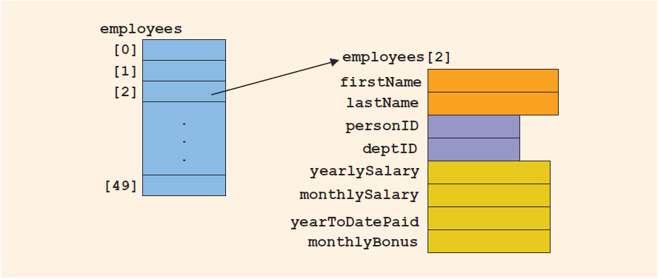
structs in Arrays (2 of 2)
employeeType employees[50]
  Declares the array employees of 50 components of type employeeType
FIGURE 9-7 Array of employees

Slide 20
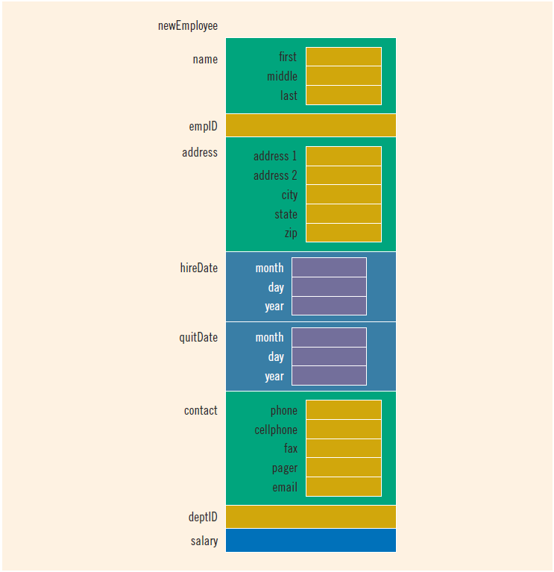
structs within a struct
FIGURE 9-8 struct variable newEmployee

Slide 21
Quick Review (1 of 2)
A struct is a collection of a fixed number of components
Components of a struct can be of different types
  Called members
  Accessed by name
struct is a reserved word
No memory is allocated for a struct
  Memory is allocated only when variables are declared

Slide 22
Quick Review (2 of 2)
In C++, the dot (.) operator is called the member access operator
  Used to access members of a struct
The only built-in operations on a struct are the assignment and member access operations
Neither arithmetic nor relational operations are allowed on structs
A struct can be passed by value or reference
A function can return a value of type struct
A struct can be a member of another struct

