Slide 1
Final Presentation – MLMI Unsupervised Structured Report Generation via Cycle GAN
Mamur A.
Munich, 27. Feb. 2024

Slide 2

Our Goal
To a build new framework that allows structured medical report generation by using unpairwised dataset
Computer Aided Medical Procedures
Notes:
Explain values (-1, 0, 1, NaN )
Unpaired dataset
Add plots ( class occurrences )

Slide 3

Motivation
Drawing from CycleGAN’s innovative approach, we aim to enhance medical image analysis by generating accurate diagnostic labels from
X-rays

Slide 4
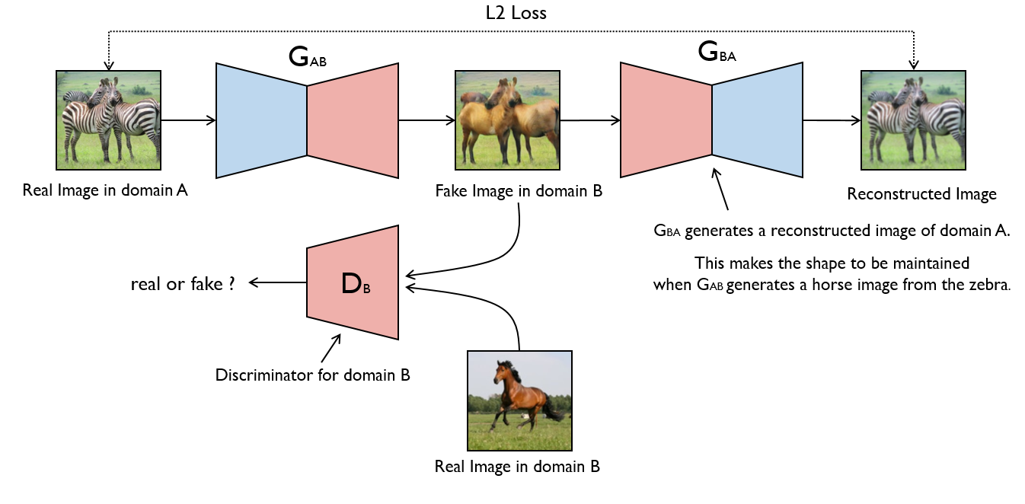
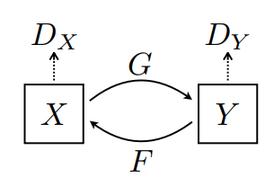
Quick Recap
CycleGAN
Image-to-Image Translation using CycleGAN Model | by Rahil Vijay | Towards Data Science

Slide 5
How model learns ?
CycleGAN
Image-to-Image Translation using CycleGAN Model | by Rahil Vijay | Towards Data Science

Slide 6
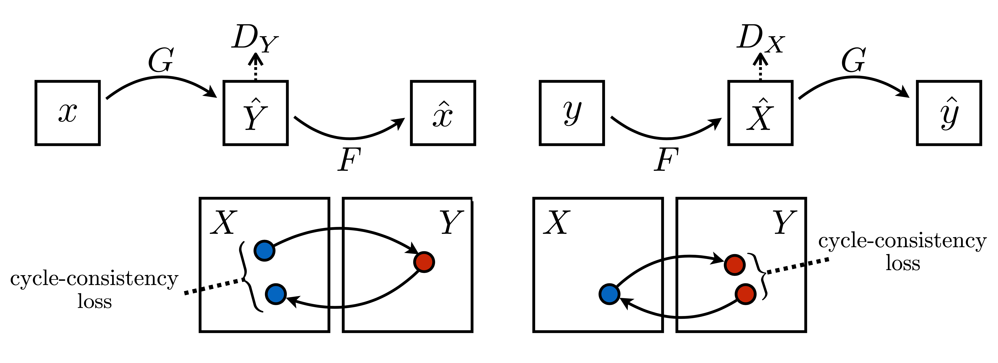
Quick Recap
CycleGAN
CycleGAN
Image-to-Image Translation using CycleGAN Model | by Rahil Vijay | Towards Data Science

Slide 7
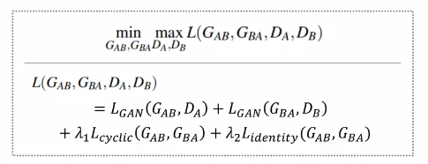
Quick Recap
CycleGAN
CycleGAN
Image-to-Image Translation using CycleGAN Model | by Rahil Vijay | Towards Data Science

Slide 8
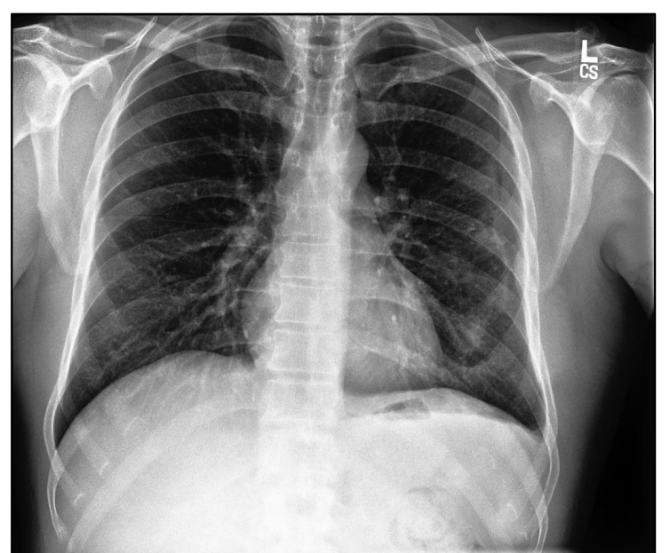

Quick Recap
What we proposed ?
G_IR
G_RI
real or fake?
DR

Slide 9
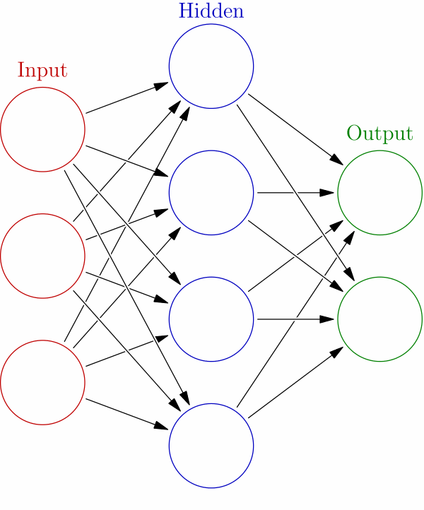
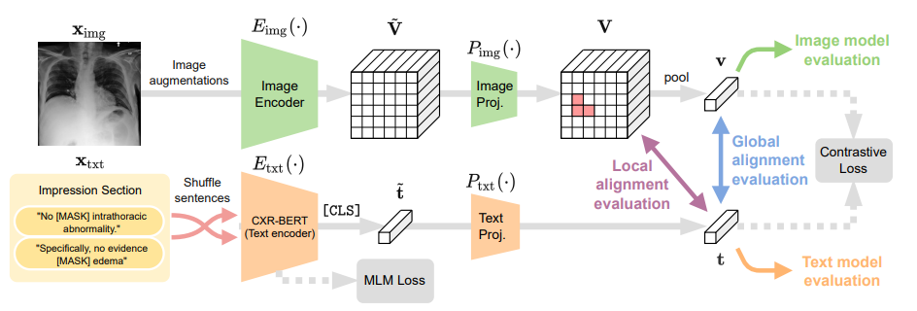
Intermediate Status
What we proposed ?

Slide 10

Intermediate Status
G_IR
$$Cosine Similarity$$
Partial Training
Cosine Similarity as adversarial
Basic GAN network

Slide 11
Intermediate Status
What we achieved / faced ?
Adversarial loss for reports
→ Tried to compare distribution of several batches with precomputed target distribution
→ Computational graph broken as loss not differentiable
→ Use cosine similarity instead → differentiable, but very simple
Basic GAN Network?
Mode Collapse
Image generation model is not complex enough to generate high quality images
Partial Training
Cosine Similarity as adversarial
Basic GAN network

Slide 12
New Updates
End to End Model Training
G_IR
G_RI
Cyclic Training
Report Discriminator Network
Conditional GAN
Difussion Models
Encoder based Perceptual Loss
Hard labels -> Soft labels
real or fake?
DR

Slide 13

New Updates
Report Discriminator Network
G_IR
$$Cosine Similarity$$

Slide 14
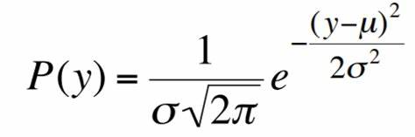
New Updates
Report Discriminator Network
G_IR
D_IR
$$Binary Representation$$
$$Soft Label Reprsentation$$

Slide 15

New Updates
Perceptual Loss
$$L1 Loss$$

Slide 16





New Updates
Adjustments & Developments
$$BioVil$$
$$ARK Model$$
$$MSE Loss$$
$$VGG19$$
$$=Loss (IRI)$$

Slide 17








New Updates
How model learns ?
$$Real Labels$$
$$Real Image$$
G_IR
G_IR
$$Perceptual Loss (IRI)$$
$$BCE Loss(IRI)$$
$$Fake Labels$$
$$Fake Image$$
G_RI
G_IR
$$Cycle Image$$
$$Cycle Labels$$

Slide 18
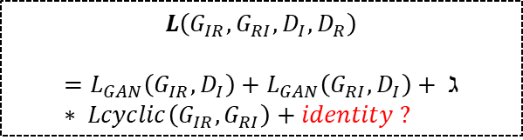
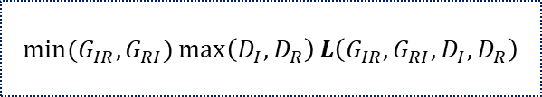
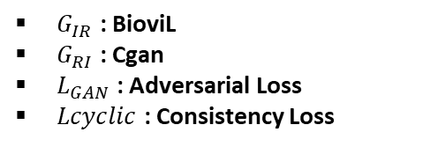
New Updates
How model learns ?
$$min(G_{IR}, G_{RI}){\max\left(D_{I}, D_{R}\right)L\left(G_{IR}, G_{RI}, D_{I}, D_{R}\right)}$$
$G_{IR}$ : BioviL
$G_{RI}$ : Cgan
$L_{GAN}$ : Adversarial Loss
$Lcyclic$ : Consistency Loss
$$L\left(G_{IR}, G_{RI}, D_{I}, D_{R}\right)$$
$$=L_{GAN}\left(G_{IR}, D_{I}\right)+L_{GAN}\left(G_{RI}, D_{I}\right)+ ℷ∗ Lcyclic\left(G_{IR}, G_{RI}\right)+identity ?$$

Slide 19
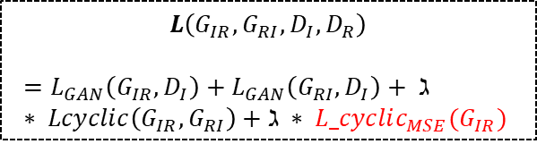
New Updates
How model learns ?
$$min(G_{IR}, G_{RI}){\max\left(D_{I}, D_{R}\right)L\left(G_{IR}, G_{RI}, D_{I}, D_{R}\right)}$$
$G_{IR}$ : BioviL
$G_{RI}$ : Cgan
$L_{GAN}$ : Adversarial Loss
$Lcyclic$ : Consistency Loss
$$L\left(G_{IR}, G_{RI}, D_{I}, D_{R}\right)$$
$$=L_{GAN}\left(G_{IR}, D_{I}\right)+L_{GAN}\left(G_{RI}, D_{I}\right)+ ℷ∗ Lcyclic\left(G_{IR}, G_{RI}\right)+ℷ ∗ L_cyclic_{MSE}(G_{IR})$$

Slide 20
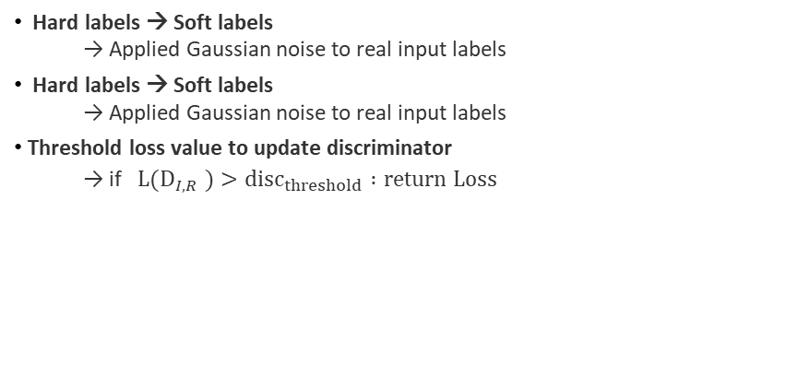
Challanges
What we achieved / faced ?
Report Discriminator loss is going down way waster than generator loss
Hard labels → Soft labels
→ Applied Gaussian noise to real input labels
Hard labels → Soft labels
→ Applied Gaussian noise to real input labels
Threshold loss value to update discriminator
→ if ${L(D}_{I,R })>{disc}_{threshold} :return Loss$
Image generation model is not complex enough to generate high quality images
Conditional GAN
Difussion Models ?
→ how to return denoised image during its training ?

Slide 21
Results
ADD TABLE WITH METRICS

Slide 22
Qualitative Results
ADD IMAGES

Slide 23
Future Work & Discussion
More experiments with different hyperparameters → Learning rate effects so much !
Difussion models can be used in image generation ?
Use power of BioViL as verifier instead of report generation
BioViL provides similarity score between given mimic-cxr reports and xray images!
→ New Architecture

Slide 24
References

