Slide 1













Data Pre-Processing - Term Project
Vehicle Resale Price Prediction
Group Members
Ahmet Arda Nalbant - 150121004
Umut Bayar - 150120043
Niyazi Ozan Ateş - 150121991
Murat Albayrak - 150120025
Kadir Pekdemir - 150121069

Slide 2

Project Overview
Objective: Predict the resale prices of vehicles using machine learning.
Problem Statement:
The used car market is highly variable, leading to challenges in fair price estimation.
This project aims to develop a predictive model to assist both buyers and sellers.
Goals:
Analyze and preprocess the dataset.
Build and train a machine learning model.

Slide 3
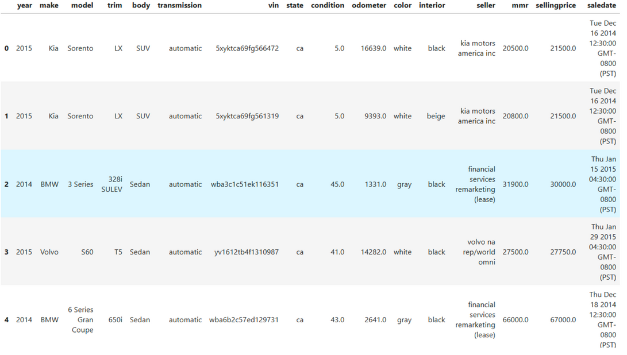
Dataset Description
Name: Vehicle Sales Data
Attributes: The dataset contains vehicle features such as Year, make, model, trim, body type, transmission type, condition, odometer, color, interior, seller details, market value (MMR), selling price, and sale date.
Sample Size: Multiple rows of vehicle records.
Source: https://www.kaggle.com/datasets/syedanwarafridi/vehicle-sales-data

Slide 4
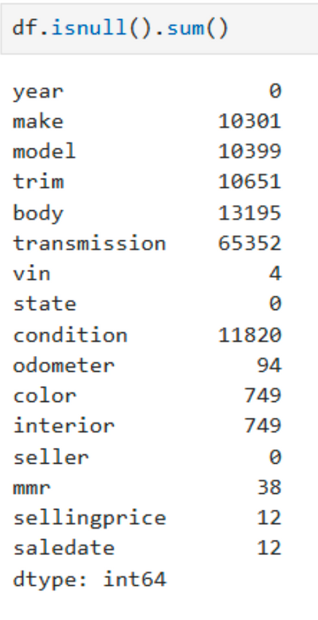
Data Preprocessing Steps
Dropped columns that are not useful (e.g., VIN and SaleDate).
Handling missing values (numeric columns filled with mean, categorical columns replaced with "unknown").
Converting categorical variables to numeric values (Label Encoding).

Slide 5
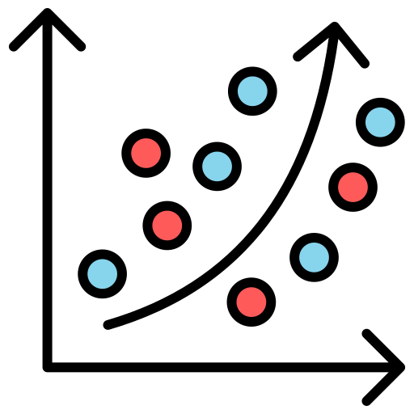
Model Development
Linear Regression:
Purpose: Predict continuous price values.
Evaluation Metrics: RMSE, R².
Ridge Regression:
Reduces overfitting with L2 regularization.
Logistic Regression:
Purpose: Classify price categories.
Metric: Accuracy score.

Slide 6
Model Optimization and Performance
Optimization: Improved model performance via hyperparameter tuning.
K-Means Clustering:
Determined optimal clusters (k=4) using the "Elbow Method".
Explored relationships between clusters (price and mileage).
Evaluation Metrics:
RMSE (Root Mean Squared Error): Measured prediction accuracy.
R² Score: Assessed the model’s explanatory power.
Accuracy Score: Evaluated classification models.
Strengths and Weaknesses:
Ridge Regression: Balanced performance due to overfitting control.
Logistic Regression: Fast and effective classification, but limited in high-dimensional data.

Slide 7
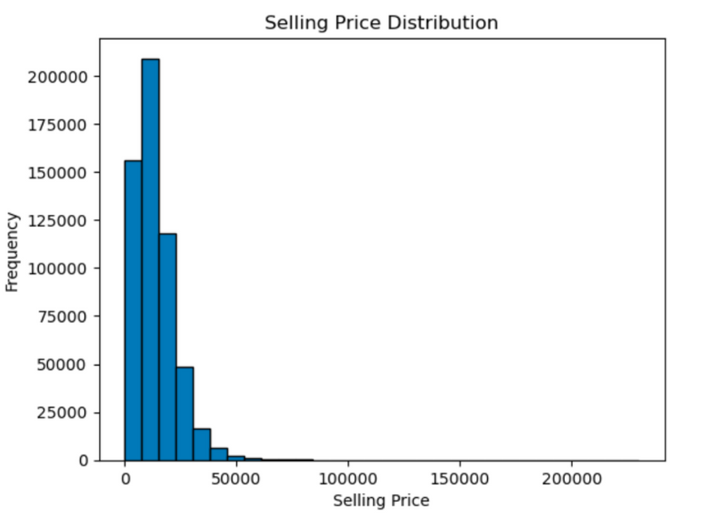
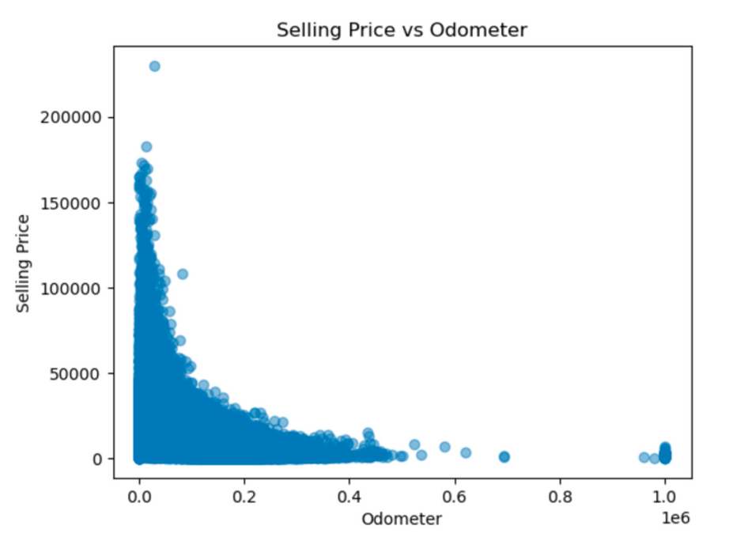
Data Analysis and Visualization
Histogram: SellingPrice (distribution of vehicle prices)
Scatter Plot: Relationship between Odometer and SellingPrice

Slide 8
Correlation Matrix
Importance of Correlations: Correlations help identify relationships between variables. Strong correlations may indicate valuable predictors for the target variable (selling price).
Strong Positive Correlations:
Year and SellingPrice: Newer vehicles tend to have higher resale prices.
Condition and SellingPrice: Vehicles in better condition are priced higher.
Negative Correlations:
Odometer and SellingPrice: Vehicles with higher mileage typically have lower resale values.

Slide 9
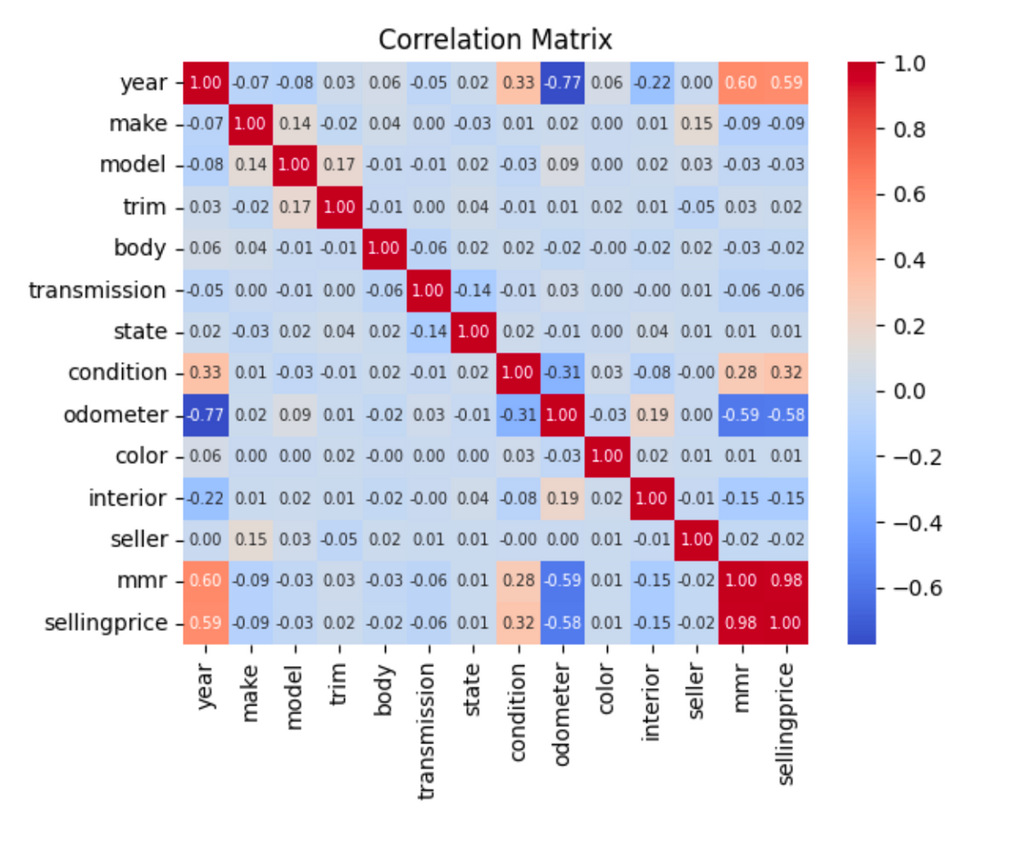
Correlation Matrix (cont.)

Slide 10
Thank you very much!

