Slide 1













Machine Learning - Term Project
Vehicle Resale Price Prediction
Group Members
Ahmet Arda Nalbant - 150121004
Umut Bayar - 150120043
Niyazi Ozan Ateş - 150121991
Murat Albayrak - 150120025
Kadir Pekdemir - 150121069

Slide 2

Project Overview
Objective: Predict the resale prices of vehicles using machine learning.
Problem Statement:
The used car market is highly variable, leading to challenges in fair price estimation.
This project aims to develop a predictive model to assist both buyers and sellers.
Goals:
Analyze and preprocess the dataset.
Build and train a machine learning model.

Slide 3
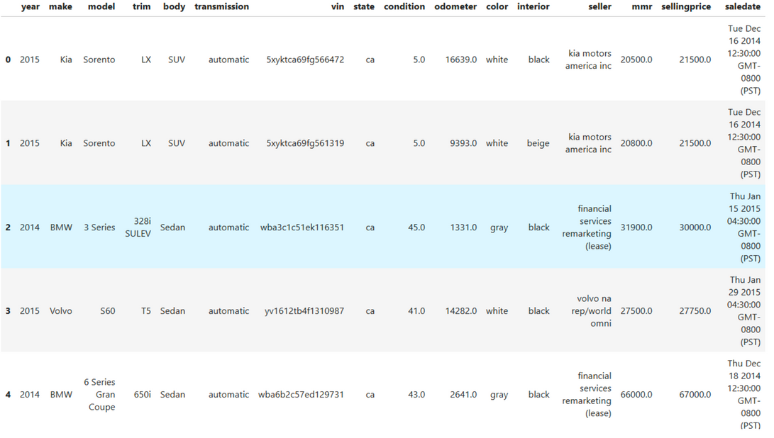
Dataset Description
The dataset in CSV format was loaded into the project and assigned to a variable (df).
Name: Vehicle Sales Data
Attributes: The dataset contains vehicle features such as Year, make, model, trim, body type, transmission type, condition, odometer, color, interior, seller details, market value (MMR), selling price, and sale date.
Source: https://www.kaggle.com/datasets/syedanwarafridi/vehicle-sales-data

Slide 4
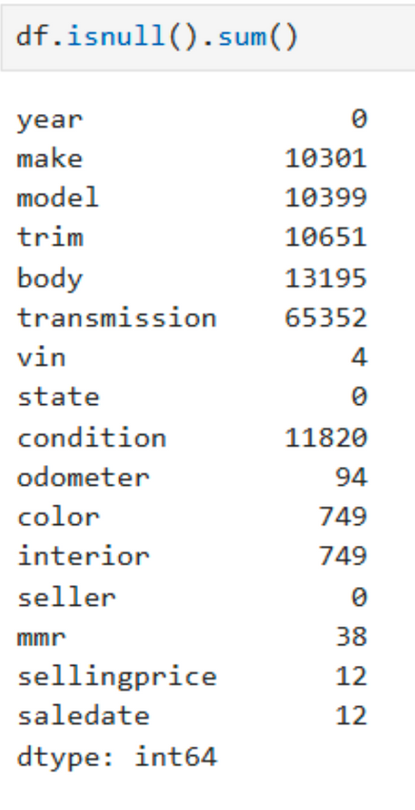
Data Preprocessing Steps
The VIN and sale date columns were removed as they do not directly contribute to model training.
Handling missing values (numeric columns filled with mean, categorical columns replaced with "unknown").
Converting categorical variables to numeric values (Label Encoding).
Necessary libraries were imported for data processing and analysis.
Numerical columns were filled with their respective mean values.
Categorical columns were filled with the placeholder value "unknown."

Slide 5
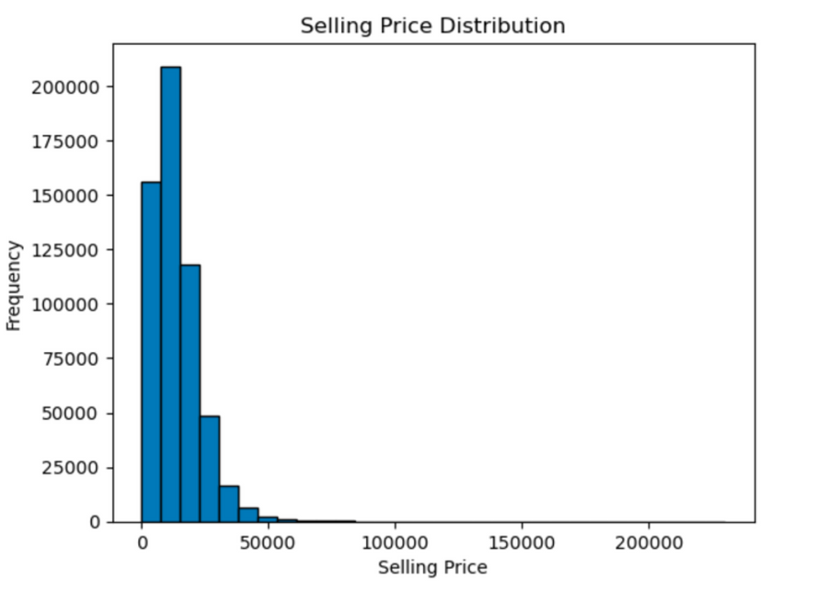
Data Analysis and Visualization
Histogram:
A histogram was created to examine the distribution of vehicle selling prices.
The data was divided into bins, and the frequency of each range was visualized.
The histogram helps identify whether prices are concentrated in specific ranges or distributed more broadly.

Slide 6
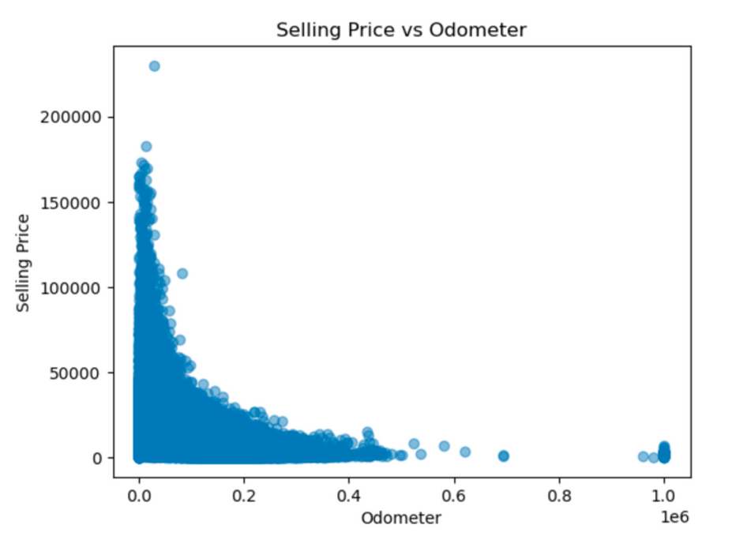
Data Analysis and Visualization
Scatter Plot: Relationship between Odometer and SellingPrice
A scatter plot was created to analyze the relationship between mileage (odometer) and selling price.
Trends in the plot may indicate that vehicles with lower mileage generally have higher prices.

Slide 7
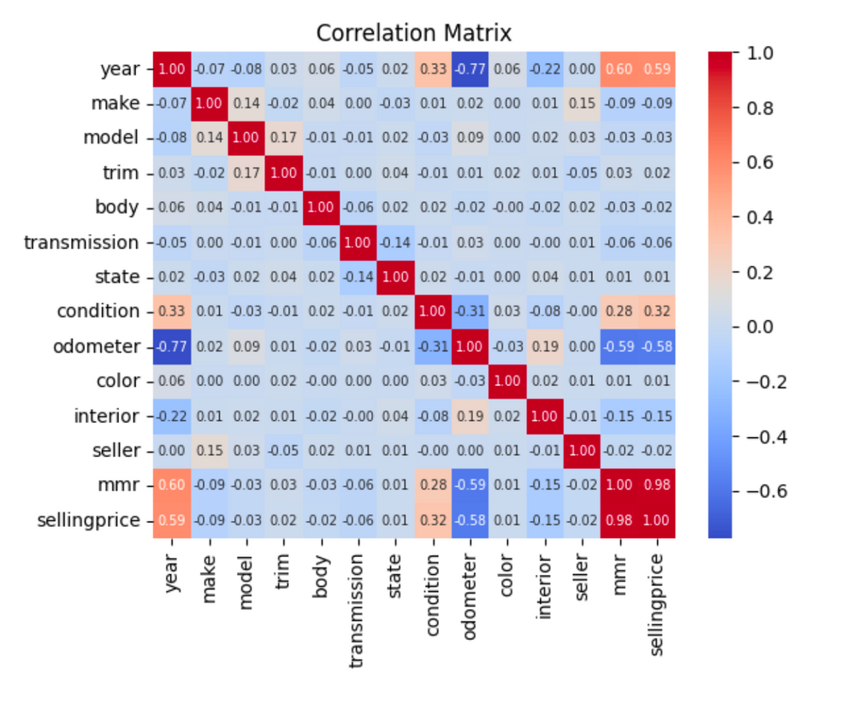
Data Analysis and Visualization
Correlation Matrix:
A correlation matrix was created to understand relationships between numerical variables.
Strong positive or negative correlations can highlight features that are important for price prediction.

Slide 8
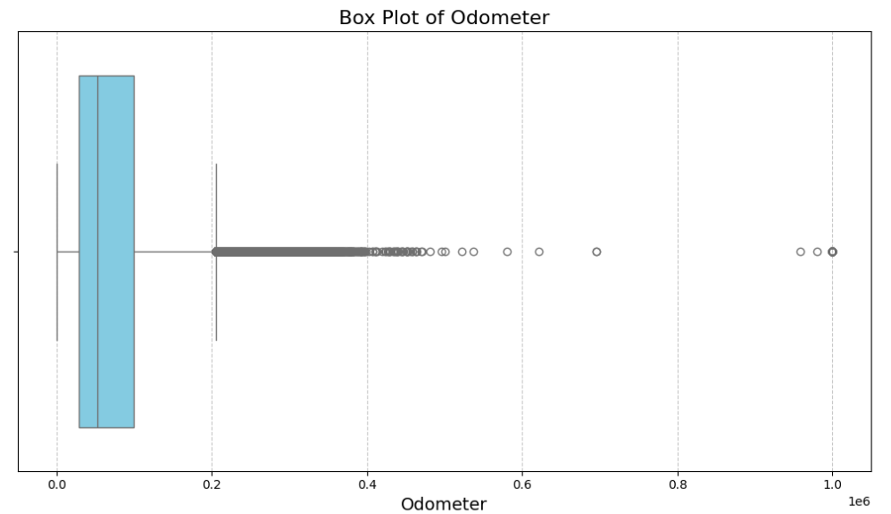
Data Analysis and Visualization
Box Plot:
A box plot was created to understand the distribution and outliers of variables such as odometer.
Outliers are critical to address before model training.

Slide 9
Model Development Process
Creating Dataset Copies:
Separate copies of the original dataset were created for each model (e.g., df_LR, df_RR, df_logistic, df_cluster) since different preprocessing steps were required.
These copies ensure that changes made for one model do not affect others.
Defining Target and Features:
The target variable "sellingprice" was identified, and features (x) were defined as the remaining columns.
The dataset was split into training and testing sets, with 80% for training and 20% for testing.

Slide 10
Model Development Process
Training the Linear Regression Model:
The model was trained using the training data and evaluated on the test data.
Performance metrics: R² Score, RMSE, MAPE.
Training the Ridge Regression Model:
The Ridge regression model adds regularization to prevent overfitting compared to the linear regression model.
During training, the error metric was reduced, enhancing model performance.

Slide 11
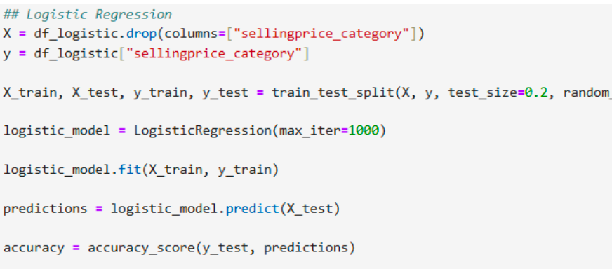
Model Development Process
Logistic Regression Model:
x: All columns except "sellingprice_category" are defined as features.
y: "sellingprice_category" is assigned as the target variable.
max_iter=1000: Ensures convergence for large or complex datasets.
The model makes predictions on the test data.

Slide 12
Model Development Process
K-Means Clustering:
Numerical and encoded categorical variables (e.g., year, condition, odometer, sellingprice) from the df_cluster dataframe are selected.
StandardScaler: Standardizes features, crucial for K-Means.
K: Models are trained for values from 1 to 10.
The elbow point indicates the optimal number of clusters (e.g., k=4).
The model is created with the optimal number of clusters, and each data point is assigned to a cluster.
A scatter plot is created to show the relationship between odometer and sellingprice.
Mean feature values for each cluster are calculated.

Slide 13
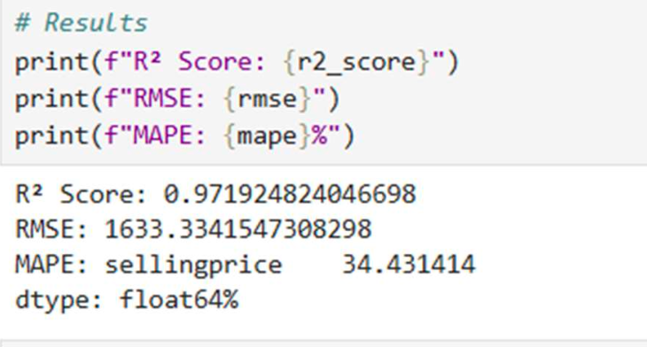
Model Evaluation and Optimization
1. Linear Regression
Predictions were made on the test data using the trained model.
R² Score: Measures how much of the variance in the target variable is explained by the model.
RMSE: Measures the magnitude of error; the smaller the error, the better the predictions.
MAPE: Measures model accuracy in percentage terms. A lower value indicates a better model.

Slide 14
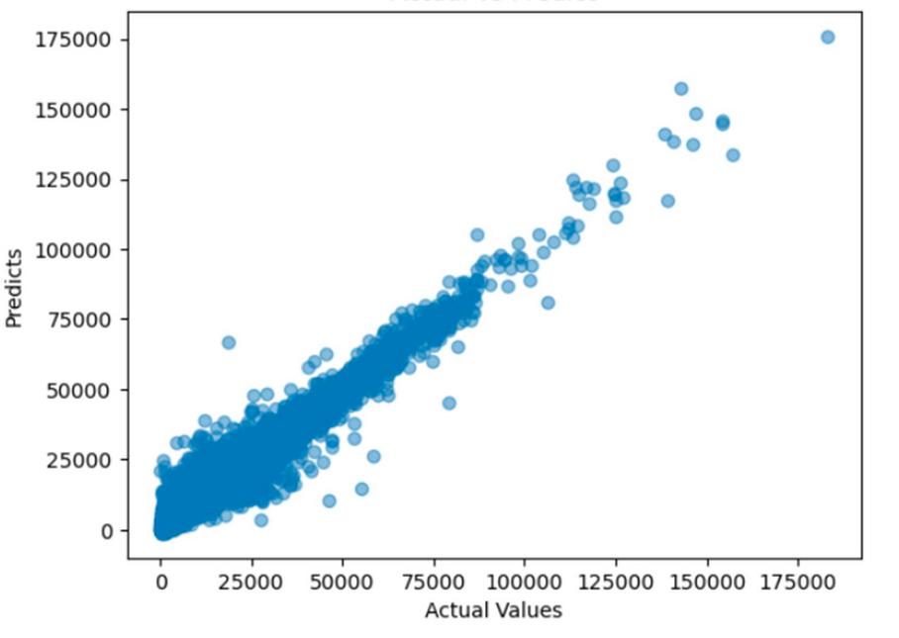
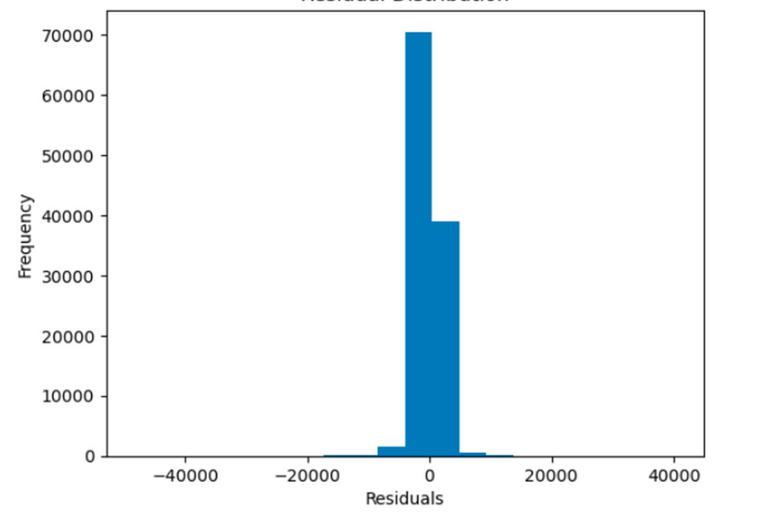
Model Evaluation and Optimization
1. Linear Regression(cont.)
Actual vs Predict graphic
Residual Distribution Graphic

Slide 15
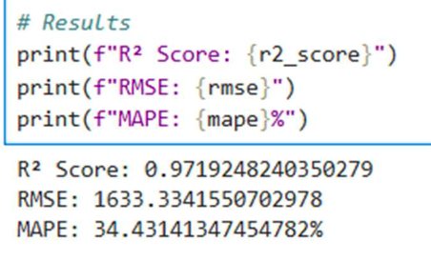
Model Evaluation and Optimization
2. Ridge Regression
Metrics such as R² Score, RMSE, and MAPE were calculated to evaluate performance.
Ridge Regression adds regularization to prevent overfitting.
Linear regression and Ridge regression models were compared in terms of performance metrics.
Ridge regression generally demonstrates better generalization.

Slide 16

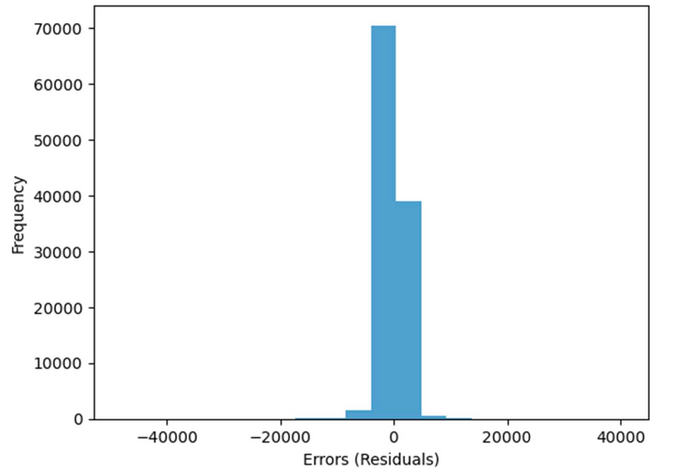
Model Evaluation and Optimization
2. Ridge Regression(cont.)
Real vs predict graphics
Error Distribution Graphics

Slide 17
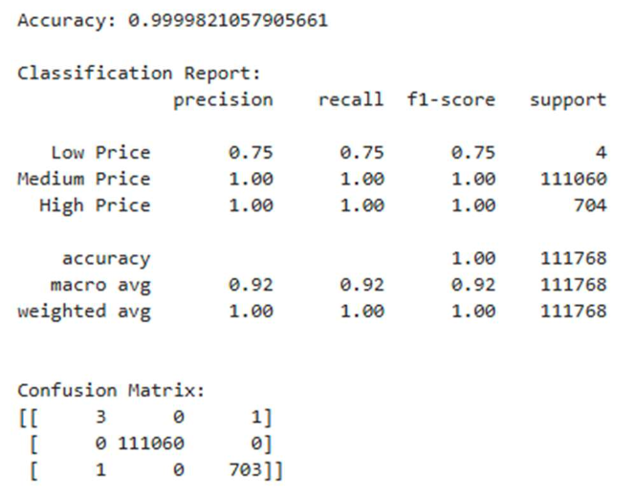
Model Evaluation and Optimization
3. Logistic Regression
The model achieved an accuracy of 99.998%. However, accuracy alone is insufficient to measure model success; other metrics should also be evaluated.

Slide 18
Model Evaluation and Optimization
4.Random Forest Classification
The model achieved an accuracy of 99.998%. However, class imbalance may affect performance, especially in "Low" or "High" classes.
Confusion Matrix is ​​used to provide a more balanced classification.
Feature Importances were used to visualize which features contributed most to the predictions.

Slide 19
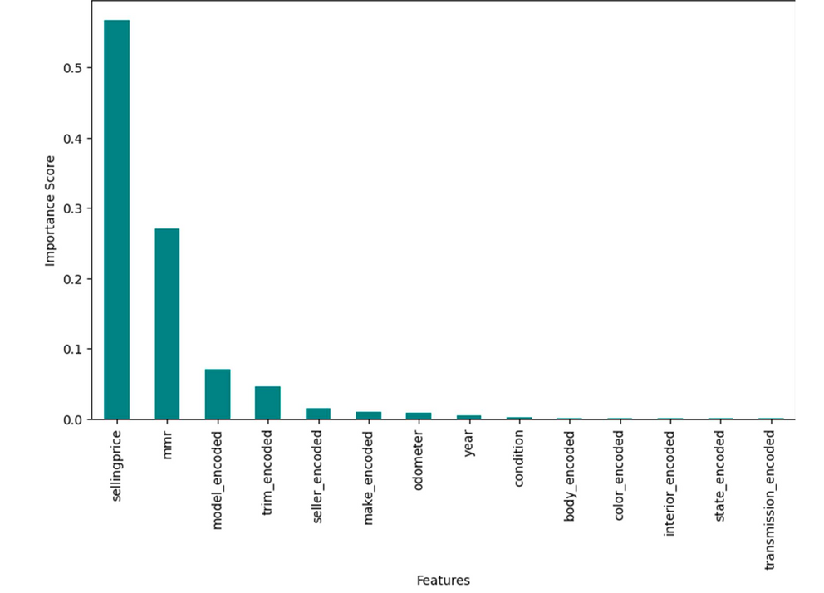
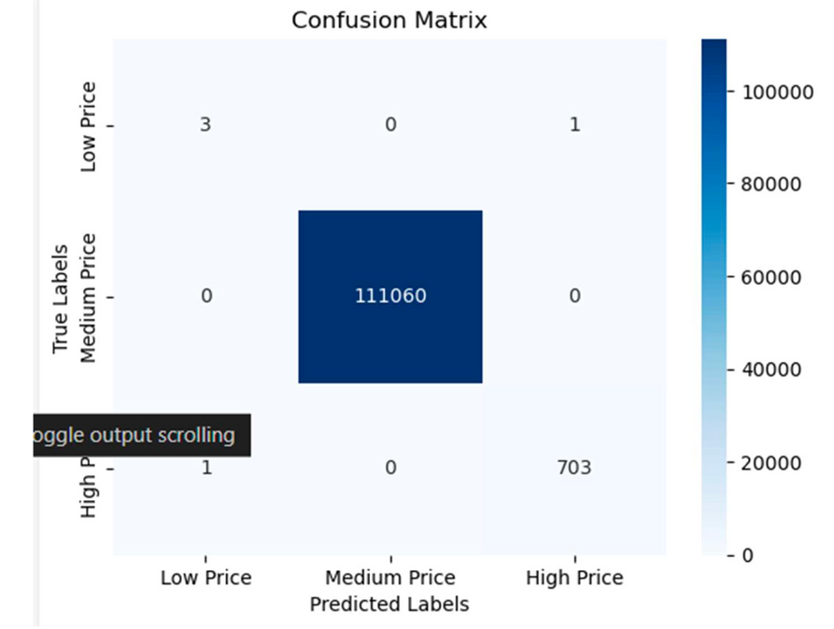
Model Evaluation and Optimization
4.Random Forest Classification(cont.)
Feature Importances Graphic
Confusion Matrix Graphic

Slide 20
Model Evaluation and Optimization
5. K-Means Clustering
Davies-Bouldin Score: A metric used to evaluate clustering quality.
Intra-cluster similarity: Measures how close data points are to their own cluster center.
Inter-cluster separation: Measures how far apart the clusters are from each other.
DB Score: 1.950
A DB score of 1.950 indicates moderate clustering quality.
While clusters are somewhat distinct, there may be overlap or suboptimal separation.

Slide 21
Model Evaluation and Optimization
5. K-Means Clustering(cont.)
Why Regression is Better for Our Dataset Compared to Clustering?
Regression is more suitable for datasets with a continuous target variable like price, as it predicts exact values.
Clustering groups data into broad ranges (e.g., low, medium, high) without considering the relationship between features and the target variable.
Regression provides granular insights with metrics like R² and RMSE, which directly measure prediction accuracy, unlike clustering metrics such as the DB score.

Slide 22
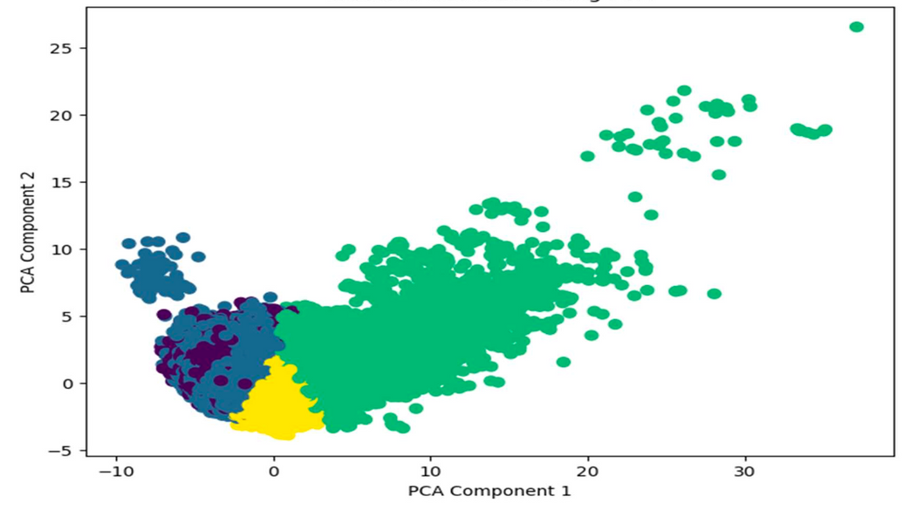
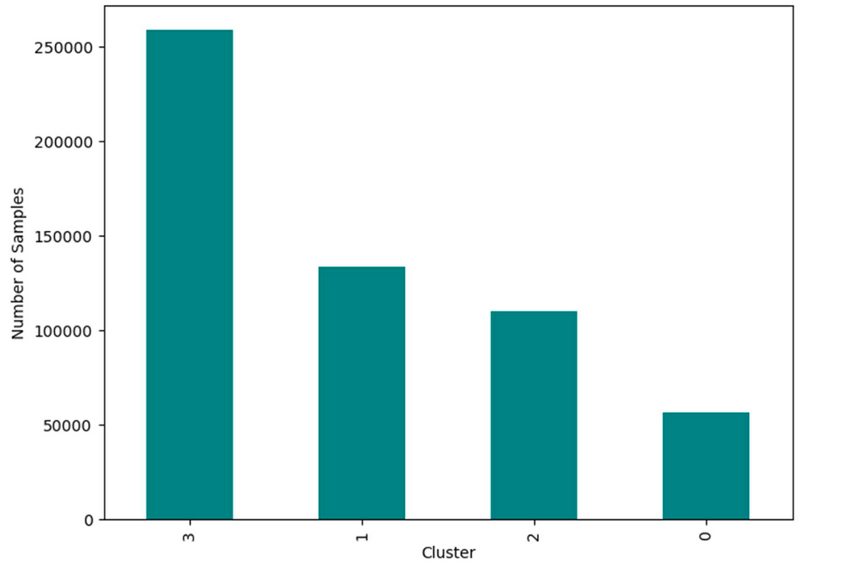
Model Evaluation and Optimization
5. K-Means Clustering(cont.)
ClusterVisualized Using PCA
Cluster Distribution Graphic

Slide 23
Thank you very much!

