Slide 1
CMPE 232 Term Project
Arda Cem Özmen
Onur bozkaya
Deniz küçük

Slide 2
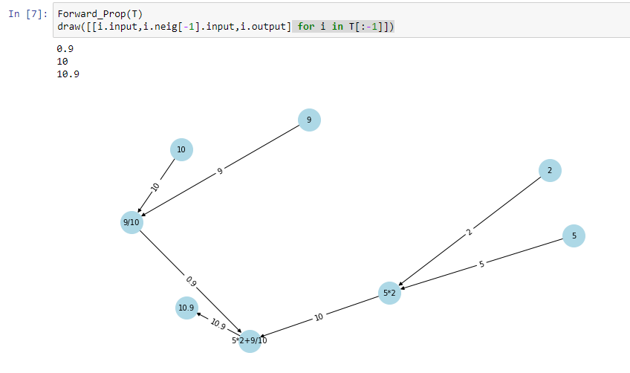
Forward Propagation
def Forward_Prop(Topologic):
for i in Topologic[:-1]:
string = type(i).__name__
if string == 'Variable':
i.output = i.input
else:
i.session()
print(i.output)
Topologic[-1].input = Topologic[-2].output
Notes:
Abim bunu dem'st'

Slide 3
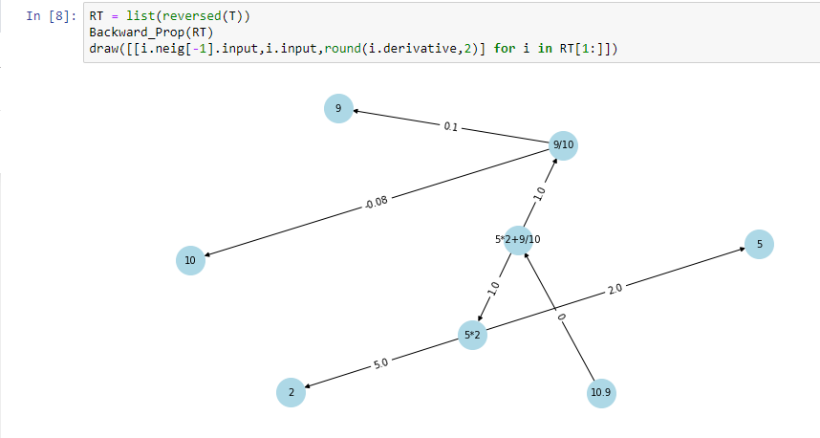
Backward Propagation
def Backward_Prop(Topologic):
for i in Topologic[1:]:
string = type(i).__name__
if not (string == 'Variable'):
i.Back()

Slide 4
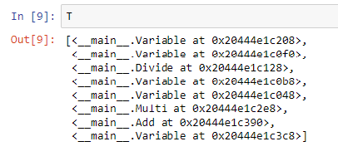
Post Order of Given Eq.

Slide 5
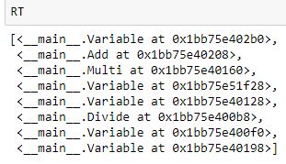
Reversed Post Order Which Concludes BFS Output

Slide 6
Thank you for listening..

