Slide 1
COMPARISON OF TEXT SUMMARIZATION ALGORITHMS
Arda Cem Özmen - 115200046
Tuğra Burak Çakıcı - 117200073
Advisor: Uzay Çetin

Slide 2
Table of Contents
Introduction
Aim of the Project
Text Summarization Approaches
Background and Data
TextRank / Approaches with NER
Seq2Seq /w(o) Attention Layer
Fine Tuned T5 Model
Comparison
Model Deployment
Conclusion

Slide 3
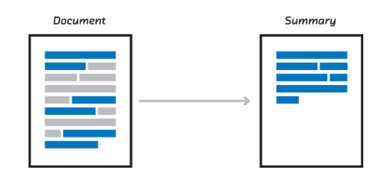
Introduction
Text Summarization as a topic has unlimited amount of potential.
Multiple Methods.
Needs to be distinguished

Slide 4
Aim of the Project
Implement 3 main models: TextRank, Seq2Seq, Transformers.
Make the comparison between them to learn optimum.
Connect them using FastAPI.

Slide 5
Text Summarization Approaches
Extractive Summarization:
Abstractive Summarization:
WORDS OF THE TEXT
WORDS OF ITS OWN

Slide 6
Background and Data
Getting familliar with Deep Learning/Machine Learning concepts.
More experience involving libraries like Keras, Pytorch, Tensorflow.
Data Scraping, mainly Turkish data for the second part of the Project.
Pulling Data => CNN dataset and popular news_summary data from Kaggle.

Slide 7
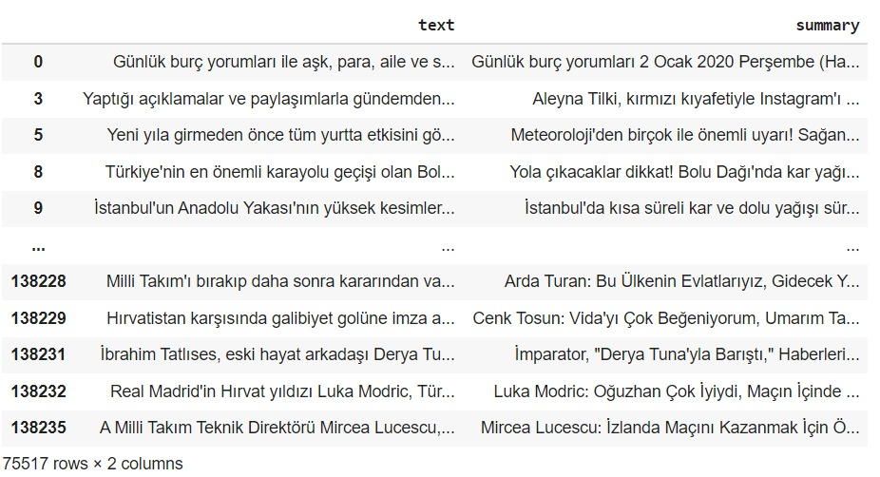
Background and Data

Slide 8
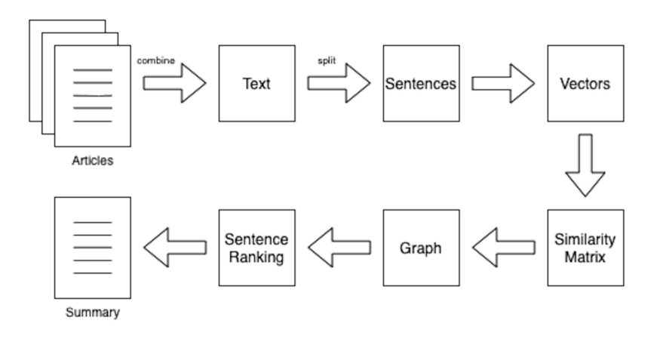
TextRank / Approaches with NER
The importance of PageRank.
How does Vector Score Graph work.
Most referenced sentence wins.

Slide 9
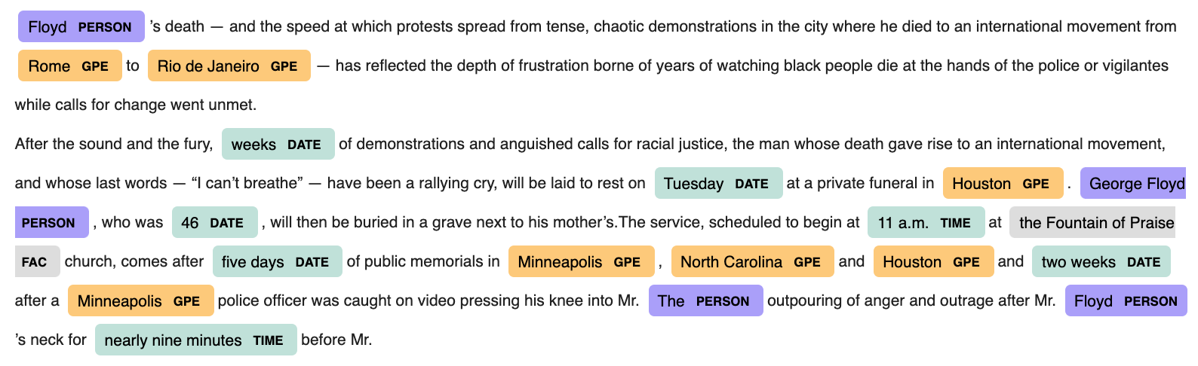
TextRank / Approaches with NER
Default NER Model OUTPUT:

Slide 10
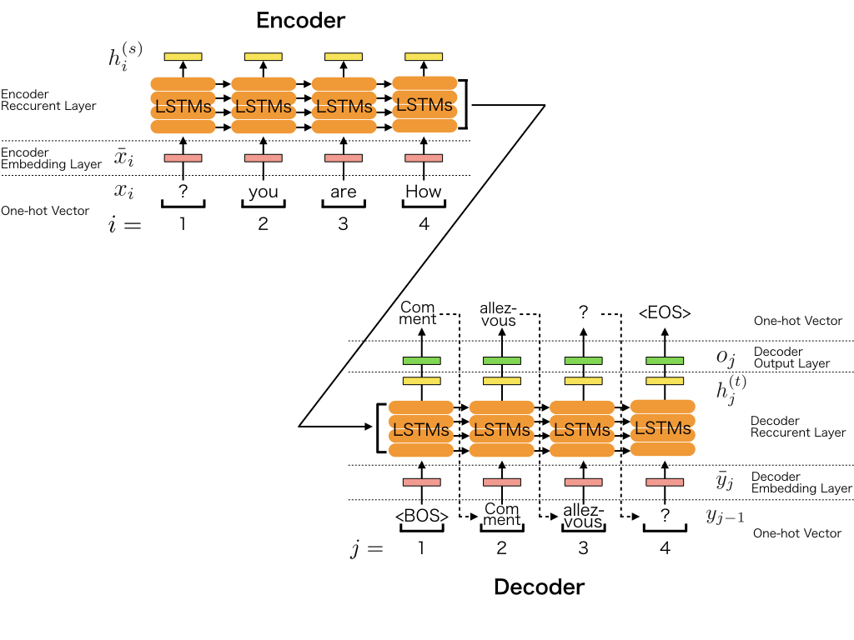
Seq2Seq /w(o) Attention Layer
Sequential learning of tokenized words
Bahdanau Attention Mechanism
Word by word probability prediction

Slide 11
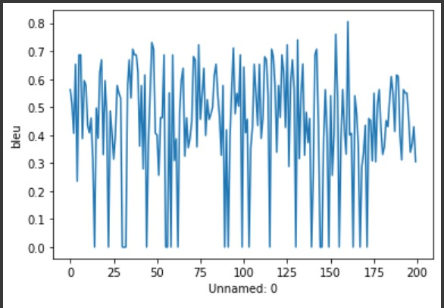
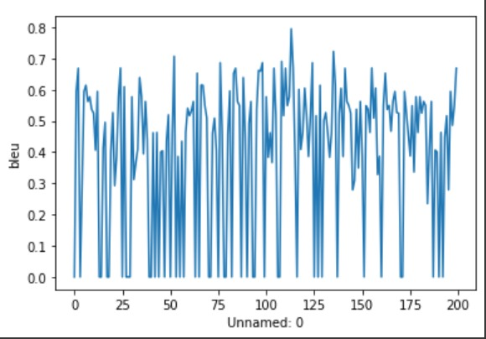
Seq2Seq /w(o) Attention Layer
With Attention
Without Attention

Slide 12
Fine Tuned T5 Model
Transformers to solve text summarization using text-2-text approach proposed in the T5
Preparing Custom Dataset
Fine Tuning the Model: Function
Validating the Model Performance

Slide 13
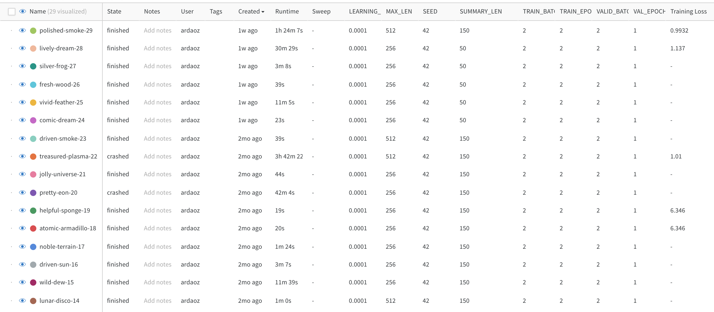
Fine Tuned T5 Model
Turkish T5 Wandb Results

Slide 14
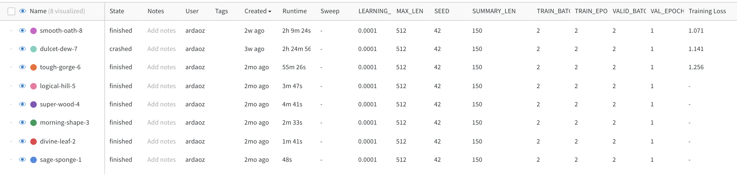
Fine Tuned T5 Model
English T5 Wandb Results

Slide 15
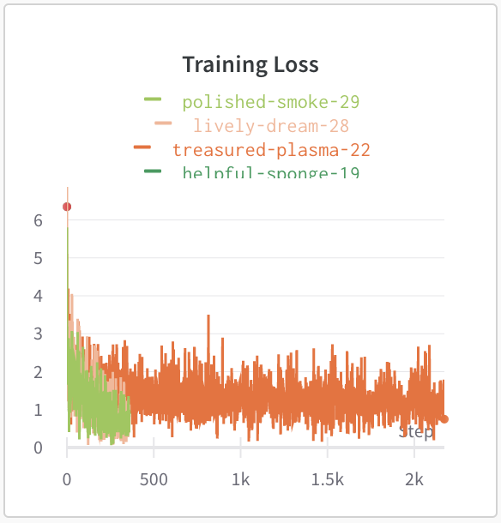
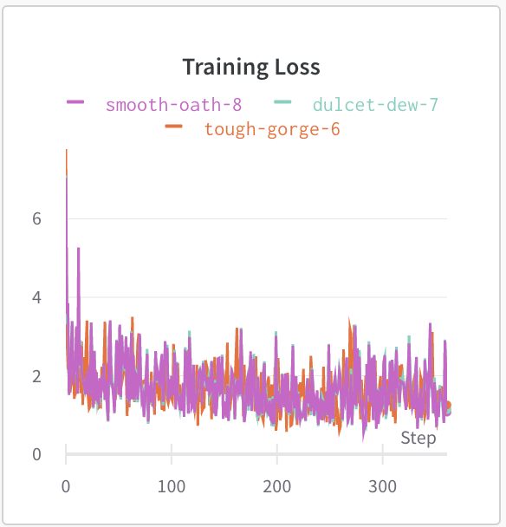
Fine Tuned T5 Model
Turkish T5
English T5

Slide 16

Comparison
Foto konulacak

Slide 17
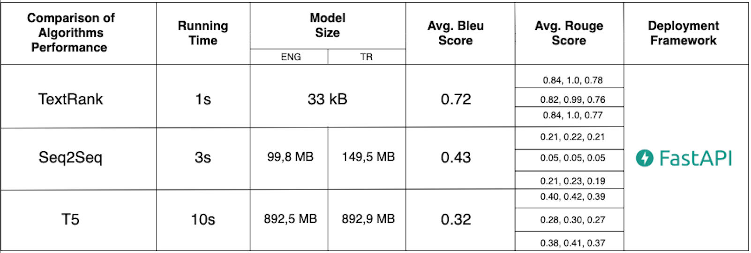
Analyze

Slide 18
Model Deployment
Deploying a FastAPI application is relatively easy.
There are several ways to do it depending on your specific use case and the tools that you use.
Model is deployed and running on localhost:8000

Slide 19
Conclusion
These three models can be used in solved different problems.
All three has their strenghts and weaknesses that can compliment each other.
There is still room for improvement.

Slide 20
THANK YOU…

Slide 21
References
https://github.com/madhav727/abstractive-news-summary/blob/master
https://patents.google.com/patent/US9165040B1/en
https://spacy.io/usage/linguistic-features#named-entities
https://spacy.io/usage/traininghttps://www.pluralsight.com/guides/nmt:-encoder-and-decoder-with-keras
https://arxiv.org/pdf/1409.0473.pdf

