Slide 1
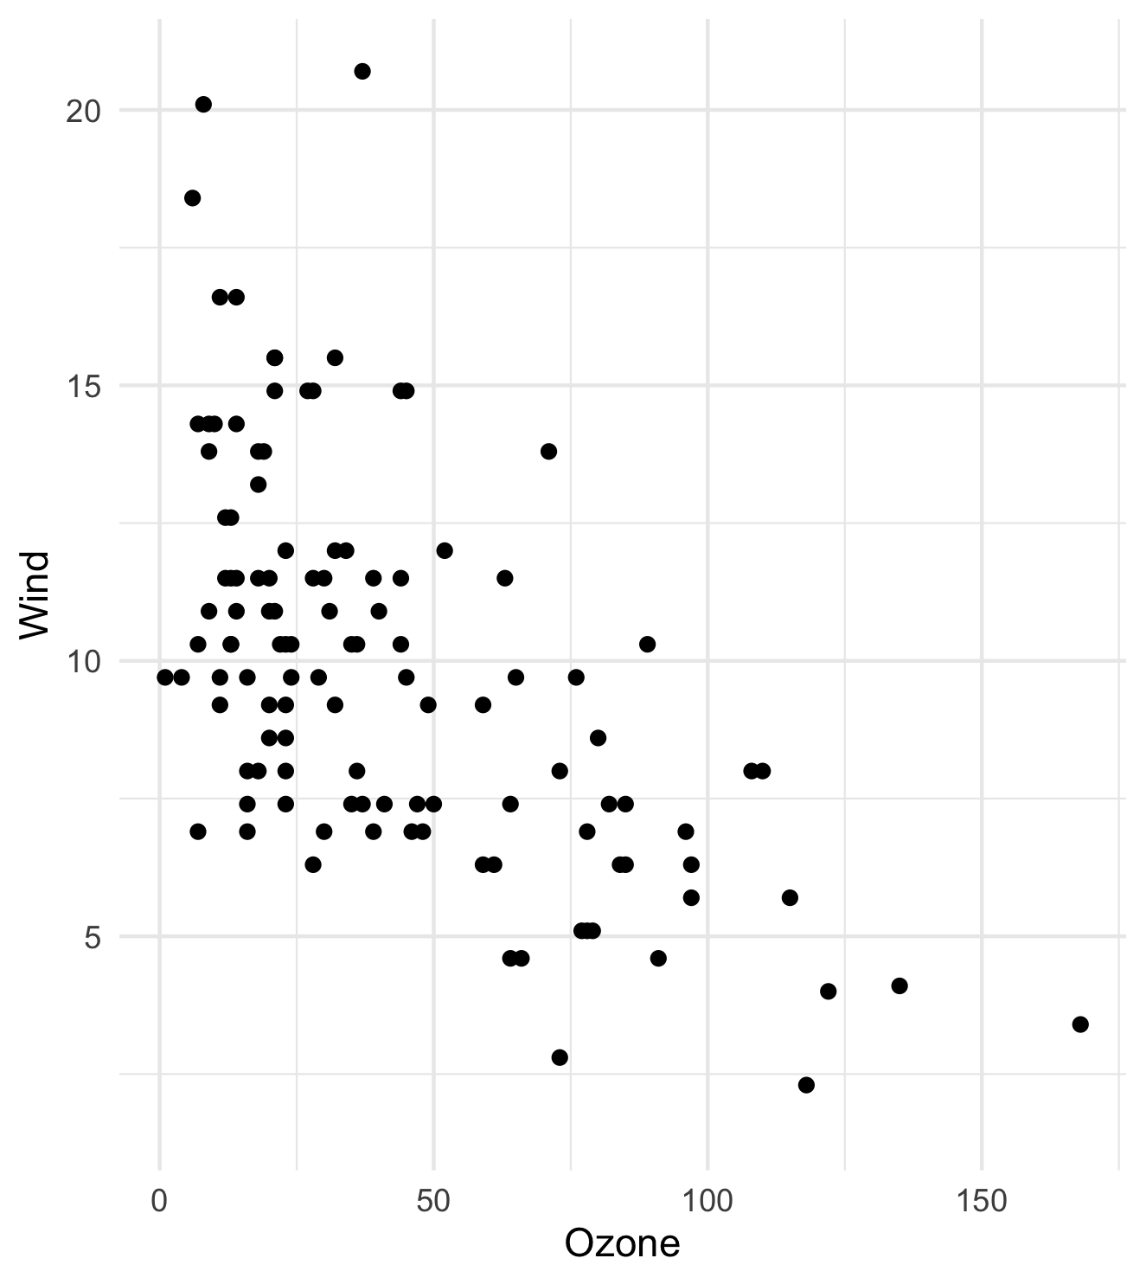
My first slide
Ozone | Solar.R | Wind | Temp | Month | Day
41 | 190 | 7.4 | 67 | 5 | 1
36 | 118 | 8.0 | 72 | 5 | 2
12 | 149 | 12.6 | 74 | 5 | 3
18 | 313 | 11.5 | 62 | 5 | 4
<na> | <na> | 14.3 | 56 | 5 | 5
28 | <na> | 14.9 | 66 | 5 | 6
23 | 299 | 8.6 | 65 | 5 | 7
19 | 99 | 13.8 | 59 | 5 | 8
8 | 19 | 20.1 | 61 | 5 | 9
<na> | 194 | 8.6 | 69 | 5 | 10
7 | <na> | 6.9 | 74 | 5 | 11

