Slide 1
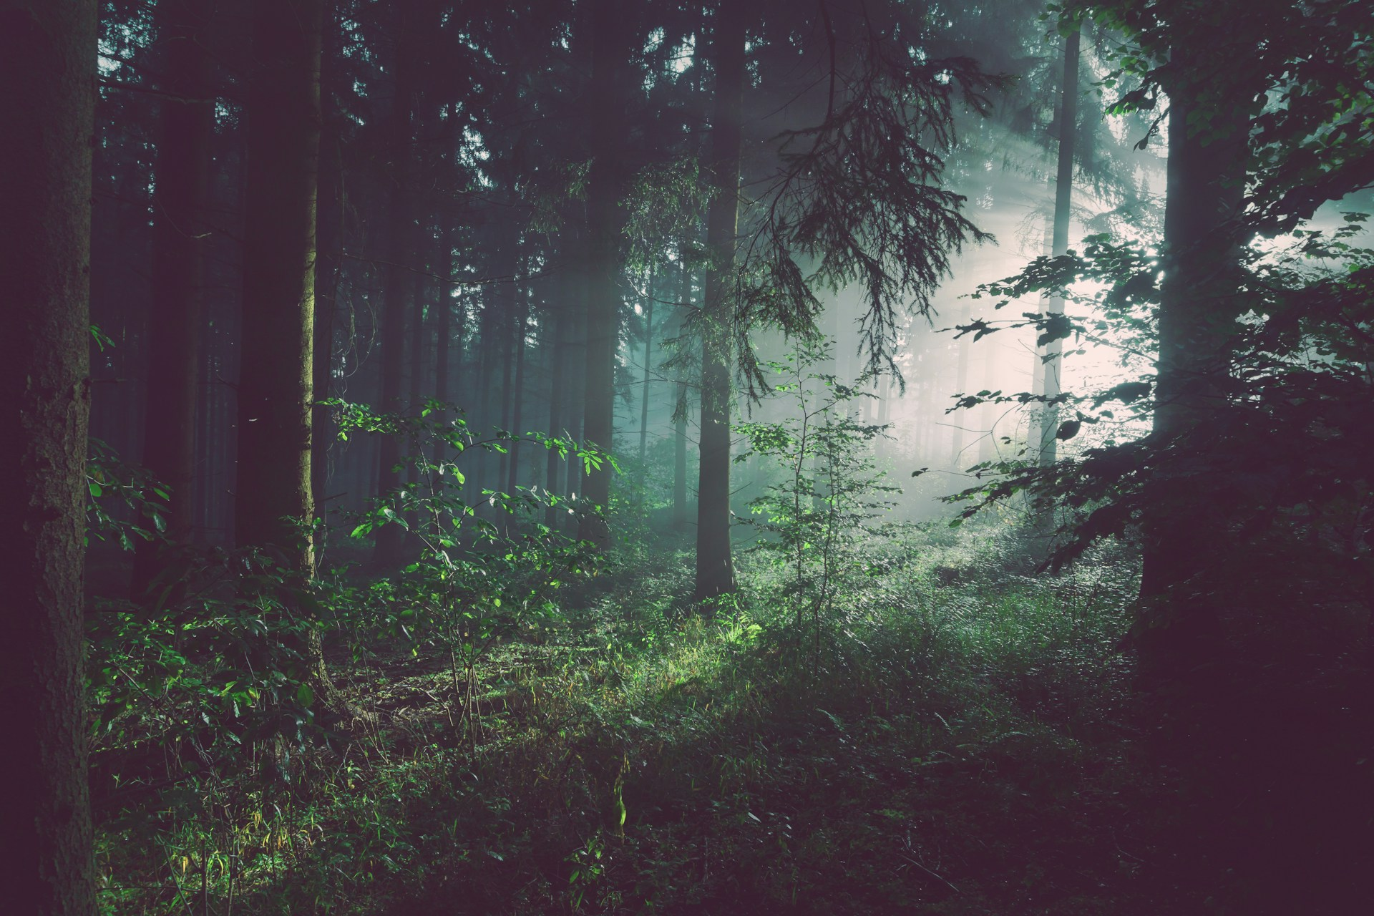
GUMP · DEFORESTATION DETECTION
The lungs of our planet
are running out of breath.
Team Gump · osapiens Makeathon 2026

Slide 2
THE HOOK
Watch this slide for 10 seconds.
That is all it takes to lose a forest the size of six football fields.
4.2 ha
GONE · EVERY 10 SECONDS · WORLDWIDE
60 % · DESTROYED
40 % · REMAINING
GUMP · OSAPIENS MAKEATHON 2026
02—10

Slide 3
DATA
Three eyes watching the forest
Multimodal satellite time-series 2020 – 2024, 21 regions, 2.3 GB feature cache.
01
02
03
SENTINEL-1
SENTINEL-2
ALPHAEARTH
Radar
Optical (L2A)
Embeddings
VV polarization
1 band · monthly
12 spectral bands
10 m · monthly
64 dims / pixel
yearly aggregated
Sees through clouds and night.
Color, NDVI, NBR — the visible signal.
Google's pre-trained Earth representation.
GUMP · OSAPIENS MAKEATHON 2026
03—10

Slide 4
THE PROBLEM
The ground truth is noisy
Three label sources tell us where the forest was cut — none of them agrees 100 %.
ONE PIXEL · THREE SOURCES · TWELVE MONTHS
WHAT GOES WRONG
RADD
False positives
GLAD-L often flags 'probable' when nothing was actually cut.
GLAD-L
False negatives
RADD misses narrow clearings smaller than 0.5 ha.
GLAD-S2
Time lag
GLAD-S2 only starts in 2019 — older events are missing entirely.
Spatial misalignment
≥ 2/3
Edge pixels disagree across sources by up to 30 m.
Months →
GUMP · OSAPIENS MAKEATHON 2026
04—10

Slide 5
THE SOLUTION
Consensus beats blind trust
A pixel is only labeled 'deforested' when ≥ 2 of 3 sources agree. Uncertain pixels count less.
CONSENSUS RULE
WHY IT WORKS
≥ 2 / 3
Weighted Focal Loss
Clear-positive pixels dominate training.
sources must agree
Uncertain pixels barely push the gradient.
PER-PIXEL WEIGHT
A single bad source is cancelled out by the other two.
3 votes
2 votes
1 vote
Focal loss prioritizes hard examples — no easy forests.
1.00
0.80
0.30
+ Forest-2020 mask (NDVI > 0.6) + Region-held-out validation split
GUMP · OSAPIENS MAKEATHON 2026
05—10

Slide 6
THE MODEL
Small. Fast. Robust.
Residual MLP on ~82 features per pixel. Trains in minutes on an AMD MI300X.
INPUT
RES-MLP
DROPOUT
SIGMOID
OUTPUT
82 features
→
256→128→64
→
p = 0.2
→
Probability
→
Binary
S2·S1·AEF + Δ
2× residual
BatchNorm
p ∈ [0, 1]
deforested?
FOCAL γ = 2
bfloat16 AMP
COSINE LR
EARLY STOP
Hard examples get higher weight
Hardware-optimized on MI300X
3e-4 with warmup, smooth decay
Best Val-F1 tracked per region
GUMP · OSAPIENS MAKEATHON 2026
06—10

Slide 7
GENERALIZATION
Why the model works on new regions
The most common mistake: random pixel splits. A pixel from the same tile must never appear in both train and val.
NAIVE APPROACH
OUR APPROACH
Random pixel split
Region-held-out split
Val pixels are neighbors of train pixels
Model learns tile-specific noise
Val-F1 ≈ 0.9, leaderboard < 0.4
TILE A · TRAIN
TILE B · TRAIN
TILE 48P · VAL
Val region completely untouched in training
Tests memorization, not generalization
Not a single pixel leaks between sets
ONE TILE · MIXED
Val-F1 honestly approximates leaderboard
Forces real pattern learning, not memorization
GUMP · OSAPIENS MAKEATHON 2026
07—10

Slide 8
RESULTS
Baseline model on region 48P
Held-out validation. Threshold calibrated on Val-F1.
PRECISION
F1-SCORE
0.386
Of all 'deforested' predictions, ~39 % are correct.
0.554
RECALL
0.980
98 % of real clearings are caught by the model.
THRESHOLD
Balanced · robust to class imbalance
0.90
Conservatively calibrated — not blindly 0.5.
GUMP · OSAPIENS MAKEATHON 2026
08—10

Slide 9
THE TOOL
Gump — an interactive map for regulators
Local Next.js app. Loads GeoJSON, filters, exports. No login, no cloud.
LIVE MAP
MODEL METRICS
CONFIDENCE MODE
21 tiles · 95 polygons
F1 / Precision / Recall
Color gradient
Leaflet + Esri satellite layer. Pan, zoom, click.
Per region, live from metrics.json — no hardcoded numbers.
Red = uncertain · yellow = medium · green = high confidence.
SEARCH & FILTER
EXPORT
OFFLINE
Year · area · confidence
CSV · merged GeoJSON
100 % local
Interactive sliders. Results update instantly.
One click for leaderboard upload. EPSG:4326 guaranteed.
Runs without internet. No privacy overhead.
localhost:8765 · npm run dev
GUMP · OSAPIENS MAKEATHON 2026
09—10

Slide 10
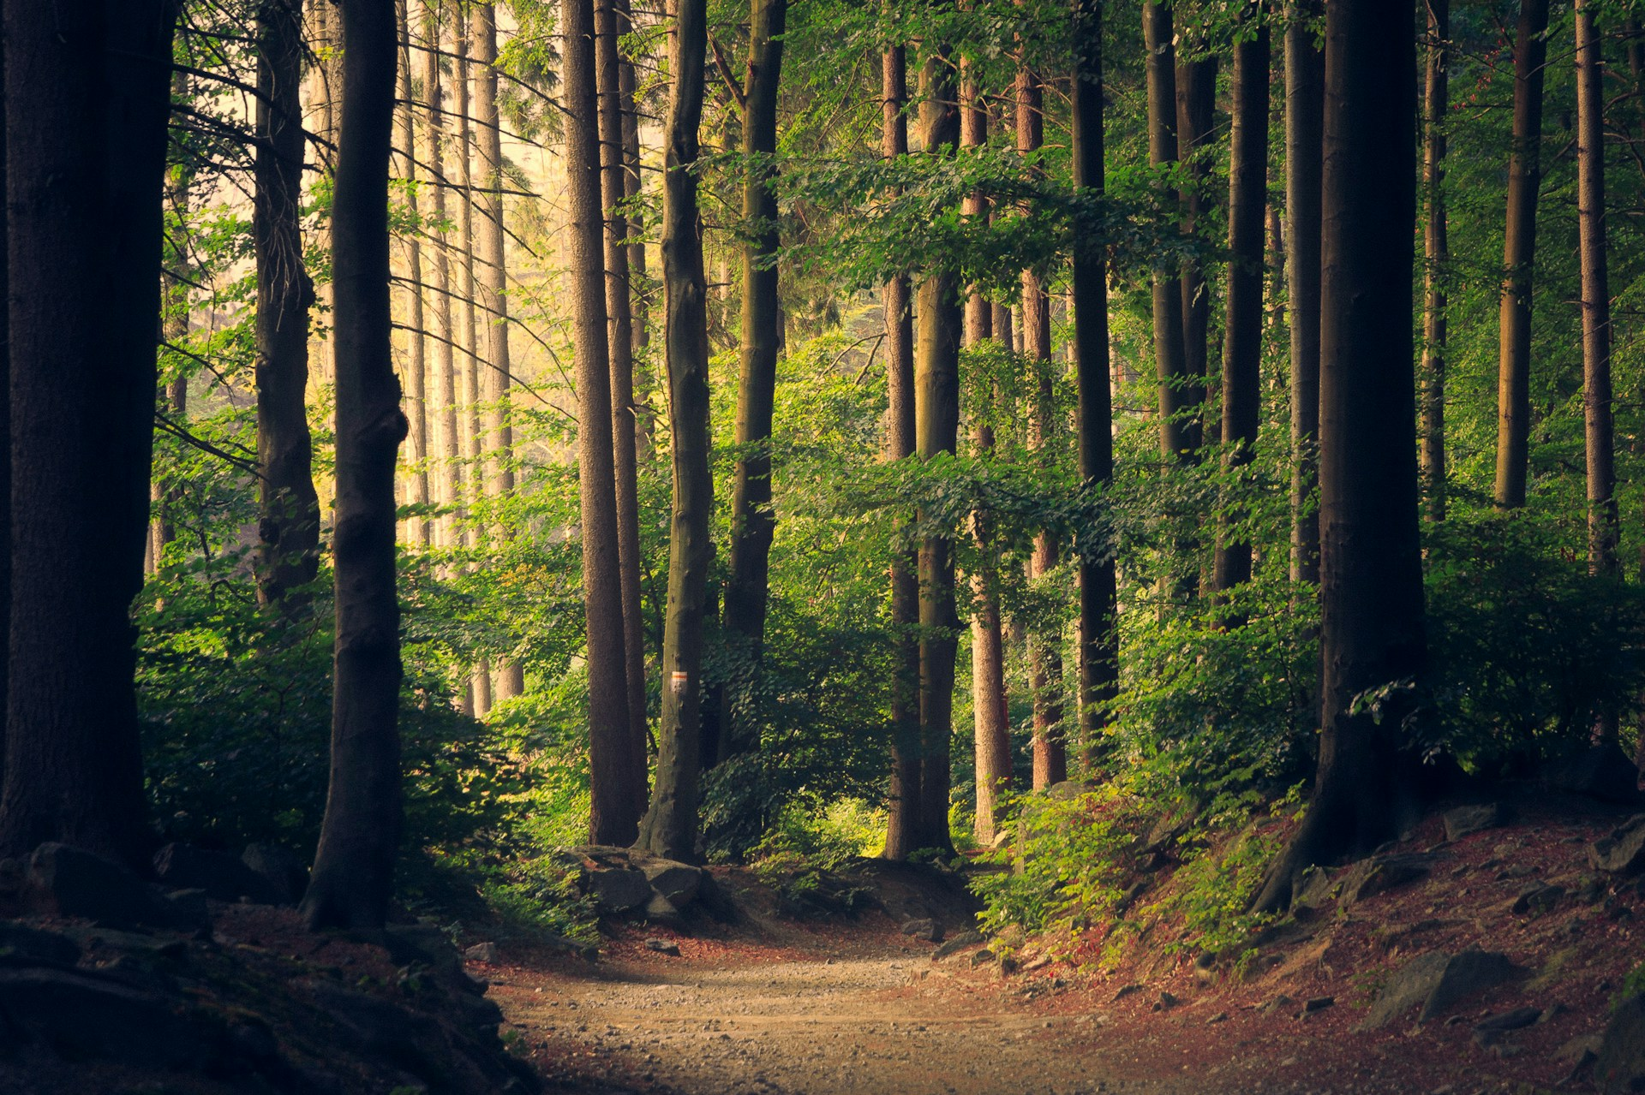
Every hectare counts.
Team Gump · osapiens Makeathon 2026

