Slide 1
Partition-Aware Isolation Forest
for Distributed Anomaly Detection on Degradation Time Series
Arda Günaydın · 231101075 Mustafa Batuhan Taş · 241111024
BIL 501 — Big Data & Distributed Data Processing · TOBB ETÜ · Research Track

Slide 2
THE PROBLEM
Distributing the detector breaks temporal order
Failure shows up as slow drift
across many cycles — not a single outlying value.
A trajectory, split across partitions:
c1 c4 c7
P1
Isolation Forest treats every row independently. When Spark partitions a run-to-failure trajectory across workers, consecutive cycles land on different partitions and the temporal ordering is lost. The detector then sees each cycle in isolation and misses the drift.
c2 c5 c8
P2
c3 c6 c9
P3
consecutive cycles scattered → drift invisible

Slide 3
OUR CONTRIBUTION
Preserve temporal locality across partitions
Partition-aware windowing: add sliding-window temporal features, and keep whole trajectories intact on a partition so every window sees the right neighbours — before any tree is built.
1
2
3
No change to the tree machinery
Implemented on Spark
Proven by ablation
A windowing layer between ingestion and detection.
Per-partition Isolation Forest via applyInPandas; MLlib k-means for conditions.
We isolate partition-awareness as the cause of the gain.

Slide 4
DATASET
NASA C-MAPSS turbofan degradation
709
160,359
4
1–6
engines
cycle records
subsets (FD001–04)
operating conditions
Run-to-failure trajectories (128–543 cycles each) under varying flight conditions and fault modes. No native anomaly labels — we derive them from remaining-useful-life: a cycle is degraded if within 30 cycles of failure.
Source: Saxena et al., PHM 2008 — public NASA Prognostics Data Repository.

Slide 5
METHOD
A five-stage PySpark pipeline
1
›
2
›
3
›
4
›
5
Ingest
→ Parquet
Preprocess
+ conditions
Partition-aware
windowing
Per-partition
Isolation Forest
Evaluate
4 configs
The windowing stage (highlighted) is the contribution; the other four are standard.
Detector: Spark MLlib has no Isolation Forest, so each Spark partition trains and scores its own scikit-learn iForest (100 trees) via applyInPandas — the standard data-parallel pattern, and exactly where partition-awareness takes effect.

Slide 6
CORE IDEA
Keep the trajectory intact on its partition
Naive distributed
Partition-aware (ours)
Random row partitions
Consecutive cycles scattered across workers
Windows (if any) computed over wrong neighbours
Whole engine assigned to one partition
Trajectory never split across workers
Rolling mean / std / delta over correct neighbours (W = 20)
→ drift invisible / windows corrupted
→ drift visible before trees are built

Slide 7
EXPERIMENTAL DESIGN
Four configurations, one controlled contrast
Cfg | Partitioning | Temporal features | Role
C1 | single node | instantaneous | reference
C2 | random rows | instantaneous | naive distributed
C3 | random rows | windowed (corrupted) | ablation
C4 | by engine (intact) | windowed (correct) | proposed
The key comparison is C3 vs C4 — identical window features and the same detector; the only difference is whether trajectories stay intact. That isolates partition-awareness as the variable.

Slide 8
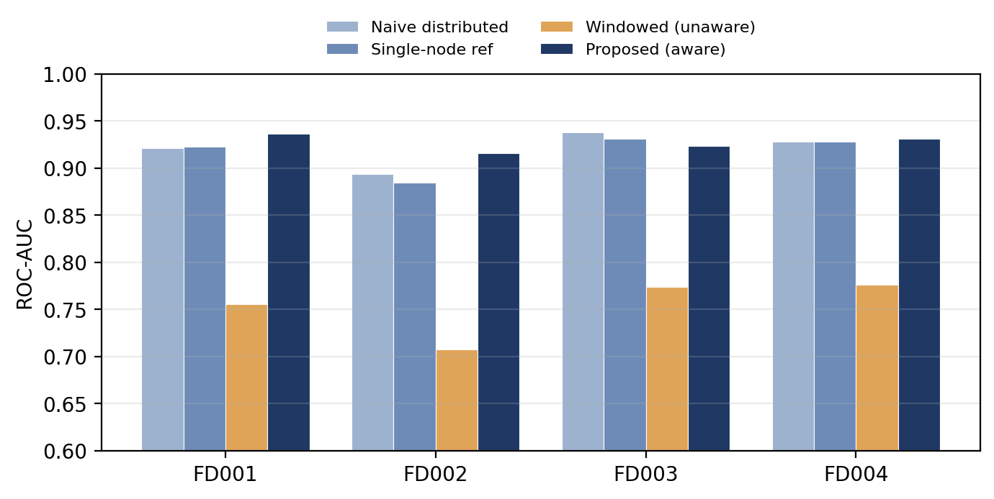
RESULTS · DETECTION QUALITY
The proposed method leads on ROC-AUC
0.927
best mean
ROC-AUC (C4)
+0.022
AUC gain on
FD002 vs naive
Best on FD001, FD002 & FD004; competitive on FD003.

Slide 9
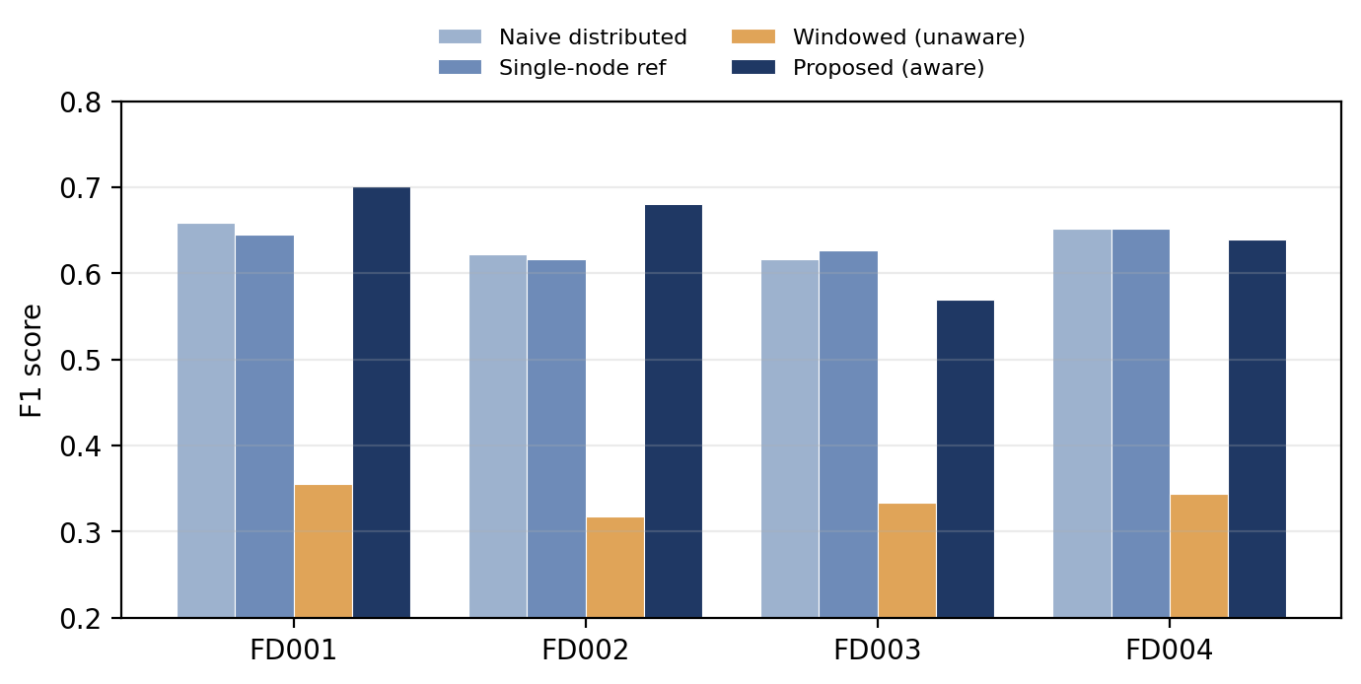
RESULTS · DETECTION QUALITY
Same ordering on F1
0.647
best mean F1 (C4)
vs 0.637 naive · 0.635 single-node

Slide 10
THE DECISIVE RESULT
Windowing without partition-awareness collapses
0.753 vs 0.920
mean ROC-AUC: partition-UNAWARE windowing (C3) vs naive baseline (C2)
Adding the identical window features on partition-unaware splits is worse than using no temporal features at all. Since C3 and C4 differ only in whether trajectories stay intact, partition-awareness is the cause of the gain — not the window features.

Slide 11
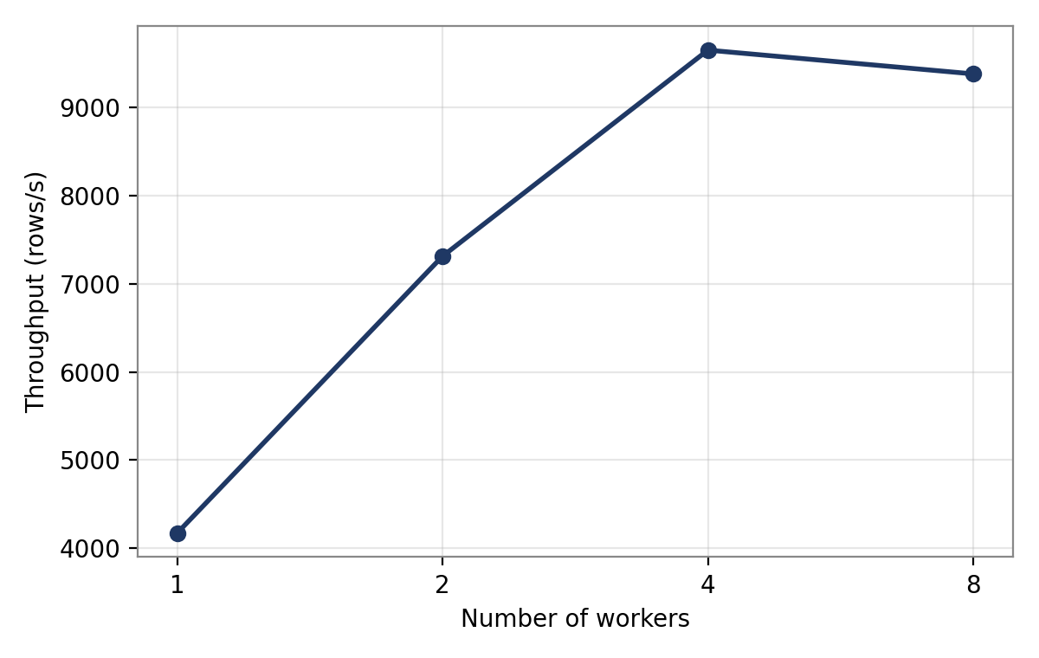
RESULTS · SCALABILITY
Near-linear scaling on the Docker cluster
2.3×
speed-up at 4 workers
9,654
peak rows/s (4 workers)
plateau
at 8 as cores saturate
Measured (1/2/4/8 workers), not estimated. Detection accuracy is hardware-independent; throughput is the one figure that needs real parallel workers.

Slide 12
CONCLUSION
Keep trajectories intact — recover the signal
A distributed Isolation Forest recovers the degradation signal it otherwise loses when temporal locality is preserved across partition boundaries — and the ablation shows partition-awareness is the reason.
Future work
Per-partition anomaly-score calibration
Extend scaling to a genuinely multi-machine cluster
Investigate the two-fault-mode subsets (FD003/FD004)

Slide 13
Thank you
Questions & demo
Arda Günaydın · Mustafa Batuhan Taş | BIL 501 — TOBB ETÜ

