Slide 1





INTERFAZ DE USUARIO
Visualización de Datos de Entrada
Visualización de Datos de Salida
BASE DE DATOS
MODELO DE OPTIMIZACIÓN

Slide 2
GRAPHICAL USER INTERFACE
Display of Input Data
Display of Output Data
DATABASE
OPTIMIZATION MODEL

Slide 3
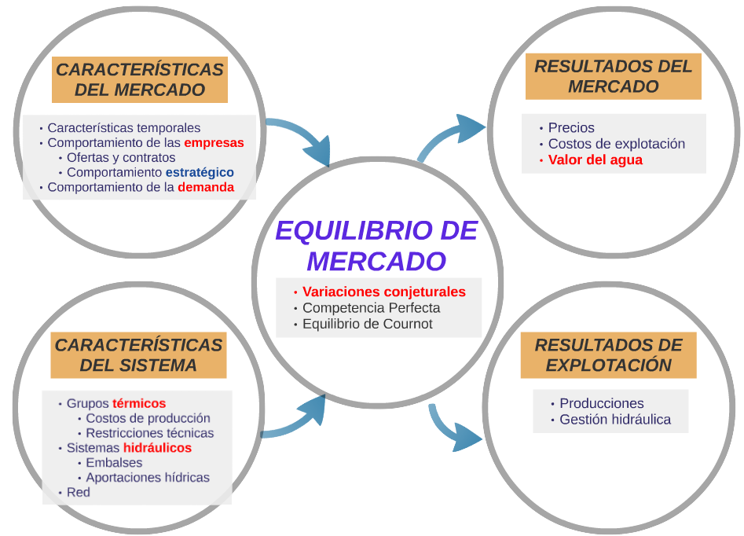

Slide 4
MARKET CHARACTERISTICS
MARKET RESULTS
Time characteristics
Firms’ behavior
Bids
Contracts
Demand behavior
Prices
Operating costs
Value of water
MARKET EQUILIBRIUM
Conjectural variations
Perfect competition
Cournot equilibrium
SYSTEM CHARACTERISTICS
OPERATING RESULTS
Generation of units
Mangement of hydro resources
Thermal Units
Production costs
Technical constraints
Hydro systems
Reservoirs
Network

