Slide 1

MINOR PROJECT PRESENTATION
ON
EDUCARE
Submitted To:
RAJIV GANDHI PROUDYOGIKI VISHWAVIDYALAYA
Presented by :
Esha Mangal 0818CS181051
Shweta Singh 0818CS181134
Veerendra Singh Kodle 0818CS181145
Guided by:
Ms. Zoha Usmani

Slide 2
Content to be covered
Introduction.
Literature Survey.
Problem Definition.
Features
Use Case Diagram
Technology Stack
Facilities required
References

Slide 3
Introduction
In contemporary world where education system is getting more and more inclined towards online platforms and new ways and technologies are playing vital role to connect pupil and instructors virtually so that it can continue to maintain our education system as the new normal term is coined as a consequence of the pandemic it not only brought new opportunities to think out of box ideas to make our education system more effective and robust but also provided students to connect globally and learn through these online platforms hand in hand with other students but we also need a local platform for students and teachers where teachers can keep records of students internal, external, attendance and assignment grades and analyse their performance and growth we are building a local platform to communicate with our instructors and pals.

Slide 4
Literature Survey
There are various previous works done for teaching in online mode using multiple online platforms like NPTEL, Coursera and Google classroom while most of these platforms does facilitate the teaching, each one of them lack some functionalities that are necessary for fluent teaching which needs to be addressed to make a suitable platform for hasslefree delivery of knowledge.
Some Online Education platforms which provide Universal access to the world's best education,Partnering with top universities and organisations to offer courses for anyone to take for free or with some cost.
NPTEL
Coursera
Tutorials Point
Udemy

Slide 5
Problem definition
Education is the targeted field for the project as because of global pandemic (COVID-19) most of the educational institutions are shifting towards online learning platforms, coming up with a solution to satisfy the continuously growing need for new technologies and platforms as per both the students and teachers perspectives is necessary the project aims to facilitate the learning process such that its hasslefree.
Students inability to grasp key ideas and concepts.
Too much focus on presentation, little time left for practice.
Lack of motivational push.
This method of education is therefore a danger to the student as this will only make the Students not qualified for the career industry.

Slide 6
Features
The features of our project will be to build our online platform will include:
1. Course management
2. Grades
3. Study material provided by instructors
4. Assignment based learning and analysis
5. Performance analysis and graphical representation
6. Video Lectures provided by instructors

Slide 7
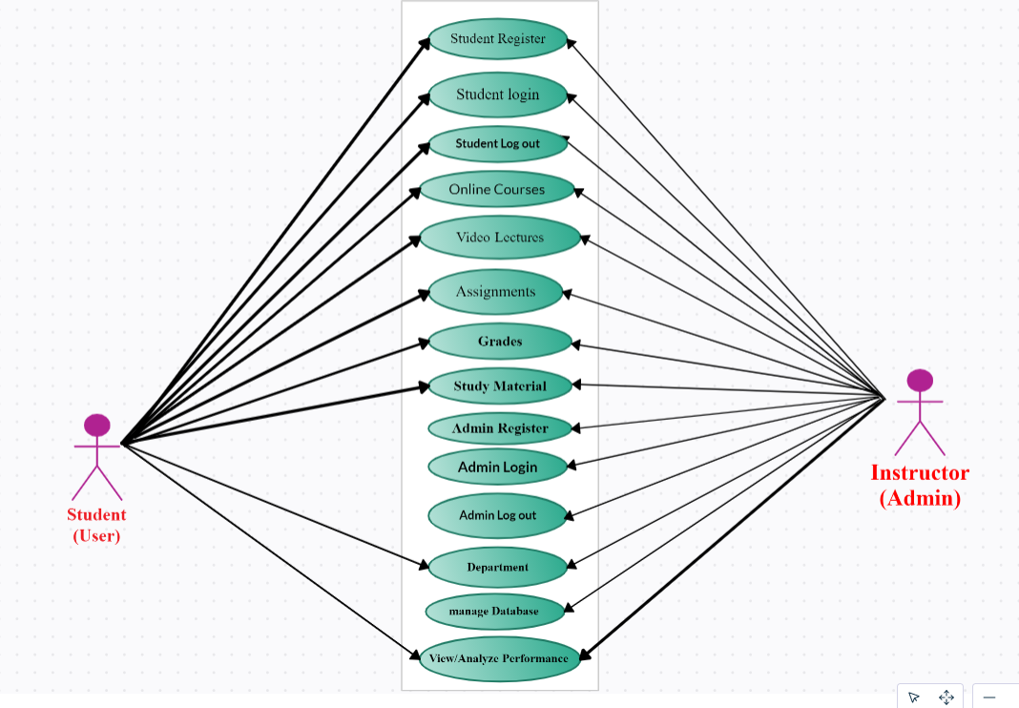
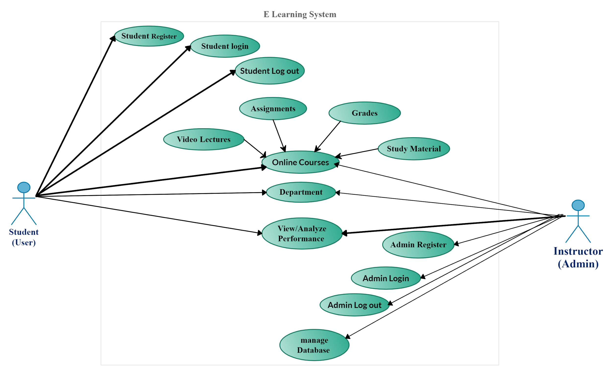
Use case diagram

Slide 8




Technology Stack
HTML, CSS, JavaScript
Bootstrap
Django
MySQL

Slide 9
Facilities required for proposed work
Hardware Requirements:
Processor : Intel i3 or above/ AMD Ryzen 3 or above
RAM : 4 GB or above
Storage: HDD/SSD 128 GB or above
Internet: Ethernet connection (LAN) OR a wireless adapter (Wi-Fi)
Software Requirements
Text editor ( VScode/Atom/Sublime/Notepad++ or any other)
Python (version 3.8 or above)
MySQL (server and workbench)
Version Control System (Git)
Browser (Mozilla Firefox/Google Chrome/ Microsoft Edge)
Operating System (Windows 10/ Mac OS/ Linux)

Slide 10
Reference
https://www.google.co.in/
https://www.w3schools.com/
https://getbootstrap.com/
https://www.djangoproject.com/

Slide 11
Thank you

