Slide 1

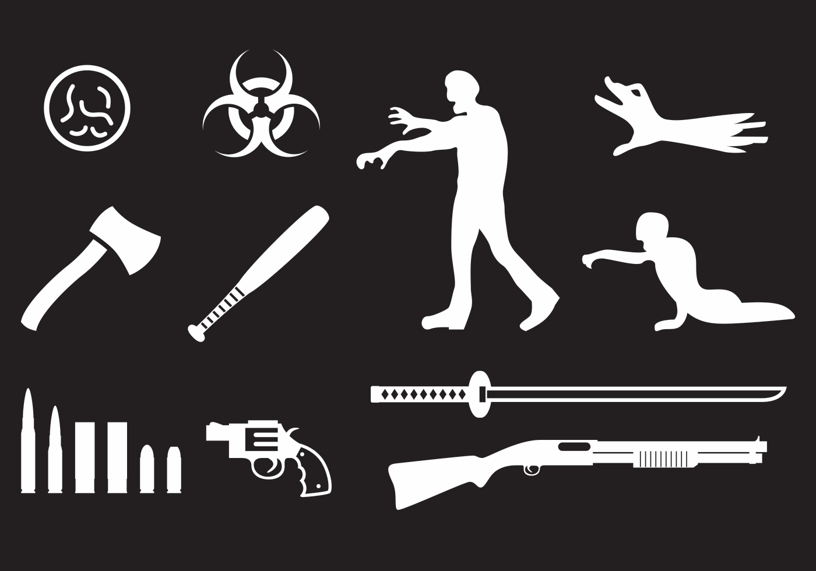


ZOMBIE TRIAGE
DATA COLLECTION for the C.D.C. FieldAgent™ App
Deanne, Audrey, Dawn Feb. 2016 Weblab

Slide 2

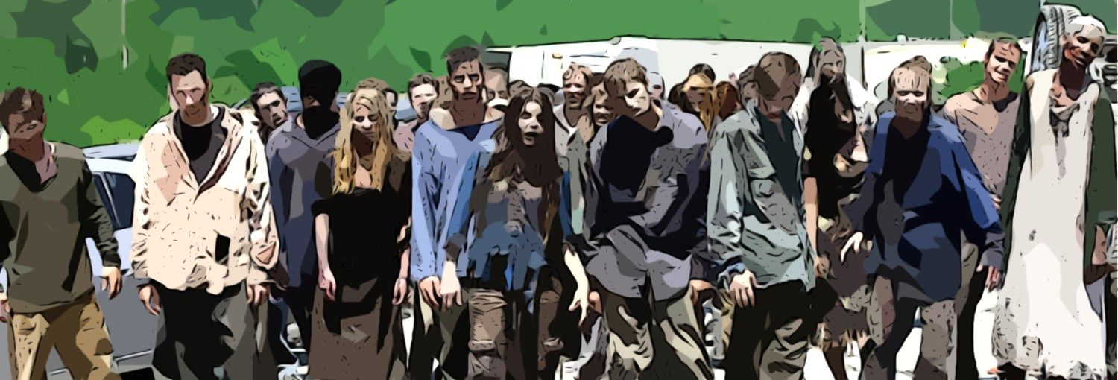
OVERVIEW
Problem: Zombie Virus Outbreak Reported in the USA less than 1 hour ago
Goal: To Locate the First Virus Carrier (Patient 0) by testing Zombie Blood- Dead or Reanimated

Slide 3


Overview: Actions 2
Task: Develop App Called FieldAgent(TM) For Zombie Hunter Teams/ Data Collectors

Slide 4
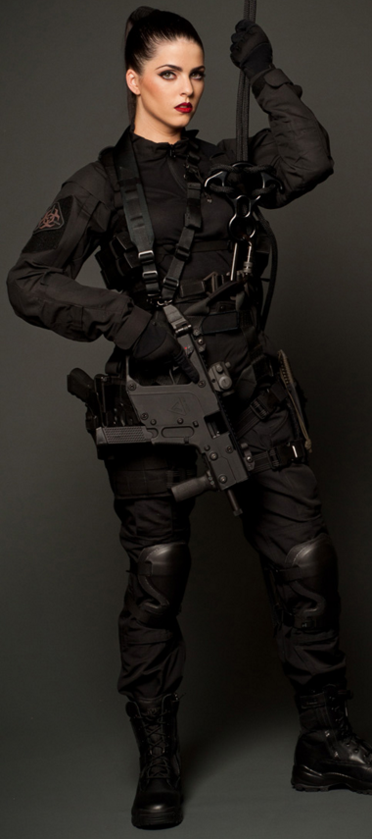
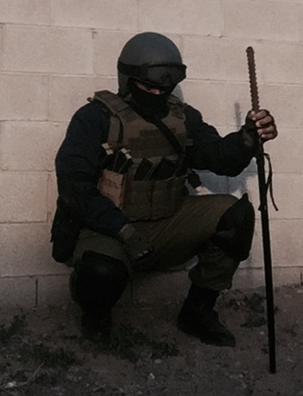
RESEARCH: The Team
Who are the Zombie Hunters/ Data Collectors?
What do they do?
Where do they work?
Why do they do it?

Slide 5
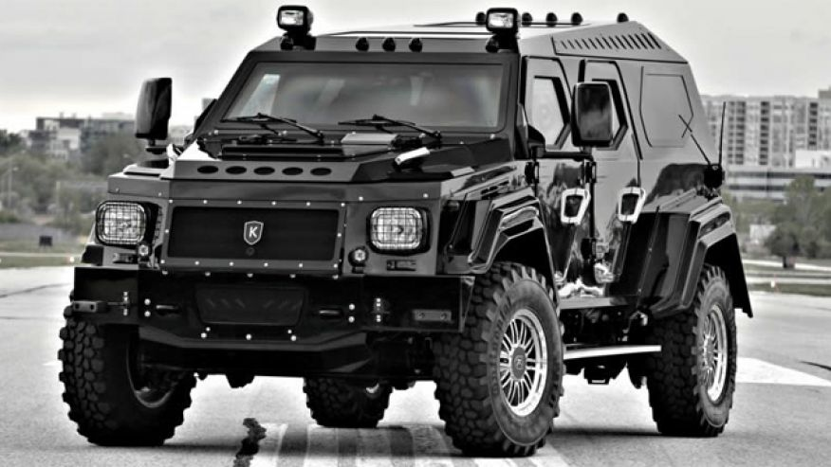
Life in the Field
Developers followed a data collection team around for three days to observe their daily activities.
Their working environment
Daily activities
Data collection
Risks
Necessary precautions
Equipment

Slide 6
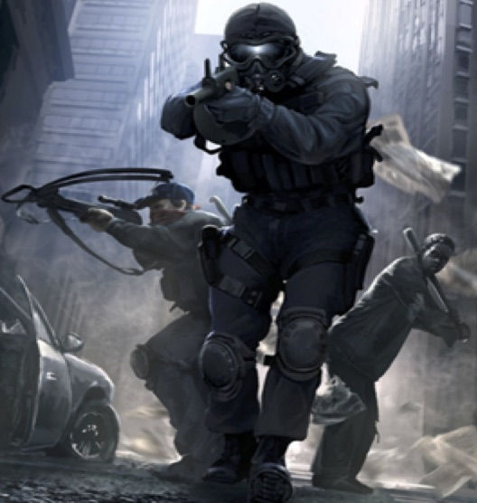
EMPATHY MAP
THINK & FEEL
Find Patient “0”
Minimize kills in case we find a cure
Don’t get myself or team infected
HEAR
We can find a cureMy Loved one had been infectedBe careful out thereThe virus is mutating
SEE
Everyone is turning into ZombiesInfrastructure is falling apartHumans in needZombies can be hiding anywhere
PAIN
To prevent infection don’t got too closeDon’t have too much time to complete
downloadHard to maneuver wearingprotective gear
SAY & DO
Do what ever it takesTravel where necessaryGet as many blood samples as possibleTake necessary precautions
GAIN
Sampling from a distance is saferFind patient “0”= cureGet as many blood samples as possibleLocation patterns gets us closer to target

Slide 7
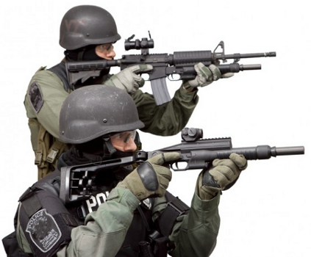

PROTOTYPE: Darts
Dart gun: Tool to get the dart to target
Darts: sensors to analyze blood, with a break off tip that has a locator chip inside (to track migration for future analysis). Bluetooth – 30 feet. Need to pair phone and each dart. Download info to phone then upload later.
Pocket in uniform to securely hold phone
Analyze blood to determine: gender, blood type, strain or new mutation
Use GPS locator for tagging.

Slide 8

HARDWARE TEST
Test distance of Bluetooth darts and Bluetooth on phones to make sure they work within 30 feet.
Make sure phone headsets work so data collection team can communicate with each other.
Test microchip that transmits location via GPS.
Test battery life and solar charging units.
Test Dart guns to make sure they are in working order.

Slide 9
SOFTWARE TEST
Make sure phones are able to store data and upload to CDC at the end of the day.
Test the maximum distance to receive data transmission from dart.
Test that blood analysis returns correct blood type, gender and strain or new mutation.
Test upload to main database.
Test the time it takes to pair dart and phone, # of darts.
Test Data Collection Criteria in each type of environment.
Test 911/Emergency and location indicators including GPS on phone.

Slide 10
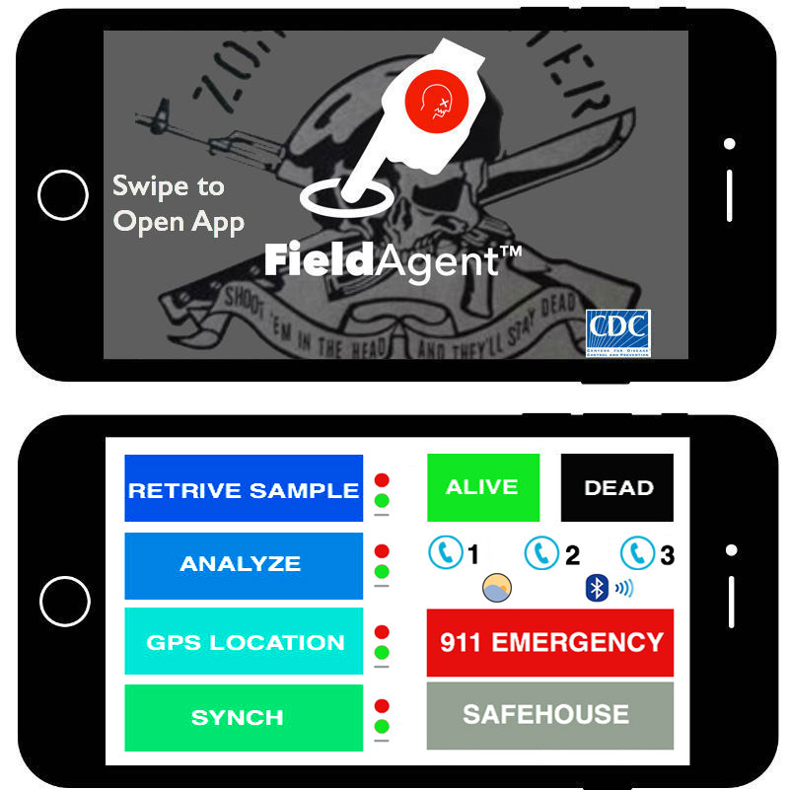
FieldAgent™App
Default Screen Swipe to Open
Retrieve Sample from Dart Sensor
Analyze Blood Sample:
  Blood Type
  Infection Strain
  Gender
Zombie Status: Alive/ Dead
Encode GPS Location
Sync with CDC
Progress Buttons: Grey to Green= Done
Phone Button to directly speak with One Team Member with Bluetooth Headset
911 Emergency
Show Safe-house Location GPS
Bluetooth Stats with Darts & Headsets
Satellite Wifi Status Indicator
Military Flux Auto Screen Enhancement/ Night Visability Red Screen

Slide 11
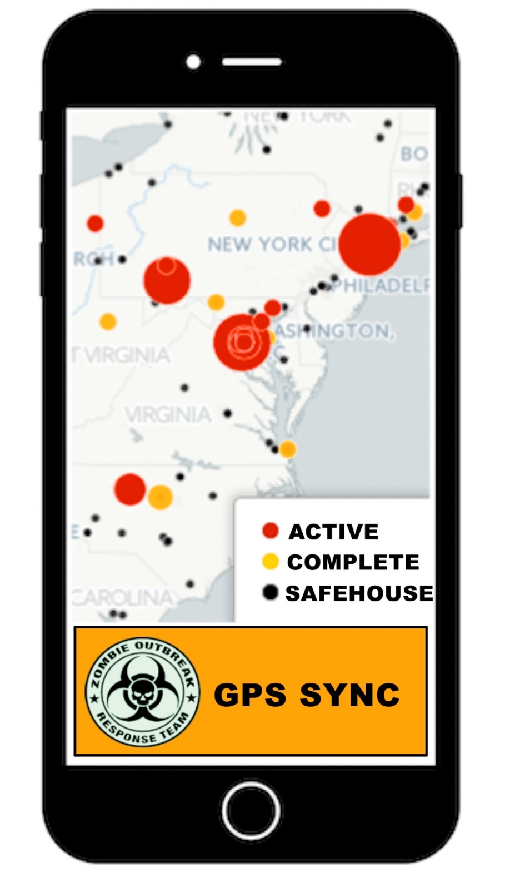
GPS SYNC
GPS Connection Through Satellite Wifi
GPS SYNC with CDC to Determine Untested Regions
Active= Not Tested
Complete= Tested
Safehouse= Military Triage & Supply Centers
GPS SYNC after Region Compete to Upload Data

Slide 12
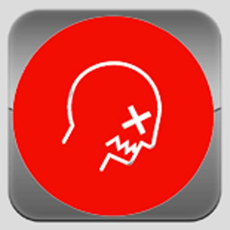
Questions?

