Slide 1
SOKA METAHEURISTIC SCHEDULING
SMA and Aquila Optimizer
A completed CloudSim comparison across 1,000 to 5,000 cloudlets
Results from the real workload dataset
30 validated runs across SMA and AO
Notes:
This deck summarizes the completed soka-metaheuristic experiment using 45,000 unique workload rows from the Google Cluster Trace-derived input.

Slide 2
WHAT THE NEW PROJECT TESTS
Experiment scope
Two optimizers solve the same scheduling problem under the same infrastructure and cost model.
Algorithms
Experiment status
• Slime Mould Algorithm (SMA)
• 45,000 unique workload rows validated
• Aquila Optimizer (AO)
• 30 runs completed: 15 SMA and 15 AO
• Same 60:40 time-to-cost objective
• Every workload size has three repetitions
The results below come from the completed server run.
SOKA metaheuristic scheduling | 2
Notes:
The runner validated unique workload ranges, non-negative metrics, and the expected 30 algorithm/workload executions before producing the charts.

Slide 3
INFRASTRUCTURE CONFIGURATION
Static CloudSim topology
Every run uses the same eight VMs and the same four fixed host assignments.
Datacenter 1
Datacenter 2
Host 0
VM 0 | VM 1
Host 2
VM 4 | VM 5
2 VMs
2 VMs
Host 1
VM 2 | VM 3
Host 3
VM 6 | VM 7
2 VMs
2 VMs
Static policy maps VM IDs to host IDs. The VM placement does not change between algorithms.
SOKA metaheuristic scheduling | 3
Notes:
The Java implementation defines VM hostId and datacenter fields, then uses StaticVmAllocationPolicy to map VM IDs 0-1 to Host 0, 2-3 to Host 1, 4-5 to Host 2, and 6-7 to Host 3.

Slide 4
NON-OVERLAPPING INPUT RANGES
Workload schedule
The largest individual test contains 5,000 cloudlets. The complete experiment consumes 45,000 unique rows.
Dry run
Cloudlets / repeat
Three contiguous ranges
1
1,000
1–1,000; 1,001–2,000; 2,001–3,000
2
2,000
3,001–5,000; 5,001–7,000; 7,001–9,000
3
3,000
9,001–12,000; 12,001–15,000; 15,001–18,000
4
4,000
18,001–22,000; 22,001–26,000; 26,001–30,000
5
5,000
30,001–35,000; 35,001–40,000; 40,001–45,000
Total unique rows: 3 × (1,000 + 2,000 + … + 5,000) = 45,000
SOKA metaheuristic scheduling | 4
Notes:
The Java loop advances one global cursor after every chunk. The validator checks that each algorithm has 15 unique ranges and that every range remains within rows 1 through 45,000.

Slide 5
DISCRETE METAHEURISTIC SEARCH
How SMA and AO assign cloudlets
Each candidate solution assigns every cloudlet to one of eight VMs.
1
2
3
4
Candidate
Repair
Evaluate
Update
A VM ID is proposed for each cloudlet
CPU and RAM violations move to a feasible VM
Makespan and execution cost form the score
SMA or AO moves the population toward better solutions
Objective score
Cost model
0.60 × normalized makespan + 0.40 × normalized cost
Σ(actual CPU time × VM price)
SOKA metaheuristic scheduling | 5
Notes:
The implementation uses a population of eight candidates and twelve iterations. SMA and AO use different update rules but share the same repair function, objective, VM specifications, and CloudSim execution model.

Slide 6
SMA VERSUS AO
Measured results
Mean values across three repetitions for each workload size
Cloudlets
SMA makespan
AO makespan
SMA cost
AO cost
1,000
90.16M
92.70M
10.58M
10.56M
2,000
127.56M
125.61M
17.08M
17.01M
3,000
213.61M
213.52M
20.56M
20.55M
4,000
268.52M
269.54M
31.59M
31.57M
5,000
341.20M
342.18M
39.76M
39.85M
Overall mean
SMA makespan 208.21M | AO makespan 208.71M
SMA cost 23.91M | AO cost 23.91M
SOKA metaheuristic scheduling | 6
Notes:
Values are means from results/summary.csv. M is the unit displayed in the source metrics. Lower makespan and lower cost are preferable; the per-size winner changes between SMA and AO.

Slide 7
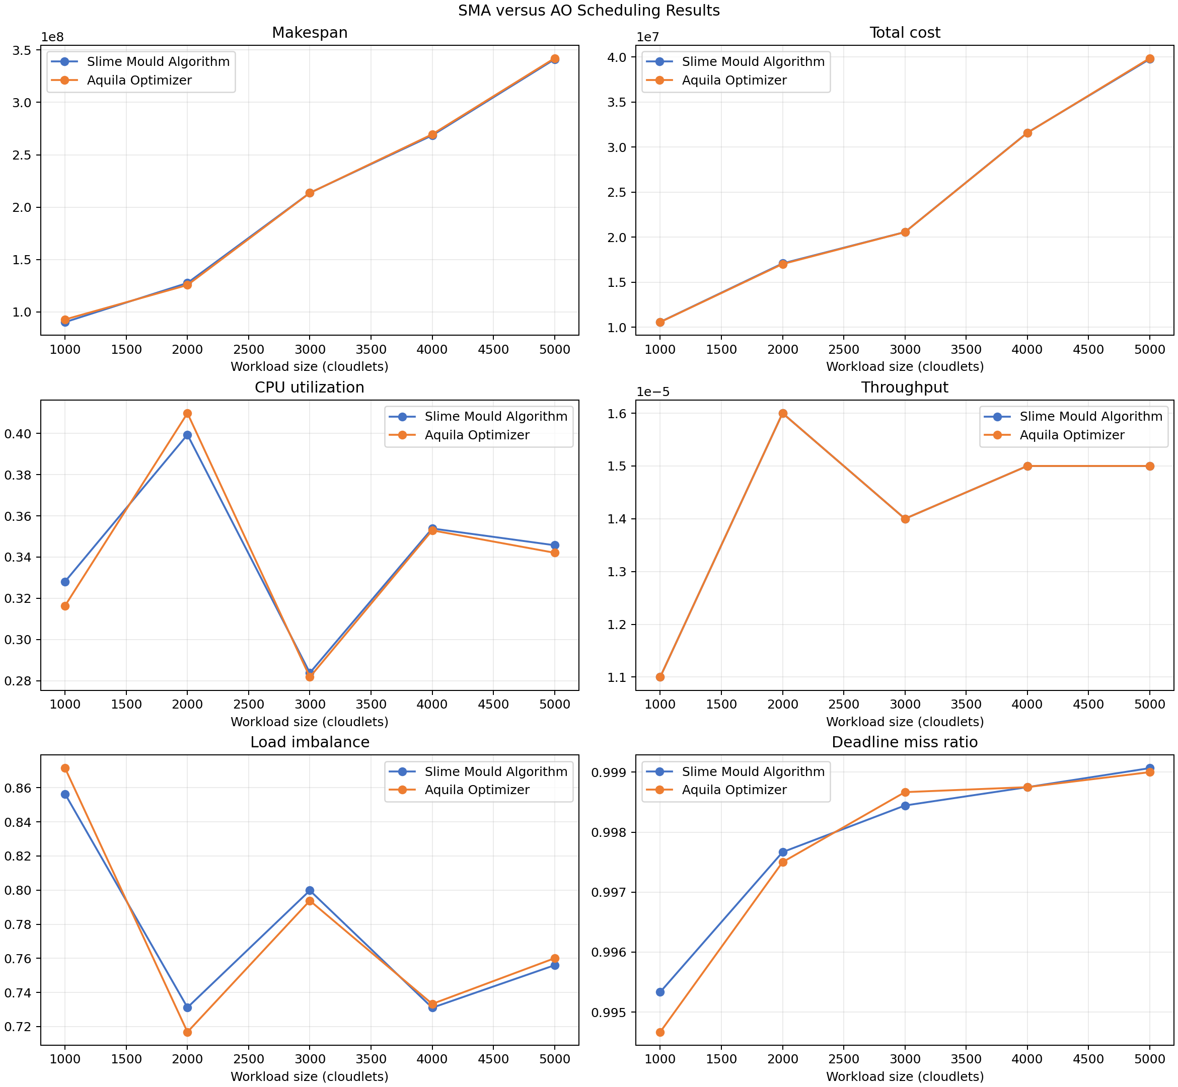
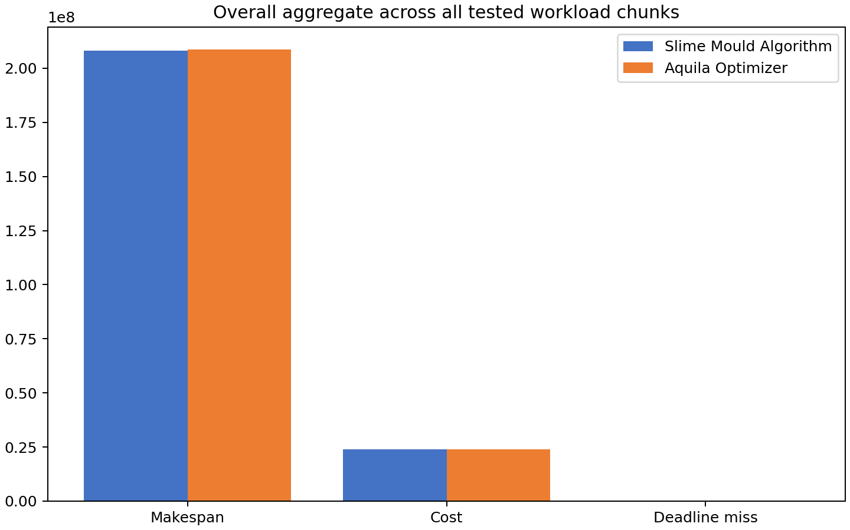
VISUAL COMPARISON FROM THE COMPLETED RUN
Result charts
The left chart compares workload-size trends. The right chart aggregates the 15 runs for each algorithm.
SMA has the lower overall makespan. AO has a slightly lower overall cost. Neither optimizer wins every workload size.
SOKA metaheuristic scheduling | 7
Notes:
These are the generated comparison.png and overall.png artifacts from the completed run. The charts use the same summary metrics shown in the preceding table.

Slide 8
HOW TO READ THE COMPLETED RUN
Outputs and interpretation
Result files
Read the comparison
runs.csv
• Lower makespan means faster completion
summary.csv
• Lower total cost means cheaper execution
• Higher throughput means more completed tasks per time
comparison.png
• Lower imbalance and deadline misses indicate better distribution
overall.png
configuration.txt
Reproduce the experiment
./run.sh --algorithm SMA,AO
The runner validates duplicates before simulation.
SOKA metaheuristic scheduling | 8
Notes:
The completed result artifacts are stored under results/. The copied local artifacts include the CSV summaries, configuration, comparison chart, and overall chart.

