Slide 1
detect_storms_in_model
README
Marine De Carlo
2023

Slide 2
Architecture of the folder
The src folder contains:
detect_storms_in_model.py
linkStorms_models.py
detection_code/
__init__.py
params_detect.py
storms_functions_detect.py
storms_functions_tracking.py
storms_functions_io.py
storms_functions_geo.py

Slide 3
Needed packages in environment
Packages to be installed:
Matplotlib
Pandas
Numpy
Scipy
Xarray
Netcdf4
H5netcdf
To use the environment in jupyter :
'<whatever_snake> install ipykernel jupyter'
python -m ipykernel install --user --name=<ENV_name> --display-name=<ENV_name_to_be_displayed>

Slide 4
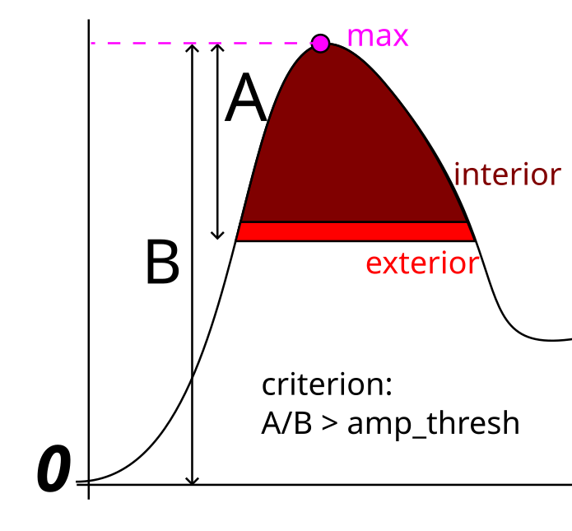
Params_detect.py
Params_detect.py contains your parameters, both paths and detection criterion.
Path parameters:
Nb_CPU : nb of cpu that you want to allow for multiprocessing if any (limitation max to avoid memory issue)
isWW3 (depending on how is the data saved =1 is monthly, =0 is daily)
PATH : where are the input files stored (without year or month info)
FORMAT_IN* : remaining of the path = part containing the temporal info + filename
PATH_SAVE_detect, PATH_SAVE_tracking : Paths where to save the results of the code
FORMAT_OUT_detect*, FORMAT_OUT_tracking*: file generic name for saving results
filedist2coast: path to nc file containing the distance to coast grid.
3 params to define Hs levels used for detection (see slide 9):
swh_crit_max, dswh_crit, min_swh => swh_levels = np.arange(min_swh, swh_crit_max + dswh_crit, dswh_crit)
Parameters for detection criterion:
amp_thresh : minimum value of the normalized prominence of the peak for a region to be detected as storm default : 1./5
min_area : minimum area for a region to be detected as storm, in km2 default : 500
area_forgotten_ratio : minimum ratio of area for a region to become a "forgotten" storm and be saved as a storm (see slide 10) default : 0.2
Parameter for tracking:
threshold_dist : distance max for a storm between 2 timesteps, in km default : 400
*write generic name with YYYY and MM (and DD for input files when isWW3 ==0)

Slide 5
How to run
To run the code :
Activate your python environment
Go to the src folder
Check the params_detect.py file (update with your data, folders etc)
Type the instruction (e.g.)
python detect_storms_in_model.py -s 0 -y 2023 -Y 2023 –m 1 –M 2
Amongst the options the '–s' (step) one is mandatory. Here are the different subroutine run for each step (for the difference between internal tracking and transition tracking, see slide 12)
Step Number | 0 | 1 | 2 | 111 | 110 | 11
Detection | ✓ |  |  | ✓ | ✓
Internal tracking |  | ✓ |  | ✓ | ✓ | ✓
Transition tracking |  |  | ✓ | ✓ |  | ✓

Slide 6
How to run detect_storms_in_model.py
python detect_storms_in_model.py -h
usage: detect_track_storms [-h] [-y YEAR] [-m MONTH] [-Y FINAL_YEAR] [-M FINAL_MONTH] [-s {0,1,2,11,111,110}] [-r] [-R]
[--multiprocessing]
options:
-h, --help show this help message and exit
-y YEAR, --year YEAR Chose the year for processing
-m MONTH, --month MONTH
Chose the month for processing
-Y FINAL_YEAR, --final_year FINAL_YEAR
Chose the final year to take into account
-M FINAL_MONTH, --final_month FINAL_MONTH
Chose the final month to take into account
-s {0,1,2,11,111,110}, --step {0,1,2,11,111,110}
Choose the step for applying the calculation process. 0: detect_only | 1: file_internal_track_only | 2:
transition_track_only | 111 : all_steps | 110: detect and file internal track steps (no transition between files
track) | 11 : all_tracking_steps
-r, --reprocess Force a reprocessing for the detection step : existing files will be deleted and re computed
-R, --reprocess_tracking
Force a reprocessing for the tracking steps : existing files will be deleted and re computed
--multiprocessing Use multiprocessing to run the code

Slide 7
Function 'run_detection' (step 0)
Loop over months (1 file for WW3 or concatenation of days for ERA5),
For each month, there is a loop over time steps: either using the python package multiprocessing or using a classical for-loop (depending on the '--multiprocessing' option of the code)
For each time step the function 'get_storm_by_timestep' is applied.
The results are then appended, concatenated and saved into 1 dataset per month.
=> The Path and name format for saving these dataset are defined in params_detect.py as 'PATH_SAVE_detect' and 'FORMAT_OUT_detect'.
The final filename is os.path.join(PATH_SAVE_detect,FORMAT_OUT_detect)

Slide 8
Function 'get_storm_by_timestep'
Inputs :
ds0 : xarray DataSet with coordinates 'longitude', 'latitude' and 'time'
levels for Hs screening: np.array() in decreasing order (see slide 9). Defined in params_detect.py
amp_thresh : relative amplitude threshold ratio criterion to select region as storm. Defined in params_detect.py (linked to condition (max(interior) - min(exterior))/max(interior) >= amp_thresh)
min_area : criterion for minimum size of a storm. Defined in params_detect.py
area_forgotten_ratio: criterion for saving a storm close to another one. Defined in params_detect.py
plot_output=False : /!\ returns the handles for the results figure
plot_example=False
Params have been removed but can still be of interest (Defined in params_detect.py )
Npix_min : for criterion on number of pixels per selection (old version of eddy_area_within_limits)
cte.d_thresh_min, cte.d_thresh_max => condition is_large_enough (criterion on 'shape').

Slide 9
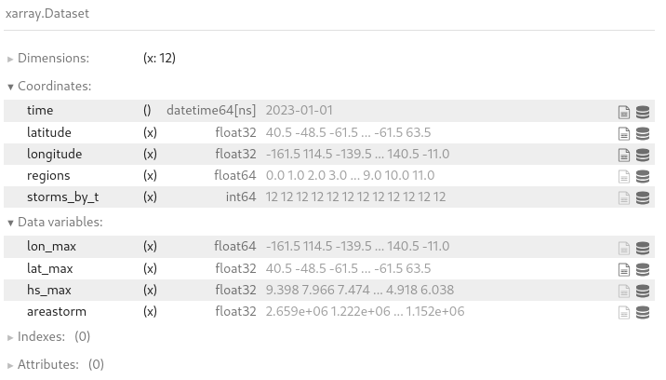
Function 'get_storm_by_timestep'
Outputs :
_results is a xarray dataset => the 'storms_by_t' coordinate is the number of storm detected by timestep the 'areastorm' is given in km².
If option plot_output is True: the handle to the figure is also returned

Slide 10
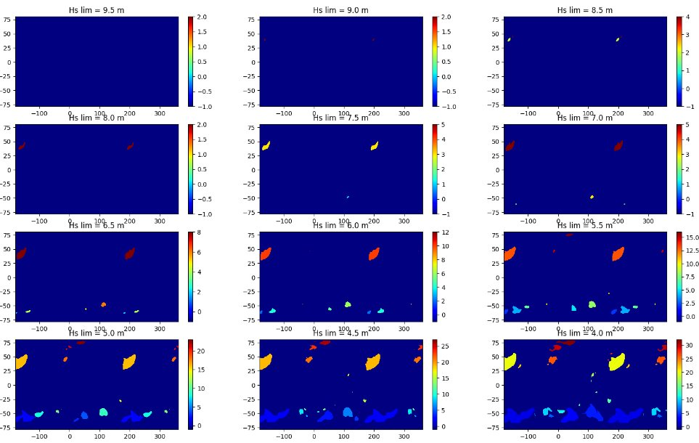
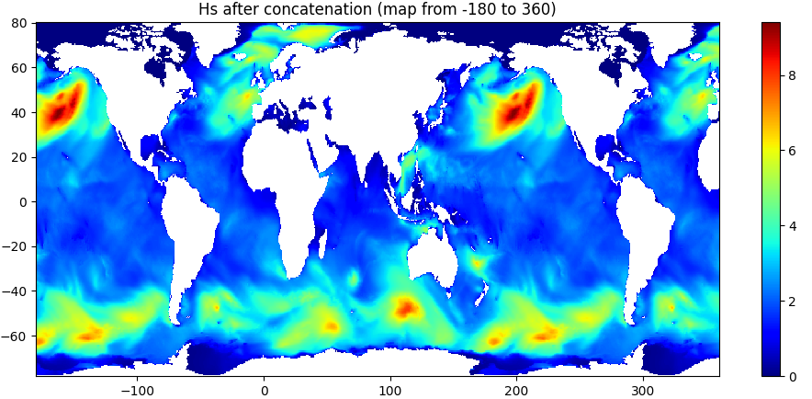
Function 'get_storm_by_timestep'
For each level in levels (in decreasing order) - 'labelisation' of regions above threshold is done - each region is studied: if criterions are matched => storm is saved !
The Hs map is duplicated from lon = [-180;180] to lon=[-180;360]
=> to avoid detection issues around 180°

Slide 11

Function 'get_storm_by_timestep'
Criterions for saving storms:
eddy_area_within_limits : the area of the region must be > min_area
has_internal_max: the maximum of the region must be properly inside and not on its edge
is_tall_storm: the difference between the max of the region and the mean of its edge should be higher than amp_thresh * max(region)
Special criterions exists to deal with problematic situations such as :
1. At previous level, both regions red and orange have been detected
2. However, at previous level, only the orange regions has been saved,
3. At current level, the detection gives the black region
=> criterion to see if the red region is a 'forgotten_storm' or not ? OR Are there 2 storms or just one ?
The criterion compares the param area_forgotten_ratio to the area ratio between the 'forgotten' region (here the red region) and the larger of the saved regions area (here the orange region) inside the new region (here the black region).

Slide 12
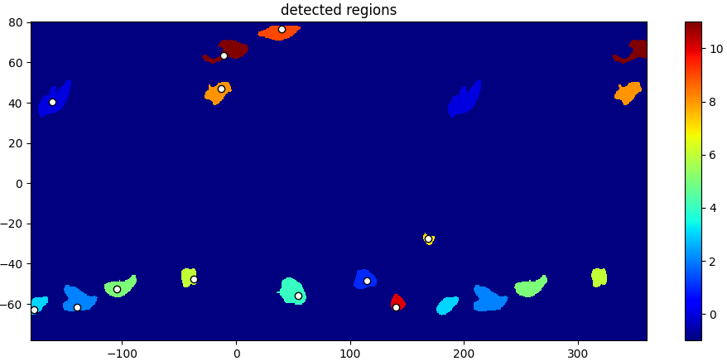
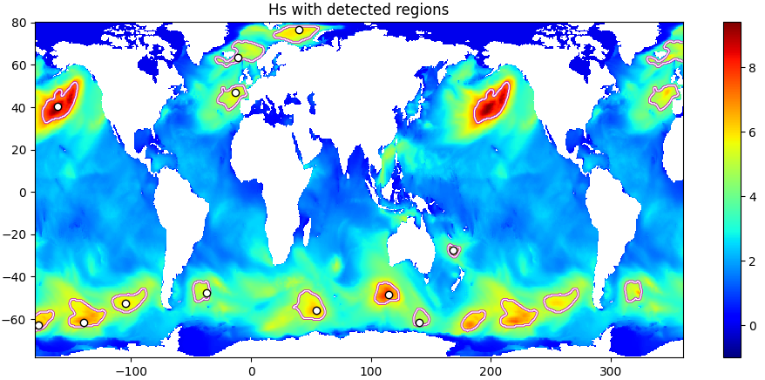
Function 'get_storm_by_timestep'
The function gets a map of "detected" or "saved" regions
The get_storm_info_from_savemap function is applied to extract the main information:
Number of storms detect
Index of the storm (called 'regions')
Hs max in the region
Area of the region in km2
'lon_max', 'lat_max' :coordinates of Hs max (same as dataset coordinates longitude, latitude)

Slide 13
Tracking functions (steps 1 and 2)
For efficiency, 2 types or tracking are done:
The first one is called internal tracking : the tracking is performed from one timestep to the next inside one month file.
Can be performed using multiprocessing
For each file, the storms number goes from 0 to N
=> Corresponds to step 1 (file_internal_track_only) and included in steps 111, 110 and 11.
The second type is called transition tracking as it makes the transition between files, tracking storms between the first date of one month and the last date of the previous one, and rename the storms
Must be performed sequentially (best with the entire sequence)
For each file, the storms number goes from N_{i} to N_{i+1}
=> Corresponds to step 2 (transition_track_only) and included in steps 111 and 11.

Slide 14
Tracking functions
For both tracking types, the comparison is directly made between time step T and T-1.
A for-loop over all storms from time step T is performed:
For each storm st in time step T, the function 'one_storm_vs_old_storms' is applied.
This function:
Computes the distance (haversine function) between the storm st and all storms (st_old_{i}) from T-1
The couples (st, st_old_{i}) with distance < threshold_dist are considered potential_points.
If there is land between st and st_old_{i} => the couple is removed from potential_points
From the remaining potential_points, the couple (st, st_old_{i}) with the minimal distance is selected, if there is no remaining potential_points st is flagged as not_linked.
If various storms st are linked to the same st_old_{i} => only the st with the min distance is kept, the others are flagged as not_linked.
For each storm st in timestep T, if there is a selected couple (st,st_old_{i}) => assign to st the number of st_old_{i} else (if not_linked) => the st is considered a new storm and assigned a new number

