Slide 1
Workshop Coding
MMT/SKM/2023

Slide 2
Rommy (@ardikars)
Kode: https://github.com/ardikars/MMT

Slide 3
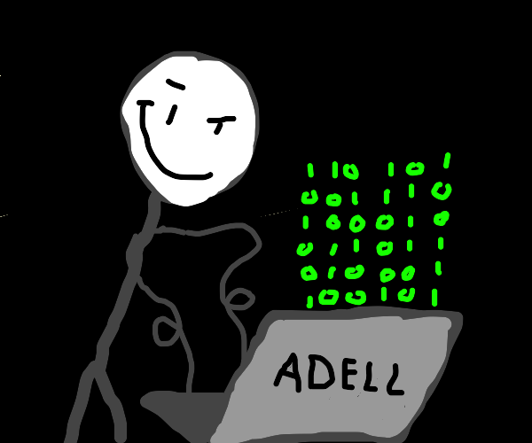

Pemrograman?
Komputer
Program
Koding

Slide 4
Pemrosesan Data
0 | 1 | 2 | 3 | 4 | 5 | 6 | 7 | 8 | 9
10 | 11 | 12 | 13 | 14 | 15 | 16 | 17 | 18 | 19
20 | 21 | 22 | 23 | 24 | 25 | 26 | 27 | 28 | 29
. | . | . | . | . | . | . | . | . | .
. | . | . | . | . | . | . | . | . | 99
100 | 101 | 102 | 103 | 104 | 105 | 106 | 107 | 108 | 109
110 | 111 | 112 | 113 | 114 | 115 | 116 | 117 | 118 | 119
. | . | . | . | . | . | . | . | . | .
. | . | . | . | . | . | . | . | . | 999
1000 | 1001 | 1002 | 1003 | 1004 | 1005 | 1006 | 1007 | 1008 | 1009
1010 | 1011 | 1012 | 1013 | 1014 | 1015 | 1016 | . | . | .

Slide 5
Pemrosesan Data (Basis 10)
0 | 1 | 2 | 3 | 4 | 5 | 6 | 7 | 8 | 9 | 10^1
10 | 11 | 12 | 13 | 14 | 15 | 16 | 17 | 18 | 19
20 | 21 | 22 | 23 | 24 | 25 | 26 | 27 | 28 | 29 |  | 10^2
. | . | . | . | . | . | . | . | . | .
. | . | . | . | . | . | . | . | . | 99
100 | 101 | 102 | 103 | 104 | 105 | 106 | 107 | 108 | 109 |  |  | 10^3
110 | 111 | 112 | 113 | 114 | 115 | 116 | 117 | 118 | 119
. | . | . | . | . | . | . | . | . | .
. | . | . | . | . | . | . | . | . | 999
1000 | 1001 | 1002 | 1003 | 1004 | 1005 | 1006 | 1007 | 1008 | 1009 |  |  |  | 10^4
1010 | 1011 | 1012 | 1013 | 1014 | 1015 | 1016 | . | . | .

Slide 6
Pemrosesan Data
0 | 1 | 2 | 3 | 4 | 5 | 6 | 7 | 8 | 9 | 10^1
10 | 11 | 12 | 13 | 14 | 15 | 16 | 17 | 18 | 19
20 | 21 | 22 | 23 | 24 | 25 | 26 | 27 | 28 | 29 |  | 10^2
. | . | . | . | . | . | . | . | . | .
. | . | . | . | . | . | . | . | . | 99
100 | 101 | 102 | 103 | 104 | 105 | 106 | 107 | 108 | 109 |  |  | 10^3
110 | 111 | 112 | 113 | 114 | 115 | 116 | 117 | 118 | 119
. | . | . | . | . | . | . | . | . | .
. | . | . | . | . | . | . | . | . | 999
1000 | 1001 | 1002 | 1003 | 1004 | 1005 | 1006 | 1007 | 1008 | 1009 |  |  |  | 10^4
1010 | 1011 | 1012 | 1013 | 1014 | 1015 | 1016 | . | . | .

Slide 7
Bagaimana dengan teks?
0 | 1 | 2 | 3 | 4 | 5 | 6 | 7 | 8 | 9
A | B | C | D | E | F | G | H | I | J
K | L | M | N | O | P | Q | R | S | T
U | V | W | X | Y | Z | a | b | c | d
e | f | g | h | i | j | k | l | m | n
o | p | q | r | s | t | u | v | w | x
y | z | spasi | + | - | * | / | % | \ | !
@ | # | $ | & | ( | ) | [ | ] | { | }
. | , | ? | “ | ‘ | ; | : | _ | ! | ~

Slide 8

Contoh kasus
0 | -> | 1 |  | A | -> | 11 |  | K | -> | 21 |  | U | -> | 31
1 | -> | 2 |  | B | -> | 12 |  | L | -> | 22 |  | V | -> | 32
2 | -> | 3 |  | C | -> | 13 |  | M | -> | 23 |  | W | -> | 33
3 | -> | 4 |  | D | -> | 14 |  | N | -> | 24 |  | X | -> | 34
4 | -> | 5 |  | E | -> | 15 |  | O | -> | 25 |  | Y | -> | 35
5 | -> | 6 |  | F | -> | 16 |  | P | -> | 26 |  | Z | -> | 36
6 | -> | 7 |  | G | -> | 17 |  | Q | -> | 27 |  |  | -> | 37
7 | -> | 8 |  | H | -> | 18 |  | R | -> | 28 |  | , | -> | 38
8 | -> | 9 |  | I | -> | 19 |  | S | -> | 29 |  | . | -> | 39
9 | -> | 10 |  | J | -> | 20 |  | T | -> | 30 |  | ! | -> | 40
40 karakter
Angka [1-40]
10^n-1 >= 40
n?

Slide 9
Contoh kasus
SKM23, KODING!
S | K | M | 2 | 3 | , |  | K | O | D | I | N | G | !

Slide 10
Contoh kasus
SKM23, KODING!
S | K | M | 2 | 3 | , |  | K | O | D | I | N | G | !
29 | 21 | 23 | 03 | 04 | 38 | 37 | 21 | 25 | 14 | 19 | 24 | 17 | 40

Slide 11

Contoh kasus

Slide 12
Contoh kasus
Encoding
Karakter tidak valid

Slide 13
Contoh kasus
Encoding
Karakter tidak valid
Decoding
Karakter tidak valid
Panjang karakter ganjil

Slide 14
Contoh kasus
Encoding
Karakter tidak valid
Decoding
Karakter tidak valid
Panjang karakter ganjil
Panjang karakter 0

Slide 15
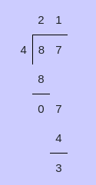
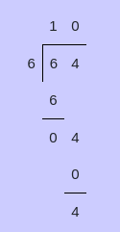
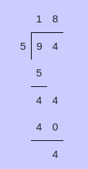
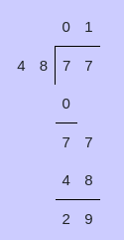
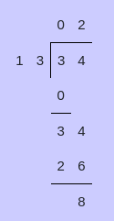
Contoh kasus

Slide 16
Contoh kasus
Sisa hasil bagi selalu lebih kecil dari pembagi.

Slide 17
Contoh kasus
Sisa hasil bagi selalu lebih kecil dari pembagi.
Kita bisa gunakan cara ini untuk menentukan sebuah angka ganjil atau genap.

Slide 18
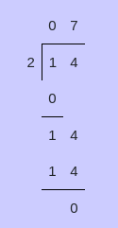
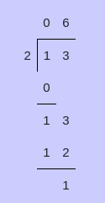
Contoh kasus

Slide 19
Contoh kasus
Jika sisa hasil bagi 0 (habis dibagi 2) berarti bilangan yang di bagi adalah genap.
Jika sisa hasil bagi 1 (tidak habis dibagi 2) berarti bilangan yang di bagi adalah ganjil.

