Slide 1
CTOF Innovation Challenge Gallery Walk Application DUE MAY 1
Project name
Solution: 2-3 sentences describing your project
Brainstorm link Team members Registered CTOF Location
Track: (1. Services 2. Financial Capabilities)

Slide 2
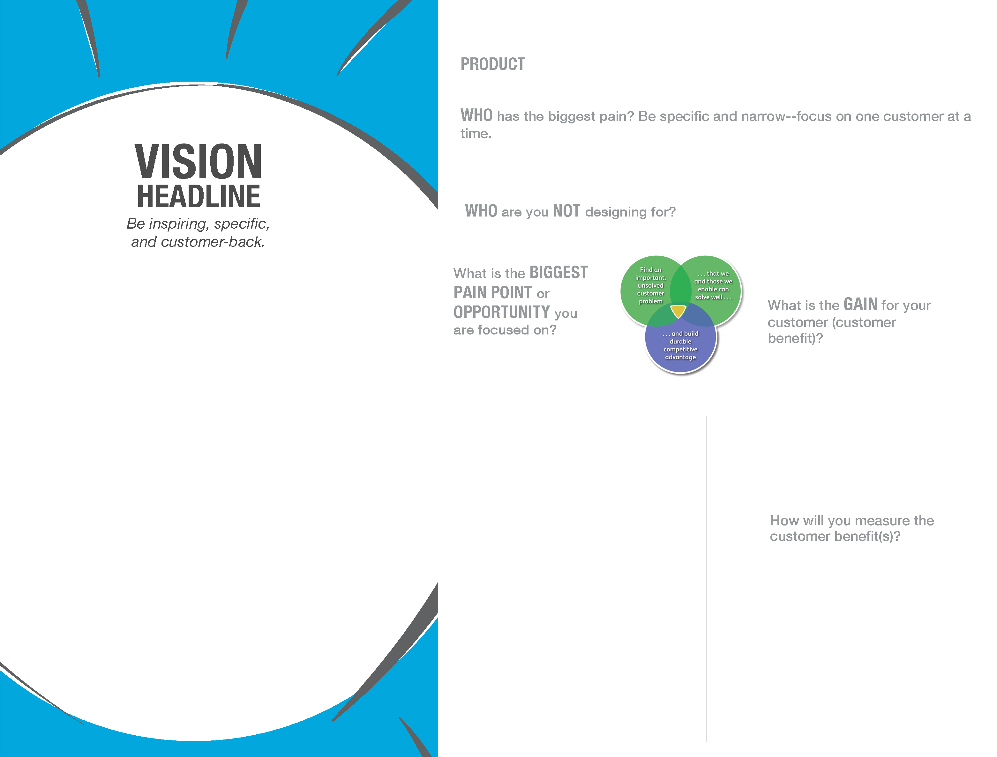
PRODUCT:
Who is your CUSTOMER? Be specific and narrow—for multiple target customers, focus on one per page.
Who are you NOT designing for?
The PAIN
The GAIN
Find an important, unsolved customer problem
…that we, and those we enable, can solve well…
What is the biggest PAIN POINT or OPPORTUNITY you are focused on?
What is the most important GAIN for your customer (customer benefit)?
Customer back vision
…and build durable competitive advantage
How will you MEASURE the amount of improvement in what matters most to the customer when choosing this product?

Slide 3
Experiment loop Complete experiment loop at least through target metric If you have more than one loop completed, download the full version: http://www.movestheneedle.com/product/lean-entrepreneur-experiment-map/

Slide 4
EXPERIMENT LOOP MAP
START
LEAP OF FAITH ASSUMPTION
For more detailed instructions, please visit www.ExperimentMap.com
Something accepted as true without evidence. The most critical assumption you are making about your idea at this time, for which you have the least amount of evidence.
Place a single sticky note in each box. Proceed down each LOOP column. Record your progress over time
HYPOTHESIS
A specific, measurable description of your hypothesis.
If we do X, then Y% of customers will behave in way Z
EXPERIMENT
Specify what you will build for the absolute minimum required to test your hypothesis, as fast as possible. Don’t just conﬁrm, learn. Include ways to capture surprises, as well as real behavior important to your idea.
BEHAVIOR
Describe how you will measure real customer behaviors associated with your hypothesis. Encourage “currency” exchange when possible. No surveys!
TARGET METRIC
Choose a number high enough to get you and your team excited if true, and relative to the experiment you are conducting.
MINIMUM REQ. FOR CTOF: COMPLETE THROUGH HERE Launch your experiment. Run your experiments as quickly and frugally as possible.
ACTUAL RESULTS
What actually happened? Record the actual metrics generated during your experiment, paying close attention to new behaviors and surprises.
WHY?
What did behaviors did you observe? Record the observable behavior, live feedback and reactions you witnessed ﬁrsthand, which inﬂuenced the actual results.
NEW INSIGHTS
Insights change the way we think about our customers or your idea. Record the new information you generated during this experiment, as well as unique observations made in the ﬁeld.
What new evidence did you generate?
DECISION
Take your next step - move forward. Look for a trend in your evidence over time. No single experiment holds all the answers. Iterate? Persevere? Pivot?
Is your decision based on the evidence you generated?
Copyright © 2014 Moves the Needle • All Rights Reserved

Slide 5
Submit your idea to the challenge
Brainstorm
TAGS
2015challenge_<yourlocation>
Ctoftrack1_services OR ctoftrack2_finacial_capability
<yourBUorFG>

