Slide 1
Virtual Switch-Openflow-OVS-Mininet
Guest Lecture – Pertamina University
Session 2
Ardimas Purwita
ardimas.andi@binus.ac.id
Notes:
1

Slide 2
Objectives
Understand about the context behind SDN: building blocks
Quick introduction to SDN

Slide 3
Virtual Switch: Linux Bridge
A Linux bridge behaves like a network switch.
It forwards packets between interfaces that are connected to it.
It's usually used for forwarding packets on routers, on gateways, or between VMs and network namespaces on a host.
It also supports STP, VLAN filter, and multicast snooping.
To sum up, other than L2-switch capability (i.e., L3-switch), we pretty much needs a third-party tool to add additional functionality to the Linux bridge
Ref: https://developers.redhat.com/blog/2018/10/22/introduction-to-linux-interfaces-for-virtual-networking#bridge

Slide 4
Important Commands
To create virtual bridge
# ip link add <virtual bridge name> type bridge
ip link add v-bridge type bridge
To attach a veth to virtual bridge
# ip link set <veth name> master <virtual bridge name>
ip link set veth-br master v-bridge

Slide 5
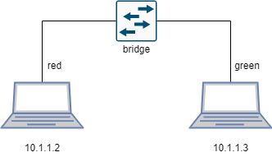
Examples of Linux Bridge acting as a normal L2 switch
#!/bin/sh
# create netns red and green
ip netns add red
ip netns add green
# create veth
ip link add veth-r type veth peer name veth-br-r
ip link add veth-g type veth peer name veth-br-g
# create v-bridge
ip link add v-bridge type bridge
# attach veth
ip link set veth-r netns red
ip link set veth-g netns green
ip link set veth-br-r master v-bridge
ip link set veth-br-g master v-bridge
# activate veth
ip netns exec red ip link set dev veth-r up
ip netns exec green ip link set dev veth-g up
ip link set dev veth-br-r up
ip link set dev veth-br-g up
ip link set dev v-bridge up
# assign ip address
ip netns exec red ip a add 10.1.1.2/24 dev veth-r
ip netns exec green ip a add 10.1.1.3/24 dev veth-g
# test
ip netns exec red ping 10.1.1.3 -c 3
Note that I don’t assign any IP to the bridge

Slide 6
Examples of Linux Bridge acting as a normal L2 switch
#!/bin/sh
# create netns red and green
ip netns add red
ip netns add green
# create veth
ip link add veth-r type veth peer name veth-br-r
ip link add veth-g type veth peer name veth-br-g
# create v-bridge
ip link add v-bridge type bridge
# attach veth
ip link set veth-r netns red
ip link set veth-g netns green
ip link set veth-br-r master v-bridge
ip link set veth-br-g master v-bridge
# activate veth
ip netns exec red ip link set dev veth-r up
ip netns exec green ip link set dev veth-g up
ip link set dev veth-br-r up
ip link set dev veth-br-g up
ip link set dev v-bridge up
# assign ip address
ip netns exec red ip a add 10.1.1.2/24 dev veth-r
ip netns exec green ip a add 10.1.1.3/24 dev veth-g
# test
ip netns exec red ping 10.1.1.3 -c 3
Note that I don’t assign any IP to the bridge

Slide 7
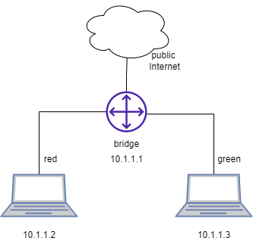
Examples of Linux Bridge acting as a normal L3 switch
#!/bin/sh
# create netns red and green
ip netns add red
ip netns add green
# create veth
ip link add veth-r type veth peer name veth-br-r
ip link add veth-g type veth peer name veth-br-g
# create v-bridge
ip link add v-bridge type bridge
# attach veth
ip link set veth-r netns red
ip link set veth-g netns green
ip link set veth-br-r master v-bridge
ip link set veth-br-g master v-bridge
# activate veth
ip netns exec red ip link set dev veth-r up
ip netns exec green ip link set dev veth-g up
ip link set dev veth-br-r up
ip link set dev veth-br-g up
ip link set dev v-bridge up
# assign ip address
ip netns exec red ip a add 10.1.1.2/24 dev veth-r
ip netns exec green ip a add 10.1.1.3/24 dev veth-g
# test
ip netns exec red ping 10.1.1.3 -c 3
# enable ipv4 forwarding
sysctl -w net.ipv4.ip_forward=1
# assign ip address to the v-bridge
ip a add 10.1.1.1/24 dev v-bridge
# set routing table in the red and green
ip netns exec red ip route add default via 10.1.1.1
ip netns exec green ip route add default via 10.1.1.1
# set NAT
iptables -t nat -A POSTROUTING -s 10.1.1.0/24 -j MASQUERADE
# test
Ip netns exec red ping 1.1.1.1 –c 3
L2 switch → L3 switch
Note that we need a third-party tool to program (e.g., iptables) the virtual bridge

Slide 8
There is a way to not use a third-party tool, but to use a ‘language’ called Openflow
First things first, we need to familiarize ourselves with a device that can talk Openflow.
One of the devices is Open Vswitch

Slide 9
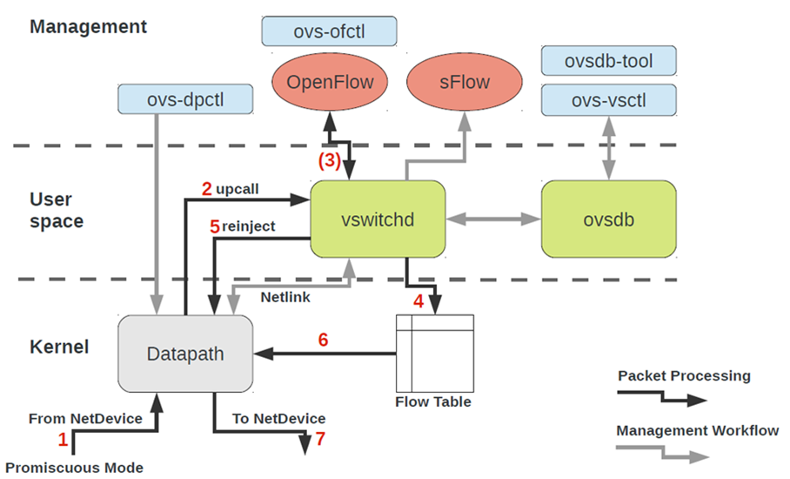
Open Vswitch
Open vSwitch is a production quality, multilayer virtual switch licensed under the open source Apache 2.0 license.
https://www.openvswitch.org/

Slide 10
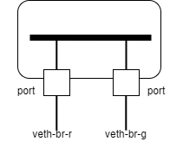
Let’s redo this, but using Open Vswitch
#!/bin/sh
# create netns red and green
ip netns add red
ip netns add green
# create veth
ip link add veth-r type veth peer name veth-br-r
ip link add veth-g type veth peer name veth-br-g
# create v-bridge
ip link add v-bridge type bridge
ovs-vsctl add-br v-bridge
# attach veth
ip link set veth-r netns red
ip link set veth-g netns green
ip link set veth-br-r master v-bridge
ip link set veth-br-g master v-bridge
ovs-vsctl add-port v-bridge veth-br-r
ovs-vsctl add-port v-bridge veth-br-g
# activate veth
ip netns exec red ip link set dev veth-r up
ip netns exec green ip link set dev veth-g up
ip link set dev veth-br-r up
ip link set dev veth-br-g up
ip link set dev v-bridge up
# assign ip address
ip netns exec red ip a add 10.1.1.2/24 dev veth-r
ip netns exec green ip a add 10.1.1.3/24 dev veth-g
# test
ip netns exec red ping 10.1.1.3 -c 3
This is now using OVS

Slide 11
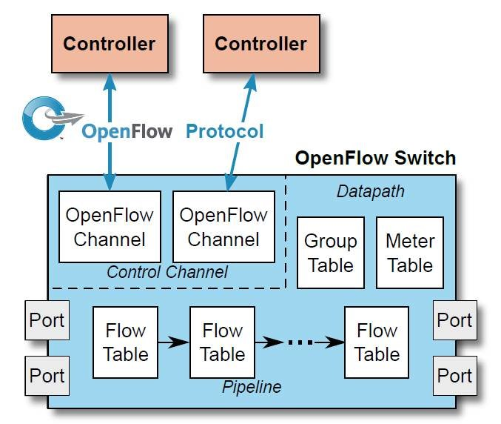
Openflow
Openflow is a standardized protocol to configure forwarding planes of network devices
https://opennetworking.org/sdn-resources/customer-case-studies/openflow/

Slide 12
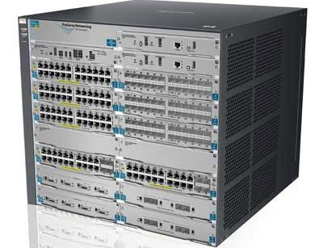
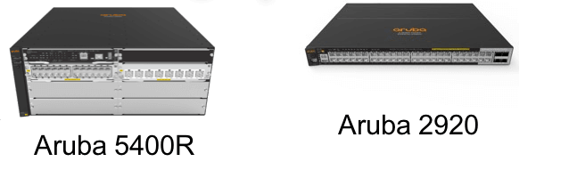
Other Examples
Controller
Openflow

Slide 13
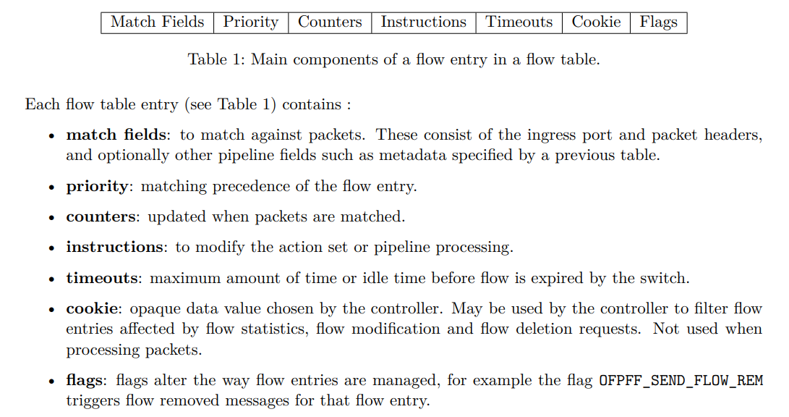
Openflow: How it works
Ref: https://opennetworking.org/wp-content/uploads/2014/10/openflow-switch-v1.5.1.pdf

Slide 14
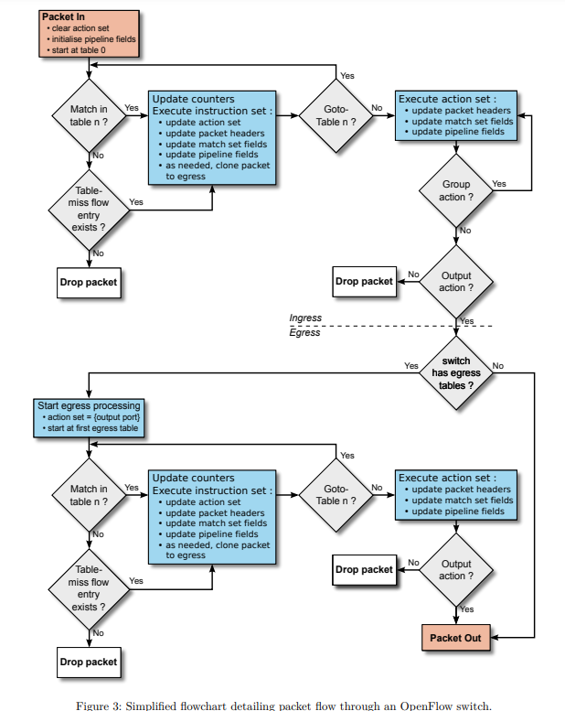
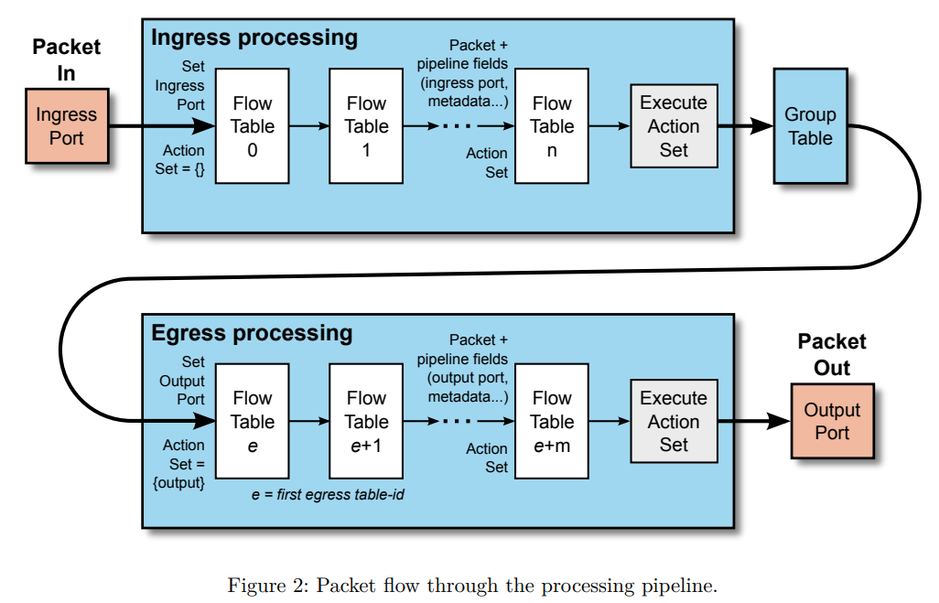
Openflow: How it works

Slide 15
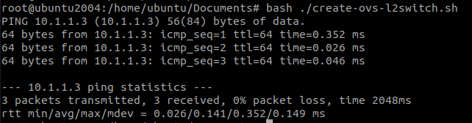
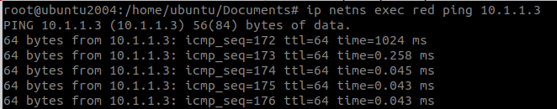
Let’s see it in action: Start from the trivial one
1. Run the setup
2. Dump the flow table
3. Delete the flow table
4. Set the flow table such that the OVS acts as a typical L2-switch

Slide 16
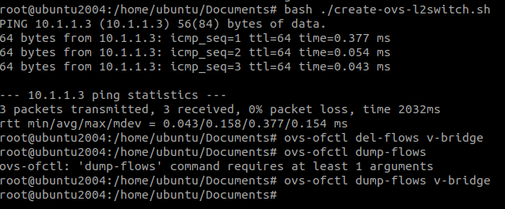
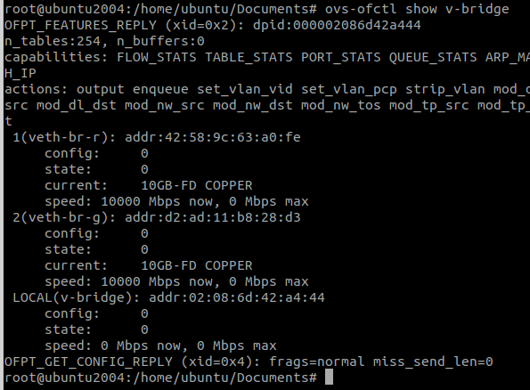
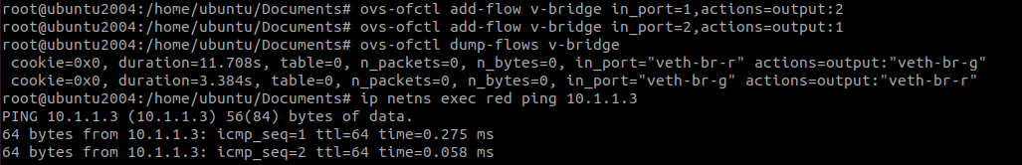
Manually using Openflow to enable L2-switch
1. Run the setup and delete the flow table
2. Check the port number
3. Add a flow entry

Slide 17
Are you not tired to create the setup manually?
Here comes mininet

Slide 18
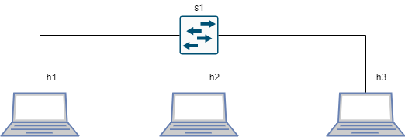
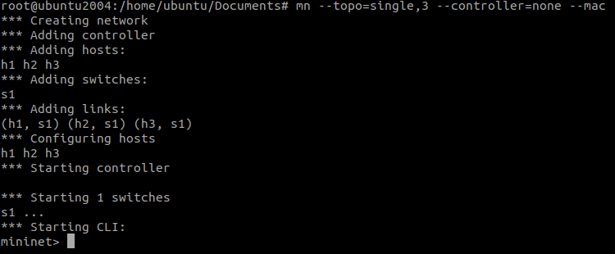
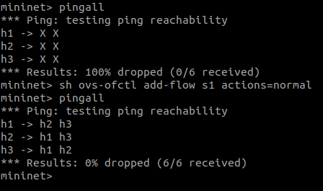
Mininet and OVS
Mininet creates a realistic virtual network, running real kernel, switch and application code, on a single machine (VM, cloud or native), in seconds, with a single command.
http://mininet.org/
1. A single command to establish the topology
2. Add a flow entry and check reachability

Slide 19
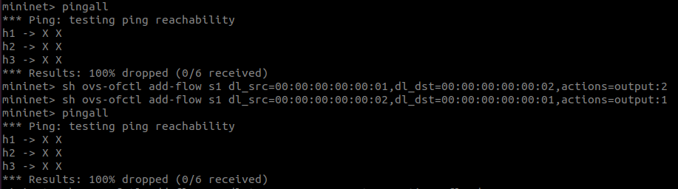
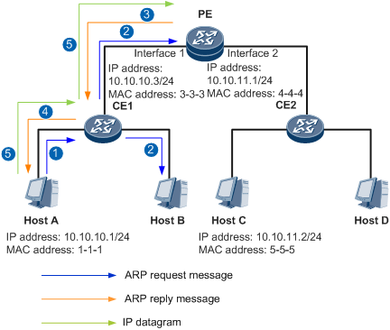
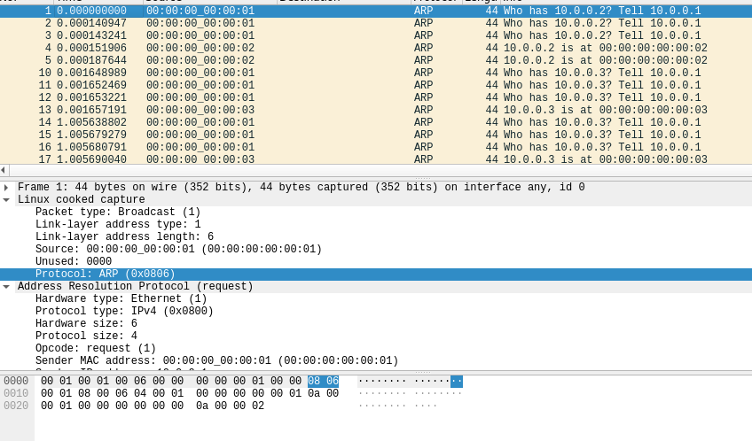
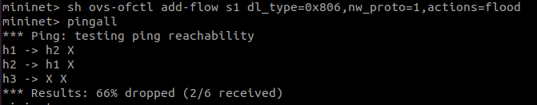
Openflow L2 matching
00:00:00:00:00:01
00:00:00:00:00:02
00:00:00:00:00:03
What’s wrong with this?

Slide 20
Are you not tired to type ovs-ofctl all the time and fancy bit of python?
Here comes Ryu (be patient, we’re getting to the SDN real soon)

Slide 21
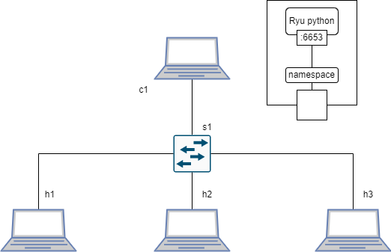
Ryu-OVS-mininet
from ryu.base import app_manager
from ryu.controller import ofp_event
from ryu.controller.handler import MAIN_DISPATCHER
from ryu.controller.handler import set_ev_cls
from ryu.ofproto import ofproto_v1_0
class L2Switch(app_manager.RyuApp):
OFP_VERSIONS = [ofproto_v1_0.OFP_VERSION]
def __init__(self, *args, **kwargs):
super(L2Switch, self).__init__(*args, **kwargs)
@set_ev_cls(ofp_event.EventOFPPacketIn, MAIN_DISPATCHER)
def packet_in_handler(self, ev):
msg = ev.msg
dp = msg.datapath
ofp = dp.ofproto
ofp_parser = dp.ofproto_parser
actions = [ofp_parser.OFPActionOutput(ofp.OFPP_FLOOD)]
data = None
if msg.buffer_id == ofp.OFP_NO_BUFFER:
data = msg.data
out = ofp_parser.OFPPacketOut(
datapath=dp, buffer_id=msg.buffer_id, in_port=msg.in_port,
actions=actions, data = data)
dp.send_msg(out)
Run your Ryu
ryu-manager ./l2-ryu.py
2. Run your mininet topology
mn --topo=single,3 --controller=remote --mac
Ref: https://ryu.readthedocs.io/en/latest/writing_ryu_app.html

Slide 22
Software Defined Networking

Slide 23
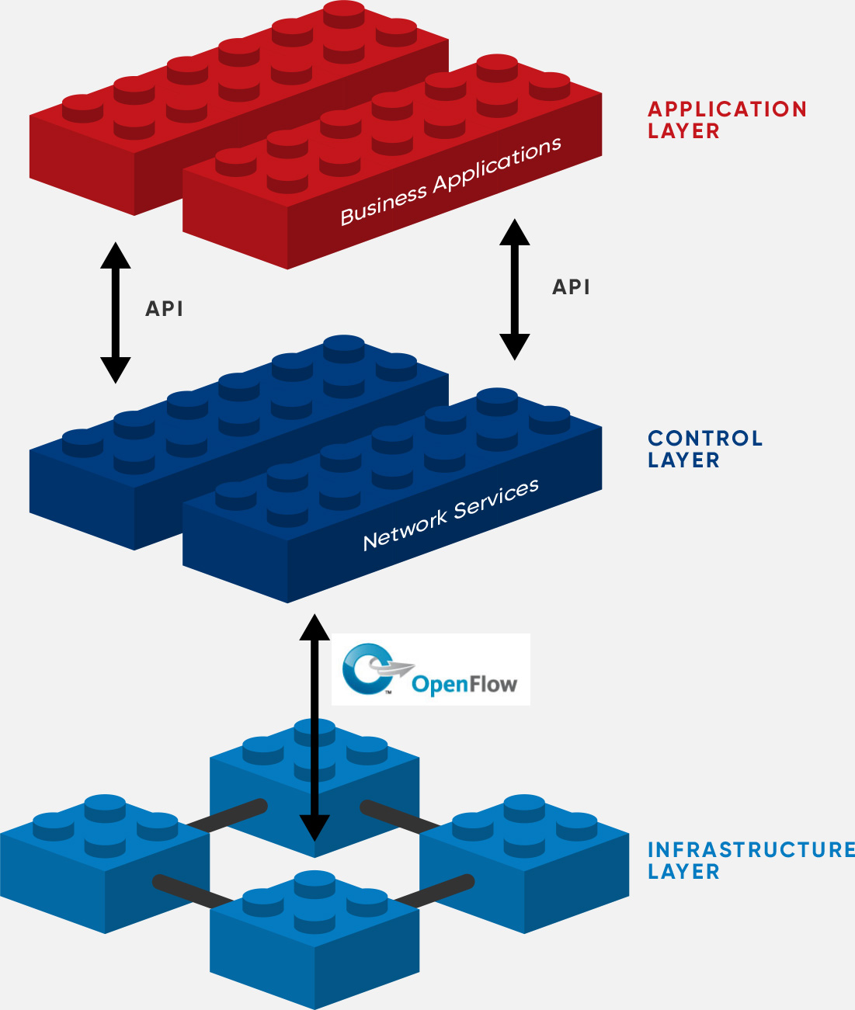
Definition
The physical separation of the network control plane from the forwarding plane, and where a control plane controls several devices.
Features:
Directly programmable
Network control is directly programmable because it is decoupled from forwarding functions.
Agile
Abstracting control from forwarding lets administrators dynamically adjust network-wide traffic flow to meet changing needs.
Centrally managed
Network intelligence is (logically) centralized in software-based SDN controllers that maintain a global view of the network, which appears to applications and policy engines as a single, logical switch.
Open standards-based and vendor-neutral
When implemented through open standards, SDN simplifies network design and operation because instructions are provided by SDN controllers instead of multiple, vendor-specific devices and protocols.
https://opennetworking.org/sdn-definition/

Slide 24
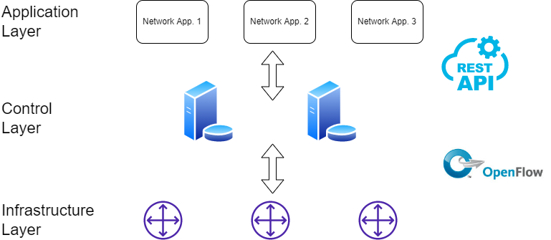
Realization

Slide 25
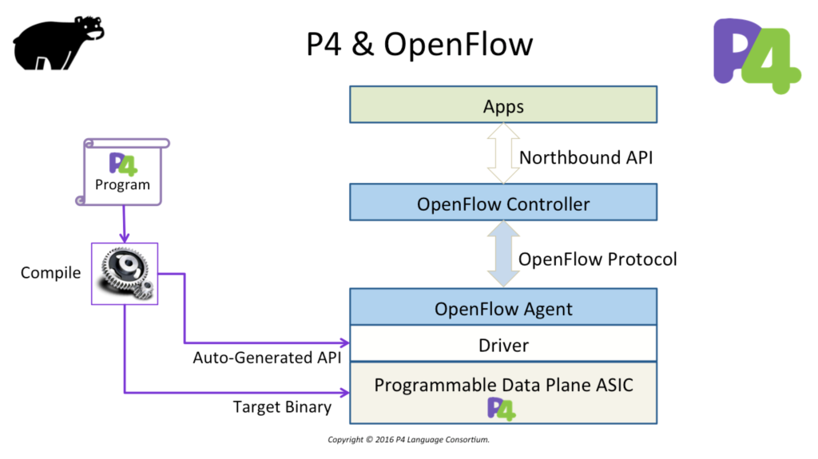
The Future

Slide 26
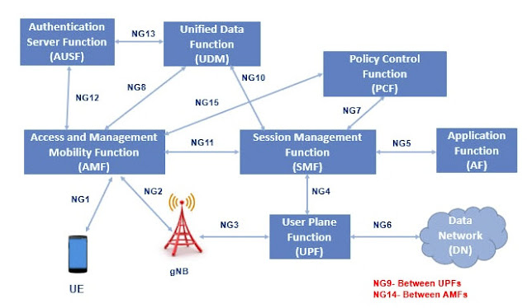
The Future

Slide 27
Conclusions
Key enablers:
virtualization technologies,
programmable network functions,
separation of concerns,
open interface and open standards.
SDN is cool!!

