Slide 1
Linux Network Namespace and Virtual Switch
Guest Lecture – Pertamina University
Session 1
Ardimas Purwita
ardimas.andi@binus.ac.id
Notes:
1

Slide 2
Goals
1st
Linux Network Namespace
Virtual Switch
2nd
Openflow
SDN

Slide 3
Objectives
Familiarize ourselves toward each other
Familiarize ourselves with the tech
Obtaining high level intuition for next week’s SDN topic

Slide 4
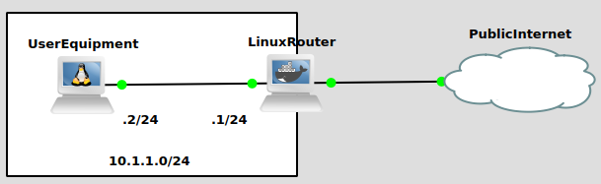
Preamble
Do you know that your old Linux laptop can be used as a router?
Now, what can a typical router do?
Forwarding
NAT

Slide 5
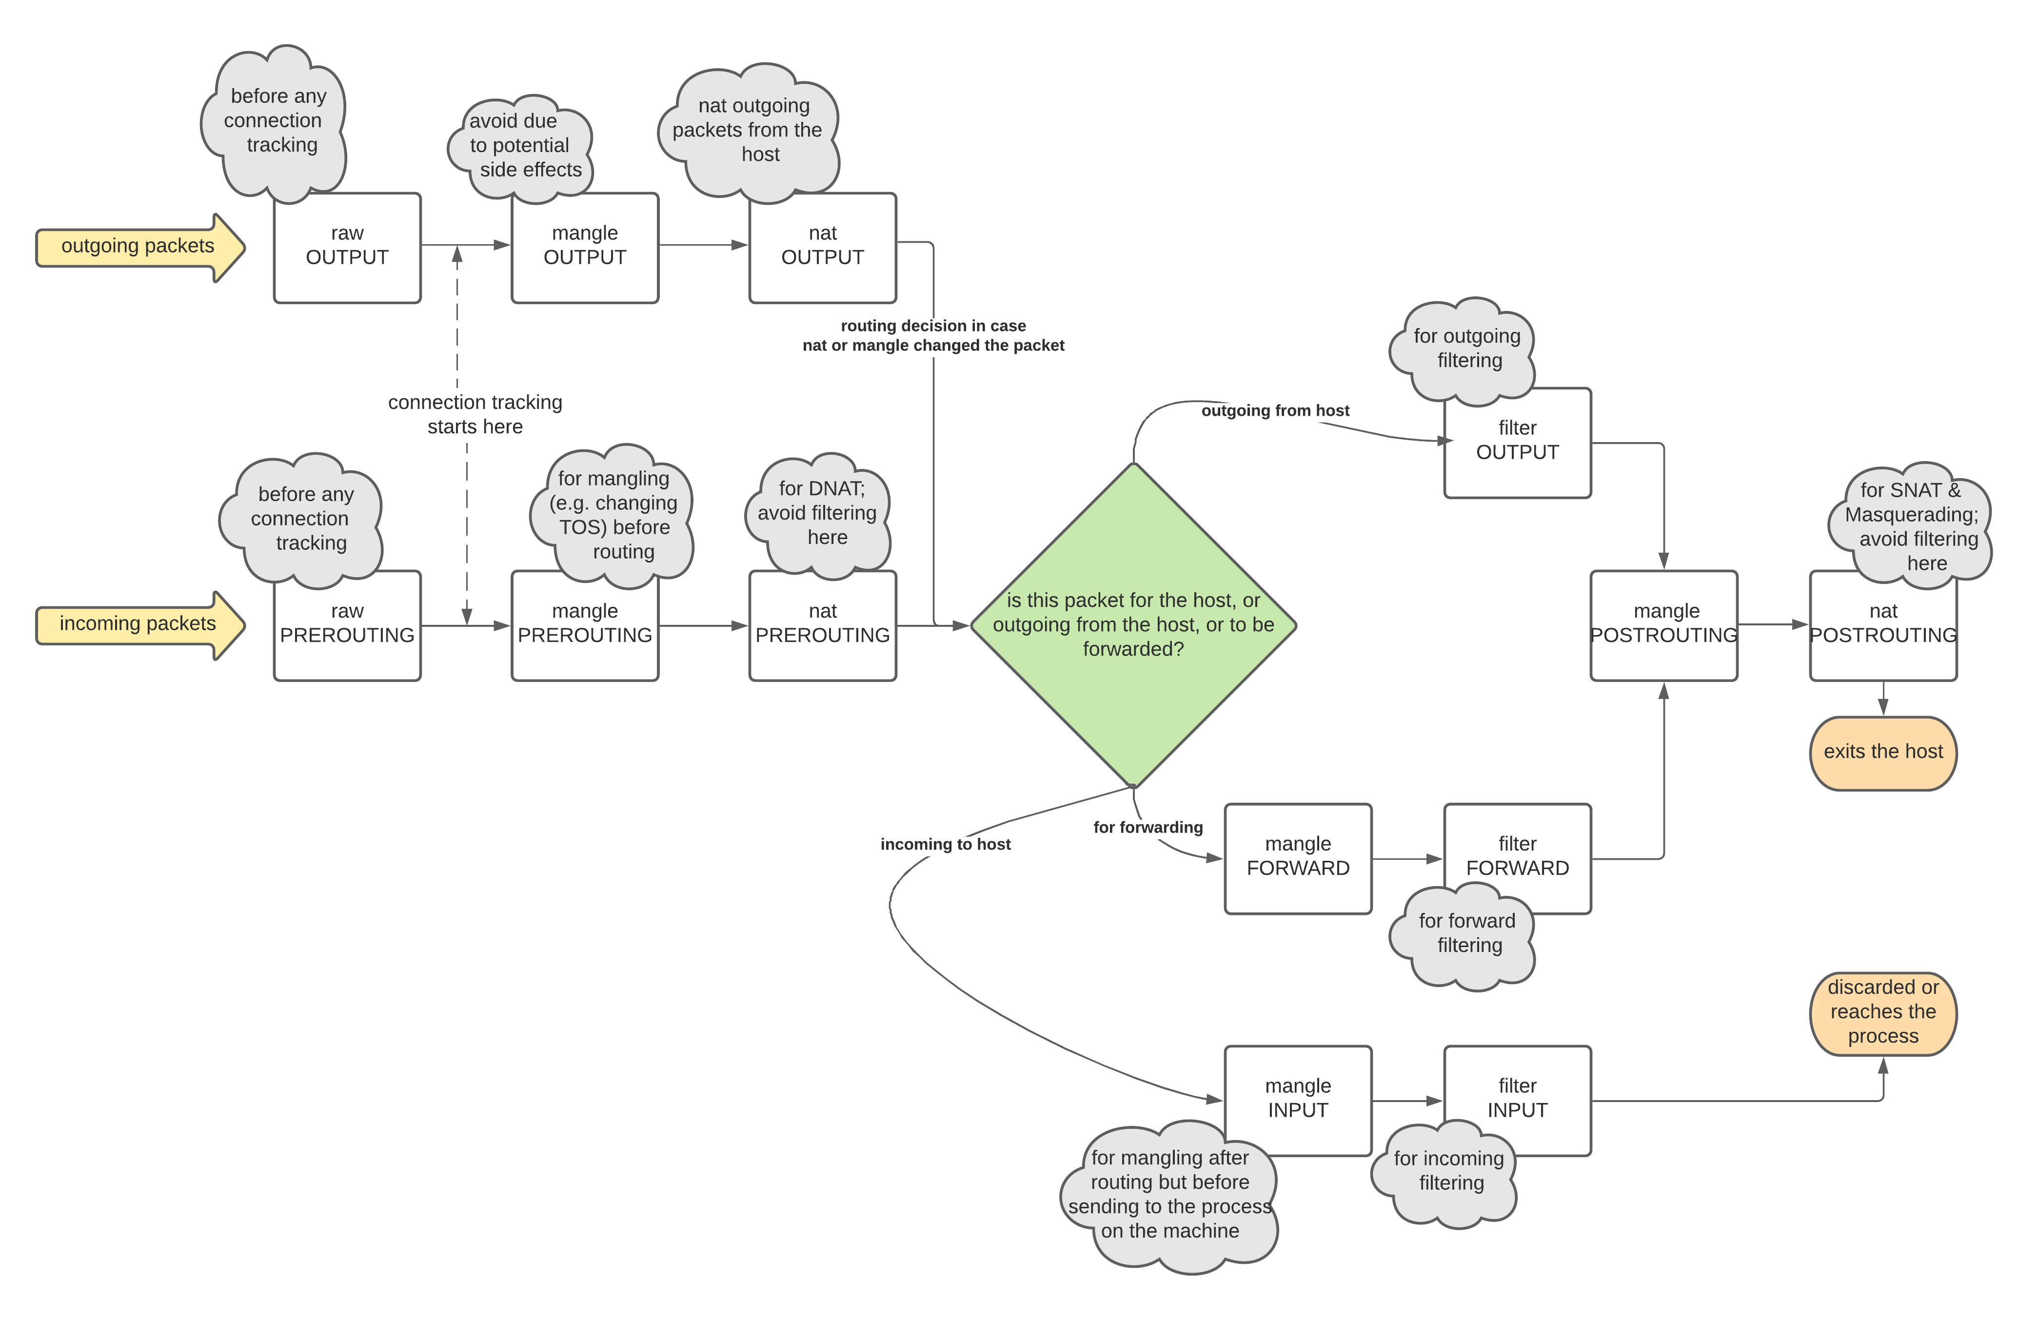
Commands
To check the forwarding capability of a Linux OS
sysctl –a | grep –i forward
Set SNAT
sudo iptables –t nat –A POSTROUTING –s 10.1.1.0/24 –j MASQUERADE
To listen to incoming traffic
tcpdump –i eth0
To block
sudo iptables –t filter –A FORWARD –d example.com –i eth0 –j DROP

Slide 6
Linux Network Namespace and Virtual Ethernet
Try answering the Linux netns and veth questions
See: https://github.com/ardimasp/gl-pu-compnet

Slide 7
Solution: A chain of three netns
# create namespace red
ip netns add red
# create veth
ip link add veth-r2g type veth peer name veth-g2r
# attach veth
ip link set veth-r2g netns red
# activate veth
ip netns exec red ip link set veth-r2g up
# assign ip address
ip netns exec red ip a add 192.168.1.2/24 dev veth-r2g
ip netns exec red ip route add 10.1.1.2/32 via 192.168.1.1
ip netns add green
ip link set veth-g2r netns green
ip netns exec green ip link set dev veth-g2r up
ip netns exec green ip a add 192.168.1.1/24 dev veth-g2r
ip link set veth-g2b netns green
ip netns exec green ip link set dev veth-g2b up
ip netns exec green ip a add 10.1.1.1/24 dev veth-g2b
ip netns add blue
ip link add veth-b2g type veth peer name veth-g2b
ip link set veth-b2g netns blue
ip netns exec blue ip link set dev veth-b2g up
ip netns exec blue ip a add 10.1.1.2/24 dev veth-b2g
ip netns exec blue ip route add 192.168.1.2/32 via 10.1.1.1

Slide 8
Virtual Switch
Try answering the virtual switch questions

Slide 9
Solution: v-bridge
#!/bin/sh
# create namespaces
ip netns add red
ip netns add green
ip netns add blue
# create veths
ip link add veth-red type veth peer name veth-red-br
ip link add veth-green type veth peer name veth-green-br
ip link add veth-blue type veth peer name veth-blue-br
# create a virtual bridge to simulate a switch
ip link add v-bridge type bridge
# attach the veths
ip link set veth-red netns red
ip link set veth-red-br master v-bridge
ip link set veth-green netns green
ip link set veth-green-br master v-bridge
ip link set veth-blue netns blue
ip link set veth-blue-br master v-bridge
# set ip addr inside namespace
ip netns exec red ip addr add 10.1.1.2/24 dev veth-red
ip netns exec green ip addr add 10.1.1.3/24 dev veth-green
ip netns exec blue ip addr add 10.1.1.4/24 dev veth-blue
# set ip addr for the v-bridge
ip addr add 10.1.1.1/24 dev v-bridge
# activate all interfaces
ip link set dev v-bridge up
ip link set dev veth-red-br up
ip link set dev veth-green-br up
ip link set dev veth-blue-br up
ip netns exec red ip link set dev veth-red up
ip netns exec green ip link set dev veth-green up
ip netns exec blue ip link set dev veth-blue up
# set ip route table
ip netns exec red ip route add default via 10.1.1.1 dev veth-red
ip netns exec green ip route add default via 10.1.1.1 dev veth-green
ip netns exec blue ip route add default via 10.1.1.1 dev veth-blue
# set nat
iptables -t nat -A POSTROUTING -s 10.1.1.0/24 -j MASQUERADE

