Slide 1


The University of Sydney, Australia / 11–14 July 2022

Slide 2
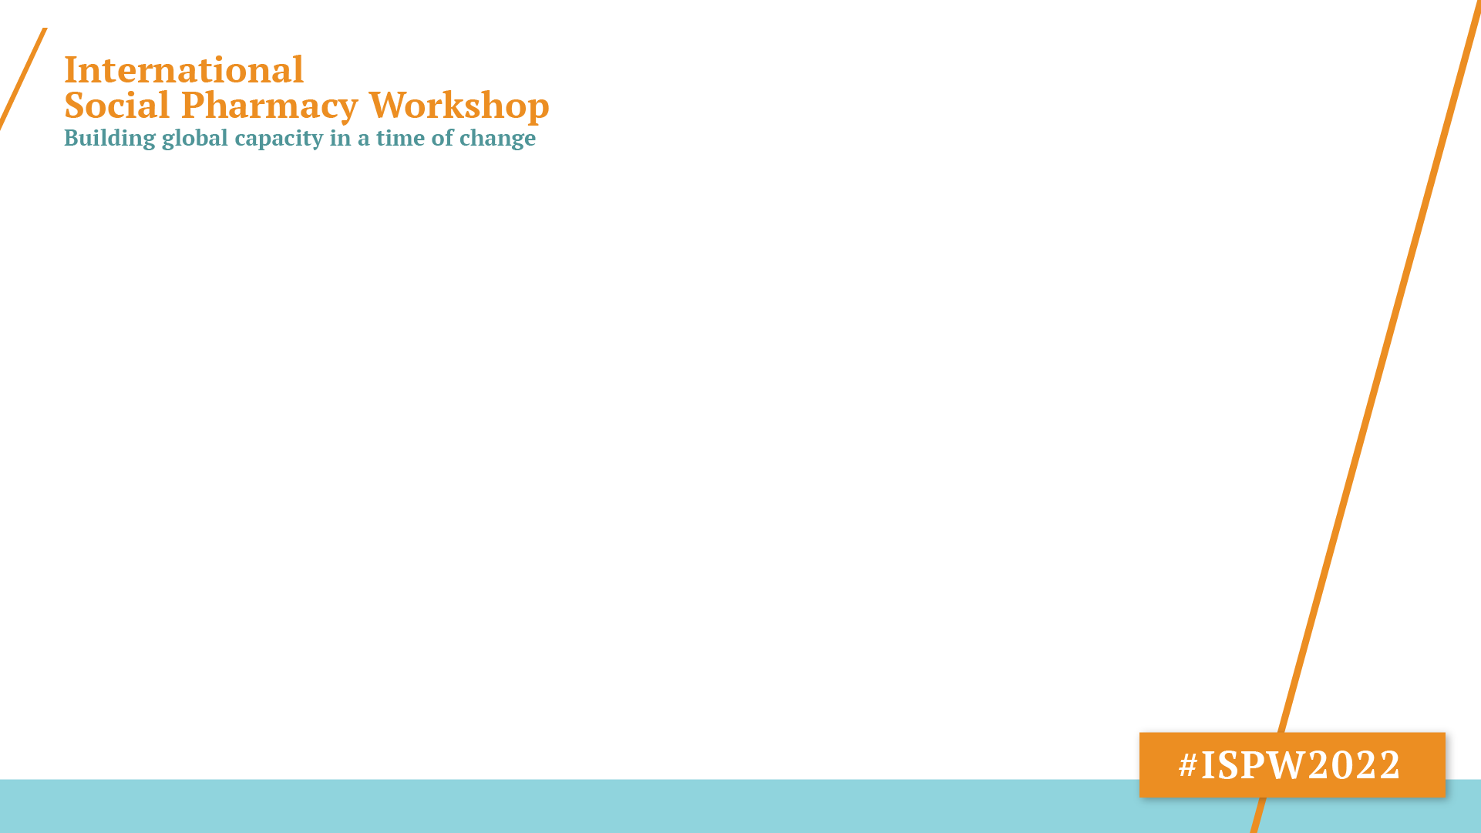
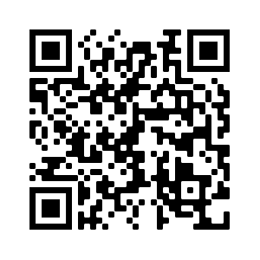
Using Agent-Based Models to Simulate Behavior: An introductory workshop Ardi Mirzaei, The University of Sydney Carl Schneider, The University of Sydney 5:30 PM, 12/07/2022, Room: N352-3

Slide 3










/ Sydney Hub sponsor
Thank you to our sponsors
/ Major sponsors
/ Student prize sponsor
/ Supporter

Slide 4
Workshop Link and Material: https://ardimirzaei.github.io/ispw2022-abm-workshop/
Using Agent-Based Models to Simulate Behaviour: An introductory workshop

