Slide 1

Palm / TI Developer Forum
Five Way Navigator
Alexandre Roux, Manager, Applications Software, Palm, Inc.

Slide 2
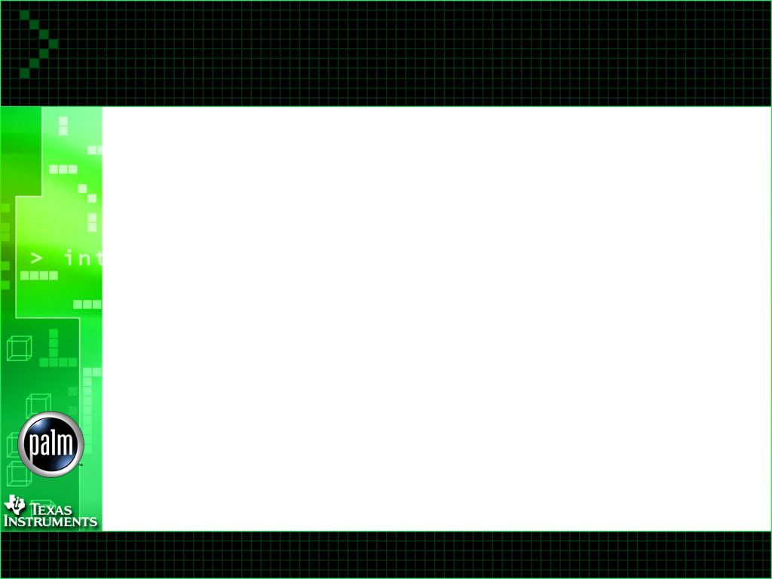
Five Way Navigator
Agenda
Discussion topics will include:
  What is Five Way Navigator
  Typical usage
  Low Level Implementation
  System Support
  Handling Five Way in your application

Slide 3
Five Way Navigator
What is it
New control for future Palm Devices
  4 directions
  Select button
It enables one-handed operation
  Lookup number and dial
  Check your calendar
  Retrieve a memo
  Playback a voice note
  …
SEL

Slide 4
Five Way Navigator
Typical usage - 1
Most Palm applications have been updated to support Five Way
Data retrieval is primary target
Data input is not supported
Applications can work with or without Five Way
Few generic system rules
‘Select’ handled on release

Slide 5
Five Way Navigator
Typical usage - 2
List View
  Up/Down scrolls page by page
  Select highlights insertion point
    Up/Down scrolls line by line
    Select open the records
    Left removes insertion point
Record View
  Up/Down scrolls within the record
  Left/Right navigates between records
  Select go back to the list view
Modal Dialog
  Select is mapped to OK/Done button

Slide 6
Five Way Navigator
Low-level implementation
Compatibility
  Up/Down generates the existing keyDown event for press and repeat
  For PalmOS 4 and 5
New keyDown event: vchrNavChange
  Generated on press/repeat/release for each button
  Generated on release for Up and Down
  keyCode field is 10-bit mask, including 5 state bits and 5 transition bits
  3 key bits (keyBitNavLeft, keyBitNavRight, keyBitNavSelect) for KeyCurrentState() and KeySetMask()
Feature Set to check the availability of Five Way

Slide 7
Five Way Navigator
System Support
Support in Menu and Popup List
Support in Modal Dialog
  For one button dialog
  For multiple button dialog
    Select = OK/Done
Long press on Select (1 s) go to the launcher
When off, Press on Select shows the clock
Default behaviors can be overridden
Everything else up to the application
Notes:
No support in Edit
See applications on Board for example

Slide 8
Five Way Navigator
Handling in your application - 1
Header File
#include “PalmChars.h”
Feature
UInt32 version;
Err err = FtrGet
(navFtrCreator, navFtrVersion, &version);

Slide 9
Five Way Navigator
Handling in your application - 2
Macro NavKeyPressed
  True on Press
    if (NavKeyPressed(eventP, Left))
    if (NavKeyPressed(eventP, Right))
    if (NavKeyPressed(eventP, Up)) (*)
    if (NavKeyPressed(eventP, Down)) (*)
      (*) Also work without Five Way
  True on Release
    if (NavKeyPressed(eventP, Select))
Notes:
Name might change

Slide 10
Five Way Navigator
Handling in your application - 3
Typical form event handler
Boolean MyFormHandleEvent(EventType* evtP)
{
if ((evtP->eType == keyDownEvent) &&
(EvtKeydownIsVirtual(evtP)))
{
    if (NavKeyPressed(evtP, Select))
      … // Handle Select here
      … // In modal dialog, return true
      … // to override system behavior
    if (NavKeyPressed(evtP, Left))
      // Handle Left here
    }
  }
Current Key status
  KeyCurrentState()

Slide 11
Five Way Navigator
Question and Answer

