Slide 1

Palm / TI Developer Forum
Marketing Benefits and Opportunities
Steve McGuigan, Manager, Business Development, Palm, Inc.
Caitlin Spaan, Director, Marketing Programs, Palm, Inc.

Slide 2

Agenda
Marketing Activities & developer Opportunities
How to Work with Palm
Q&A

Slide 3
Marketing Activities
Public Relations
Channel
Advertising
In-Box
E-marketing
Event Marketing
Promotion

Slide 4
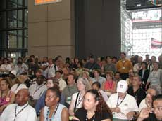
Public Relations
Activities
Worldwide Launch Event
Analyst / MediaTour
Press Release
CD demo of new ARM based Palm handheld capabilities including OMAP
Press Review Units / VIP Units
B-roll
Promotional Units (radio)

Slide 5
Public Relations –
Developer Opportunities
Application Due: Summer (late July / early Aug.)
  Inclusion of application in press/analyst briefings
  Inclusion of application description on demo CD
  Inclusion of application in reviewers’ guide
Application Due: Fall
  Inclusion of application at launch event
  Inclusion of application with promotional units
  Inclusion of application on B-roll

Slide 6
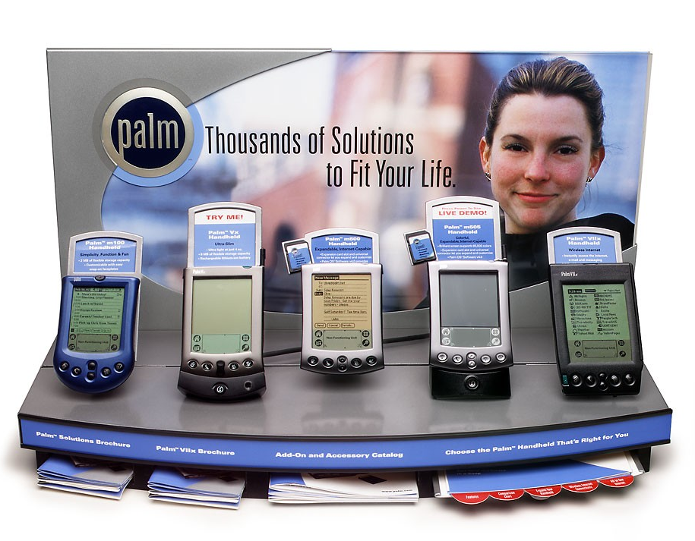
Channel
Activities
In-store merchandising
  Collateral printed materials
  On-device self-running demo
Consumer Channel Sales Training
  In person training
  Video / printed collateral
In-Store customer demonstrations (demo days)
RetailVision Industry Show
  Targets retail buyers from US and Canada

Slide 7
Channel –
Developer Opportunities
Application Due: Late Summer (Aug. / Sept.)
  Inclusion in on-device POP demo
    Charge: $5k
  Inclusion in printed in-store merchandising materials
  Inclusion in training materials (video, written materials)
Application Due: Fall
  Participation at RetailVision as part of Palm Partner Pavillion (event takes place in September)
    Charge: $12k
  In Store Demos by Palm in-person training team

Slide 8
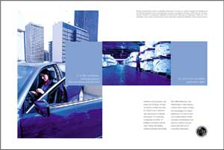
Advertising
Activities
Targeted Online new ARM based Palm handheld Ads
Co-op Print Campaign
Developer Opportunities
Application Due: Fall
  Application Highlighted in Co-op print campaign
    Charge: 10k and up

Slide 9
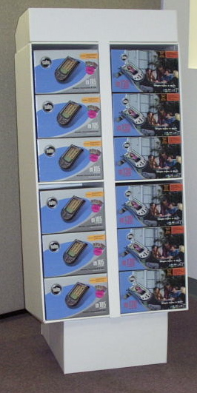
In-Box
Activities
Solutions Catalog / Affinity Guide
“Getting the Most out of new ARM based Palm handheld” CD
  Highlight 3rd party applications making the most out of OMAP.
    Distribute initially at point of purchase then transition to inbox

Slide 10
In-Box –
Developer Opportunities
Application Due: September
  Inclusion in “Getting the Most out of new ARM based Palm handheld” CD
    Charge: Revenue Share via Software Connection
  Inclusion in 3rd Parties section of Solutions Catalog
    Charge: 10k and up

Slide 11


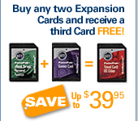
E-Marketing
Activities
Publicity on Palm.com
Targeted emails to user base
Co-op Direct Mail highlighting OMAP developers
Software Connection
Pop ups on Palm.com
Palm Store sales/bundles

Slide 12
E-Marketing –
Developer Opportunities
Application Due: Fall
  Inclusion of application in introductory emails at launch to Palm user base
  Targeted emails featuring application to new ARM based Palm handheld purchasers post launch
    Charge: $3-$6k
  Co-op Direct Mail highlighting OMAP developers
    Charge: $6-$9k

Slide 13
E-Marketing –
Developer Opportunities (cont.)
Application Due: Fall
  Inclusion on Software Connection, supported by
    Pop ups on Palm.com
    Inclusion of application as part of special Software Connection Showcase(s)
    Charge: 30% Revenue Share via Software Connection (downloadable applications)
  Palm Store distribution/sales of CD and SD/MMC based applications
    Supported by bundles, special promotions etc.

Slide 14
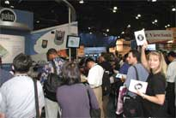
Event Marketing
Activities
Theatre Presentation at Comdex
Large Booth at Comdex
Developer Opportunities
Application Due: November
  Opportunity to participate in Palm Partner Pavilion at Comdex
    Charge: $10k
  OMAP Developer Showcase
    Charge $5k-10k

Slide 15
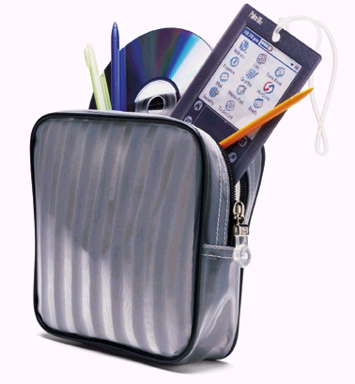
Promotion
Activities
Palm Holiday promo – special offer with purchase of Palm product(s) during holiday
Developer Opportunities
Application Due: Fall
  Provide a special offer as part of Holiday Coupon Book distributed to customers redeeming Palm promotion
    Charge: Fund special offer

Slide 16
How do you participate?
PluggedIn Program membership level:
  Business
  Marketing
  Member
Strategic importance of application
Solution time-to-market
Funding
Communicate!!!

Slide 17
Marketing Benefits and Opportunities
Question and Answer

