Slide 1

Palm / TI Developer Forum
OMAP Developer Network Overview
Dana Myers, OMAP Developer Network Manager, TI
Notes:
This is a joint presentation by Palm and TI. Both presenters should be on wireless mics.

Slide 2

Agenda
Intro to TI Wireless
OMAP Platform
OMAP Developer Network

Slide 3

TI Fuels the Wireless Revolution
10 years wireless semiconductor
expertise
Wireless Building Blocks:
complete hardware, software
software solutions plus tools and
reference designs for turn key or
custom products
Delivers processors for all wireless standards including world’s largest-- GSM
Wireless leaders already agree – TI wireless solutions are the best choice for 2.5 and 3G
Notes:
TI Fuels the Wireless Revolution
Before diving into the benefits behind our OMAP platform, I would like to spend several minutes discussing TI’s long-standing position in the wireless space and our perspective of this exciting wireless market evolution to real time applications and services.
For more than ten years, TI has played a major role in the wireless industry’s growth in second-generation digital devices.
Today, more than 58% of today’s wireless handsets are fueled by TI’s DSP-based processors. Along the way, we dramatically improved sound quality, greatly increased battery life and made the devices much smaller and easier to use. These improvements fueled the industry’s huge growth, and more than 700 million people subscribe to wireless service today.
TI ‘s expertise has extended well beyond wireless processors to provide complete wireless solutions and reference designs for fast product development, allowing manufacturers to develop cost effective products and quickly get them to market.
TI solutions have enjoyed success in all of the worlds leading wireless standards, including the world’s largest standard -- GSM
Combining this proven expertise with new, leading edge products that we will discuss today have already positioned TI as the de facto standard solution for 2.5 and 3G

Slide 4
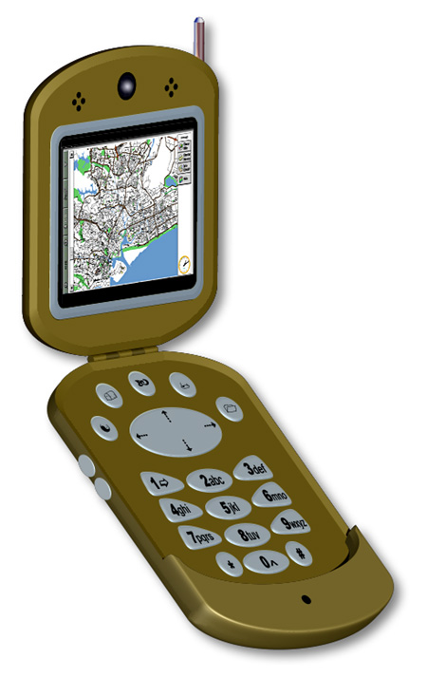
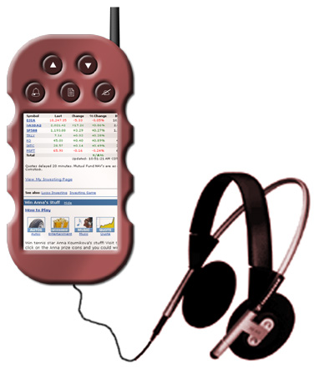
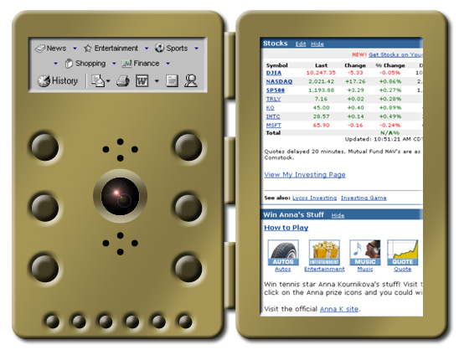
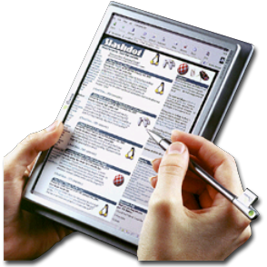
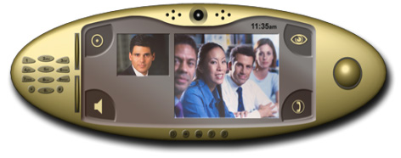
TI Supports the Wide World of
Mobile Devices and Market Segments
Device Manufacturers and Application Developers Require Flexible, Scalable Architecture to Support Diversified Market
Notes:
Walk through the agenda. Invite them to ask questions and let them know that our discussion will interactive. At this time, we can also ask new publications about their awareness of wireless market information, TI, etc. before we get started.

Slide 5













TI’s OMAP Platform is More than Hardware
Processors
Software
Support
Applications Processor
Integrated Baseband and Applications Processor
OMAPTM Developer Network
Development Tools
Operating Systems
Independent
OMAPTM Technology
Centers
TI Support
DSP Specialist

Slide 6


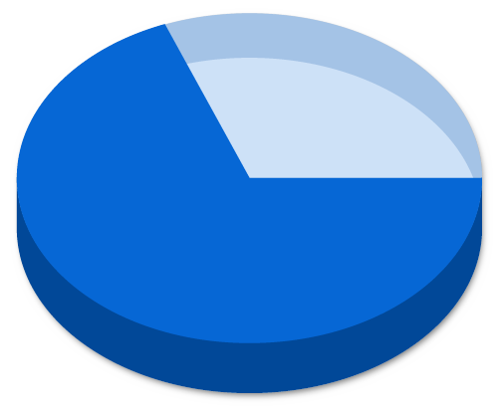








TI OMAP Platform Market
Providing Developers the Broadest Access to the Wireless Market
Wireless Market
Share of
Today’s OMAP
Supporters
Quanta
ASUS Tech
Chi Mei Comm.
Yet to be announced…
Source: TI

Slide 7
TI OMAP Developer Network
What is TI’s OMAP Developer Network?
A one-stop resource center for differentiated mobile applications, middleware and services.
What are the benefits of TI’s OMAP Developer Network?
The world’s leading application developers and service providers
Applications OMAP optimized for best consumer experience – delivering unparalleled performance and battery life
The ability to effortlessly integrate optimized multimedia middleware -- OMAP Media Engines -- for enhanced application development by high level software programmers.
Notes:
KEY MESSAGE: The OMAP Developer Network delivers a one-stop resource center for obtaining optimized mobile applications, middleware, codecs and support services.
Script
So exactly what does TI’s OMAP Developer Network provide to differentiate your product offering? Simply, the OMAP Developer Network provides [CUSTOMER] with a one-stop resource center for obtaining optimized mobile applications, middleware, codecs and support services.
For [CUSTOMER], the OMAP Developer Network offers a range of software and support including:
Leading edge applications optimized specifically for the OMAP family of processors. These applications range from multimedia, interactive gaming, and location-based services, to speech technology, productivity and mobile security.
A library of optimized DSP and ARM codecs for the OMAP1510, 710 and 310. These codecs include industry standards (such as MP3, AAC, MPEG4 encode/decode, H.263, speech recognition) as well as market leading codecs (Windows Media, Real Audio & Video and key crypto security libraries).
Comprehensive technical support for system and software integration though a system of Independent OMAP Technology Centers (OTCs). Located worldwide, OTCs offer contract services for OS support and integration, developer support, reference designs, and more.
Finally, the Developer Network collaborates with [CUSTOMER] to provide a software solution that best fits the targeted market requirements

Slide 8

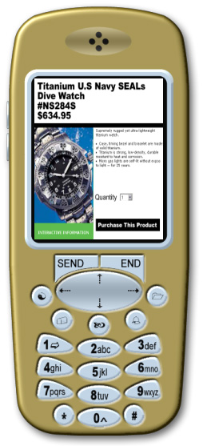
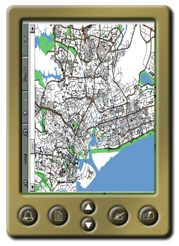
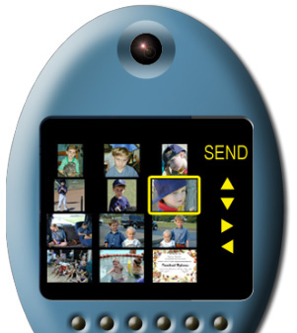
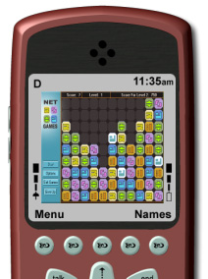
Real-Time Communications Bring New Services
Internet Audio
Video Conferencing
Location-Based
Services
Multimedia
Messaging
M-Commerce
Games
Notes:
Delivered in real-time, the new generation of applications will combine to bring new dimensions to a person’s wireless Internet experience
Next generation wireless applications will require real-time communications processing, a core competency of TI
Review examples. Begin with what will be available first, then what is further out.

Slide 9
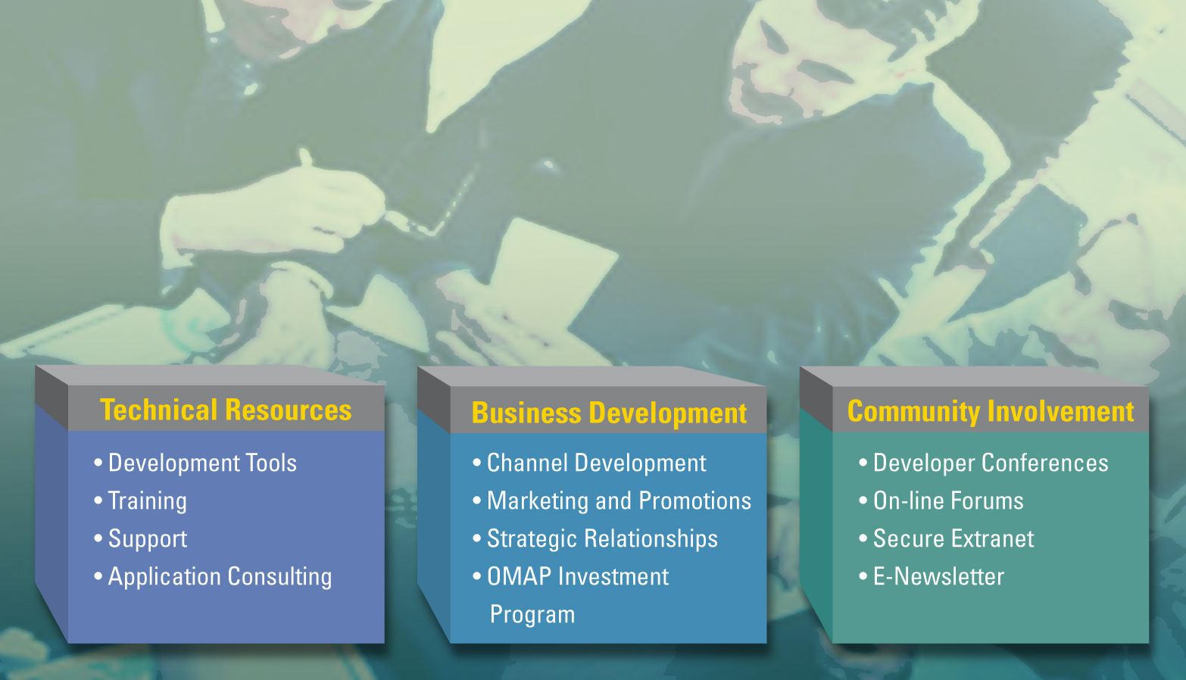
TI Provides Building Blocks for Wireless Development
Notes:
Succeed with TI’s OMAP Developer Services
Application developer’s benefit from a suite of OMAP developer services that spark differentiation, innovation and fast return-on-investment. TI seeks to offer unparalleled technical support, including a host of easy-to-use, world-class tools, as well as business development services to link developers to the pioneers in wireless development.
OMAP Developers Network Services give developers what’s required to succeed:
OMAP Technical Support
· Platform and tool support
· Training/software development assistance
· Application planning/consulting
OMAP Business Development
· Channel development
· Marketing/promotion
· Strategic partnerships
· OMAP Investments
· DSP-enhanced applications and hardware
A [Attached is a two page document that details each of the above programs]

Slide 10
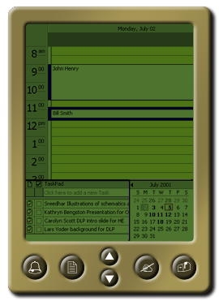
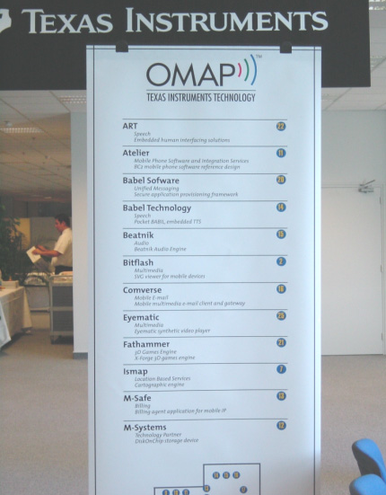


OMAP Developer Forums
TI’s OMAP Developer Forums are collaboration events between OMAP application developers, device manufacturers and carriers to accelerate 2.5 and 3G wireless services.

Slide 11

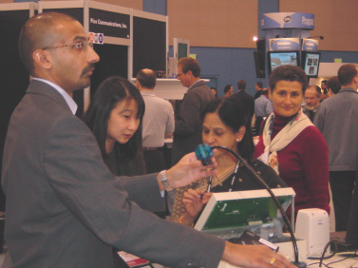

OMAP Developer Forums
TI’s OMAP Developer Events, including leading wireless trade conferences, provide developers with exposure to key wireless carriers, device manufacturers, media and analysts.
PalmSource 2002
San Jose, CA
3GSM 2002
Cannes, France

Slide 12
TI & You
Power A Wireless World That Delivers …
Richer Applications,
Richer Services,
Richer Possibilities
Notes:
Conclusion
[Alain, you will introduce the next two speakers who will provide detailed hardware and software specifics on the OMAP architecture. They are … ]

Slide 13
OMAP Developer Network Program Overview
Question and Answer

