Slide 1

Palm / TI Developer Forum
PluggedIn Program
Peter Castanon, Manager, Developer Relations, Palm, Inc.
Notes:
This is a joint presentation by Palm and TI. Both presenters should be on wireless mics.

Slide 2

Mission Statement
The PluggedIn Program is the complete developer resource for Palm™ strategic solutions
The PluggedIn Program provides hardware, software and SD/MultiMediaCard developers with a complete set of programs and services
Assists with the rapid development of hardware add-ons and peripherals for Palm handhelds
Notes:
What is the PluggedIn Program? Targeted towards 3rd party expansion developers, the PluggedIn Program provides a complete set of resources for the development of Palm handheld specific solutions. From Software Development Kits (SDKs) to Hardware Development Kits (HDKs) and all kinds of marketing and promotion benefits, the PluggedIn Program provides the resources you need to bring your solution to market and improve your chances for success in the Palm Economy.

Slide 3
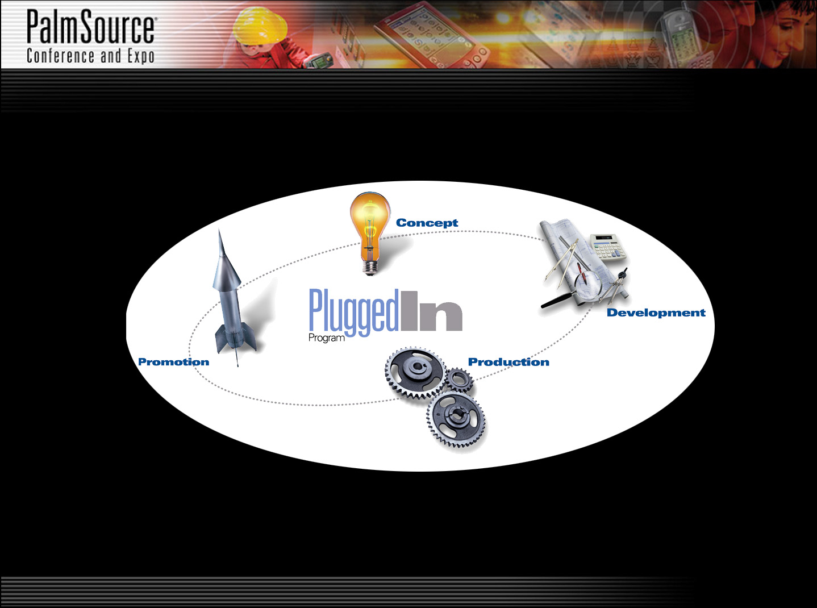
Overview
New Technology Information
Software and Hardware Development Kits
CAD Files and Mechanical Drawings
White Papers and FAQs
Solutions Guide
Palm Store
In-Sync Online
Co-Marketing Opportunities
Channel
Introductions
Packaging
Assistance
Tradeshows
and Events
Go to Market
Partners
Designed for Palm Handhelds*
Expansion Parts Store
Early Seed Units*
Current
Product
Information
Unannounced
Product
Information
Reference
Designs
Technical Support
Tooling Services
Compatibility Testing
Manufacturing and ServicePartners
Republishing and ROM/Flashing Services
Pre-negotiated Component and Service Pricing

Slide 4
Program Facts
Introduced and established November 2000
Originally created as a service to 3rd party expansion developers
New and improved web site launched November 2001
Approximately 1000 developers and growing!

Slide 5
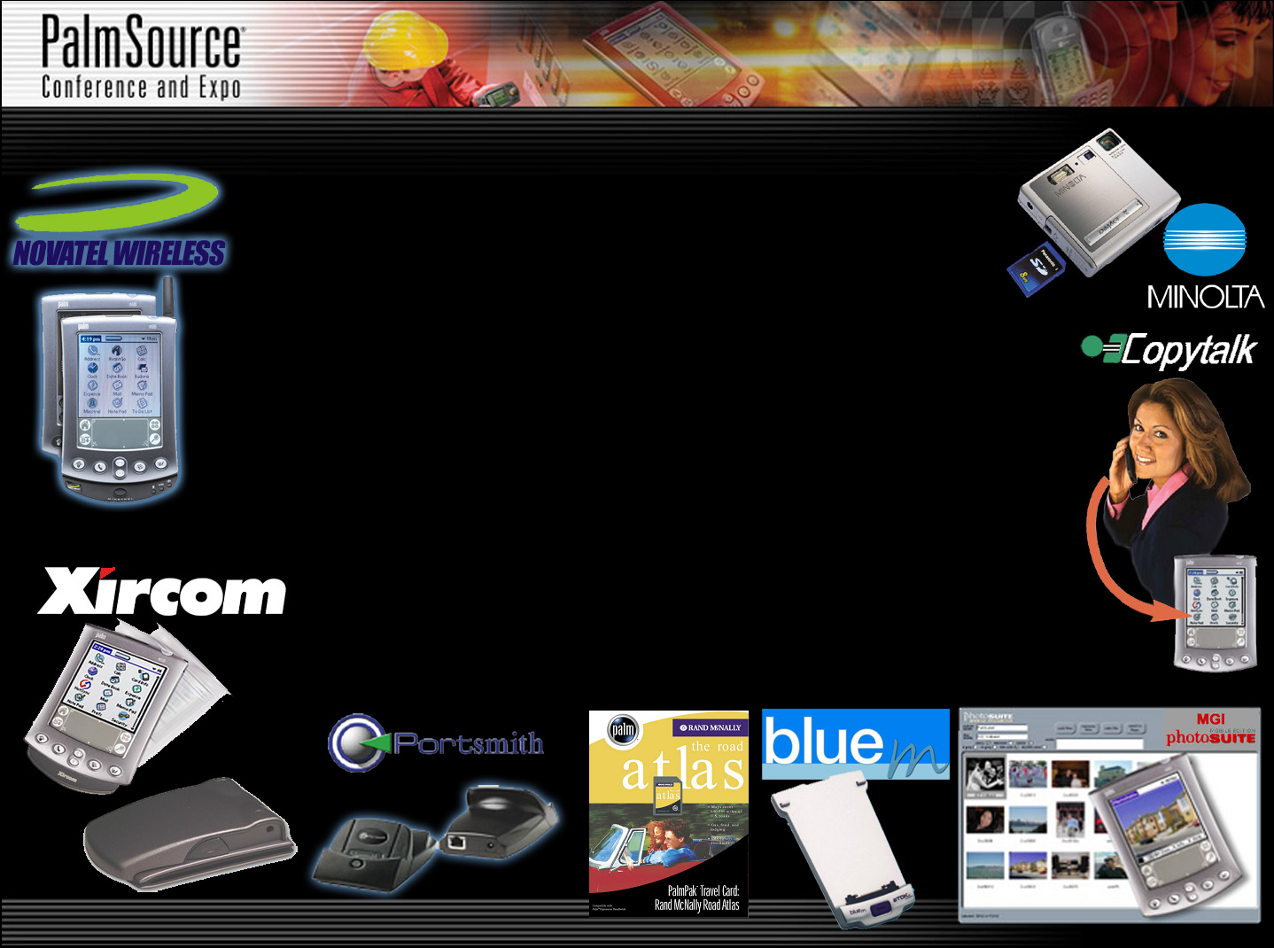
Program Facts (cont.)
Over 100 new 3rd party developed solutions
delivered in 2001 including:
  - Wireless solutions - Cases
  - Imaging - Cables
  - Content cards - Styli
  - InBox software - and many others

Slide 6
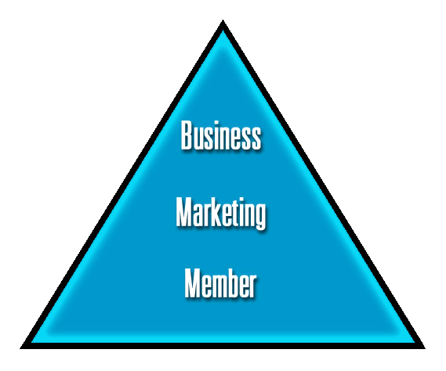
3 Program Levels

Slide 7
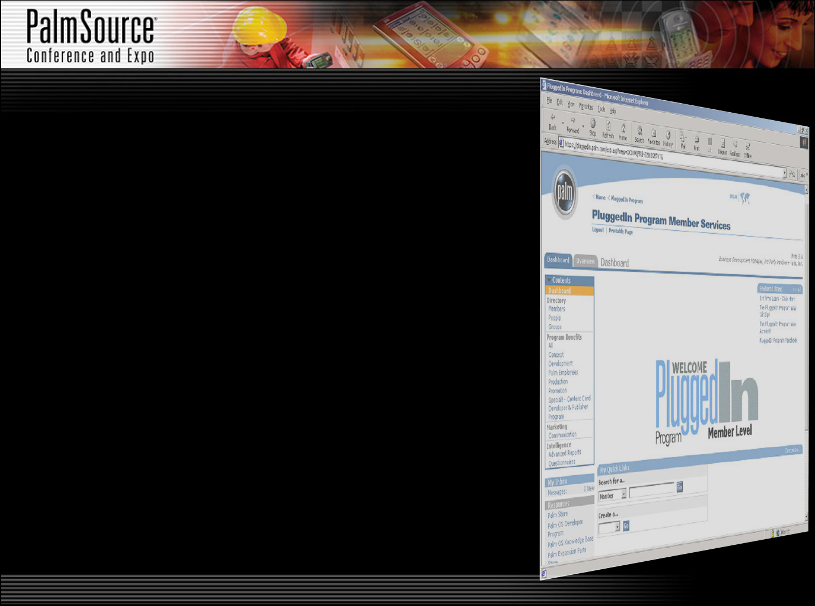
New and Improved Web Site
Launched November 2001
More information
Targeted information
Easier to navigate
Self-administered
Notes:
The new and improved PluggedIn Program web site was launched this past November.
Based on a Partner Relationship Management (PRM) system, it is easier for the PluggedIn Program to post information. As soon as information is made available, it is put onto the web site in a matter of hours. Not the days or weeks that it would take if the web site were simply HTML pages.
The PRM system allows the PluggedIn Program to target specific information to specific developers based on their membership level and profile. In the future, developers will be able to subscribe to information they think they need most.
The new web site is broken down into the four (4) phases of the development life-cycle: Concept, Development, Production and Promotion. Resources in each of these phases are organized into folders containing documents, links, and possibly other folders.
The new web site even has the ability to allow you to give the PluggedIn Program immediate feedback on a particular resource. If you see something you like or think that we could do better, simply click on the “rating system” and we will get your comments.
The “self-administration” feature allows you to update all of your company information and preferences online. You even have the ability to add additional contacts. If you would like any particular contact to have access to the PluggedIn Program, simply send an email to the PluggedIn Program Coordinator.

Slide 8

Program Service Providers
Notes:
Solid Concepts, Inc. is the manufacturer of the most widely used CAD viewer in the world – SolidView. PluggedIn Program developers receive an exclusive discount on any purchase of SolidView.
Hitachi is one of the leaders in the SecureMMC arena. Hitachi is actively looking for developers and applications for SecureMMC.
Berkley Industries LLC is a custom thermoformer that specializes in packaging for both the medical and consumer industries. We enhance our thermoforming capabilities with our in-house tooling and design expertise and contract packaging services. Warehouse/ Distribution and value-added services complete the total turnkey solution we offer to meet all our customer’s packaging needs. We are ISO 9001 Registered and Y2K compliant.
Berkley Industries LLC
14450 Industry Circle
La Mirada, CA 90638-5811
Telephone: (714) 522-5400
Fax: (714) 522-5544
http://www.berkleyindustries.com

Slide 9
How to Join
Step 1
Apply for the PluggedIn Program at:
www.palm.com/pluggedin
Step 2
Send in the completed paperwork
Step 3
Once approved, take advantage of the PluggedIn Program web site and its many resources
Step 4
Develop a Palm solution
Step 5
Keep us informed!
Notes:
Apply for the PluggedIn Program – Make sure that you fill out the application completely and mail in the appropriate paperwork
Once approved, log onto the PluggedIn Program web site and take advantage of its many resources
Develop a Palm specific software solution
Let us know what you are up to by sending the PluggedIn Program an email and join the rest of the developers in the thriving Palm Economy!

Slide 10

Peter Castanon
Palm SG, Group Manager, Expansion Programs

Slide 11
Overview
Palm handheld compatibility testing and promotional program
Designed for Palm Handhelds logo for packaging and promotional items
Available to qualified program members that develop Palm handheld specific solutions

Slide 12

Benefits
Expanded access to Palm technical, marketing and distribution resources including:
  Automatic upgrade to the PluggedIn Program “Marketing” level
  Package templates, guidelines and tools
  much, much more …
DFPH benefits may not be applicable for some solutions.

Slide 13

Requirements
Must contact and submit product samples to the PluggedIn Program
Must successfully pass independently administered hardware and/or software compatibility test
Also available to non-electrical and non-software solution developers on a case-by-case basis
Notes:
To obtain the Designed for Palm Handhelds logo, you must do several things. First, you must contact Palm and submit product samples of your solution. Second, you must submit your solution and successfully pass without exception an independently administered Palm compatibility test. The test costs a minimum of approximately $3500 USD.
More information about the compatibility test can be found at the Quality Partners web site located at: http://www.???.com.

Slide 14

Resources
For more information and to apply for the PluggedIn Program
  URL: http://www.palm.com/pluggedin
  Email: PluggedIn@palm.com
  Phone: +1 (408) 878-9955
Palm OS
  URL: http://www.palmos.com

Slide 15


Resources (cont.)
SD Association
  http://www.sdcard.org
MultiMediaCard Association
  http://www.mmca.org
Compatibility testing for Designed for Palm Handhelds performed by Quality Partners
  http://www.qpqa.com
  (925) 984-1426

Slide 16
PluggedIn Program
Question and Answer

