Slide 1
New Jersey Sales Territory Analysis
MIAMI VUE · NORTHEAST REGION
A walkthrough of the SQL queries, the results and what to focus on next quarter
In-store sales, January 2022 to December 2025
Notes:
About 30 seconds. Introduce yourself and the territory: New Jersey, managed by Miami Vue, in the Northeast region. Say that the next ten minutes cover the data, five queries with their results, and recommendations for next quarter.

Slide 2
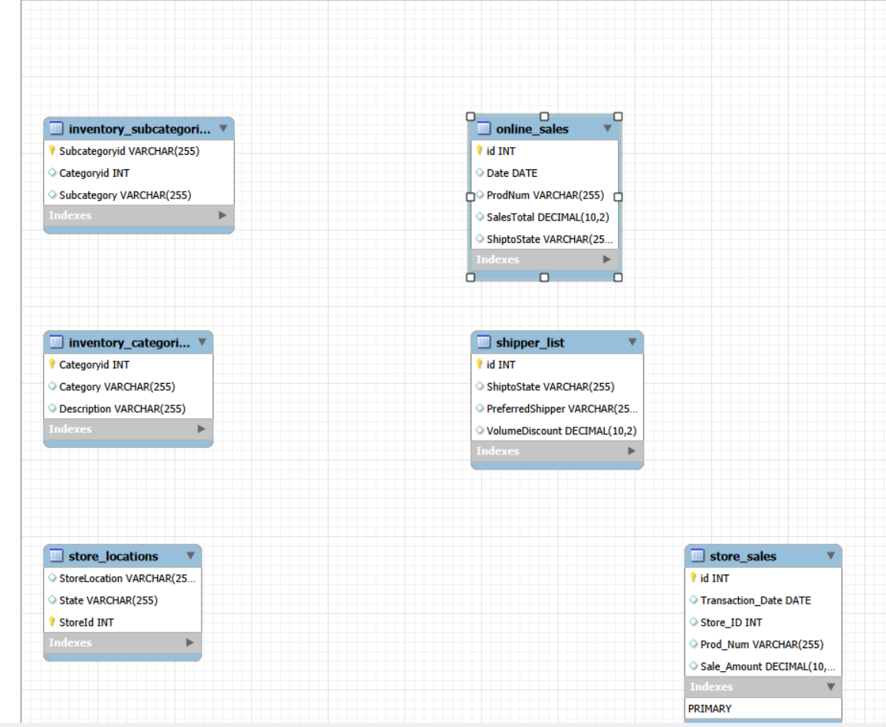
Territory, data and approach
THE PROJECT
Territory
New Jersey, in the Northeast region, managed by Miami Vue. 16 stores.
Data
Four years of in-store sales (2022 to 2025) joined to stores, products, categories and regions.
Approach
Five SQL questions in MySQL Workbench, charted in Excel and combined in a dashboard.
New Jersey Territory Sales Analysis · 2
Notes:
About 45 seconds. Show the model: sales sit in store_sales and connect to store_locations for the state, to products and categories for what was sold, and to management for the region and manager. Point out that online sales exist in the database, but every query here covers in-store sales only, which is the first limitation to mention.

Slide 3
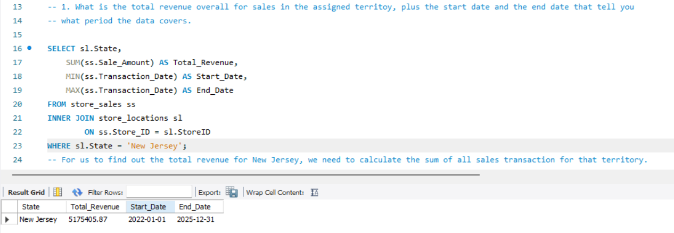
Total revenue and the period covered
QUERY 1 OF 5
$5,175,405.87
Total in-store revenue
4 years
2022-01-01 to 2025-12-31
Join store_sales to store_locations, filter to New Jersey, then use SUM for revenue and MIN and MAX for the first and last transaction dates.
New Jersey Territory Sales Analysis · 3
Notes:
About 45 seconds. Read the question: what is the total revenue for the assigned territory, and what period does the data cover? Explain the join and the filter, then land the answer: $5.18 million over four years, from January 2022 to December 2025. Say that every later query uses this same New Jersey filter.

Slide 4
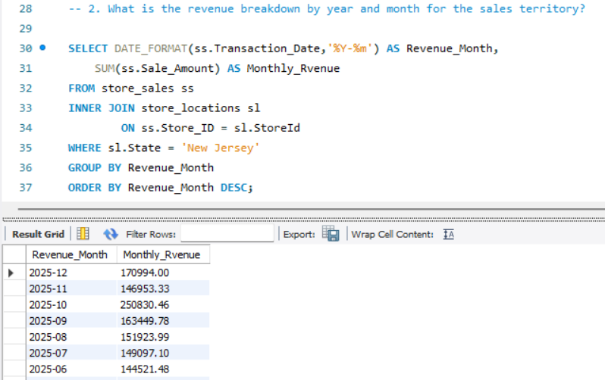
Revenue by year and month
QUERY 2 OF 5
+53.7%
2025 revenue versus 2024
+29%
December 2024 to January 2025, a sudden step up
$250.8K
October 2025 peak, about 60% above the months around it
New Jersey Territory Sales Analysis · 4
Notes:
About 60 seconds. The question: what is the revenue breakdown by year and month? DATE_FORMAT turns each transaction date into a year-month label, and GROUP BY adds up each month. Results: monthly revenue grew from about $70K in early 2022 to $171K in December 2025. 2024 was flat against 2023, then January 2025 jumped 29% in one month, and 2025 ended 53.7% above 2024. October 2025 reached $250.8K, which is worth investigating before assuming it will repeat.

Slide 5
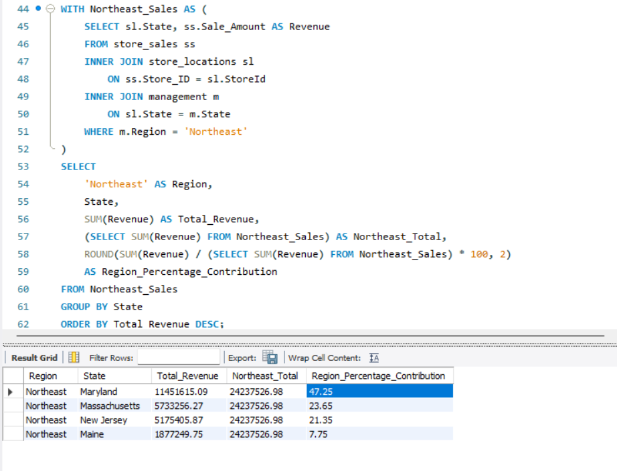
Share of Northeast revenue using a CTE
QUERY 3 OF 5
21.35%
New Jersey’s share of Northeast in-store revenue, third of four states
$558K
Gap to Massachusetts (23.65%) over four years, a realistic target
47.25%
Maryland leads with $11.45M, so it is a benchmark rather than a target
New Jersey Territory Sales Analysis · 5
Notes:
About 60 seconds. The question: how does New Jersey compare with the rest of its region? A common table expression, the WITH block, first collects every Northeast sale by state through the management table. The main query then divides each state's revenue by the regional total of $24.2 million. New Jersey earns 21.35 percent, third behind Maryland and Massachusetts. Catching Massachusetts means closing about $558K over four years, roughly $140K a year.

Slide 6
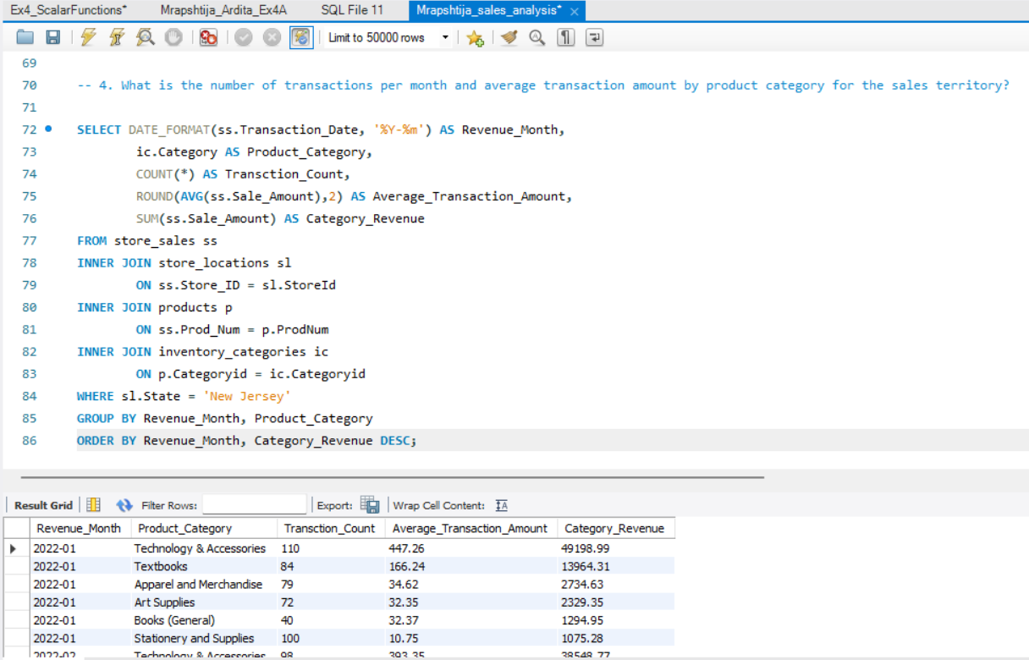
Transactions and average sale by category
QUERY 4 OF 5
70%
Technology & Accessories share of revenue ($3.63M)
$447
Average technology sale in January 2022, versus $11 to $166 elsewhere
88%
Technology plus Textbooks, a concentration risk
New Jersey Territory Sales Analysis · 6
Notes:
About 60 seconds. The question: how many transactions happen each month, and what is the average sale, by product category? This query joins four tables: sales, store locations, products and categories. In the January 2022 rows on screen, technology has 110 transactions averaging $447, while stationery has 100 transactions averaging under $11. Over the full period technology brings in 70 percent of revenue and textbooks 18, so two categories carry 88 percent. That is both the strength and the risk of the territory.

Slide 7
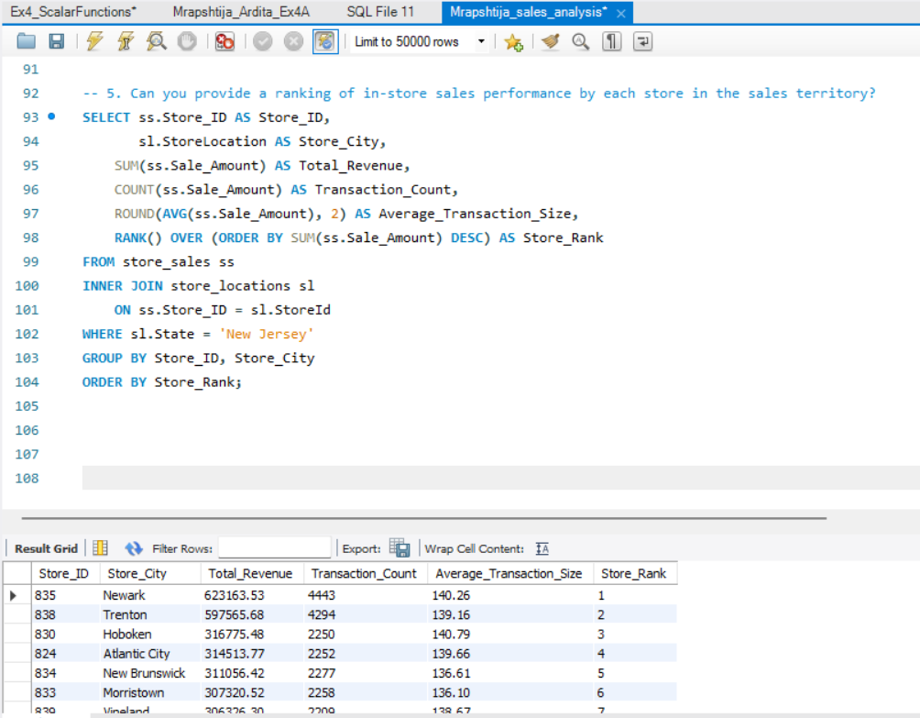
Ranking in-store performance by store
QUERY 5 OF 5
24%
Share of territory revenue from Newark ($623K) and Trenton ($598K)
$135
Typical average sale at every store, so volume drives the gaps
$67K
Paterson, last of 16 stores, with only 427 transactions
New Jersey Territory Sales Analysis · 7
Notes:
About 60 seconds. The question: how do the stores in the territory rank? The RANK window function orders the stores by total revenue. Newark and Trenton earn about twice as much as any other store and together make up 24 percent of revenue. Stores three through fifteen sit in a narrow band of roughly $262K to $317K, and their average sale is nearly the same everywhere, around $135, so the differences come from how many transactions each store makes. Paterson is the outlier at $67K from only 427 transactions, and the data does not say why.

Slide 8
What the five queries show
SUMMARY
GROWTH
STORES
PRODUCTS
REGION
+53.7%
24%
70%
3rd of 4
2025 revenue versus 2024
of revenue from just Newark and Trenton
from Technology & Accessories
Northeast states, $558K behind Massachusetts
Revenue is growing, but it leans on a few stores and one product category.
Notes:
About 60 seconds. Pull the five queries into one message. Growth is strong at 53.7 percent, but it is concentrated: two stores bring in 24 percent of revenue, one category brings in 70 percent, and New Jersey sits third in its region. Everything in the recommendations that follow comes from one of these four numbers.

Slide 9
Where to focus next quarter
RECOMMENDATIONS
1. Protect Newark and Trenton
2. Grow transactions in the middle
3. Investigate Paterson first
They earn 24% of revenue. Keep inventory and staffing full, especially technology stock.
$67K from 427 transactions. Find out whether it opened late, closed or has missing data before investing.
Stores 3 to 15 earn $262K to $317K with similar sale sizes. Run local promotions and loyalty offers, and track transaction counts.
4. Lean on technology, add depth
5. Explain 2025’s jump and spike
6. Target Massachusetts
Revenue rose 29% in January 2025 and peaked in October. If the cause is repeatable, plan to repeat it.
Closing the $558K gap, roughly $140K a year, would put New Jersey level with Massachusetts.
Technology and Textbooks are 88% of revenue. Prioritize both and bundle small categories as add-ons.
New Jersey Territory Sales Analysis · 9
Notes:
About 2 minutes, the core of the talk. Take each in about 20 seconds. One: protect Newark and Trenton, because a problem there hurts the whole territory. Two: the middle stores have nearly identical sale sizes, so the lever is more transactions, through local promotions and a loyalty offer. Three: Paterson is far below the rest, so find out why before spending money. Four: technology and textbooks carry 88 percent of revenue, so protect them and use small categories as add-ons to raise basket size. Five: January 2025 and October 2025 broke the pattern, so identify the cause. Six: Massachusetts is a realistic benchmark, about $140K a year.

Slide 10
Goals and limits to keep in mind
NEXT QUARTER
Goals
Limits
Beat the Q1 2025 baseline of $418K in revenue
Raise transaction counts at Hoboken, Atlantic City and New Brunswick
Explain Paterson’s results by the end of the quarter
Find the cause of the January and October 2025 changes
In-store sales only, online sales are not included
Two pairs of monthly totals match to the cent, so check the source data
No clear seasonal pattern yet, so confirm before planning around one
New Jersey Territory Sales Analysis · 10
Notes:
About 45 seconds. Give three measurable goals for the quarter. The Q1 2025 baseline is $418K (January, February and March 2025 combined). Then be open about the limits: online sales are excluded, two pairs of monthly totals are identical to the cent (2023-01 and 2024-12, and 2023-08 and 2024-07) and should be checked against the source data, and the data shows no steady seasonal pattern, so do not assume a Q1 slump or boost.

Slide 11
Protect the anchors, grow the middle, investigate Paterson
IN SHORT
Questions?
Notes:
About 15 seconds. Close with the one-line takeaway and invite questions. If asked about online sales, say they are not included in these figures and would be the natural next analysis.

