Slide 1
New Jersey Territory Sales
SALES TERRITORY REVIEW
Answering the manager’s six questions, January 2022 to December 2025
REGION
MANAGER
SCOPE
Northeast
Miami Vue
In-store sales
Notes:
About 20 seconds. This is a review of the New Jersey sales territory in the Northeast region, managed by Miami Vue. The data covers January 2022 to December 2025 and is in-store sales only. I will answer the six questions my manager asked, in order, and finish with a recommendation.

Slide 2
The six questions from my manager
THE ASSIGNMENT
QUESTION 1
QUESTION 2
QUESTION 3
What is total revenue overall for sales in the assigned territory, plus the start date and end date that tell you what period the data covers?
What is the revenue breakdown by year and month for the sales territory?
Provide a comparison of total revenue for the specific sales territory and the region it belongs to.
QUESTION 4
QUESTION 5
QUESTION 6
What is the number of transactions per month and average transaction amount by product category for the sales territory?
Can you provide a ranking of in-store sales performance by each store in the sales territory, or a ranking of online sales performance by state within an online sales territory?
What is your recommendation for where to focus sales attention in the next quarter?
New Jersey Territory Sales · 2
Notes:
About 30 seconds. These are the six questions my manager asked. The first five describe the territory: how much it earns, how revenue moves over time, how it compares with the region, what sells, and which stores perform best. The sixth asks what to do about it. The rest of the talk follows these questions in order. For question five I answered the in-store option, ranking stores, because the data covers in-store sales only.

Slide 3
New Jersey earned $5.18M over four years
QUESTION 1 · TOTAL REVENUE AND PERIOD
TOTAL REVENUE
REVENUE BY YEAR
$5,175,405.87
2022
$0.88M
2023
$1.21M
PERIOD COVERED
2024
$1.22M
2022-01-01 to 2025-12-31
$1.87M
2025
2025 was the strongest year, up 53.7% on 2024.
New Jersey Territory Sales · 3
Notes:
About 30 seconds. Answer to question one: total revenue for the New Jersey territory is $5,175,405.87. The data starts on January 1, 2022 and ends on December 31, 2025, so it covers four full years. By year: about $0.88 million in 2022, $1.21 million in 2023, $1.22 million in 2024 and $1.87 million in 2025. 2025 is the strongest year by a wide margin. All figures are in-store sales.

Slide 4
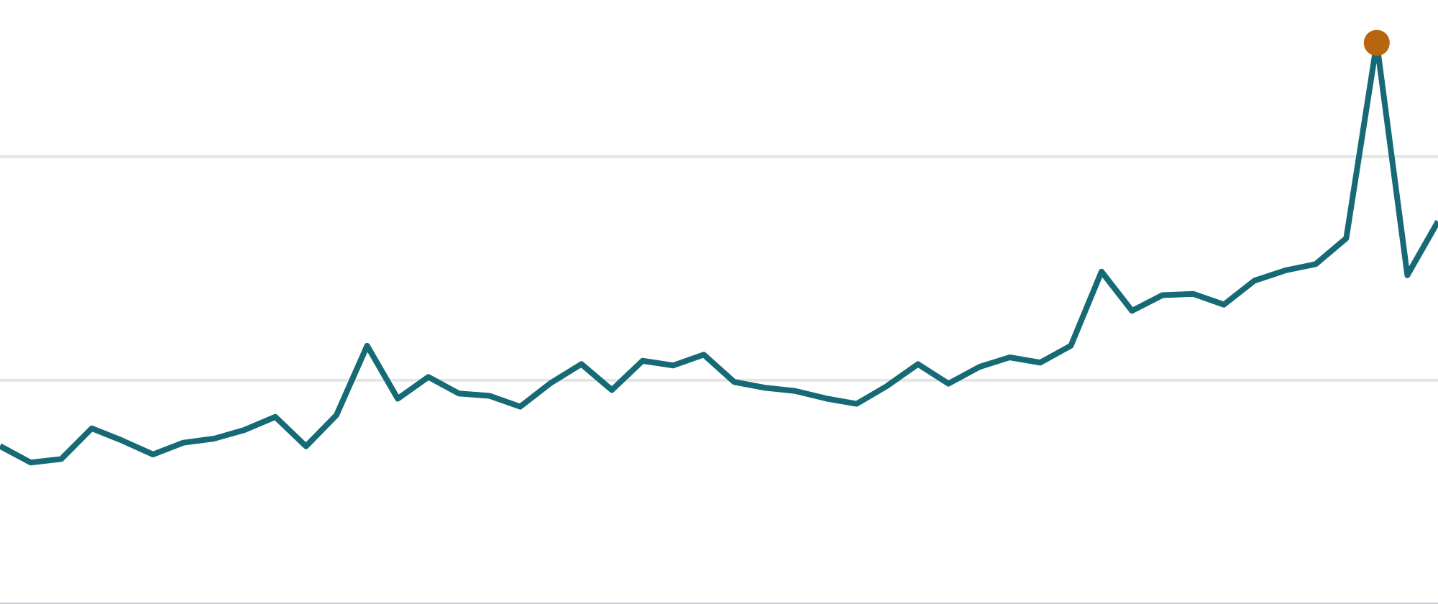
Revenue stepped up in 2025 after a flat 2024
QUESTION 2 · REVENUE BY YEAR AND MONTH
Oct 2025: $250.8K
+53.7%
$200K
2025 versus 2024, after +37.9% in 2023 and +0.2% in 2024
+29%
$100K
January 2025 versus December 2024
$250.8K
Jan 2022
Jan 2023
Jan 2024
Jan 2025
Best month, October 2025
New Jersey Territory Sales · 4
Notes:
About 35 seconds. Answer to question two: revenue by year and month, shown as 48 monthly points. Monthly revenue began at about $70,600 in January 2022. 2023 grew 37.9 percent, 2024 was flat at 0.2 percent, and 2025 grew 53.7 percent. The step happened in January 2025, when revenue rose 29 percent over December 2024. The best month was October 2025 at $250,830. I do not see a steady seasonal pattern, so I would not plan around a seasonal slump or boost yet.

Slide 5
New Jersey is third of four Northeast states
QUESTION 3 · TERRITORY VERSUS REGION
REVENUE BY STATE, NORTHEAST REGION
21.35%
Maryland
$11.45M · 47.3%
New Jersey’s share of regional revenue
Massachusetts
$5.73M · 23.7%
New Jersey
$5.18M · 21.4%
$558K
Gap to Massachusetts, about $140K a year
Maine
$1.88M · 7.7%
Region total: $24.24M
New Jersey Territory Sales · 5
Notes:
About 30 seconds. Answer to question three: the Northeast region earned $24.24 million in total. Maryland leads with $11.45 million, 47 percent of the region. Massachusetts follows with $5.73 million. New Jersey is third with $5.18 million, 21.35 percent of the region. Maine is fourth at $1.88 million. The gap between New Jersey and Massachusetts is about $558,000 over four years, roughly $140,000 a year, which makes Massachusetts a realistic benchmark. Maryland is counted in the Northeast in the management table I used.

Slide 6
Technology and Textbooks bring in 88% of revenue
QUESTION 4 · TRANSACTIONS AND AVERAGE SALE BY CATEGORY
Category | Transactions | Per month | Avg sale | Revenue | Share
Technology & Accessories | 7,883 | 164 | $460.58 | $3.63M | 70.2%
Textbooks | 5,419 | 113 | $172.87 | $0.94M | 18.1%
Apparel and Merchandise | 7,353 | 153 | $32.27 | $0.24M | 4.6%
Art Supplies | 6,129 | 128 | $32.16 | $0.20M | 3.8%
Books (General) | 3,146 | 66 | $28.71 | $0.09M | 1.7%
Stationery and Supplies | 8,265 | 172 | $10.06 | $0.08M | 1.6%
Stationery has the most transactions but the smallest sale. Technology sells at $460.58 each.
New Jersey Territory Sales · 6 · Per month is the 48-month average, 38,195 transactions in total
Notes:
About 35 seconds. Answer to question four: transactions per month and average sale by product category. Per month is the four-year average across 48 months. Technology and Accessories is the clear leader: about 164 transactions a month at $460.58 each, 70.2 percent of revenue. Textbooks add 18.1 percent at $172.87 per sale. The other four categories together are under 12 percent of revenue, with average sales between $10 and $32. Stationery has the most transactions, about 172 a month, but the smallest sale. That matters for the recommendation: the territory leans heavily on two categories.

Slide 7
Newark and Trenton lead, and Paterson is the outlier
QUESTION 5 · IN-STORE RANKING BY STORE
STORE REVENUE, 16 STORES
24%
1. Newark
$623K
of territory revenue comes from Newark and Trenton
2. Trenton
$598K
3. Hoboken
$317K
About $135
4. Atlantic City
$315K
typical average sale, so transaction volume drives the gaps
5. New Brunswick
$311K
Stores 6 to 14 each earn $286K to $307K
15. Montclair
$262K
16. Paterson
$67K
427
transactions at Paterson, versus about 2,200 at a typical store
New Jersey Territory Sales · 7 · In-store ranking; online sales are not in this data
Notes:
About 35 seconds. Answer to question five. The question allows an in-store ranking by store or an online ranking by state; this data is in-store, so I ranked the 16 stores. Newark at $623,000 and Trenton at $598,000 earn about twice as much as any other store and together make up 24 percent of territory revenue. Stores three through fourteen sit in a tight band of roughly $286,000 to $317,000, and Montclair is fifteenth at $262,000. Average sale is similar everywhere, around $135, so the differences come from how many transactions each store makes. Paterson is last at $67,000 from only 427 transactions, and the data does not say why.

Slide 8
Protect the anchors, grow the middle, investigate Paterson
QUESTION 6 · WHERE TO FOCUS NEXT QUARTER
1. Protect Newark and Trenton
2. Grow the middle stores
3. Investigate Paterson first
They earn 24% of revenue. Keep staffing and technology stock full.
Sale sizes are alike, so run local promotions and loyalty offers to lift transactions.
$67K from 427 transactions. Check for a late opening, closure or missing data before investing.
4. Add depth beyond technology
5. Explain the 2025 jump
6. Use Massachusetts as the target
Find the cause of January’s +29% and October’s peak. Repeat it if you can.
Technology and Textbooks are 88% of revenue. Bundle small categories as add-ons.
Closing the $558K gap, about $140K a year, puts New Jersey level with it.
QUARTER GOAL
Beat the Q1 2025 baseline of $418K
New Jersey Territory Sales · 8
Notes:
About 60 seconds, the main answer. Take each point in about 10 seconds. One: protect Newark and Trenton, because a problem there hurts the whole territory. Two: the middle stores have nearly identical sale sizes, so the lever is more transactions. Three: Paterson is far below the rest, so find out why before spending money. Four: technology and textbooks are 88 percent of revenue, so protect them and use small categories as add-ons. Five: January 2025 and October 2025 broke the pattern, so identify the cause. Six: Massachusetts is a realistic benchmark at about $140,000 a year. For the quarter, the goal is to beat the Q1 2025 baseline of $418,000.

