Slide 1
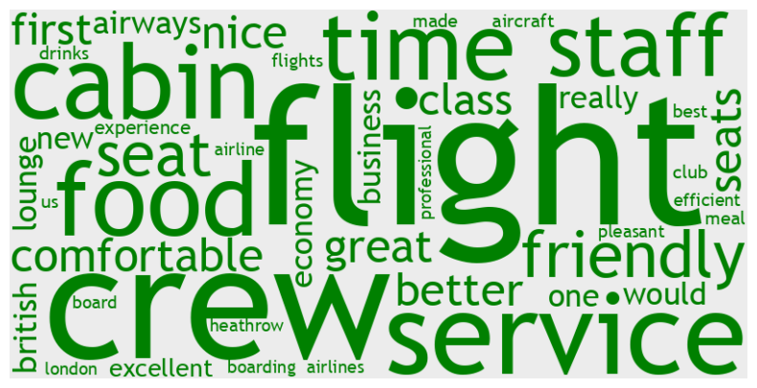
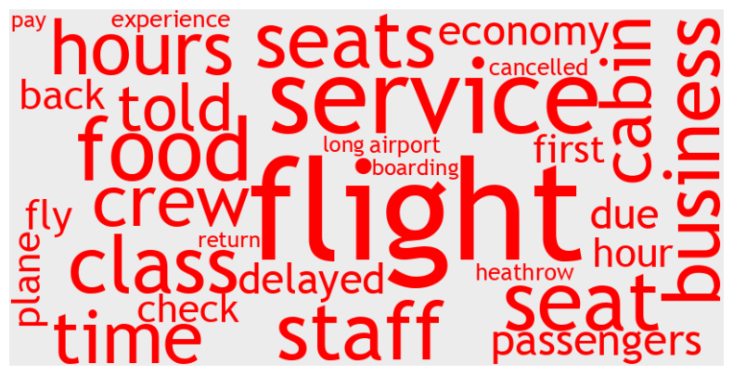

Analyze customer reviews to uncover insights about British Airways.
DATA SOURCE:
airlinequality.com
REVIEWS EXTRACTED:
3686
Review Score AVG 3.77PAST 3 YEARS
4.73ALL TIME (MAX 10)
Economy Class 3.15PAST 3 YEARS
4.33ALL TIME
Business Class 4.55PAST 3 YEARS
5.10ALL TIME
Premium Economy 4.16PAST 3 YEARS
4.86ALL TIME
First Class 5.54PAST 3 YEARS
6.03ALL TIME (MAX 10)
Traveller Type 34.00% Couple Leisure
30.46% Solo Leisure
21.92% Family Leisure
13.62% Business
Cabin Type
52.05% Economy Class
32.35% Business Class
9.80% Premium Economy
5.80% First Class
Couple Leisure 4.00PAST 3 YEARS
4.51ALL TIME
Solo Leisure 4.24PAST 3 YEARS
4.99ALL TIME
Family Leisure
2.96PAST 3 YEARS
3.51ALL TIME
Business
3.25PAST 3 YEARS
4.34ALL TIME
Analysis of Rating Columns
Seat Comfort - Positive
Cabin Staff Service - Excellent
Food and Beverages - Could be better
Inflight Entertainment - Bad
Ground Service - Could be better
Wifi and Connectivity - Worst Reviews
Value For Money - Average
NLP - Sentiment Analysis on Review Body
Neutral+Positive 59.21%(14308) Negative 40.79% (9857)
THE MOST COMMON POSITIVE WORDS THE MOST COMMON NEGATIVE WORDS
Airline Recommendation
40.44% YES 59.56% NO
24th October 2023 Data Science Team (DST) Manuel Ardizio READ MORE: github.com/ardizio

