Slide 1

The ARDoCo Tool Landscape: REST API, TraceView, and TraceViz for Architecture Traceability
  Jan Keim, Dominik Fuchß, Sophie Corallo, Tobias Hey,
  Julian Winter, Kevin Feichtinger
  KASTEL / KIT – ASE 2026, Munich, Tools and Datasets Track
REST API
TraceView
TraceViz
Notes:
[0:00-0:20]
Hi, I am Dominik Fuchss from KIT, presenting joint work with Jan Keim, Sophie Corallo, Tobias Hey, Julian Winter and Kevin Feichtinger.
This is a tools paper. We are not proposing a new traceability approach today - we are making the ones we already have usable: through a REST API, a browser frontend, and a VS Code extension.
(*switch*)

Slide 2
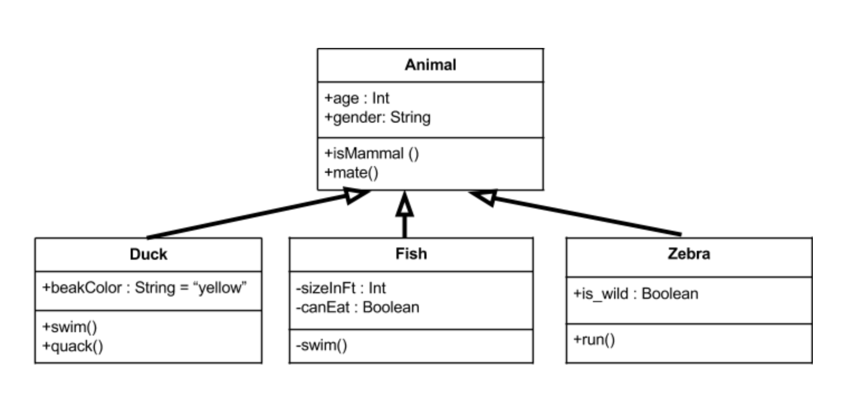

What makes Trace Links important?
Requirements
Design
Issues
Trace links are evidently
useful for
Software Maintenance
Bug Localization
Software Architecture Documentation
Software Architecture Models
Code
Change Impact An.
package network
class Consensus {
…
}
package security
class Encryption {
…
}
System Security
package service
class Controller {
…
}
package dataaccess
class Products {
…
}
class Users {
…
}
…
Artifact
Relation
Notes:
[0:20-1:05]
A quick reminder of why we care.
Software development produces many interrelated artifacts: requirements, design, issues - and, in the focus of ARDoCo, software architecture documentation, architecture models, and source code.
Trace links make explicit which elements across these artifacts talk about the same thing. That is what powers software maintenance, bug localization, change impact analysis, security analyses, and so on.
The catch: maintaining those links by hand is tedious and error-prone. So we want to recover them automatically - and that is hard, because of the abstraction gaps between natural language, models, and code.
(*switch*)

Slide 3
Automating Requirements and Documentation Comprehension
Documentation
natural language · SAD
Architecture Model
UML / Palladio · SAM
Source Code
Java
One engine: ARDoCo trace-link recovery & inconsistency detection
SWATTR
SAD ↔ SAM
F1 0.81
ArCoTL
SAM ↔ Code
F1 0.98
TransArC
SAD ↔ Code
F1 0.82
Inconsistency Det.
MEAT inconsistencies
F1 0.89
Notes:
[1:05-2:00]
In the ARDoCo project we have been building exactly such approaches for years, and they work.
The inputs are the three artifacts from the previous slide: documentation, architecture model, code. They all feed one engine.
SWATTR links documentation sentences to model components - F1 of 0.81. ArCoTL links model components to code - 0.98. TransArC composes the two transitively to get documentation-to-code links: 0.82, against 0.37 for the best direct baseline. And the same engine detects inconsistencies - model elements nobody documented - at 0.89.
By the classification of Hayes et al. that is excellent performance, and it is all evaluated on our benchmark of five open-source Java projects.
(*click*) And yet: every one of these shipped as a Java library or a command-line tool. You clone it, you build it, you write a configuration - and then you get a CSV of trace links with no way to look at them.
So the people who would benefit most never get to use them. That is the gap this paper closes.
(*switch*)

Slide 4
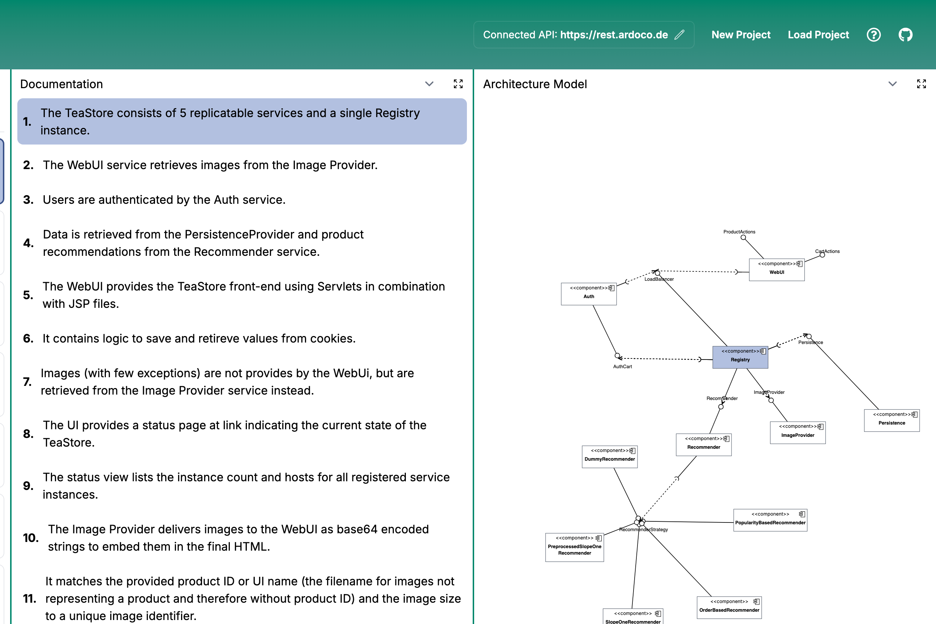
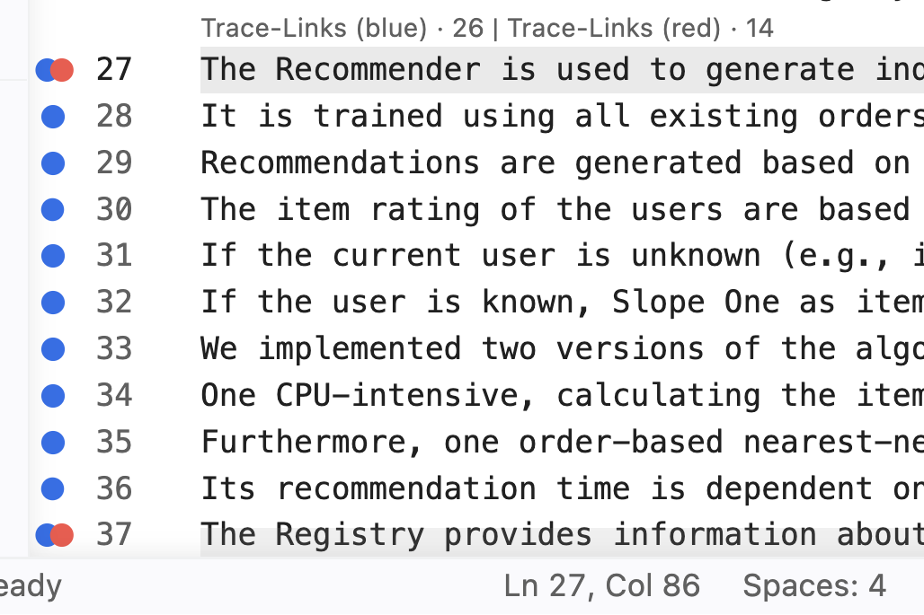
Three Interfaces of ARDoCo
SWATTR · ArDoCode · ArCoTL · TransArC
ARDoCo REST API
for tool integrators
TraceView
for architects
TraceViz
for developers
POST /api/swattr/start
inputText, inputArchitectureModel
202 { "requestId": "MediaStore-5c1c…" }
GET …/wait-for-result/{id}
200 { "traceLinks": [
{ "sentence": 17,
"modelElement":
"MediaManagement" } ],
"cached": true }
• Four TLR pipelines, one HTTP call
• Async: start · wait-for-result
• Cached in Redis, JSON, Swagger UI
• Zero install
• All three artifacts side by side
• Click once; see related elements.
• Trace links as gutter dots
• One click: sentence ↔ code.
• REST API, CSV or local LiSSA approach (LLM)
Notes:
[2:00-2:50]
Our answer is one engine behind three interfaces, each aimed at a different audience. This is the whole paper on one slide.
For tool integrators, the ARDoCo REST API: a Spring Boot service that puts the four pipelines behind plain HTTP, asynchronously, with caching.
For architects and non-developers, TraceView: a browser frontend, nothing to install, that shows documentation, model and code side by side.
For developers, TraceViz: a VS Code extension that puts the trace links into the editor, right next to the code. It talks to the REST API, and it can additionally run LiSSA locally.
All three are publicly deployed - Docker images and an extension package. Let me show you each of them.
(*switch*)

Slide 5
ARDoCo REST API
for tool integrators rest.ardoco.de · github.com/ardoco/rest
  Spring Boot service, publicly deployed
  Four pipelines, one controller each
      sad-sam – SWATTR + inconsistencies
      sam-code – ArCoTL
      sad-code – ArDoCode
      sad-sam-code – TransArC
  Four endpoints each: start, start-and-wait, get-result, wait-for-result
  Transparent caching: the run ID is a hash of the request → Redis, 24 h
POST /api/sad-sam-code/start
inputText, inputArchitectureModel,
inputCode
202 { "requestId": "MediaStore-5c1c02dc…" }
GET /api/sad-sam-code/wait-for-result/{id}
200 { "traceLinks": [
{ "sentence": 17, "modelElement":
"MediaManagement" },
{ "sentence": 19, "modelElement":
"Packaging" } ] }
· identical input → served from cache
· Swagger UI at /swagger-ui
Notes:
[2:50-3:35]
The REST API is the shared backend, live at rest dot ardoco dot de.
Four pipelines, one controller each - documentation-to-model, model-to-code, the direct documentation-to-code baseline, and the transitive TransArC pipeline.
TLR runs take a while, so each controller offers the same four endpoints. You POST your artifacts to start and immediately get a request ID back; then you either long-poll with wait-for-result, or fetch it later with get-result. There is a synchronous start-and-wait for small inputs.
And the detail we like most: that request ID is a hash of the request content. So identical inputs transparently hit the Redis cache instead of re-running the pipeline - results live for 24 hours. In a demo or a workshop that is the difference between waiting minutes and getting an answer instantly.
Everything is JSON, and there is a Swagger UI, so you can try it without writing a line of code.
(*switch*)

Slide 6
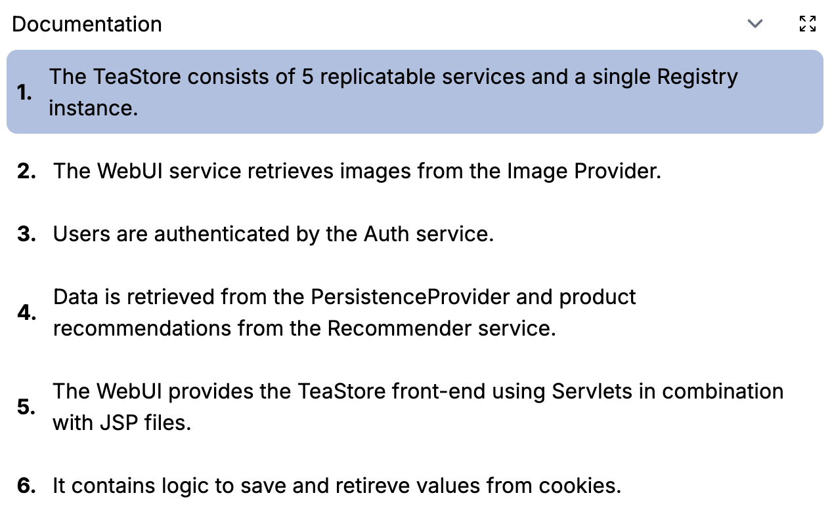
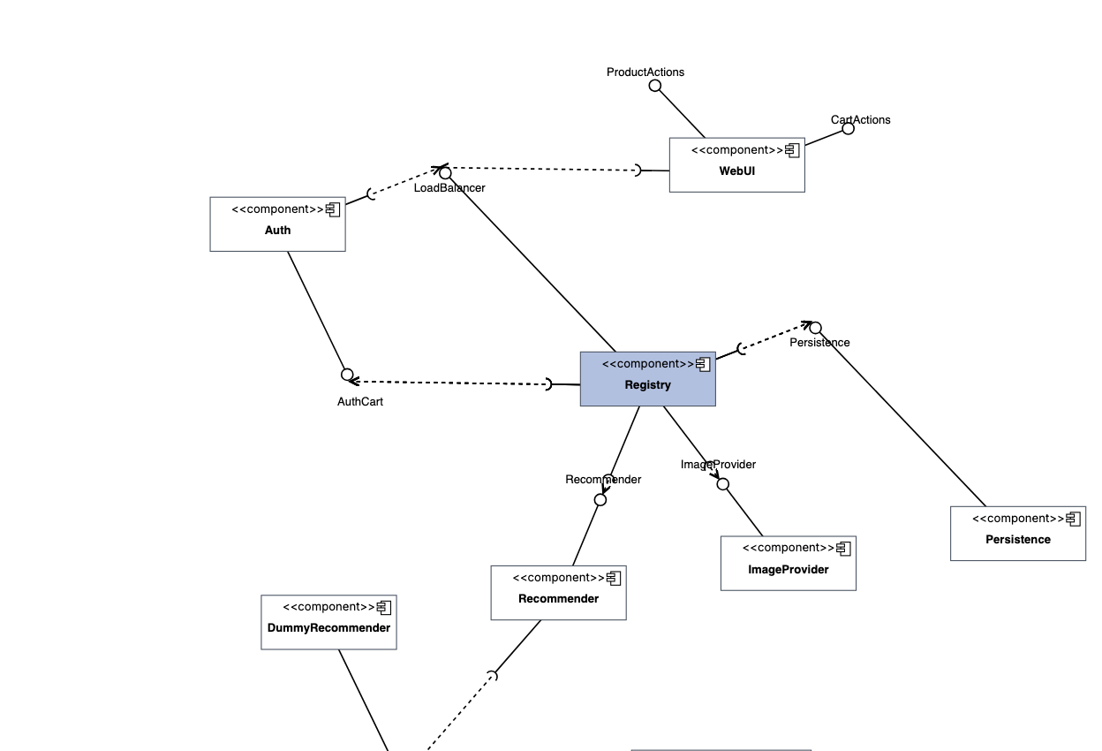
TraceView: Trace Links in the Browser
for architects tv.ardoco.de · no installation, four-step wizard
Documentation (SAD)
Architecture Model (SAM)
Select the first trace link: sentence 1 names a "single Registry instance", and the Registry component lights up in the model.
Notes:
[3:35-4:35]
TraceView is the installation-free entry point - you open a URL, that is it.
A four-step wizard takes you there: upload the documentation, the architecture model and the code model; name the project and pick which trace links you want - TransArC, SWATTR, ArDoCode or ArCoTL, and optionally inconsistency detection; adjust the ARDoCo configuration if you like; review a summary. TraceView submits that to the REST API and tells you when the run is done. There is a screenshot of every step in the backup.
What you get back is a multi-panel view - up to three resizable panels side by side. I am showing you two of them, zoomed in.
On the left the documentation. On the right the architecture model.
I clicked the first recovered trace link, and both ends light up at once: sentence one, which says the TeaStore consists of five replicable services and a single Registry instance - and over in the model, the Registry component. Click anything in any panel and its counterparts highlight in the others.
The same view also surfaces our inconsistency detection: documented entities missing from the model, and model elements nobody documented.
(*switch*)

Slide 7
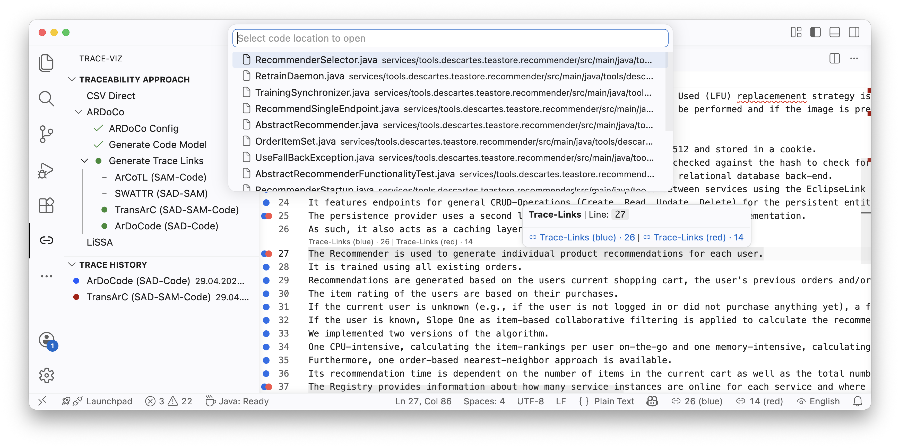
TraceViz: Trace Links in the IDE
for developers github.com/ardoco/traceviz · VS Code extension
Sidebar
pick the traceability approach, keep a history of runs
Gutter dots
one per linked documentation line; hovering line 27 shows blue 26 · red 14
One click
a Quick Pick with the linked code
Approach-agnostic
ARDoCo REST API · CSV · LiSSA (LLMs)
Notes:
[4:35-5:35]
TraceViz takes the other route: instead of bringing you to the trace links, it brings the trace links to you. This is the whole extension in one screenshot.
On the left, the sidebar: you pick a traceability approach - the ARDoCo pipelines, plain CSV, or LiSSA - trigger a run, and every past run stays in a history you can re-activate with one click.
In the editor, every documentation line that has trace links gets a coloured gutter dot. Hovering line 27 tells you how many links there are - twenty-six in the blue set and fourteen in the red one. Two link sets at once, in colours you choose, which makes comparing two approaches, or an approach against the gold standard, very direct.
And when you click, you get the Quick Pick you see at the top: the linked code locations, and you jump straight into the source. No separate window, no CSV file. There are zoomed screenshots of the dots and the Quick Pick in the backup.
One more thing: it is approach-agnostic. Besides our REST API and LiSSA, it imports plain CSV in our benchmark format, so you can visualize trace links from any tool, not only ours.
(*switch*)

Slide 8


Conclusion
  State-of-the-art architecture TLR:
      REST API: four pipelines over HTTP, async + Redis caching
      TraceView: browser wizard and exploration incl. inconsistencies
      TraceViz: trace links on the gutter, one click into the code
  All three publicly deployed as Docker images / extension package
  Next:
      LLM-based approaches LiSSA, ExArch behind the REST API
      Revisit preliminary study (n = 7): in-IDE visualization improves comprehension
paper · tools · data
ardoco.de/c/ase26-tools
screencast
youtu.be/IOTEPZQ3tVs
rest.ardoco.de · tv.ardoco.de · github.com/ardoco/traceviz
replication package: doi.org/10.5281/zenodo.21533985
Notes:
[6:15-7:00]
To wrap up.
We presented the ARDoCo tool landscape: a REST API that puts four TLR pipelines behind HTTP with asynchronous execution and caching; TraceView, a browser frontend with a wizard and an interactive multi-panel result view including inconsistency detection; and TraceViz, which brings trace links into VS Code.
All three are publicly deployed and open source, and a preliminary study indicates that the in-IDE visualization genuinely helps comprehension.
Next up: we want LiSSA and our LLM-based component name extraction, ExArch, behind the same REST API, so both frontends get them for free; support for more artifact types such as requirements; better visualization for projects with very many links; and larger, controlled user studies.
The big QR code takes you to everything - paper, tools, replication package. The small one is the screencast. Please try it and tell us where it breaks.
Thank you - I am happy to take questions.
(*switch*)

