Slide 1

Beyond Retrieval: A Study of Using LLM Ensembles for Candidate Filtering in Requirements Traceability
Dominik Fuchß, Stefan Schwedt, Jan Keim, Tobias Hey
Notes:
Hello my name is Dominik Fuchß from KIT in Germany and I‘m happy to present you our work on an alternative (or maybe not an alternative – let‘s see) for current retrieval stategies.
And .. As the title suggests, we have investigated this alternative in the context of requirements traceability (simply because our research focuses on traceablity link recovery)
However, this is just the task we used to evaluate for our idea.

Slide 2


Requirements Traceability using Information Retrieval (IR)
Ranked List
Vectorize
R$→\left({\begin{aligned}0.1337 \\ ⋮\end{aligned} \atop 0.4242}\right)$
Calculate Similarity
(HLR,LLR) $→\text{∠}$
Low-Level | Similarity
LLR3: … | 0.9
LLR1: … | 0.7
LLR2: … | 0.15
LLR4: … | 0.1
LLR9: … | 0.042
High-Level Requirement
t=0.5
„The user shall be able to login with username and password.“
k=4
Similarity Thresholds, e.g., t=0.5
Top-K-Retrieval, e.g., k=4
Low-Level Requirements
LLR1: …
LLR2: …
LLR3: …
…
Notes:
So lets take a look into classical requirements traceability using information retrieval methods.
… what do we have and what do we want to achieve …
EXPLAIN
…
TRACE LINKS !!
so whats now the problem with thesholds and top-k values ..
This is where it begins to be tricky and that s the first part of our paper .. We looked into how two core metrics (recall and precision) behave reg. diff. thresholds, k’s for different projects. And this is illustrated here …

Slide 3
Requirements Traceability using Information Retrieval (IR)
Notes:
Please .. Please .. Don’t look to detailed into the graphs now .. I will zoom in in a second ..
But what do we will see ..
Each dot is a different threshold for the IR-Method LSI.
On the x-axis you can see the recall of the resp. configuration meaning how many of the correct trace links have been found
On the y-axis you can see the precision of the resp. config - meaning how many of the predicted trace links are actual trace links.
If everything would work perfectly, we would be in the right upper corner :D

Slide 4
Requirements Traceability using Information Retrieval (IR)
Notes:
Now let’s take a more detailed look ..
I now marked the global and local best configurations for each dataset .. Optimum by F2-score a combination of Precision of recall and precision that weights recall as more important (typically used for semi-automatic approaches with human involvement)
What we see now is that the local and global opimum differs for each project. E.g. dronology: global optimum 0.17, for dronology it should be 0.43
.. There is not one value

Slide 5
Requirements Traceability using Information Retrieval (IR)
Problem
“Guessing” thresholds and good “k”s for IR approaches is hard / project-dependent.
Notes:
.. And that’s the problem ; guessing is hard ..

Slide 6
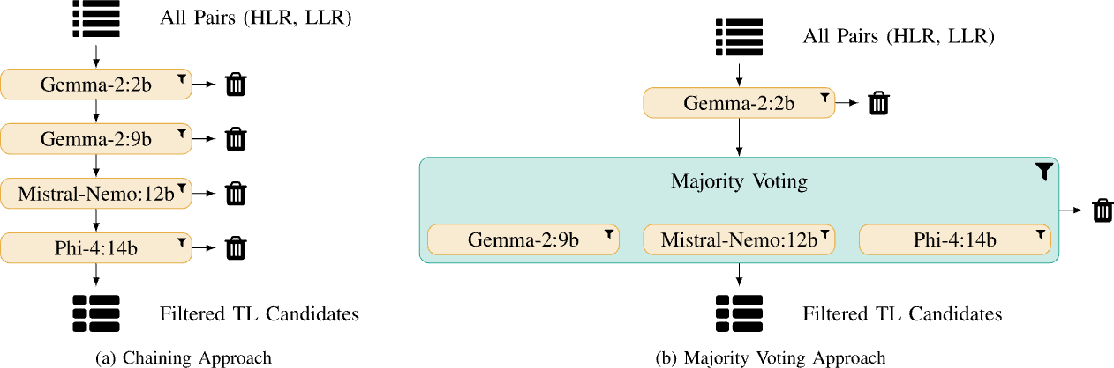
Idea: Small LLMs to lightweightly filter all requirement pairs
Notes:
.. So and whats now our idea .. We do a full classification, but lightwightly .. With small LLMs. We considered two configurations, one that strictly filters and one that first filters and then does some majority voting of still small but more powerful llms. ; the idea here was to increase the recall that is important
SIMPLE CLASSIFICATION PROMPT

Slide 7
Evaluation: Reduction of Search Space & Maintaining Recall
Retrieved combinations + Recall per project
Notes:
Again we have some values for you .. Here, we see the amount of positive pairs. After each filtering .. Let’s for now take a look at dronology, the largest dataset.
The combinatoric of HLR and LLR leads to 21 thousands of combinations to classifiy.
What’s important now, the smaller models remain a recall of 1 but already filter 2000 wrong candidates.
With the more powerful small LLMs, we slightly reduce the recall but filter them to roughly 2500
Interesting is also that chaining works (w.r.t. remaining (more) recall than the models seperatly)

Slide 8
Evaluation: Comparison to State of the Art Approaches
Approaches for Comparison
VSM: IR with similarity threshold
LSI: IR with similarity threshold
Embeddings: IR with Top-K
LiSSA: RAG-based with Top-K
Metrics
F₁-score (esp. full automation)
F₂-score (esp. semi-automatic)
Approach | F₁-score | F₂-score
VSM_{GO} | .27 | .34
LSI_{GO} | .23 | .33
Embeddings_{GO} | .40 | .50
LiSSA (GPT-4o) | .50 | .51
Majority Voting | .18 | .34
Chaining | .28 | .45
Chaining + GPT-4o | .34 | .50
Notes:
Globally Optimized (F2) VSM, LSI and Embedding approaches
Furthermore the SotA LiSSA approach: that uses Embeddings, TopK-Retrieval with Classification in a RAG-based approach

Slide 9


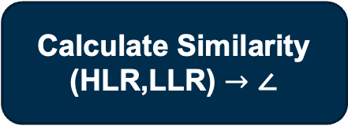

Conclusion
Problem: “guessing” thresholds and good “k”s for IR is hard / project-dependent
Approach: Use small LLMs to reduce search space while maintaining recall
Results: Ensembles of small LLMs …
can filter non-linked candidate pairs
can outperform classical methods like VSM / LSI
do not outperform embedding-based top-k approaches
have higher computational costs, but no thresholds → trade-off decisions
Vectorize
R$→\left({\begin{aligned}0.1337 \\ ⋮\end{aligned} \atop 0.4242}\right)$
Calculate Similarity
(HLR,LLR) $→\text{∠}$
Ranked List
Low-Level | Similarity
LLR3: … | 0.9
LLR1: … | 0.7
LLR2: … | 0.15
ardoco.de/c/aire25
Notes:
Outlook:
Evaluation of ensembles on other (traceability) tasks
Prompt engineering
Ensemble design choices (#, models, layering, …)

Slide 10
Backup

Slide 11
Evaluation: Reduction of Search Space & Maintaining Recall
Notes:
Again we have some values for you .. Here, we see the amount of positive pairs. After each filtering .. Let’s for now take a look at dronology, the largest dataset.

Slide 12
Evaluation: Comparison to State of the Art Approaches
Approaches for Comparison
VSM: IR with similarity threshold
LSI: IR with similarity threshold
Embeddings: IR with Top-K
LiSSA: RAG-based with Top-K
Metrics
Precision
Recall
F₁-score (esp. full automation)
F₂-score (esp. semi-automatic)
Approach | Precision | Recall | F₁-score | F₂-score
VSM_{GO} | .22 | .56 | .27 | .34
LSI_{GO} | .17 | .61 | .23 | .33
Embeddings_{GO} | .30 | .61 | .40 | .50
LiSSA (GPT-4o) | .52 | .52 | .50 | .51
Majority Voting | .10 | .95 | .18 | .34
Chaining | .18 | .88 | .28 | .45
Chaining + GPT-4o | .25 | .77 | .34 | .50

Slide 13
Research Questions
RQ1: To what extent does the performance of IR techniques for TLR is affected by thresholds or top-k?
RQ2: To what extent can small LLMs effectively reduce the search space for inter-requirements traceability?
RQ3: How does an LLM ensemble compare to existing retrieval-based methods for TLR?

