Slide 1

Project Title -
Student Name - Aravind R Nair
College Name – Amal Jyothi College of Engineering (Passout)
AICTE STU ID : STU6839c4b652a021748616374

Slide 2

PROBLEM STATEMENT
(Agricultural activities are influenced by seasonal variations in environmental conditions, farming practices, resource availability and market conditions. As a result, agricultural performance may differ from one season to another. However, raw agricultural data does not clearly explain how agricultural performance changes across seasons or what patterns can be observed in different seasonal conditions. The problem is to analyze the given agricultural dataset and investigate seasonal differences in agricultural performance by identifying meaningful patterns, trends, relationships and variations within the available data.

Slide 3
Project Description This project analyzes a dataset of 4,000 farm records spanning three agricultural seasons — Kharif, Rabi, and Zaid — across 8 Indian states, 8 crops, and 4 irrigation methods. The dataset captures environmental conditions (rainfall, temperature, soil health), resource usage (fertilizer, pesticide, water), and economic outcomes (cost, revenue, profit) for each farm. The analysis follows a full data-analytics workflow: exploring the raw data, cleaning missing values and outliers, engineering derived metrics (profit margin, cost/revenue per hectare), and applying statistical tests (ANOVA, Kruskal-Wallis, Chi-square, Pearson correlation) alongside visualizations to determine whether — and why — agricultural performance differs by season. The goal is to move from raw numbers to evidence-based conclusions that could inform seasonal agricultural planning.

Slide 4

WHO ARE THE END USERS?
Farmers and agricultural cooperatives planning crop and season choices
State agricultural departments and policymakers designing seasonal support programs
Agri-finance and insurance providers assessing seasonal risk
Agronomy researchers studying environment–yield relationships
Students and analysts using this as a template for real-world seasonal data analysis

Slide 5

Technology Used
Language: Python 3
Environment: Google Colab (Jupyter Notebook)
Data handling: pandas, NumPy
Visualization: Matplotlib, Seaborn
Statistical testing: SciPy (ANOVA, Kruskal-Wallis, Chi-square, Pearson correlation)
Version control: GitHub

Slide 6
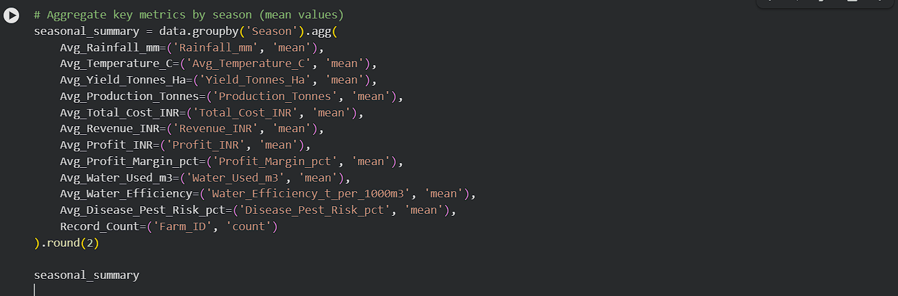
RESULTS
Seasonal summary table
Avg_Rainfall_mm | Avg_Temperature_C | Avg_Yield_Tonnes_Ha | Avg_Production_Tonnes | Avg_Total_Cost_INR | Avg_Revenue_INR | Avg_Profit_INR | Avg_Profit_Margin_pct | Avg_Water_Used_m3 | Avg_Water_Efficiency | Avg_Disease_Pest_Risk_pct | Record_Count
Season
Kharif | 852.11 | 28.45 | 2.25 | 18.48 | 531804.41 | 710719.06 | 91727.66 | -40.96 | 5680.51 | 4.04 | 54.47 | 1779
Rabi | 435.94 | 23.49 | 2.03 | 16.53 | 513836.58 | 601526.05 | 39059.89 | -45.36 | 5505.50 | 3.73 | 40.48 | 1627
Zaid | 299.12 | 31.04 | 1.81 | 15.01 | 543976.73 | 519171.90 | -51621.92 | -69.21 | 5999.48 | 3.25 | 38.22 | 594
Kharif leads in yield (2.25 t/ha) and profit (₹91,728 avg); Zaid is loss-making on average (–₹51,622)

Slide 7
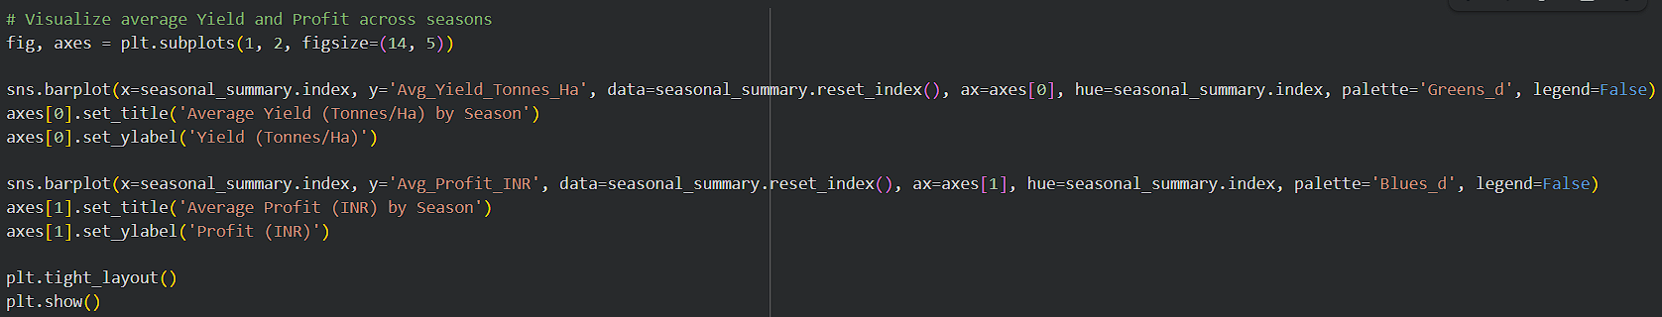
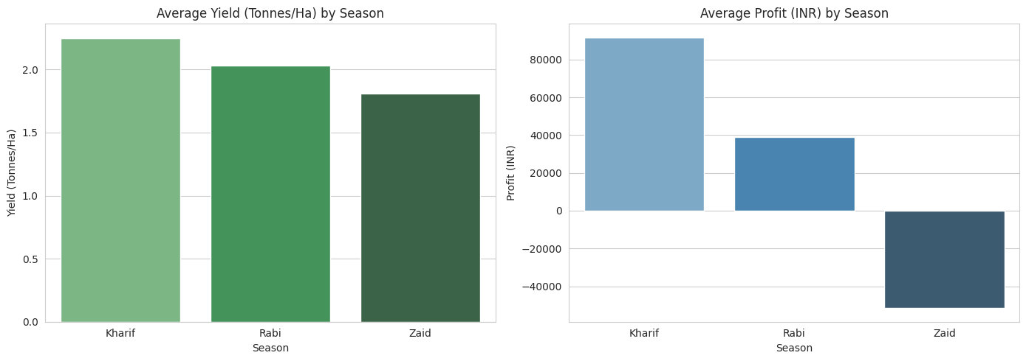
RESULTS
Yield and Profit bar charts by season
ANOVA confirms the seasonal difference is statistically significant (Yield: p<0.001, Profit: p<0.001)

Slide 8
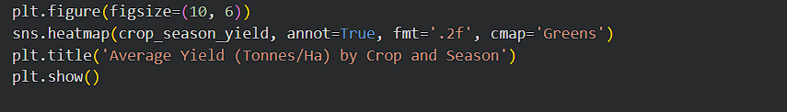
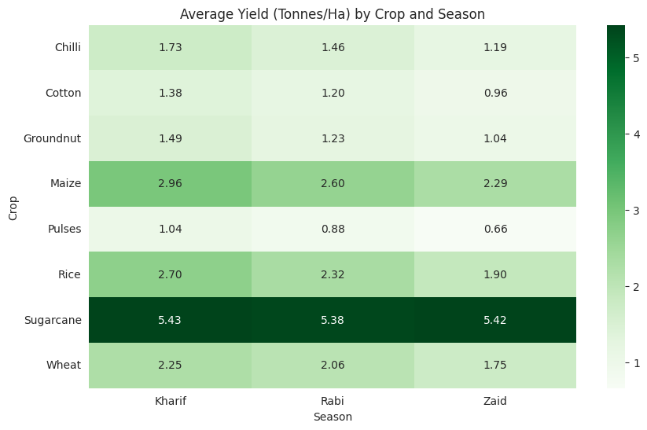
RESULTS
Crop × Season yield heatmap
Sugarcane stays stable across seasons (5.4 t/ha); Rice drops ~30% from Kharif to Zaid

Slide 9
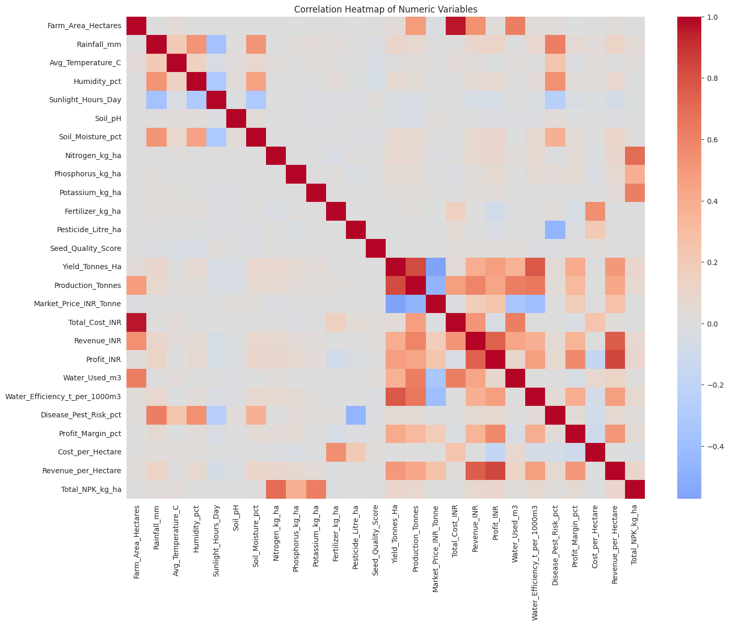
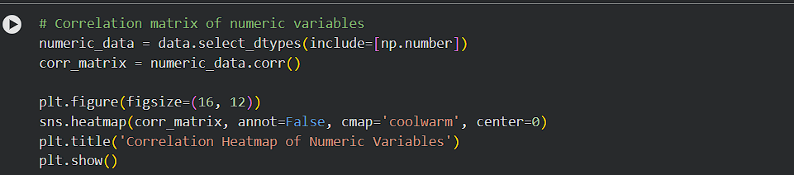
RESULTS
Correlation heatmap / top correlations
Water efficiency (r=0.77) predicts yield far better than rainfall alone (r=0.10)

Slide 10
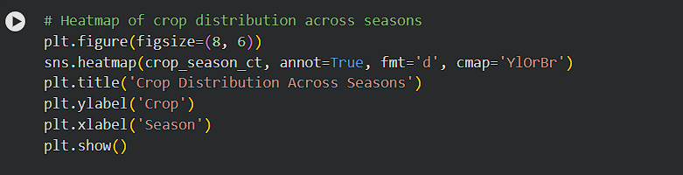
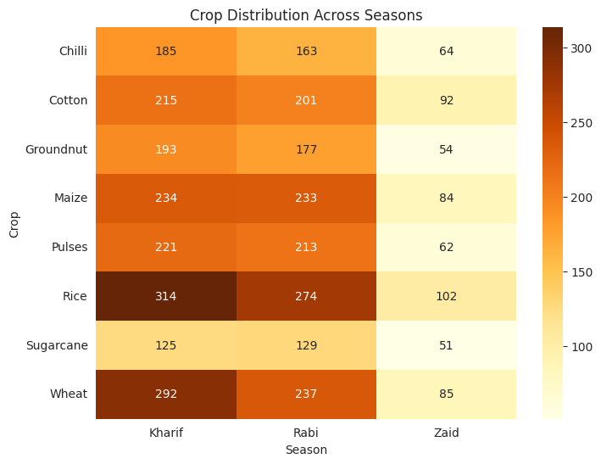
RESULTS
Crop Distribution Heatmap
Kharif has the highest crop distribution, followed by Rabi, while Zaid consistently shows the lowest crop distribution across all crops.

Slide 11
Future scope
Extend the dataset across multiple years to test whether the Zaid loss pattern is consistent or year-specific
Build a predictive model (e.g., regression) to forecast profit/yield from seasonal and resource inputs
Incorporate real-time weather and market-price feeds for a live seasonal advisory tool
Study the mechanisms behind Kharif's high disease/pest risk to design targeted interventions
Deploy findings as an interactive dashboard for farmers and policymakers

Slide 12
GitHub Link
https://github.com/ardr000005/Seasonal-Agriculture-Performance-Analysis.git

Slide 13
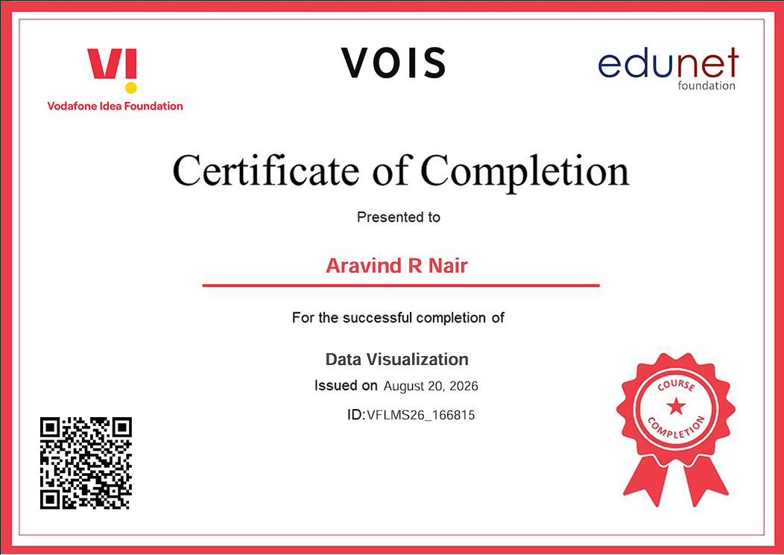
VOIS Course completion certificate - Course name- Data Visualization

Slide 14
Thank you
.
.

