Slide 1
THE 15th INTERNATIONAL IEEE CONFERENCE ON COMPUTING, COMMUNICATION AND NETWORKING TECHNOLOGIES (ICCCNT)
Feature – Enhanced Semi-Supervised Attention U-Net for Cell Segmentation

Slide 2
Outline
Introduction
Problem Statement
Literature Review
Proposed Solution
Results
Conclusion
Reference

Slide 3
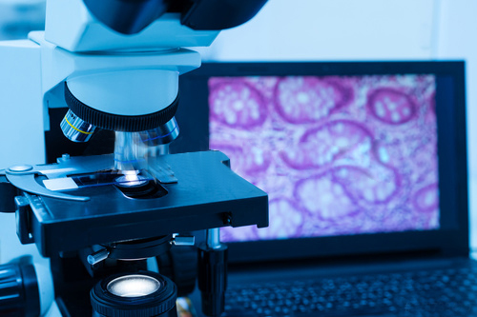
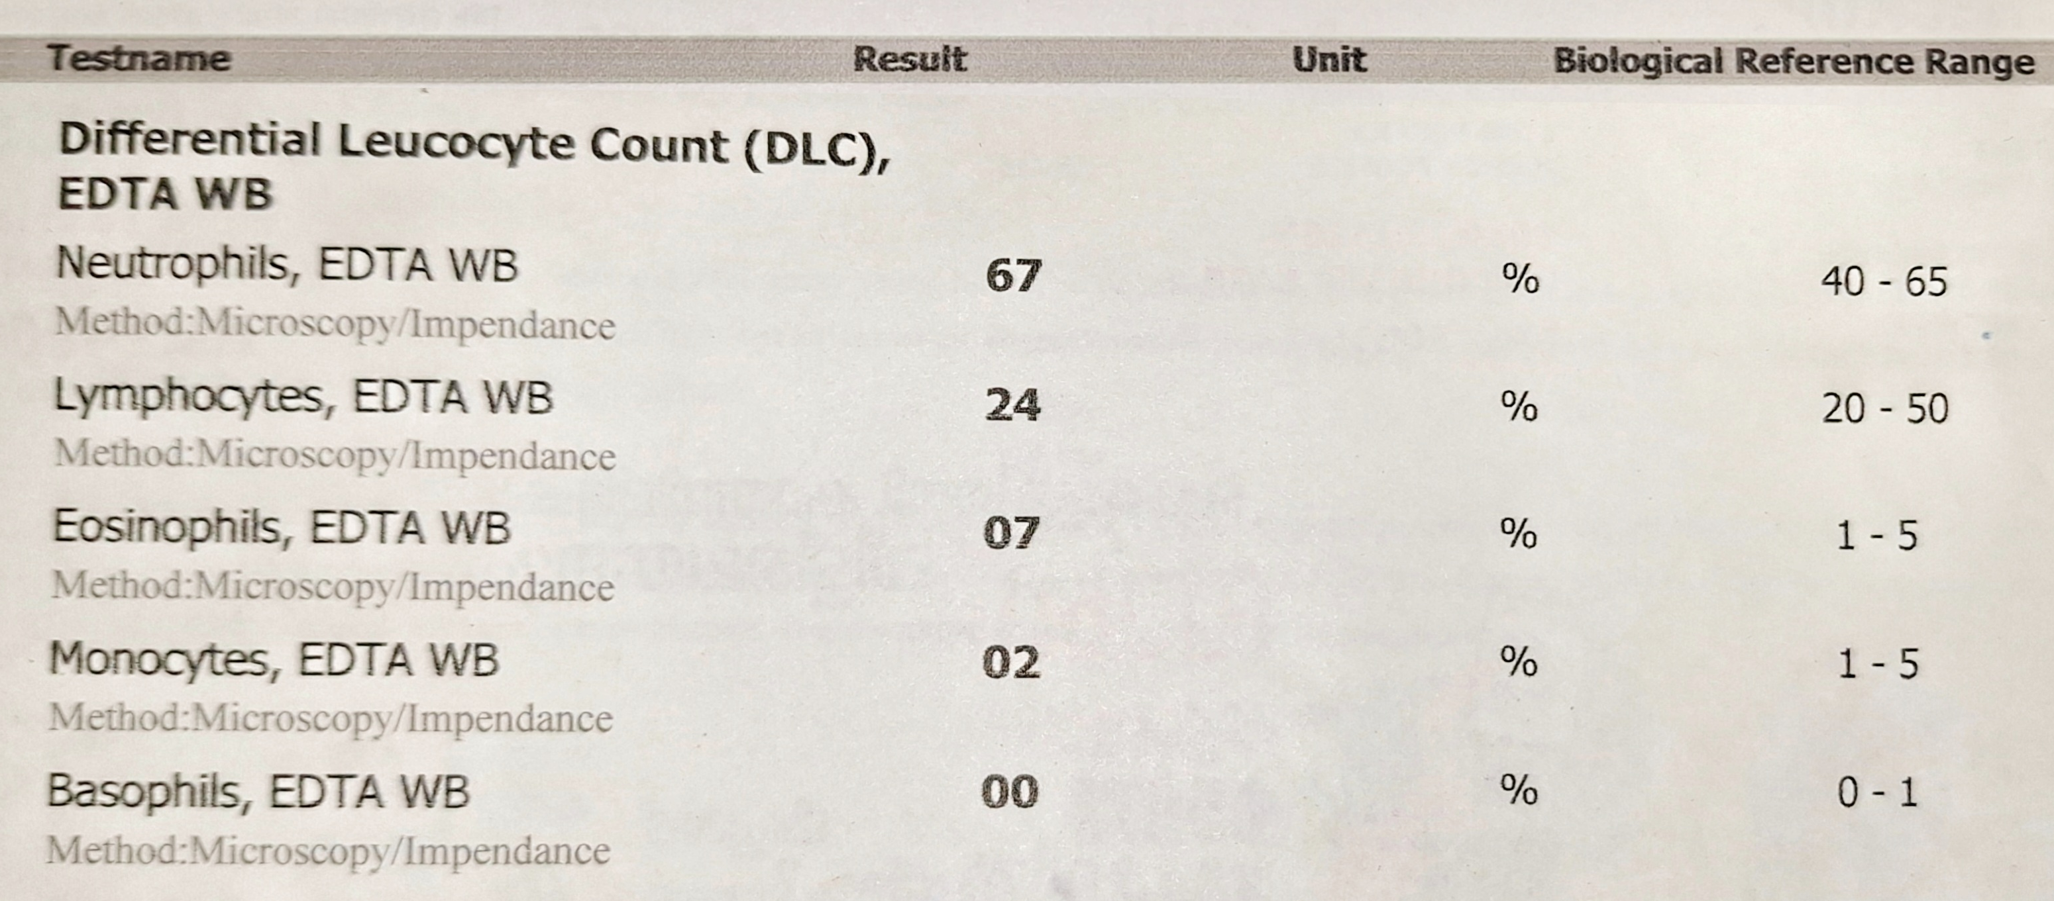
Introduction
Blood test is one of the primary measures utilized for detecting and monitoring of various health conditions. It has the range of each cells needed for a healthy person to the actual percentage of cells in the body.
To get the correct proportion of each cells, they need to be properly segment out from the background. The process of segmenting cells from the background is cell segmentation.
Cell segmentation aids in :
Proper Identification of diseases
Measuring disease severity
Figure 1. Blood Test report of a patient

Slide 4
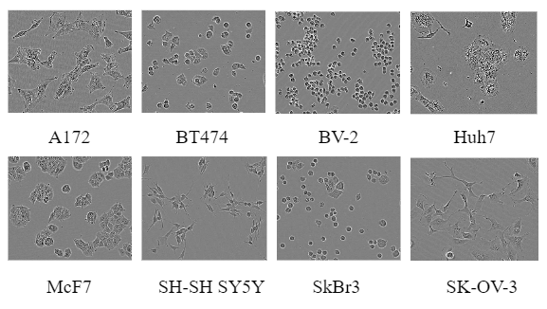
Cell Segmentation Approaches
Manual counting of cells are Time Consuming and prone to human errors
Traditional approaches including water-shed segmentation and thresholding are sensitive to image variation and struggles in handling complex cells
Deep learning approaches like U-Net is specially designed for bio-medical image segmentation. It’s symmetric structure allows efficient segmentation with varying size and shape.
Dataset
Most of the researches involve cells that are stained, but these affect the true nature of the cell, thereby alter the results.
Livecell datasets are limited and most of the existing datasets only have fewer images.
LIVECell [1] – A large-scale dataset for label-free live cell segmentation, with 5239 manually annotated images, with more than 1.6 million individual cells.
Figure 2. 8 different cell types in LIVECell [1]
Problem of labelling datasets
Manually annotating cell images is time-consuming and labor-intensive. Each cell must be carefully outlined, often requiring expert knowledge to distinguish between touching or overlapping cells.

Slide 5
Related works
U-Net has demonstrated success in different medical imaging tasks, because of its U-Shaped structure. Comparison between the efficiency of U-Net and SegNet [6] on segmenting cells has been done in 2021, and the results underscores U-Net as a good choice for cell segmentation.
Attention U-Net is another variation of U-Net with attention gates. For liver segmentation, the Multi-Scale Attention U-Net [7] demonstrated superior performance compared to both the U-Net and U-Net++ in 2021.
In 2023, SBU-Net [8] underscores the significance of feature extraction in cell segmentation. Innovative feature extraction methods integrated into the U-Net model using a tensor voting mechanism significantly boosted the segmentation performance.
Model | Year | Dice Score | Take Aways
Mask RCNN [1] | 2021 | 0.83 | Anchor-based architecture fails to detect a greater share of true cell objects than an anchor-free architecture.
Deep UNet [2] | 2022 | 0.60 | Added additional layers to U-Net Extended dataset - cropping out background and placed in new region.
Center Mask [2] | 2022 | 0.82 | Evaluate on LIVECell on a CenterMask architecture with the largest VoVNet2 backbone finetuned on LIVECell
LACSS [3] | 2023 | 0.824 | Principal Model – ConvNeXt Collaborator Model – CNN (light weight) Use consistency loss for knowledge sharing
Table 1. Researches done on LIVECell dataset

Slide 6
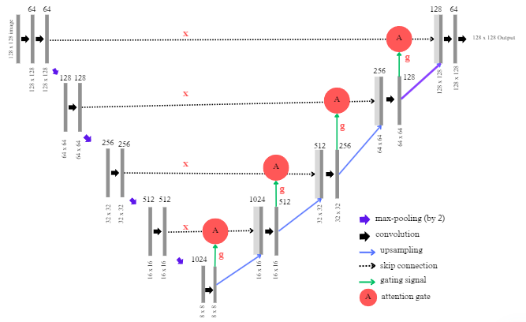
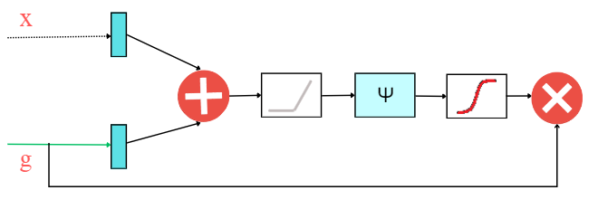
METHODOLOGY
Dataset extraction and Preprocessing
Generate mask by converting coco annotation to binary masks.
Image resizing
Normalization
Attention U-Net [4]
U-Net has contracting and expansive path, each pair connected using skip connections
Encoder has convolutional and pooling layer, that extract local features and reduce the spatial dimension of feature map.
Decoder restores the spatial dimension using up sampling (transpose convolution). This restoration is to ensure that the segmentation output has the same dimensions as the input.
Skip connections are used to concatenated encoder feature with the up sampled features in the decoder. This help in restoring fine details that might lost during down sampling.
As feature representations are poor in the initial layer, many low-level feature extractions were taken.
Attention mechanism suppress activations in irrelevant region and better focus on important regions.
Spatial information from the encoder(x) and gating signal from the decoder are summed element wise and the output is passed through relu activation layer. The resulting vector undergoes scaling in the range [0,1] and passed through a sigmoid layer, Thus the attention coefficient formed is multiplied by vector x and passed along the skip connection
Figure 3. U-Net Architecture
Figure 4. Attention gate

Slide 7
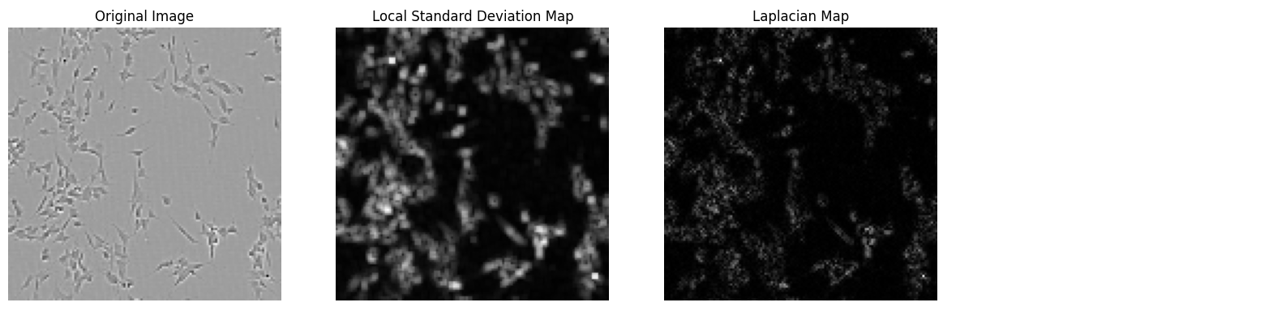
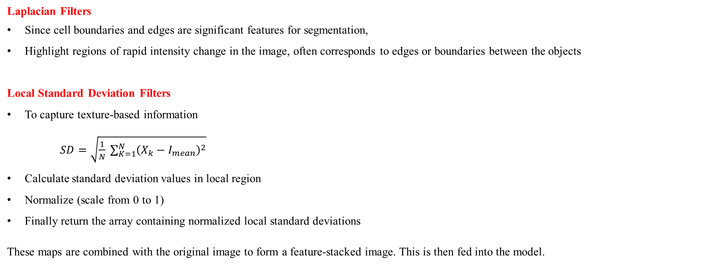
METHODOLOGY
Laplacian Filters
Since cell boundaries and edges are significant features for segmentation,
Highlight regions of rapid intensity change in the image, often corresponds to edges or boundaries between the objects
Local Standard Deviation Filters
To capture texture-based information
$SD=\sqrt{\frac{1}{N} \sum_{K=1}^{N}{{\left(X_{k}−I_{mean}\right)}^{2}}}$
Calculate standard deviation values in local region
Normalize (scale from 0 to 1)
Finally return the array containing normalized local standard deviations
These maps are combined with the original image to form a feature-stacked image. This is then fed into the model.
Figure 5. Laplacian and Local Standard Deviation Maps extracted from input image

Slide 8
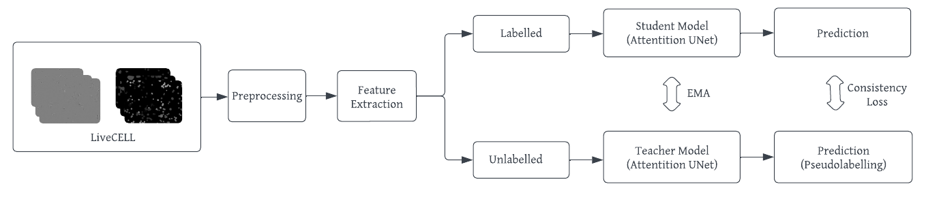
METHODOLOGY
Mean Teacher Attention UNet [5]
A semi-supervised learning approach where, model learns from both labeled and unlabeled data.
It has :
Student Model and Teacher Model
Exponential Moving Average is maintained between student and teacher model weights. This 𝐸𝑀𝐴 update is determined based on
𝐸𝑀𝐴 = 𝑡 ∗ 𝛼 + 𝑠 ∗ ( 1− 𝛼)
where 𝑡 and 𝑠 are teacher and student model weights, and alpha (𝛼) is the smoothing factor.
Thus, the teacher model creates pseudo-labels, which are utilized by the student model for prediction.
The mean squared error is used as the consistency loss to encourage the predictions to be consistent among the models.
Figure 6. Block diagram of MTA-U-Net Model

Slide 9
RESULT AND VAILIDATION
Evaluation Metrics
Dice
IoU
Attention Mechanism used in the code, helps the model attain good segmentation performance.
Mean Teacher model also attained comparable scores, only with 60% labelled data
Cells | UNet (100% training data) |  | Attention UNet (100% training data) |  | Semi - Supervised Mean Teacher Attention UNet (60% training data)
 | IoU | Dice | IoU | Dice | IoU | Dice
A172 | 0.7499 | 0.8568 | 0.8729 | 0.9321 | 0.8793 | 0.9357
BT474 | 0.5580 | 0.7163 | 0.7002 | 0.8235 | 0.6988 | 0.8227
BV-2 | 0.4781 | 0.6468 | 0.6609 | 0.7953 | 0.6474 | 0.7859
Huh7 | 0.5820 | 0.7356 | 0.7282 | 0.8427 | 0.6498 | 0.7877
MCF7 | 0.6928 | 0.8185 | 0.8031 | 0.8907 | 0.8157 | 0.8985
SH-SHY5Y | 0.5534 | 0.7122 | 0.6805 | 0.8097 | 0.6714 | 0.8034
SkBr3 | 0.5389 | 0.6998 | 0.8205 | 0.9013 | 0.8127 | 0.8967
SK-OV-3 | 0.4300 | 0.6006 | 0.7424 | 0.8521 | 0.7267 | 0.8417
LIVECell | 0.5626 | 0.7148 | 0.7502 | 0.8556 | 0.7477 | 0.8556
Table 2. Scores Obtained by running U-Net, Attention U-Net and MTA-U-Net on LIVECell Dataset

Slide 10
RESULT AND VAILIDATION
Applying Feature Extraction approaches lead to a good increase in score.
UNet models are performing better for cells with large flat irregular size and protrusive branching like SK0V3, A172, SHSY5Y ,compared to small, round / irregular shaped cells like HUH7, BT474 and BV2
Cells | UNet (100% training data) |  | Attention UNet (100% training data) |  | Mean Teacher Attention UNet (60% training data) |  | LACSS (State-of-the-Art) | Center Mask
 | IoU | Dice | IoU | Dice | IoU | Dice | Dice | Dice
A172 | 0.8363 | 0.9107 | 0.8916 | 0.9426 | 0.8794 | 0.9358 | 0.802 | 0.92
BT474 | 0.6765 | 0.8069 | 0.7503 | 0.8572 | 0.7183 | 0.8360 | 0.830 | 0.81
BV-2 | 0.5630 | 0.7202 | 0.6939 | 0.8188 | 0.6601 | 0.7952 | 0.782 | 0.82
Huh7 | 0.7041 | 0.8263 | 0.7658 | 0.8672 | 0.7302 | 0.8441 | 0.831 | 0.81
MCF7 | 0.7729 | 0.8718 | 0.8228 | 0.9027 | 0.8174 | 0.8995 | 0.728 | 0.88
SH-SHY5Y | 0.6065 | 0.7549 | 0.6906 | 0.8168 | 0.6778 | 0.8079 | 0.703 | 0.80
SkBr3 | 0.6679 | 0.8007 | 0.8332 | 0.9090 | 0.8140 | 0.8975 | 0.898 | 0.90
SK-OV-3 | 0.8195 | 0.9007 | 0.8650 | 0.9276 | 0.8333 | 0.9091 | 0.864 | 0.91
LIVECell | 0.7176 | 0.8324 | 0.7956 | 0.8844 | 0.7908 | 0.8831 | 0.824 | 0.823
Table 3. Scores Obtained by running Feature Extracted (FE) U-Net, Attention U-Net and MTA-U-Net on LIVECell Dataset

Slide 11
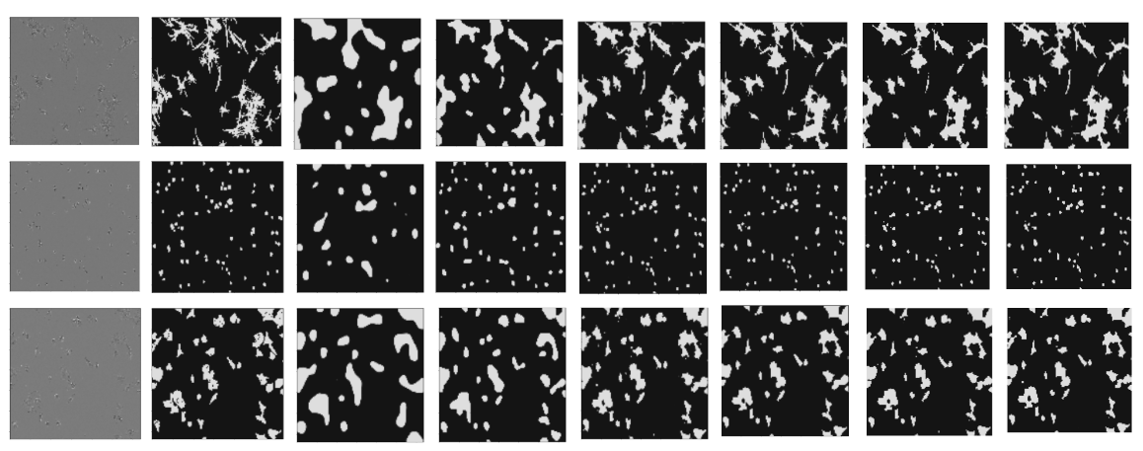
Predicted Mask
Image Mask U-NET FE-U-NET AU-NET FE-AU-NET MTA-U-NET FE-MTA-U-NET
Figure 7. Image , Mask and Predicted mask

Slide 12
CONCLUSION
This research focused on the segmentation of live cell images using different UNet models.
We compared UNet and Attention UNet, and found that Attention UNet is working better for cell segmentation tasks
The Laplacian and local standard deviation feature extraction technique improved all the UNet models, thus leads to better segmentation masks.
We also introduced a semi supervised Mean Teacher Attention UNet and applied feature extraction and obtained comparable scores
The model shows promising results on LIVECell, but its generalization capability to other datasets is to be checked. Additionally, there is a scope to explore more feature extraction approaches that are effective for cell segmentation tasks.

Slide 13
REFERENCE
[1] Edlund, Christoffer, et al. "LIVECell—A large-scale dataset for label-free live cell segmentation." Nature methods 18.9 (2021): 1038-1045.
[2] Kim, Grace, Will Song, and Lucia Zheng. "Deep Learning for Cell Segmentation." (2022).
[3] Yu, Ji. "Point-supervised Single-cell Segmentation via Collaborative Knowledge Sharing." IEEE Transactions on Medical Imaging (2023).
[4] Oktay, Ozan, et al. "Attention u-net: Learning where to look for the pancreas." arXiv preprint arXiv:1804.03999 (2018).
[5] Zhang, Binyu, et al. "MT2: Multi-task Mean Teacher for Semi-Supervised Cell Segmentation." (2023).
[6] Asha, S. B., and G. Gopakumar. "Deep Learning-Based Semantic Segmentation of Blood Cells from Microscopic Images." International Conference on Big Data, Machine Learning, and Applications. Singapore: Springer Nature Singapore, 2021.
[7] Wu, Jiawei, et al. "U-Net combined with multi-scale attention mechanism for liver segmentation in CT images." BMC Medical Informatics and Decision Making 21 (2021): 1-12.
[8] Asha, S. B., G. Gopakumar, and Gorthi RK Sai Subrahmanyam. "Saliency and ballness driven deep learning framework for cell segmentation in bright field microscopic images." Engineering Applications of Artificial Intelligence 118 (2023): 105704.

Slide 14
Thankyou !

