Slide 1
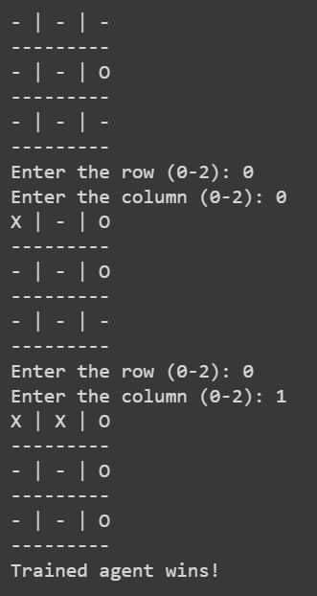
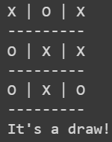
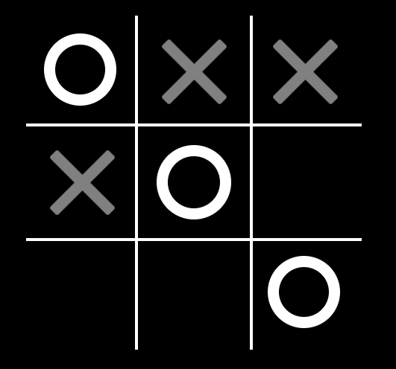
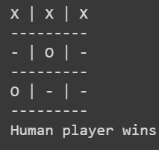
Tic - Tac -Toe Using Q-Learning Approach
Introduction
Develop an AI agent capable of playing the game of Tic-Tac-Toe using Q – Learning. Q-learning is a is a model-free, off-policy algorithm, that enable an agent to learn optimal action selection policy by interacting with environment.
Methodology
Setting Up the Game by creating board and defining players (X and O) Q-table is initialized to store Q values of state-action pair. Functions are defined to display current board state, to check if game is over by examining the rows (check if all elements are same and none of cell is empty) , columns and diagonals for a winning condition or a draw.
Result
After training for 10,000 episodes, the agent has learned to play Tic-Tac-Toe effectively using Q-learning. It develop a strategy to make intelligent moves based on the current board state and maximize its chances of winning or drawing the game.
Defining Q-Learning Algorithm
In each episode, 1) Game starts with empty board and a randomly chosen starting player. 2) Agent choose action based on current state using Epsilon greedy strategy which balance exploration (choosing random action) and exploitation (choose action with high Q-value) Q(state,action) = R(state, action)+ learning rate*max(next state, all action) 3)The agent make move by updating the board based on chosen action. 5)If the game is over Q-table is updated with final reward based on game outcome. If game is not over, Q table is updated based on immediate reward and next state.
Formulate The Problem As MDP
State : Board state of player , which is a 3 x3 grid (- , X , O) Action : Available position for player to make move ( E g : (1,2),(2,0),(2,1)) For the first time action will be random. From the next, action with highest Q-value is taken, to maximize expected reward Transition Probability : Probability of transition from 1 state to other. Each action taken by player results in a new state. Thus it is not defined Reward : Feedback that agent receives after taking an action (1 if win, 0 if loss, 0.5 if tie) Discount Factor : determine importance of future reward compared to immediate reward
Conclusion
Agent Learns an optimal policy to play tic-tac-toe Through interactions with the environment and updating the Q-table, the agent improves its performance over time and learns to make intelligent decisions to win or draw the game.
Reference
"Reinforcement Learning: Tic Tac Toe" by Charles L. Isbell et al. An implementation of Q-Learning for Tic-Tac-Toe" by Samuel Arzt - Repository

