Slide 1

Student Management System
Submitted by ,
Ardra Rajesh
CODEVEDX Python Programming Internship (B.Tech CSE)
15 June 2026

Slide 2

Why this project?
Problem
Solution
Manual student records become difficult to manage as population grows.
A Python console app to store records, attendance, marks, and reports locally (JSON).
Learning Goals
Applied file handling, OOP, validation, exceptions, and data processing in Python.

Slide 3

Objectives
1
Complete record system
CRUD operations for student data.
2
Attendance & grades
Maintain attendance, calculate percentages, generate grades.
3
Analytics & reports
Statistics, leaderboard, predictions, and recommendations.
4
Skill growth
Improve programming via functions, classes, and file handling.

Slide 4
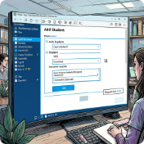


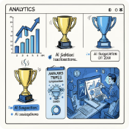
Key Features
Student Management
Attendance Management
Marks Management
Analytics & AI
Performance prediction, personalized study suggestions, leaderboard, stats.
Add, view, update, delete, and search students by ID or name.
Mark daily attendance, compute percentage, alert if < 75%.
Record five-subject marks, calculate average and auto-generate grades.

Slide 5
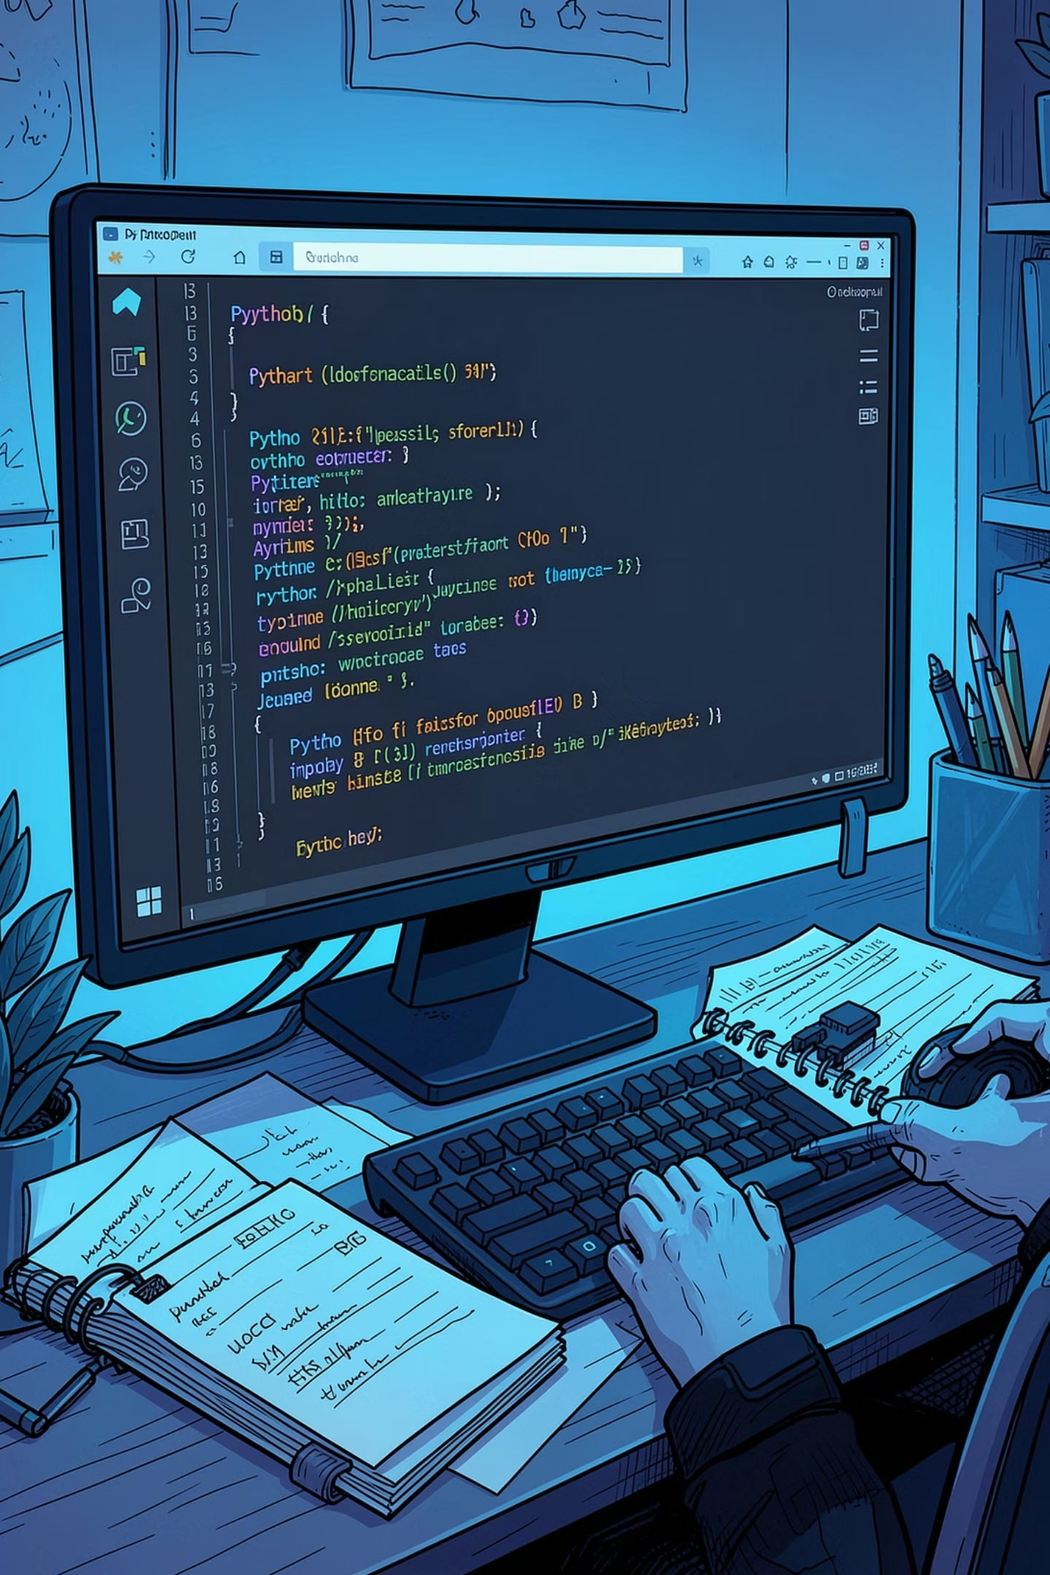
Technologies & Modules
Stack
Python Modules
Python 3 — core language
JSON — local persistent storage
VS Code, Git, GitHub — tooling
json — read/write student, attendance, marks
os — file existence checks
datetime — record attendance dates
collections.defaultdict — department & grade stats

Slide 6

Project Workflow
Start Program
Main Menu
Select Option
Perform Action
The console app follows a menu-driven linear flow that stores and retrieves data from JSON files and returns results to the user.

Slide 7
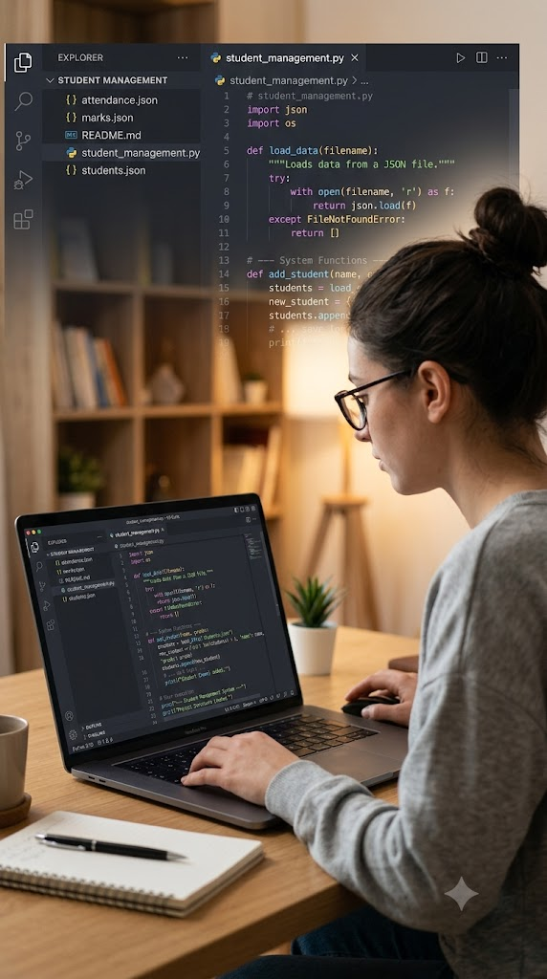
Project Structure & Files
Student_Management_System
student_management.py — application source code
students.json — student details
attendance.json — attendance records
marks.json — marks and grades
README.md — instructions & features

Slide 8
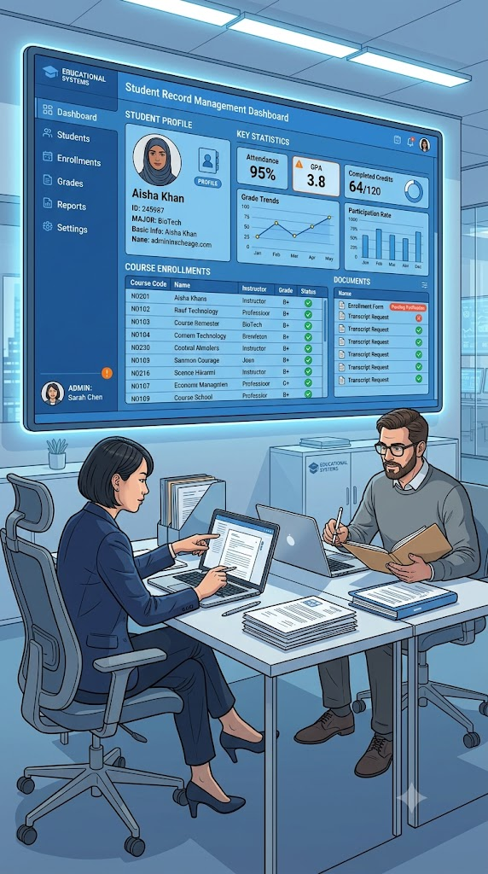
Validation, Error Handling & Sample Output
Validations
Resilience
Checks for empty fields, duplicate IDs, invalid email/phone/age, incorrect marks, and menu selections.
Missing JSON files are auto-created; exceptions handled to keep the app stable.
Sample Output
CLI menus, student record displays, attendance percent (e.g., 100.0%), marks avg and grade (e.g., 88.0 → A), and leaderboard.

Slide 9


Future Enhancements & Conclusion
Future Roadmap
Conclusion
GUI with Tkinter
Authentication for admins
Export to Excel/PDF & email alerts
Cloud DB or web app (Flask/Django) & mobile support
ML model for advanced predictions
This project demonstrated practical Python application development: modular code, JSON persistence, validation, analytics, and AI-driven study suggestions — strengthening real-world software skills.
Data saved locally in JSON; Goodbye message confirms persistence.

