Slide 1

Password Generator & Strength Checker
Author: Ardra Rajesh
CODEVEDX Python Internship
Department: B.Tech CSE.
Date: 27 June 2026.

Slide 2

Why this project matters
Security Risk
Goal
Weak passwords are a leading cause of breaches.
Generate cryptographically secure passwords and evaluate strength.
Learning
Secure programming, modular design, regex, file handling.

Slide 3
Objectives
Secure generation
Strength analysis
Use Python's secrets module for cryptographic randomness.
Score passwords by length, diversity, patterns, repeats, sequences.
Safe history
Developer growth
Store only metadata (timestamp, length, score, rating), never actual passwords.
Practice exception handling, JSON, input validation, modular code.

Slide 4

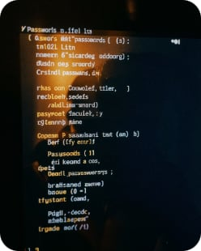
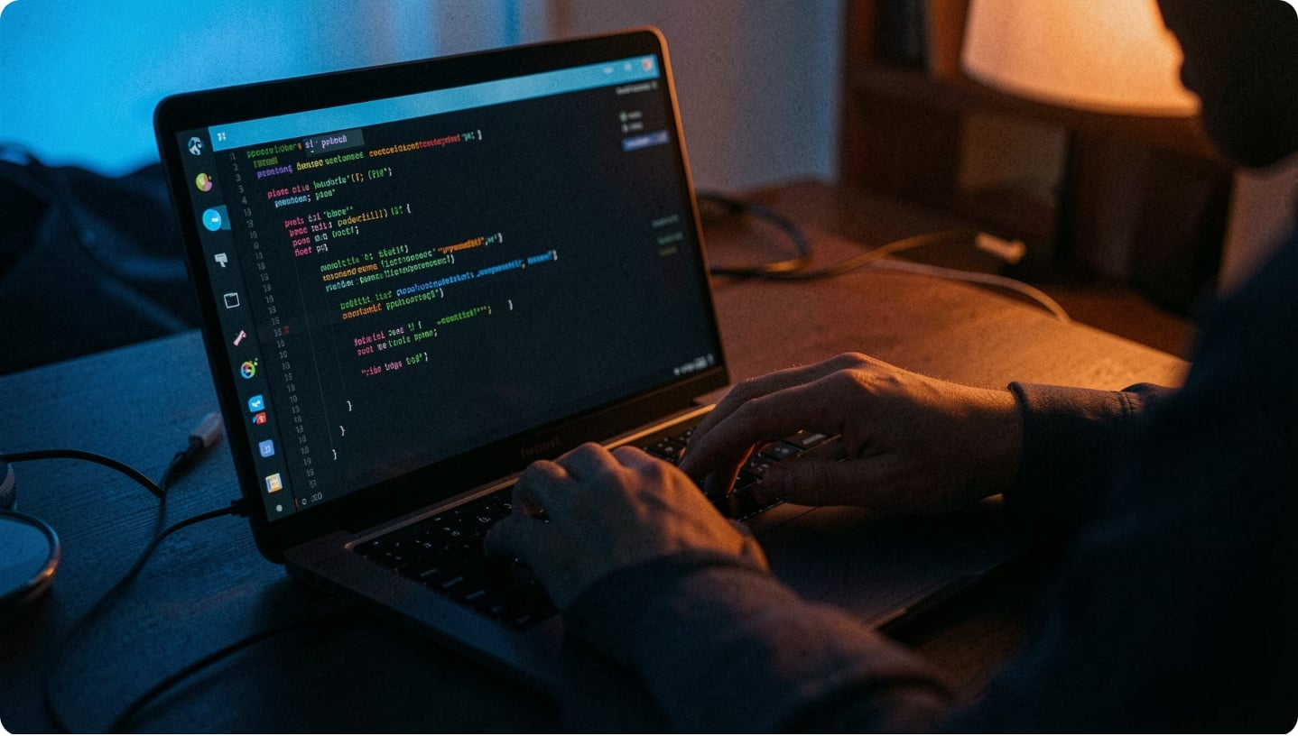
Features — Generation
Custom options
Batch generation
Select length; include uppercase, lowercase, numbers, symbols; guarantee each chosen category appears.
Generate up to 20 unique passwords at once; prevents duplicates.

Slide 5
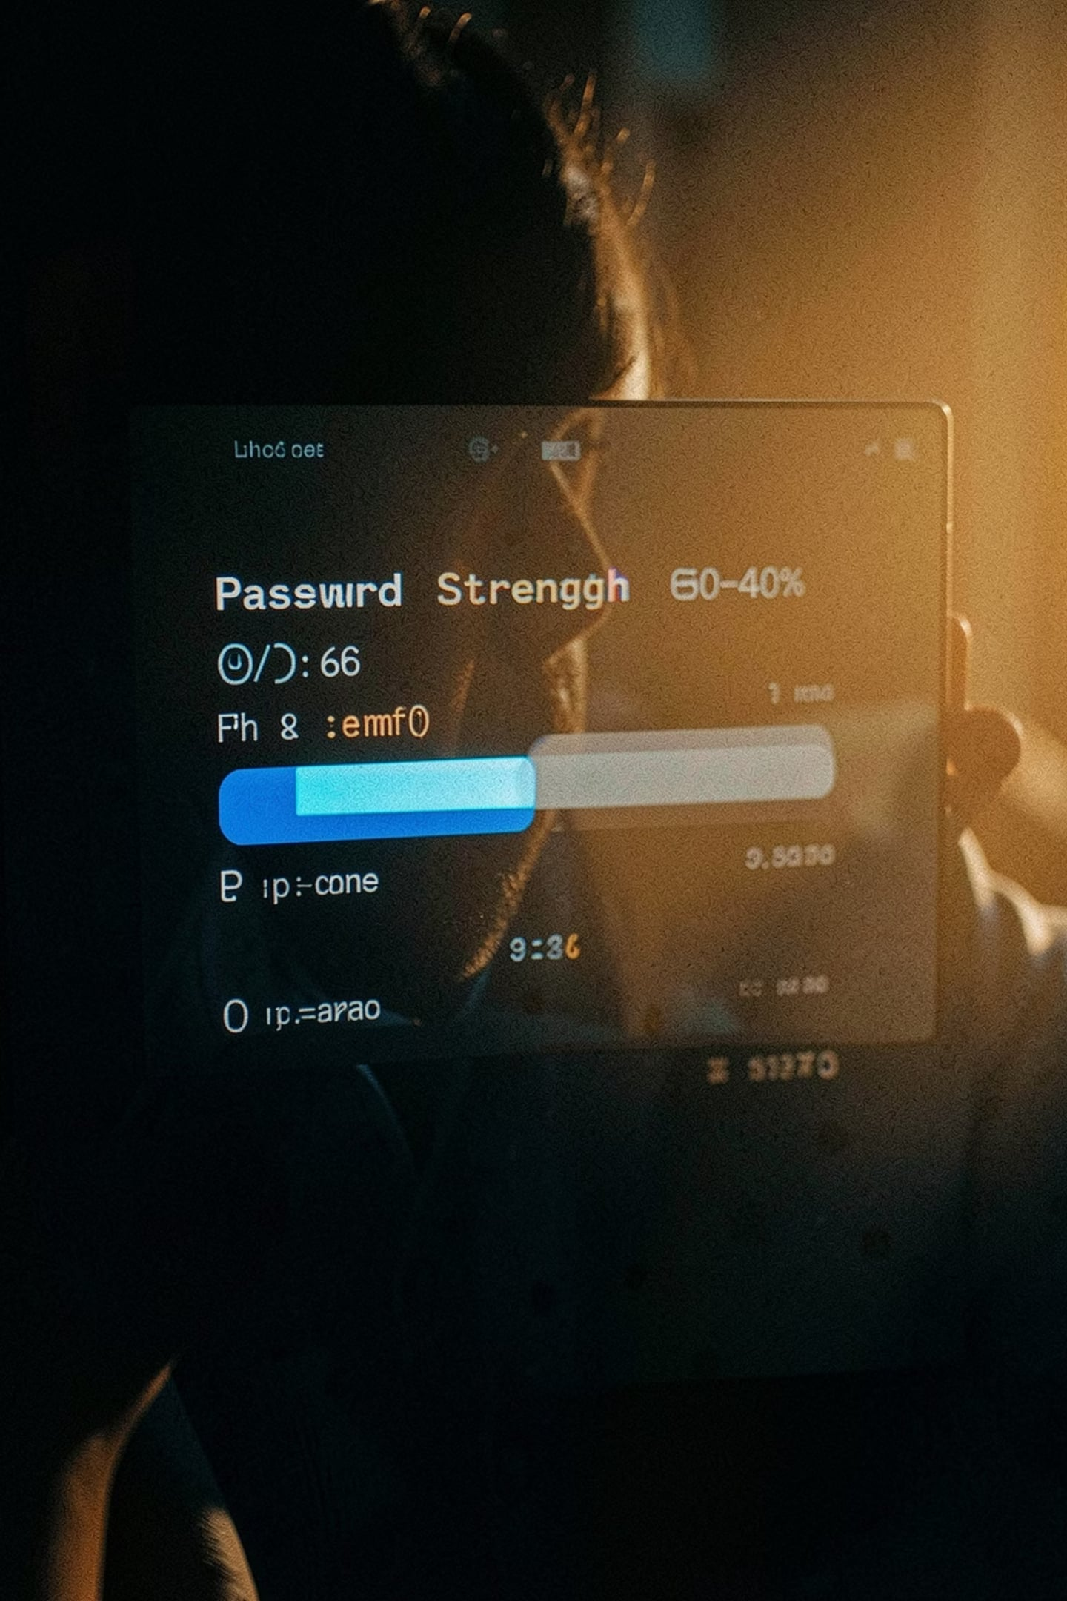
Features — Analysis & Feedback
Strength metrics
Length, character diversity, common weak lists, repeated chars, sequential patterns.
Scoring & rating
Numeric score and strength label, plus improvement suggestions and a visual progress bar.
Privacy-first
Only metadata saved (timestamp, length, score, rating). Passwords never stored.

Slide 6
Technologies & Modules
Python 3
Main language; scripts run in console.
secrets
JSON
Cryptographic randomness for passwords.
Local storage for password metadata.
VS Code
re
Editor used during development.
Regex checks for patterns and strength analysis.
datetime & os
Timestamps and file management for history handling.

Slide 7
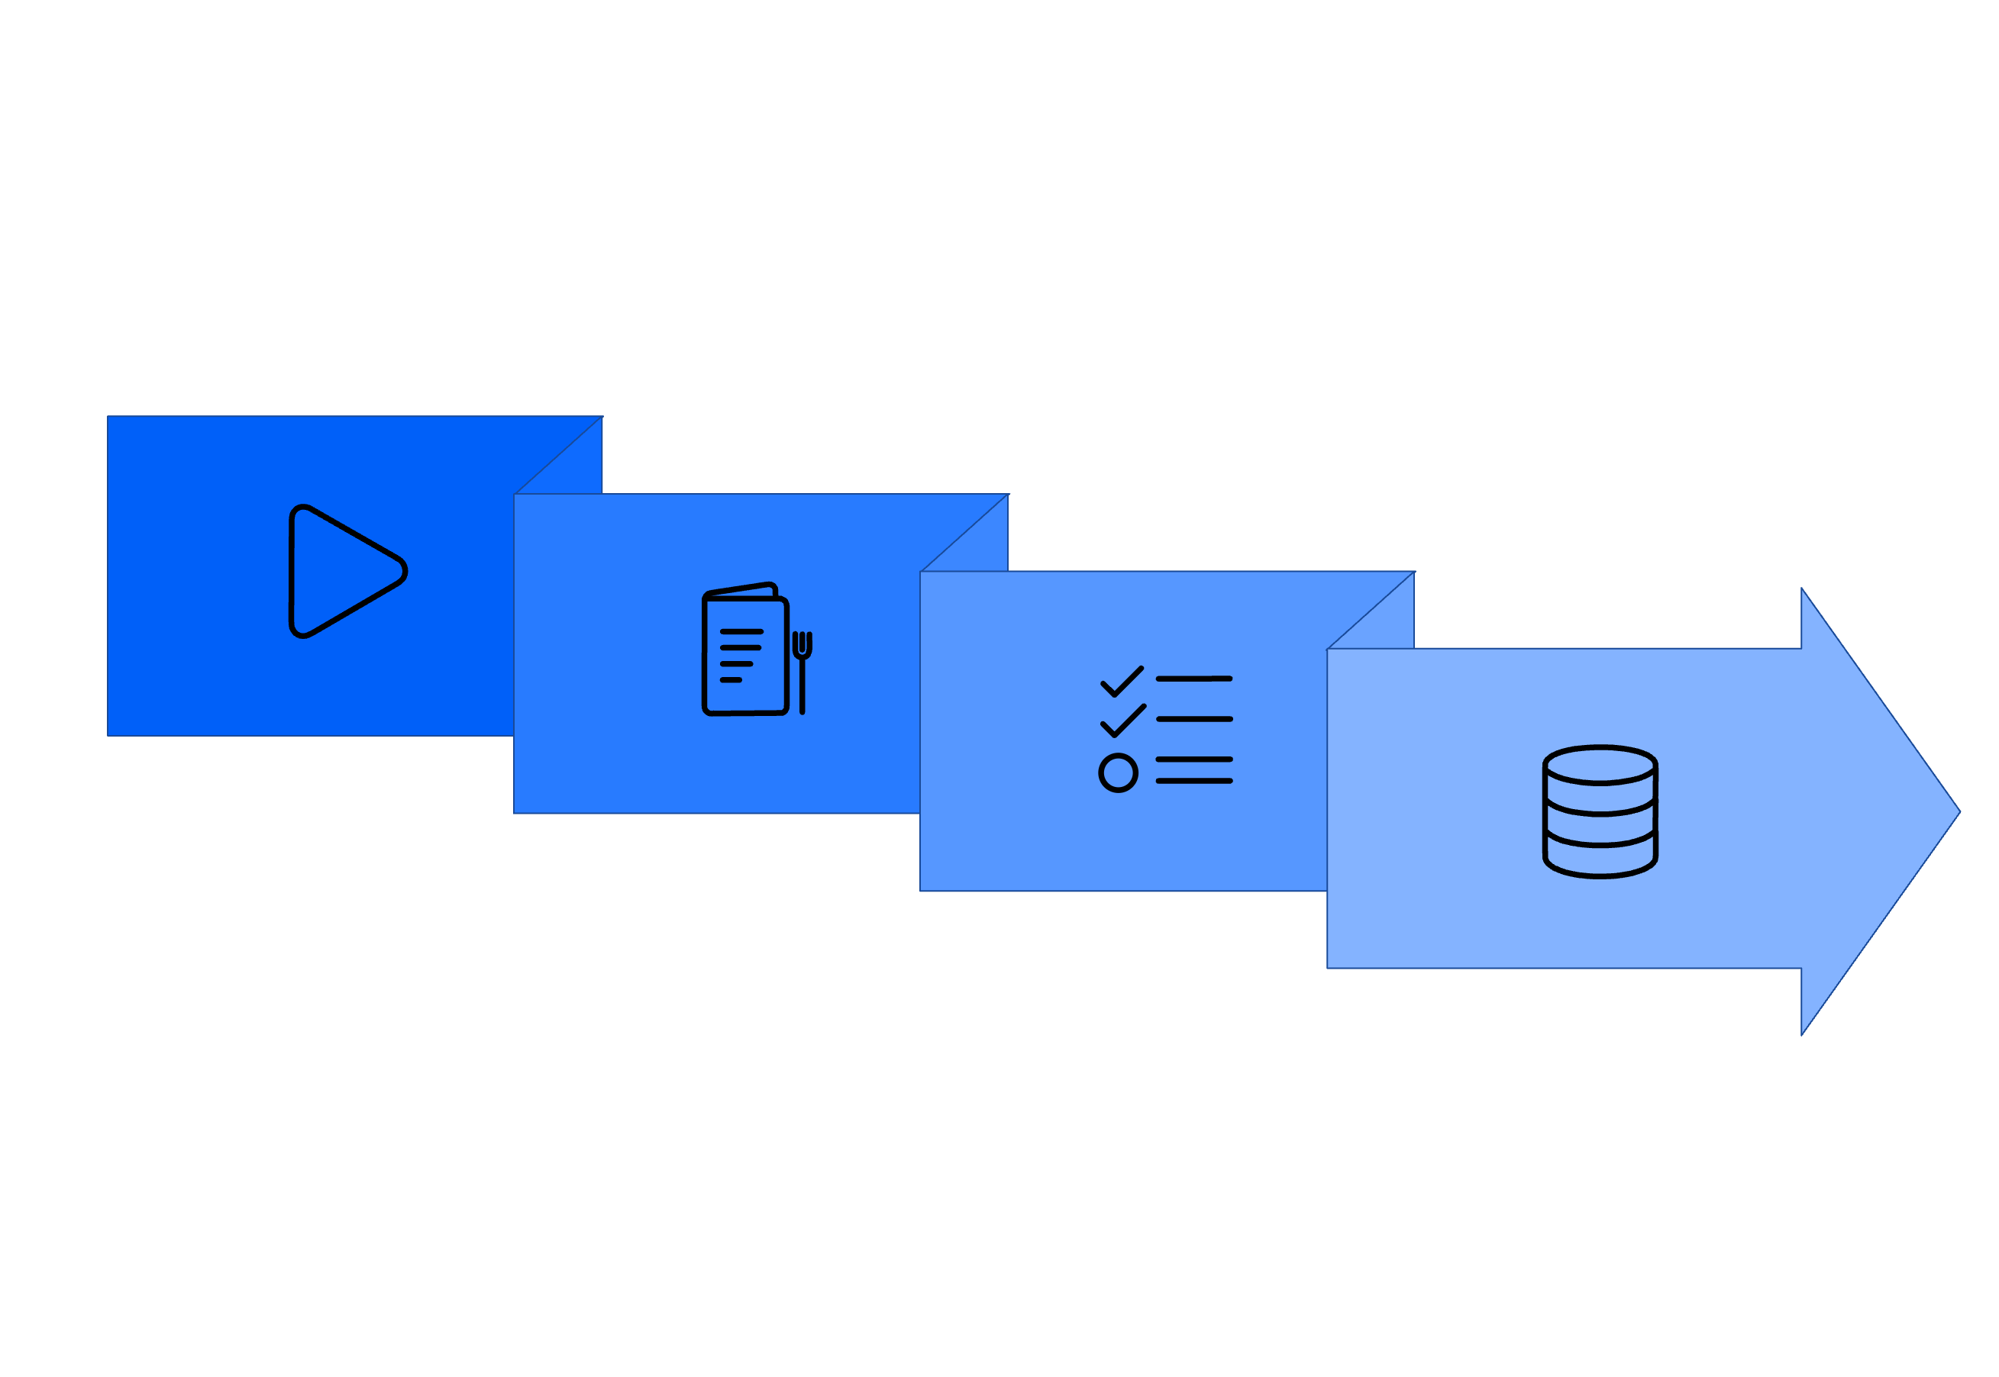
Project Workflow
Main Menu
Execute & Store
Start
Select Action
The menu-driven flow guides users through generation, analysis, history viewing, and exits while storing only metadata.

Slide 8
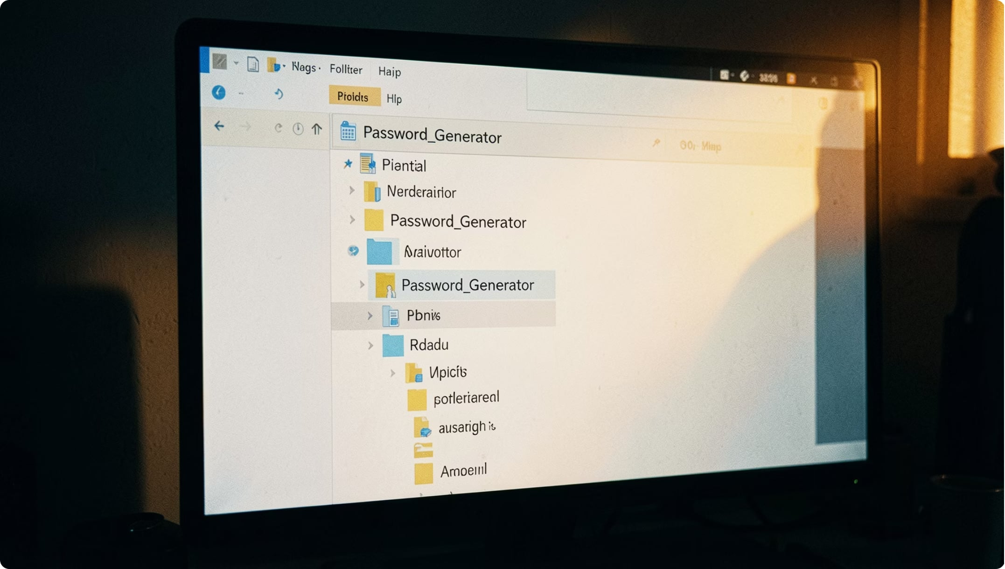
Project Structure
password_generator.py
Main script: UI, generation, strength checks, history handling.
password_history.json
Stores metadata: timestamps, lengths, scores, ratings.
README.md
Project notes and usage instructions.

Slide 9
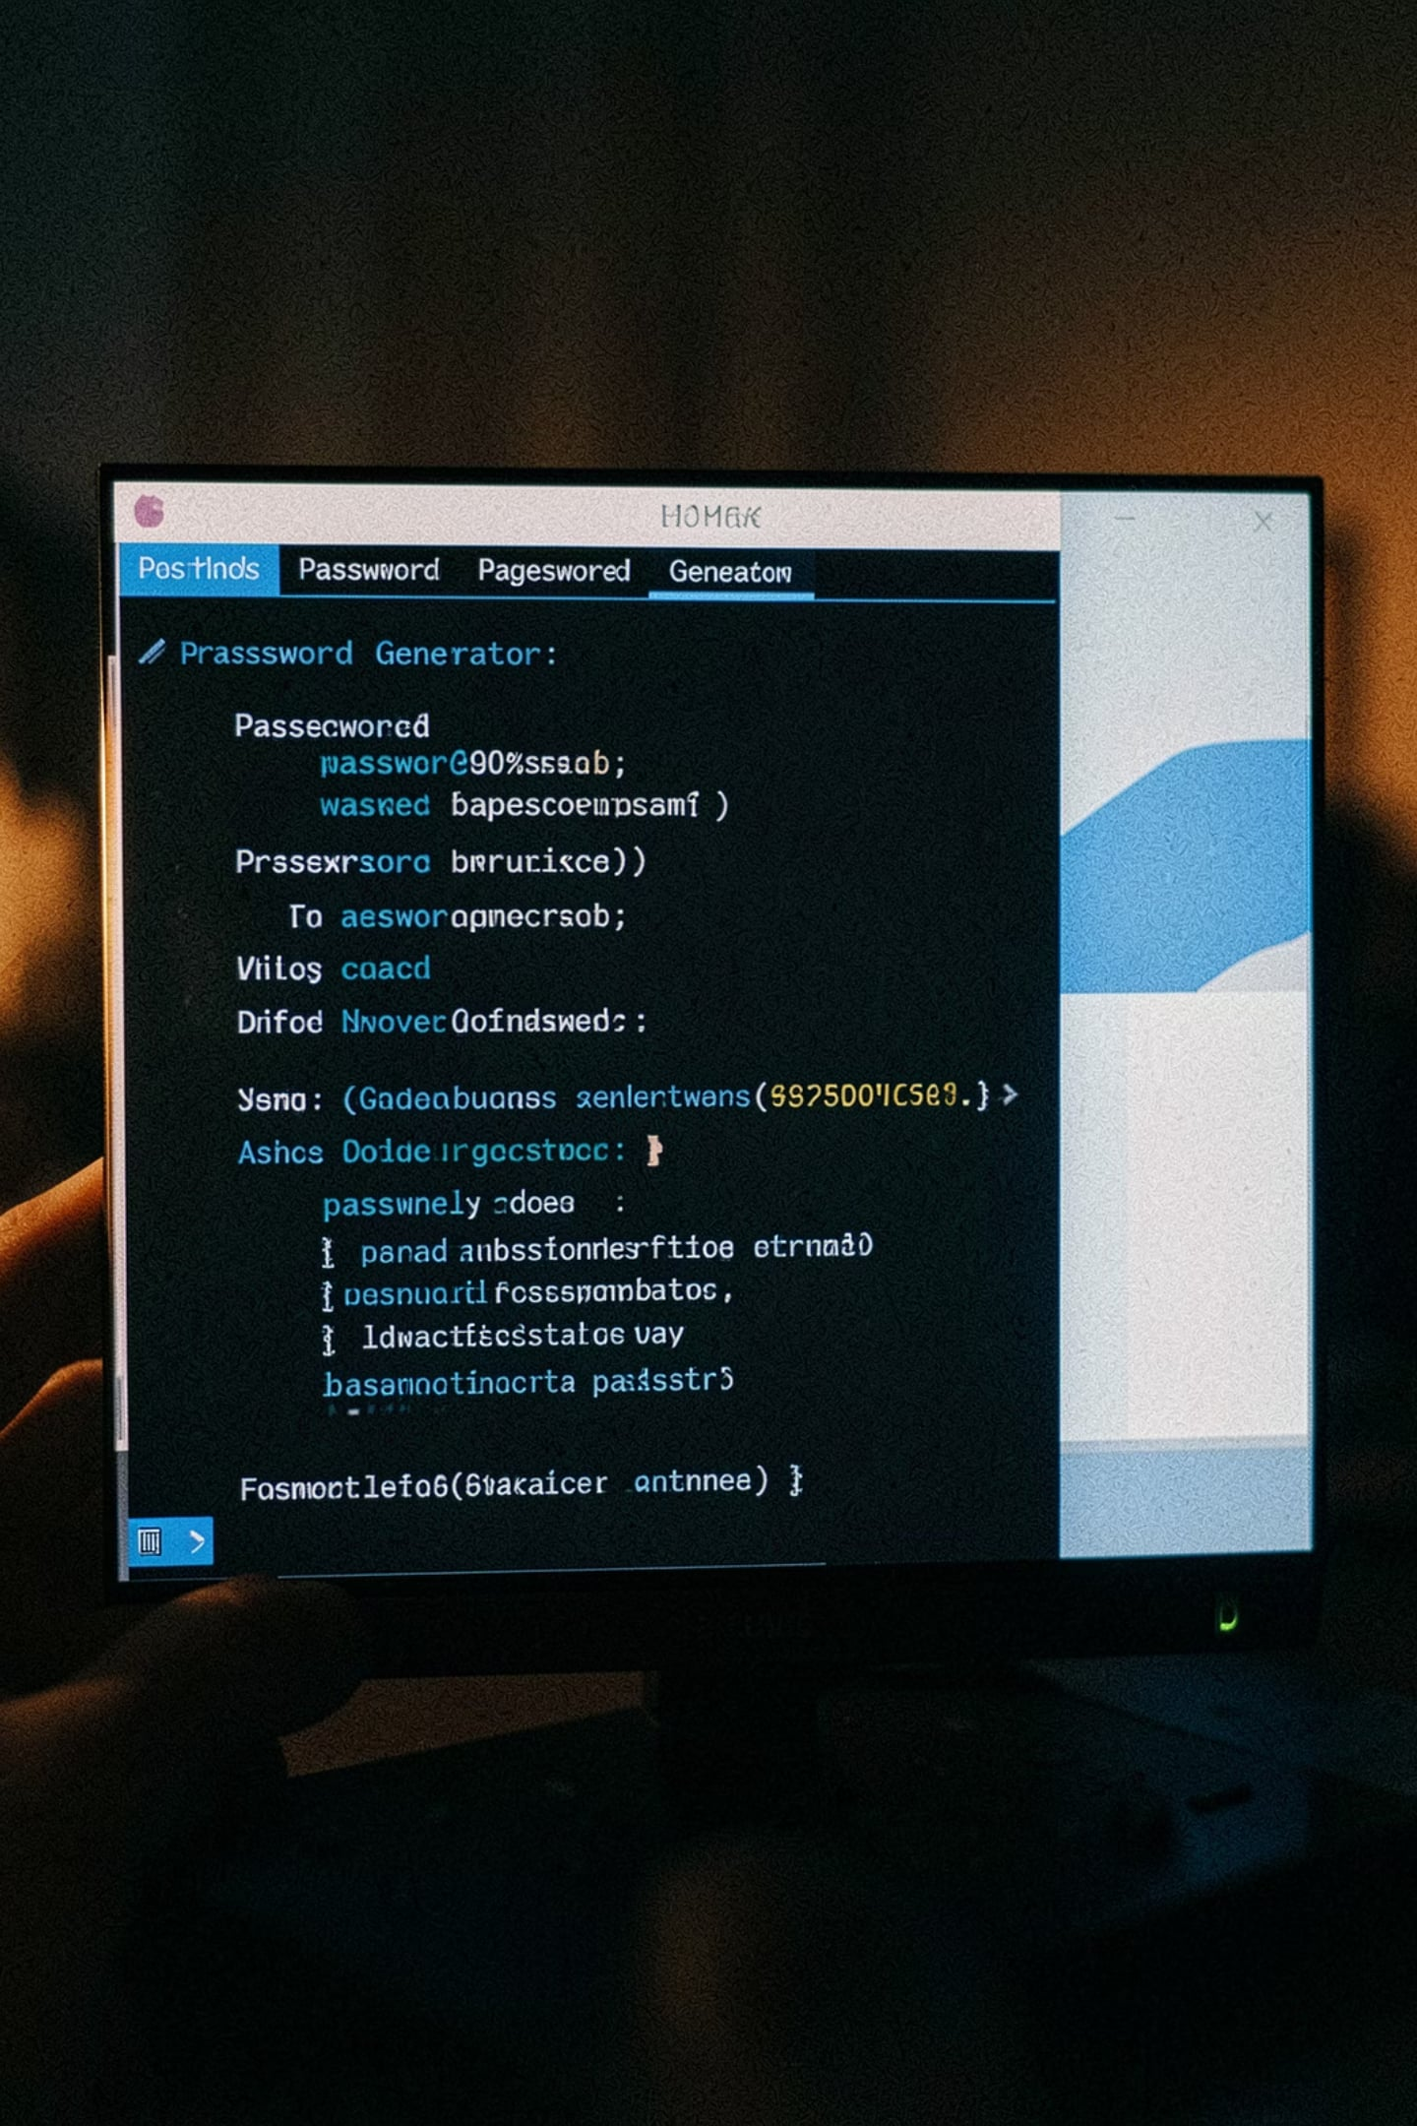
User Experience — Examples & Error Handling
Console samples
Menu options for single/multiple generation, strength check, history. Example outputs show scores and progress bar.
Validations
Checks: empty input, invalid menu choices, invalid lengths, no categories selected, duplicate detection in batches.
Robustness
Auto-create missing JSON, handle corrupted files, and catch exceptions for safe UX.

Slide 10


Conclusion & Next Steps
Outcome
Practical tool demonstrating secure password generation and strength analysis while preserving privacy.
Skills gained
Cryptography-aware coding, regex, JSON handling, input validation, exception management.
Future enhancements
GUI (Tkinter), encrypted exports, clipboard copy, passphrases, exclude similar chars, expiry reminders, cloud backup, ML risk prediction, multi-language support.
Project metadata stored securely; passwords never saved. Theme accents use #609DFF, #041938, #013180.

