Slide 1

Task Automation Tool
Submitted by Ardra Rajesh
CODEVEDX Python Programming Internship
B.Tech CSE
Date: 06 July 2026

Slide 2
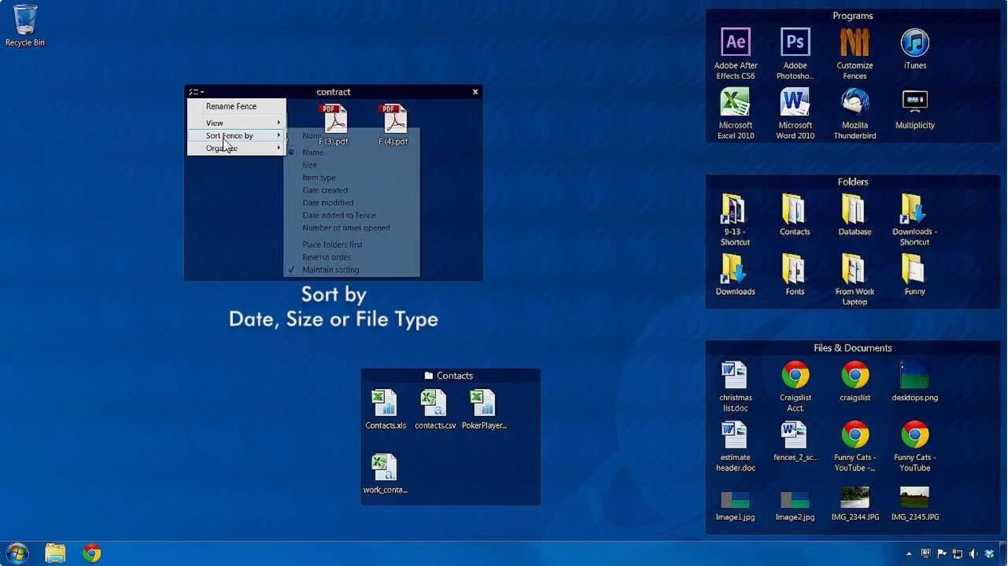
Overview
Console-based Python application that automates file management: organizes files by extension, generates reports, and can email summaries. Runs interactively or via command-line, uses the standard library only, and emphasizes logging, security, and robust error handling.

Slide 3

Objectives
Automate Tasks
Organize Files
Reduce repetitive file management work.
Sort files into categorized folders by extension.
Reporting & Email
Secure & Logged
Generate reports and optionally send summaries via email.
Use environment variables for credentials and maintain logs.

Slide 4


Key Features
File Organization
Dry Run Mode
Report Generation
Email Notifications
Preview moves without changes to verify actions safely.
Categories: Images, Documents, Videos, Audio, Archives, Scripts, Others. Creates folders and renames duplicates.
Export detailed reports as .txt and .csv with processed/moved/skipped/failed lists.
Attach reports and send summaries via Gmail SMTP using app passwords stored in environment variables.

Slide 5

Technologies & Modules
os, shutil
File and directory operations.
csv
Generate CSV reports.
smtplib, email.message
Compose and send emails with attachments.
argparse
Command-line interface support.
logging, datetime, socket
Activity logs, timestamps, and network-timeout detection.

Slide 6

Project Workflow
Start
Menu
Select
Execute
Results
A clear, repeatable flow supports both interactive and CLI usage.

Slide 7
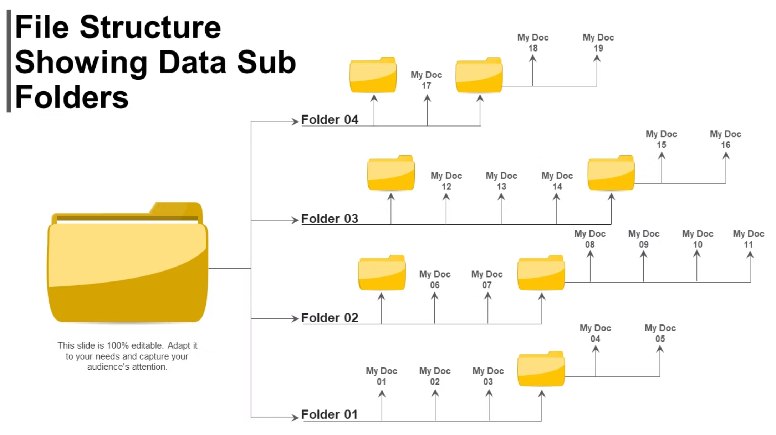

Project Structure
Task_Automation_Tool/
task_automation_tool.py
sample_data/
reports/
logs/automation.log
README.md
Modular layout keeps code testable and maintainable.

Slide 8
Error Handling
Validations
File Errors
Email & Network
Robust Logging
Check for missing source folders and invalid menu selections.
Handle permission denied, duplicate names, and filesystem errors.
Validate addresses, credentials, SMTP auth failures, and network timeouts.
Timestamped logs assist debugging and auditing of automation runs.

Slide 9
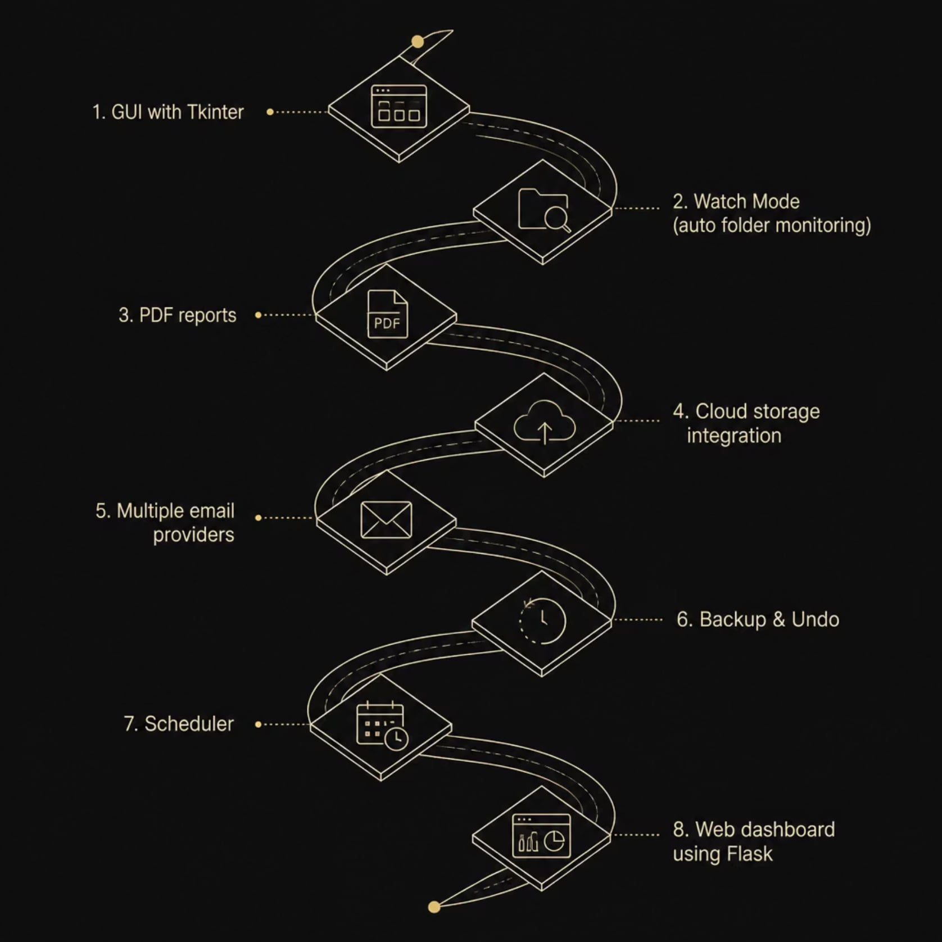


Future Enhancements & Conclusion
The Task Automation Tool provided practical experience in Python automation: file handling, logging, secure email integration, CLI design, and exception handling. Its features—dry-run, duplicate handling, reporting, and email summaries—make it a practical, safe utility.
Built with Python standard libraries; ready for extension into GUI, scheduling, and cloud features.

