Slide 1

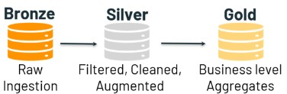




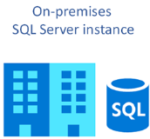


Azure Data Lake
Azure Synapse Analytics
Power BI
Azure Data Factory
Data Ingestion Layers
Azure Databricks
Security & Governance
Key Vaults
Azure Active Directory

