Slide 1
Title: Artificial Neural Networks in Medical Diagnosis Author:Qeethara Kadhim Al-Shayea
Link: https://pdfs.semanticscholar.org/7e1a/23188b00c719e656b7949a7c9a1ff2ab841e.pdf
Group members: Ardra Ayyappath 2016A3PS0261P
Arpit Anshuman 2016A3PS0250P
Akshat Sharma 2016A3PS0139P

Slide 2
INTRODUCTION
Medicine has always benefited from the forefront of technology. Artificial Neural Networks (ANN) is currently the next promising area of interest. It is believed that neural networks will have extensive application to biomedical problems in the next few years. Already, it has been successfully applied to various areas of medicine, such as diagnostic systems, biochemical analysis, image analysis, and drug development.

Slide 3
CONTRIBUTION OF EACH MEMBER
All members contributed equally in collecting data and programming the network.
Arpit Anshuman – programmed the network and trained the data.
Ardra Ayyappath - programmed the network and made the presentation.
Akshat Sharma - programmed the network and collected the data.

Slide 4
HYPOTHESIS
This study is aimed at evaluating artificial neural network in disease diagnosis. Two cases are studied. The first one is acute nephritis disease – using disease symptoms as the data. The second is heart disease- using cardiac Single Proton Emission Computed Tomography (SPECT) images. Each patient classified as infected or non-infected. Feed-forward back propagation neural network is used in both cases.

Slide 5
METHODOLOGY
A typical feed-forward neural network is proposed to diagnosis diseases. It consists of three layers: the input layer, a hidden layer, and the output layer. One hidden with 20 hidden layer neurons is created and trained. The input and target samples are automatically divided into training, validation and test sets. The training set is used to teach the network. Training continues as long as the network continues improving on the validation set. The test set provides a completely independent measure of network accuracy.

Slide 6
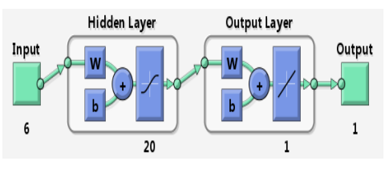
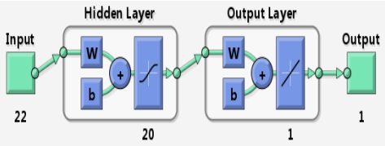
FLOWCHART
Proposed neural networks for diagnosis
Acute nephritis
Heart disease

Slide 7
IMPLEMENTATION DETAILS
Deep Learning toolbox from MATLAB was used to evaluate the performance of the proposed networks. Inbuilt functions (feedforwardnet() and patternnet() ) were used for the analysis.
For diagnosis of acute nephritis, a two-layer feed-forward network with 6 inputs and 20 sigmoid hidden neurons and linear output neurons was created.
A two-layer feed-forward network with 22 inputs and 20 sigmoid hidden neurons and linear output neurons was created for diagnosis of heart disease.

Slide 8
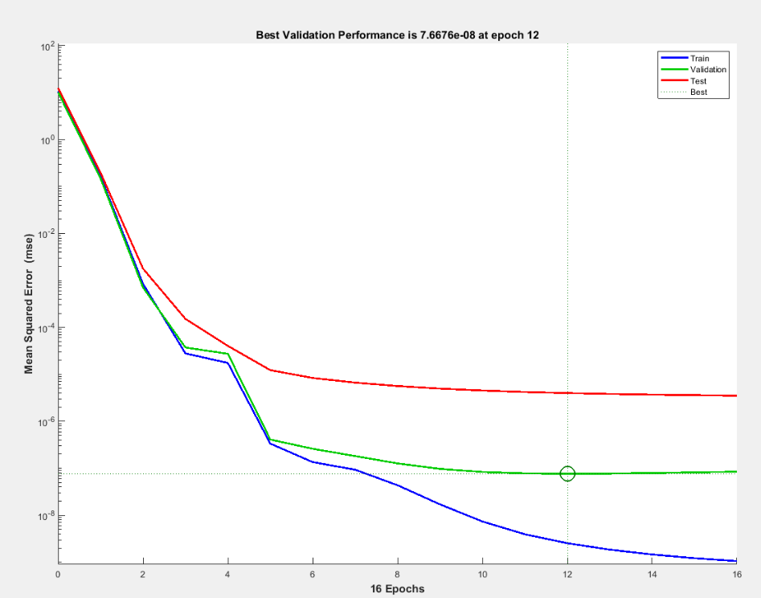
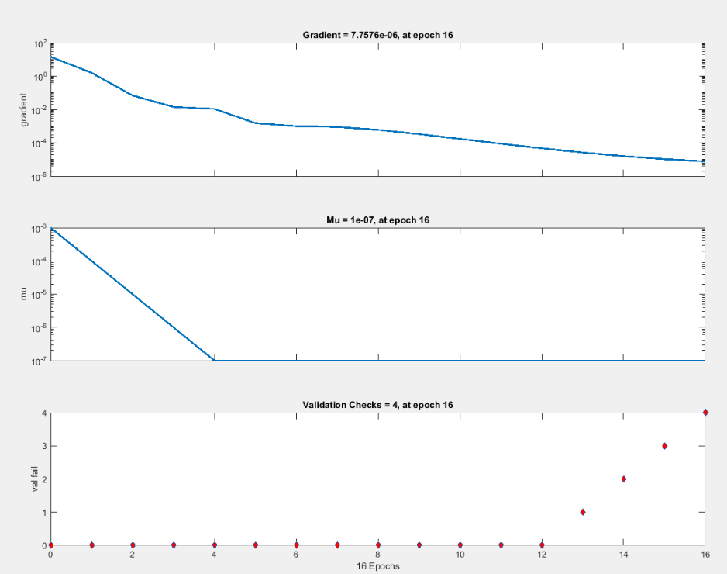
RESULTS-ACUTE NEPHRITIS

Slide 9
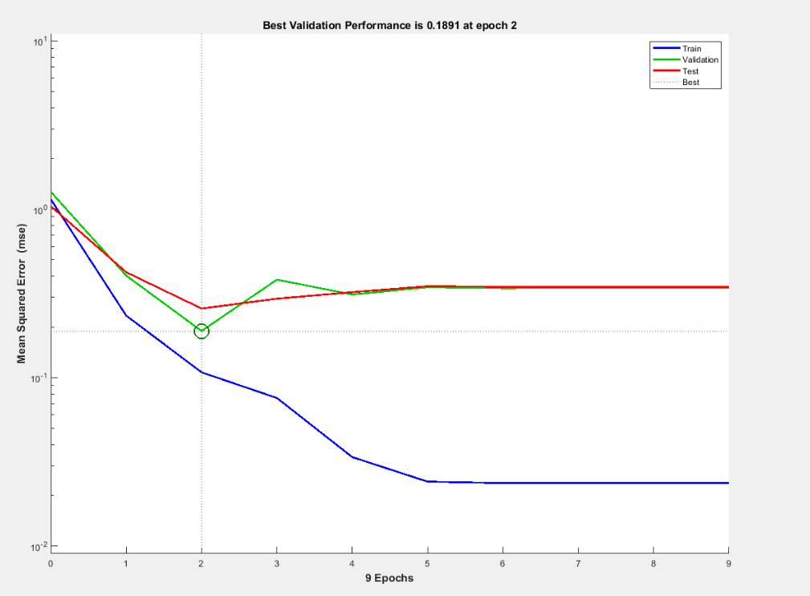
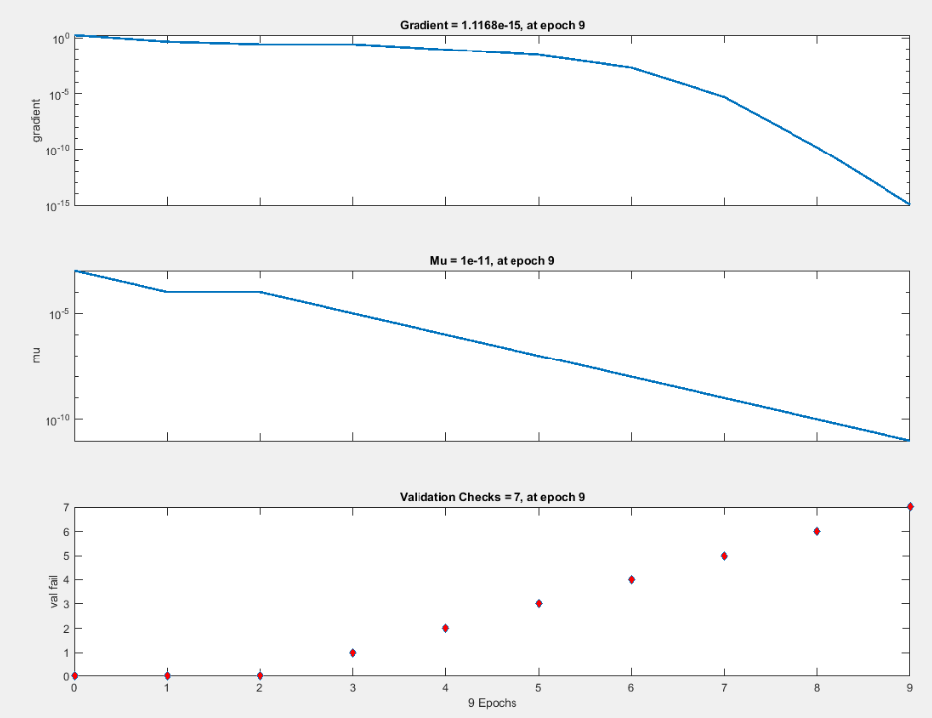
RESULTS-HEART DISEASE

Slide 10
CONCLUSIONS
The proposed feed-forward back propagation neural network with supervised showed significant results in dealing with data represented in symptoms and images. Results showed that the proposed diagnosis neural network could be useful for identifying the infected person. The results of applying the artificial neural networks methodology to distinguish between healthy and unhealthy person based upon selected symptoms showed very good abilities of the network to learn the patterns corresponding to symptoms of the person

Slide 11
CONCLUSIONS
The results for the Heart Disease analysis wasn’t as expected and shown in the paper. The performance value we got was approximately 0.18 which is not at par with the 0.08 performance value that the author obtained.

Slide 12
REFERENCES
Khan, Zope, Suralkar, I.Y.K.,P.H.Z,S.R.S, 2013. Importance of Artificial Neural Network in Medical Diagnosis disease like acute nephritis disease and heart disease. International Journal of Engineering Science and Innovative Technology (IJESIT), [Online]. 2, 1-8. Available at: https://www.researchgate.net/publication/285831313_Importance_of_Artificial_Neural_Network_in_Medical_Diagnosis_disease_like_acute_nephritis_disease_and_heart_disease[Accessed 18 November 2018]
Qeethara Kadhim Al-Shayea and Itedal S.H. Bahia, “Urinary system Dieseases Diagnosis Using Artificial neural networks”, IJCSNS, Vol.10, No.7, July 2010.
Kamruzzaman,Hasan,Siddiquee,Mazumdar, S.M.K.,A.R.H,A.B.S, E.H.M, 2004. MEDICAL DIAGNOSIS USING NEURAL NETWORK. International Conference on Electrical & Computer Engineering ICECE, [Online]. 3, 1-4. Available at: https://arxiv.org/abs/1009.4572 [Accessed 18 November 2018]
W. David Aha and Dennis Kibler, “Instance-based prediction of heart disease presence with the Cleveland database”

