Slide 1
QUEST ARUCO AVATAR
How the avatar is placed
on the mannequin
Floor-locked, grid-selected runtime • installed 5 September 2026
CAMERA
MARKERS
COMMON POSE
FILTER
AVATAR

Slide 2
CURRENT QUEST RUNTIME
The placement problem
Three physical markers must describe one virtual body anchor.
ID0
common
Pose = position (X,Y,Z) + orientation
ONE COMMON
6-DoF POSE
The calibration stores a full marker → common transform, including both translation and rotation.
ID1
chest
ID2
torso
marker world pose × marker-to-common offset = common estimate
navel_provider.gd • default_navel_calibration.cfg
2

Slide 3
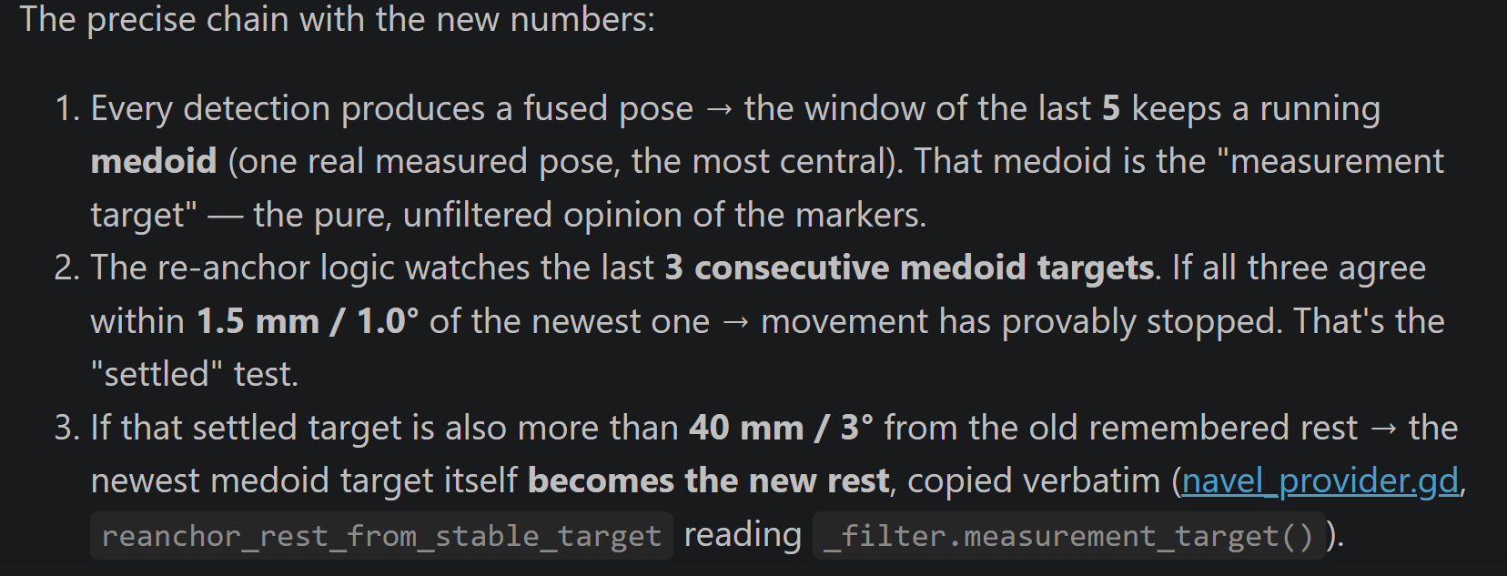
CURRENT QUEST RUNTIME
Reconstruct, fuse and floor-lock the common pose
Only markers from the exact newest camera result are combined; orientation is then constrained to the floor.
1 marker
Use its reconstructed common pose
FLOOR-LOCK
2 markers
Mean position + sign-aligned quaternion average
Marker local Y → horizontal body direction
Quest UP → vertical reference
Cross product → sideways axis
Marker pitch + roll discarded
3 markers
Mean position + sign-aligned quaternion average (same as 2)
navel_provider.gd::_fuse • navel_provider.gd::_floor_lock
4

Slide 4
CURRENT QUEST RUNTIME
Startup: learn a robust session rest pose
The avatar stays hidden while independent fused poses are collected.
30
33
36
39
E0
E1
E2
E3
Each estimate uses coordinate-median position + one measured rotation medoid over all collected poses.
Stable comparison
Δ position ≤ 1.5 mm AND Δ rotation ≤ 1.0°
4 stable comparisons → detection 42 earliest
Detection 100 fallback ≈ 10 s at 10 Hz
Grid-selected on the 2026-09-04 session • ≥95% stationary confirmation • ≤5% moving false acceptance
5

Slide 5
CURRENT QUEST RUNTIME
After startup: the runtime filter
1
2
3
4
5
FLOOR-LOCKED
MEASUREMENT
5-POSE
MEDOID
DEAD
ZONES
EXPONENTIAL
SMOOTHING
LOCAL REST
PULL
Updates once per new OpenCV timestamp,
Rejects a lone temporal outlier
Holds tiny position / rotation changes
Moves continuously
Always active;
Selected values: window 5 • radius 0.20 m • position dead zone 20 mm • rotation dead zone 0.3° • smoothing τ = 1.2 s • prior τ = 2 s • rest re-anchor beyond 40 mm / 3°
simple_pose_stabilizer.gd • avatar_rig_navel.gd
6

Slide 6
CURRENT QUEST RUNTIME
Why the five-pose medoid rejects jumps
bad
score = position distance
+ radius × rotation angle
M2
chosen
M1
M6
M3
M5
Selected radius = 0.20 m
At this radius, 1° rotation contributes approximately the same score as 3.5 mm of position error.
Six measurements agree; one is far away. The medoid chooses the actual measured pose with the smallest total distance to all others.
simple_pose_stabilizer.gd::_medoid • 0.20 m selected on the 2026-09-04 session replays
7

Slide 7
CURRENT QUEST RUNTIME
Dead zone, smoothing and prior do different jobs
DEAD ZONE
SMOOTHING
REST PRIOR
≤20 mm position
≤0.3° rotation
Hold the corresponding output channel.
τ = 1.2 s
63% after 1.2 s
95% after 3.6 s
τ = 2 s
Always active; after a re-anchor the landing rule closes onto the new rest at smoothing speed.
A stable endpoint beyond 40 mm or 3° re-anchors the remembered rest itself, so the prior pulls toward the new location instead of dragging a relocated mannequin backwards.
Filtering order: medoid → dead zones → smoothing → weak rest pull • rest re-anchors at stable endpoints
8

Slide 8
CURRENT QUEST RUNTIME
Two poses exist: displayed pose and remembered rest
Measurement-only
5-pose medoid
3-target window
stationary?
Remembered rest
re-anchors (jumps)
Re-anchor floor: 40 mm / 3°
Rest never learns from a single raw pose and never from the displayed pose, because that output already contains smoothing and prior feedback. It adopts the measurement-only medoid target once the complete 3-target window is stationary (≤1.5 mm / ≤1.0°) and clearly displaced from the old rest. Position and rotation re-anchor independently.
LIMIT: the newest stationary test exposed stable viewpoint errors up to 114 mm. The re-anchor floor cannot reject a large, stable wrong pose; marker agreement must be fixed before fusion.
navel_provider.gd::reanchor_rest_from_stable_target • simple_pose_stabilizer.gd::_update_stable_endpoint_state
9

Slide 9
CURRENT QUEST RUNTIME
Tracking loss and Quest-menu resume
Temporary marker loss
App resumes after Quest menu
No new marker result
for 300 ms
Hide avatar
keep last internal pose
Old XR world rest
may no longer be valid
Keep permanent
marker offsets
Collect 5 fresh detections
≈0.5 s at 10 Hz
Relearn startup rest
55–100 detections
≈11–20 s
marker_freshness.gd • avatar_rig_navel.gd::_notification
10

Slide 10
CURRENT QUEST RUNTIME
Final render transform
A persistent fixed offset here cannot be repaired by waiting, smoothing, the prior or 600-second healing.
FILTERED
COMMON POSE
FIXED MODEL
ALIGNMENT
VISIBLE
AVATAR
×
=
Scale 0.77
Rotation −90° X (lay flat)
Position (0.07256, −0.127499, 0.177248) m
Floor-lock sets local Z down and local Y to horizontal body heading before this fixed model correction is applied.
main_3d.tscn: mannequin child transform • AvatarRig.global_transform = filtered pose
11

Slide 11
Manikin Scale Logic
GLB model size: Length = 0.8082 m (Z‑axis), Width = 0.5457 m, Depth = 0.2807 m
Scale factor meaning: 0.77 = real manikin length ÷ GLB model length
Your measurement: Real manikin ≈ 0.622 m → 0.622/0.8082=0.7696 → 0.77
Uniform scaling: One scale value stretches all axes together → length, width, depth all multiplied by 0.77
Scaled dimensions:
  Length: 62.2 cm
  Width: 42.0 cm
  Depth: 21.6 cm

Slide 12
CURRENT QUEST RUNTIME
Re-anchoring - the full story of a mannequin move
0. AT REST - the avatar sits pinned at the remembered rest R. Measurements jitter a few millimetres; the dead zone hides it and the prior (τ = 2 s) holds the avatar at R. Every detection still updates the 5-pose medoid target.
1. THE MANNEQUIN IS MOVED - the markers report the new position; the medoid target follows within ~5 detections. The display chases it smoothly (τ = 1.2 s) while the prior still leans slightly toward the old R.
2. MOVEMENT STOPS - the targets cluster. SETTLED test: the last 3 targets all lie within 1.5 mm / 1.0° of the newest one → the move has provably ended.
3. REAL OR BIAS? - DISTANCE test: the settled target sits more than 40 mm / 3° from the old R → too large to be viewpoint bias → a genuine relocation. (Smaller settled offsets are treated as bias and never move R.)
4. RE-ANCHOR - the newest medoid target becomes the new R, copied verbatim, in one invisible internal step. Position and rotation update independently. The viewer sees nothing: only the internal anchor jumps.
5. LANDING - target and R now agree, so the dead zone yields and the display closes the final millimetres onto the new R at smoothing speed. The prior now holds the avatar at the NEW home - back to phase 0.
R never learns from the displayed pose (that would be a feedback loop), from a single raw detection (glitch risk), or from an average (only one real measured pose is ever adopted). Between re-anchors, R is completely frozen.
navel_provider.gd::reanchor_rest_from_stable_target • SimplePoseStabilizer.measurement_target() • landing in _landing_position
17

Slide 13
CURRENT QUEST RUNTIME
How each value was selected - the grid method
INPUT - one labelled session (2026-09-04): calibration sweep, six stationary viewpoints, one measured 617.5 mm A→B→A move.
STARTUP REST - every start/step/threshold/checks/fallback combination is replayed on sliding trials of the recordings. Hard gates: ≥95% of stationary trials must confirm and ≤5% of moving trials may falsely confirm. Survivors ranked by error against the reference pose and by confirmation speed. → 30 / step 3 / 1.5 mm / 1.0° / 4 checks / fallback 100.
DISPLAY FILTER - coordinate-descent passes over the groups (window+radius, dead zones+smoothing, prior, endpoint+re-anchor floor, timeout): every candidate is replayed end-to-end and scored half on stationary stability (wobble, jump, drift vs raw) and half on movement (Retained, delay, endpoint error, return error). → window 5 • radius 0.20 m • 20 mm / 0.3° • 1.2 s • 2 s • 40 mm / 3°.
WINNER VALIDATION - movement retained 99.7% • endpoint error 4.8 mm • return error 10.4 mm.
tune_filter.py • winner in tune_filter_best.txt • every evaluated configuration in tune_filter_results.csv
18

Slide 14
CURRENT QUEST RUNTIME
Measuring wrongness 1/3 - the six stationary rulers
POSITION (p[n] = 3D point of frame n)
ROTATION (q[n] = unit quaternion of frame n)
step[n] = ‖p[n+1] − p[n]‖ × 1000 (mm)
movement between two neighbouring frames
WOBBLE = median{ step }
the typical shiver - fast shaking that goes nowhere
JUMP = P95{ step }
the rare biggest hop: a glitch in 1% of frames is invisible to the median, but the 95th percentile catches it
c = ( median{pₓ}, median{p_y}, median{p_z} )
home = componentwise median position
DRIFT = median{ ‖p[n] − c‖ } × 1000
typical distance from home - catches a slow crawl even when every single step is tiny
θ(q₁,q₂) = 2·arccos|q₁·q₂| · 180/π (deg)
shortest turning angle; |·| because q and −q are the same physical rotation
r[n] = θ(q[n], q[n+1])
WOBBLE = median{ r } JUMP = P95{ r }
q* = argmin over q[i] of Σⱼ (1 − |q[i]·q[j]|)
home = MEDOID: the one measured rotation closest to all others (a componentwise median is invalid for quaternions)
DRIFT = median{ θ(q[n], q*) }
typical angle away from the rotation home
filter_errors.py::measure_errors - returns wobble / jump / drift for position (mm) and rotation (deg)
19

Slide 15
CURRENT QUEST RUNTIME
Measuring wrongness 2/3 - the four movement rulers
Setup: the mannequin was slid A → B → A, physically measured D = 617.5 mm. u = unit vector along the raw A→B line. out_A, out_B, out_return = the avatar's median position in the three still phases.
RETAINED = ½ [ (out_B − out_A)·u / D + (out_return − out_B)·(−u) / D ]
share of the real distance travelled, out-move and back-move averaged; 1.0 = full distance. The projection ·u counts only motion along the true line - a sideways miss is charged to ENDPOINT instead.
g(t) = (p(t) − A)·u / D t₉₀ = first moment with g(t) ≥ 0.90
DELAY = max(0, t₉₀ filtered − t₉₀ raw), averaged over out and back
seconds the avatar covers 90% of the trip later than the raw markers. If the avatar NEVER reaches 90%, delay is set to 10⁶ - that candidate is instantly eliminated.
ENDPOINT = ‖ out_B − (A + D·u) ‖ × 1000 (mm)
miss between where the avatar stopped and where the mannequin truly is
RETURN = ‖ out_return − A ‖ × 1000 (mm)
miss from the original spot after sliding back
A and B come from the RAW markers, D from a tape measure - the filtered avatar is always graded against physical reality, never against itself.
tune_filter.py::movement_metrics / crossing_time - five labelled phases: still A, move, still B, move back, still A
20

Slide 16
Yeah, the formulas look tougher than the idea. Use a 1D example.
Say the true mannequin motion is:
A = 0 cm B = 100 cm then back to A = 0 cm
Now suppose the filtered avatar does:
start: 0 cm at B: 96 cm after back: 3 cm
Then:
RETAINED = “how much of the real travel did it preserve?”
  out: 96 / 100 = 0.96
  back: (96 - 3) / 100 = 0.93
  average: (0.96 + 0.93)/2 = 0.945
  so 94.5% retained
DELAY = “how late did filtered motion reach 90%?”
  raw reaches 90 cm at 1.00 s
  filtered reaches 90 cm at 1.20 s
  delay = 0.20 s
ENDPOINT = “how far from B did it stop?”
  true B = 100 cm
  filtered B = 96 cm
  endpoint error = 4 cm = 40 mm
RETURN = “after coming back, how far from A is it?”
  true A = 0 cm
  filtered return = 3 cm
  return error = 3 cm = 30 mm

Slide 17
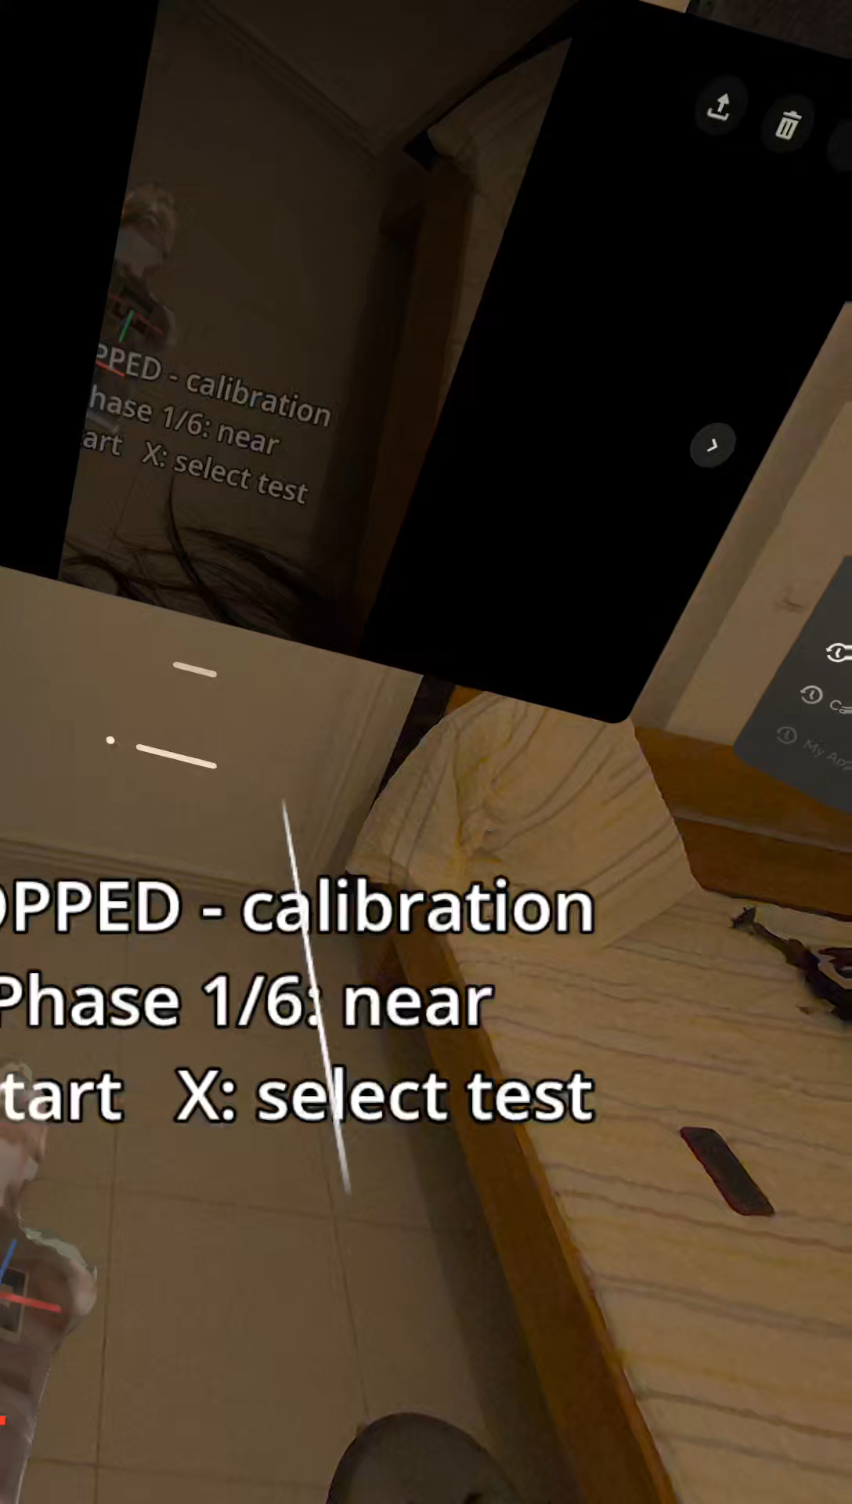
QUESTIONS
1.Filetring
Exp done/Mostafa/filter param found
Wobble reduced
Floor question
Avatar below floor/solved
Edge case scenario
2.ALS/ case from pulmonary embolism,person look blue,orinflamated limbs
3.Meet with Rowan
2.Bettr positioning
3.Accss to data science lab *Ardra,Denis,Paul

Slide 18
Actions:
• coffee
• breakfast
• clean teeth
• leave
Example rule:
clean teeth requires breakfast + coffee.
CCBM for NaReT CPR
CCBM example
NaReT CPR
Question
Few actions
One person
Known causal rules
Parallel actions
Errors + corrections
Multiple sensors
How should the model change?

Slide 19
CCBM FOR NARET
Challenge A — no single “current action”
Coffee / Day example
Real CPR at one moment
A compact action variable can be enough:
current activity = coffee
then breakfast
then clean
…
Person A: chest compressions
Person B: preparing AED
Person A/B: communicating
AED: changing state
exploding
the number of possible states?

Slide 20
Direct CPR translation
Assess patient
Check breathing
Call for help
Start compressions
Use AED
Resume CPR
This is analogous.
Participants can act in parallel, repeat actions, omit steps, correct mistakes, and interact with shared equipment while sensors are uncertain.

Slide 21
Challenge B
Raw inputs
Missing layer
CCBM
RGB cameras
XR hand tracking
Microphone
Mannequin / device sensors
A separate recognition system must convert raw data into:
P(compression)
P(check breathing)
P(AED use)
…
So multimodal labeling_
How do we combine and label all of these so they describe the same CPR action at the same time

Slide 22
Challenge C — learner errors are part of the task
A training system must recognise not only valid actions, but deviations from the expected process.
In the simple domain
In NaReT
Needed modelling decision
The model knows predefined legal actions and their preconditions.
Learner may:
• skip a step
• repeat a step
• do it in wrong order
• perform an unknown action
• make an error and self-correct
• if an observed action would violate a precondition, that trajectory may simply become impossible or very unlikely under the model
How many different wrong sequences should we explicitly model without making the CCBM too large and complicated?
wrong order
repeated step
wrong action
action by wrong person
action too early/too late etc
This is a major difference from the coffee example: mistakes are not noise — they are the behaviour we want to detect.

