Slide 1
Sales & Inventory management System
Implementation in python using pandas

Slide 2
Project Description
Admin Panel
Sales Panel
Facilitating Back-end modification of the stock.
Viewing current Stock position.
Password security to prevent unauthorized access.
Facilitating Front-end sales and billing from the counter.
Automatic Updation of the Stock.
Generating Sales Report

Slide 3
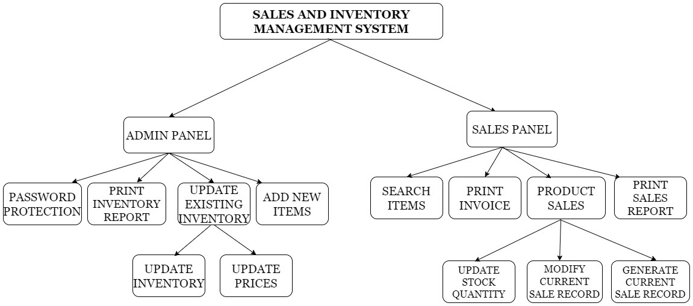
Cartesian Decomposition Expected & final implementation is similar

Slide 4
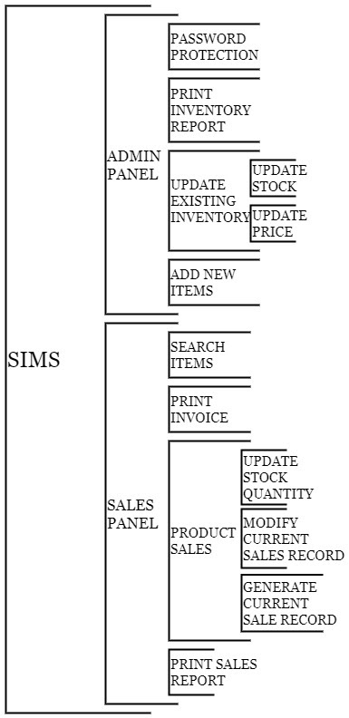
Modular Structure Expected & final implementation is similar

Slide 5
Status of Additional Features
Claimed in project description
Additional Features | Current Status
Password Protection | Implemented
Search Items | Implemented
Modify Current Sales | Implemented

Slide 6
Code Flow

Slide 7
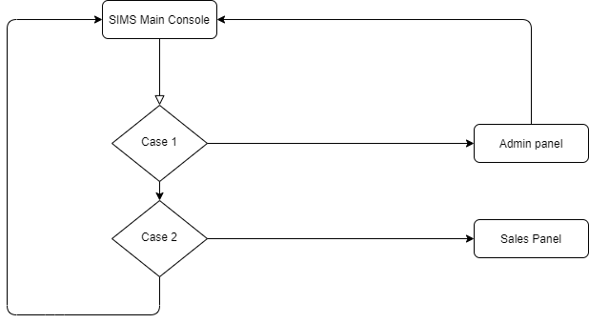
SIMS Main Console

Slide 8

Contributions of Group Members
Akshat Saxena
Ardra Suresh
Admin Panel Designing & Coding .
Sales panel Designing & Coding
Equal contribution in Project Description and Designing of Print Sales Record Node.
The purpose of Cartesian Decomposition is well served as the work is equally divided between both of us.

Slide 9
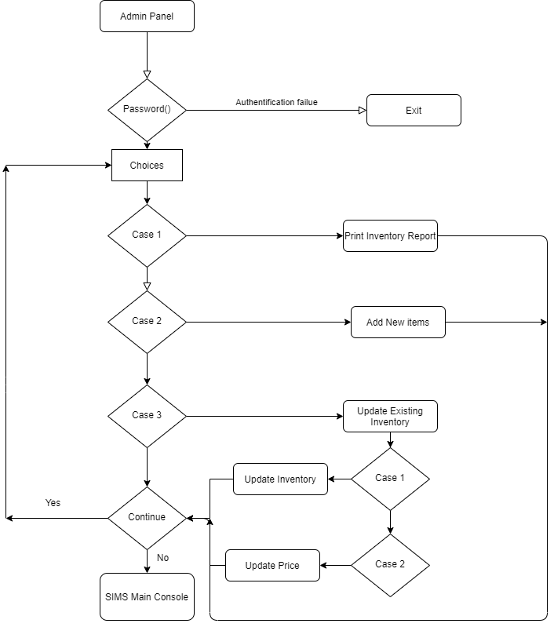
Admin Panel- Code Flow

Slide 10
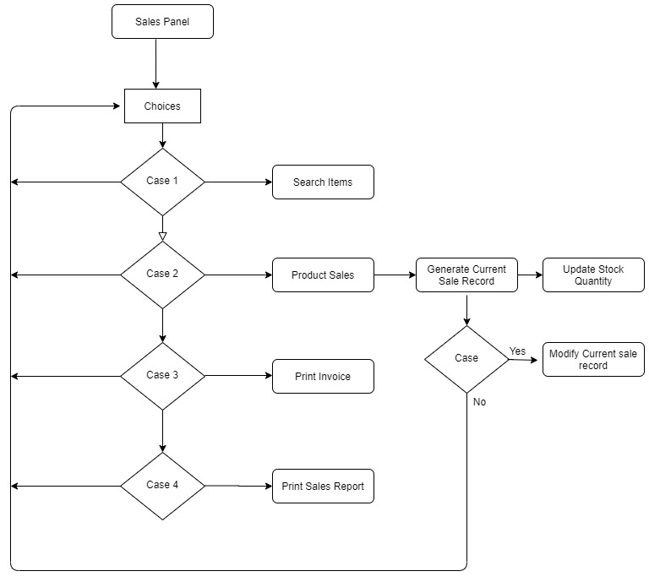
Sales Panel- Code Flow

Slide 11
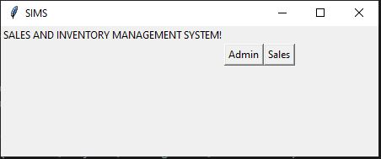
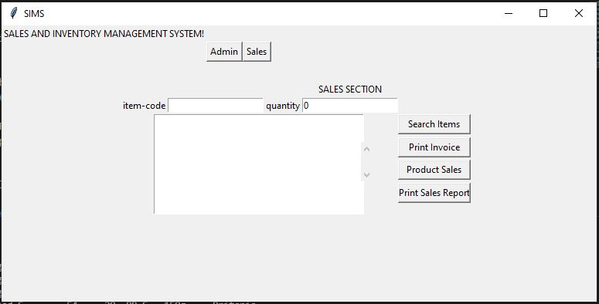
Future Scope:
We tried to implement GUI, but we observed that it is difficult to implement without objects.
Hence as a future scope of this project we are planning to implement the GUI.
The screenshot of the designed GUI is as shown
This GUI is implemented using tkinter library and objects were not used to make this

Slide 12
THANK YOU
Akshat Saxena (MT20137)
Ardra Suresh(MT20143)

