Slide 1

DENTAL VISITORS
ANALYSIS

Slide 2
• Patient Segmentation &
Service Optimization
CURRENT
RELEVANCE
• Revenue & Profit Tracking
• Operational Efficiency
• Marketing & Retention
Notes:
Current Relevance
Patient Segmentation & Service Optimization Understanding who visits (e.g. age groups, treatment types) helps clinics tailor services, appointment scheduling, and marketing strategies.
Revenue & Profit Tracking Analyzing visit trends alongside financial metrics (like average revenue per visit or discount rates) enables better forecasting and pricing decisions.
Operational Efficiency Identifying peak visit times, common procedures, and patient flow helps optimize staffing and resource allocation.
Marketing & Retention Insights into visit frequency and patient demographics support targeted campaigns and loyalty programs.

Slide 3
FUTURE
RELEVANCE
• Rise of Dental Tourism
• Integration with AI &
Predictive Analytics
• Personalized Care &
Experience Design
• Strategic Expansion &
Partnerships
Notes:
Future Relevance
• Rise of Dental Tourism
The global dental tourism market is projected to grow from $10.8 billion in 2023 to over $43 billion by 2030, driven by demand for affordable, high-quality care. Clinics that analyze visitor data can better attract and serve international patients.
• Integration with AI & Predictive Analytics
Future dashboards may use machine learning to predict patient churn, treatment needs, or even detect anomalies in visit patterns.
• Personalized Care & Experience Design
As patient expectations rise, data-driven personalization (e.g. treatment reminders, tailored offers) will become a competitive advantage.
• Strategic Expansion & Partnerships
Clinics can use visitor analytics to identify underserved regions, plan new branches, or collaborate with travel and wellness providers.

Slide 4
DATASET
Patient Name
X-Ray Cost
Gender
OPD Cost
Age
Lab Charges
Visit Date
Discount
Consulted By
Total Paid
Treatment
Due
Patient Type
Profit
Treatment Cost
Payment Method

Slide 5
KEY
INSIGHTS
Total Revenue
₹ 18,95,579.80
Total Patients
897
Total Profit
₹ 14,75,629.80

Slide 6
KEY
INSIGHTS
Outstanding Dues
₹ 62,781
Average Treatment Cost
₹ 2,113.24
Average Discount
₹ 53.78

Slide 7
ISSUES IDENTIFIED
&
RECOMMENDATIONS
Evaluate Dr. Karan's
consultation duration
and gather patient feedback
regarding the quality
of care provided.

Slide 8
ISSUES IDENTIFIED
&
RECOMMENDATIONS
• OPD + X-Ray and OPD alone account for over 80% of total treatments.
Indicates that initial consultations and diagnostics are the clinic’s primary touchpoint.

Slide 9
ISSUES IDENTIFIED
&
RECOMMENDATIONS
• Cleaning is the most common procedure after diagnostics.
Suggests good patient awareness or clinic emphasis on hygiene.

Slide 10
ISSUES IDENTIFIED
&
RECOMMENDATIONS
• Cosmetic treatments (Braces, Bleaching) are more frequent than restorative ones (Filling, Crown, RCT).
May reflect patient priorities: appearance > function

Slide 11
ISSUES IDENTIFIED
&
RECOMMENDATIONS
• RCT, Crown, and Filling are relatively low.
Could be due to:
Cost barriers
Lack of awareness
Preference for extraction over restoration

Slide 12
ISSUES IDENTIFIED
&
RECOMMENDATIONS
• Highlight success stories and benefits of implants and braces.
Offer EMI plans or bundled packages to increase accessibility
Notes:
1. Implants & Braces Drive Revenue
• These two treatments alone contribute over ₹14.8 lakh, indicating strong demand for premium and cosmetic services.
2. High-Volume Services Yield Low Revenue
• OPD and OPD + X-Ray are frequent but contribute less than ₹1.4 lakh combined.
• Suggests they are entry-point services, not revenue drivers.
3. Restorative Treatments Underperform
• RCT, Crown, and Filling together generate less than ₹1.7 lakh.
• May reflect cost sensitivity, lack of awareness, or preference for extraction.
4. Preventive & Cosmetic Services Show Potential
• Bleaching and Cleaning have moderate revenue, indicating room for growth with better packaging or promotion.

Slide 13
ISSUES IDENTIFIED
&
RECOMMENDATIONS
• Use OPD visits to explain the value of RCT, crowns, and fillings.
• Create packages like “Smile Makeover” (Cleaning + Bleaching).
Notes:
1. Implants & Braces Drive Revenue
• These two treatments alone contribute over ₹14.8 lakh, indicating strong demand for premium and cosmetic services.
2. High-Volume Services Yield Low Revenue
• OPD and OPD + X-Ray are frequent but contribute less than ₹1.4 lakh combined.
• Suggests they are entry-point services, not revenue drivers.
3. Restorative Treatments Underperform
• RCT, Crown, and Filling together generate less than ₹1.7 lakh.
• May reflect cost sensitivity, lack of awareness, or preference for extraction.
4. Preventive & Cosmetic Services Show Potential
• Bleaching and Cleaning have moderate revenue, indicating room for growth with better packaging or promotion.

Slide 14
ISSUES IDENTIFIED
&
RECOMMENDATIONS
In March and November promote premium treatments or packages during these months.
May–September shows low engagement.
Consider:
Seasonal discounts
School holiday campaigns (targeting families)
Preventive care drives

Slide 15
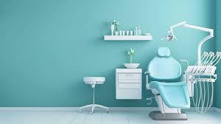
CONCLUSION
Revenue is primarily driven by high-value treatments.
Routine and restorative services showed low revenue performance.
Implants and braces are the most profitable, suggesting strong demand for cosmetic and premium care.
OPD and X-Ray services, while high in volume, generate minimal revenue—highlighting a need for better conversion strategies.
Notes:
Project Conclusion: Dental Visitors Analysis
The dental visitors analysis revealed that revenue is primarily driven by high-value treatments such as implants and braces, which together contribute over 70% of total earnings. In contrast, routine and restorative services like fillings, RCTs, and cleanings showed low revenue performance, indicating potential gaps in patient awareness or treatment conversion.
Key insights include:
• Implants and braces are the most profitable, suggesting strong demand for cosmetic and premium care.
• OPD and X-Ray services, while high in volume, generate minimal revenue—highlighting a need for better conversion strategies.
• Preventive and restorative treatments are underutilized, presenting opportunities for targeted education and bundled offerings.
Strategic recommendations were proposed to:
• Promote high-margin treatments through packaging and financing options.
• Improve consultation-to-treatment conversion rates.
• Enhance uptake of preventive and restorative care via patient education and seasonal campaigns.
This project enabled data-driven decision-making to optimize service offerings, improve revenue mix, and align treatment strategies with patient behavior.

Slide 16
CONCLUSION
Preventive and restorative treatments are underutilized, presenting opportunities for targeted education and bundled offerings
Strategic recommendations were proposed to:
Promote high-margin treatments through packaging and financing options.
Improve consultation-to-treatment conversion rates.
Enhance uptake of preventive and restorative care via patient education and seasonal campaigns.
Notes:
Project Conclusion: Dental Visitors Analysis
The dental visitors analysis revealed that revenue is primarily driven by high-value treatments such as implants and braces, which together contribute over 70% of total earnings. In contrast, routine and restorative services like fillings, RCTs, and cleanings showed low revenue performance, indicating potential gaps in patient awareness or treatment conversion.
Key insights include:
• Implants and braces are the most profitable, suggesting strong demand for cosmetic and premium care.
• OPD and X-Ray services, while high in volume, generate minimal revenue—highlighting a need for better conversion strategies.
• Preventive and restorative treatments are underutilized, presenting opportunities for targeted education and bundled offerings.
Strategic recommendations were proposed to:
• Promote high-margin treatments through packaging and financing options.
• Improve consultation-to-treatment conversion rates.
• Enhance uptake of preventive and restorative care via patient education and seasonal campaigns.
This project enabled data-driven decision-making to optimize service offerings, improve revenue mix, and align treatment strategies with patient behavior.

Slide 17
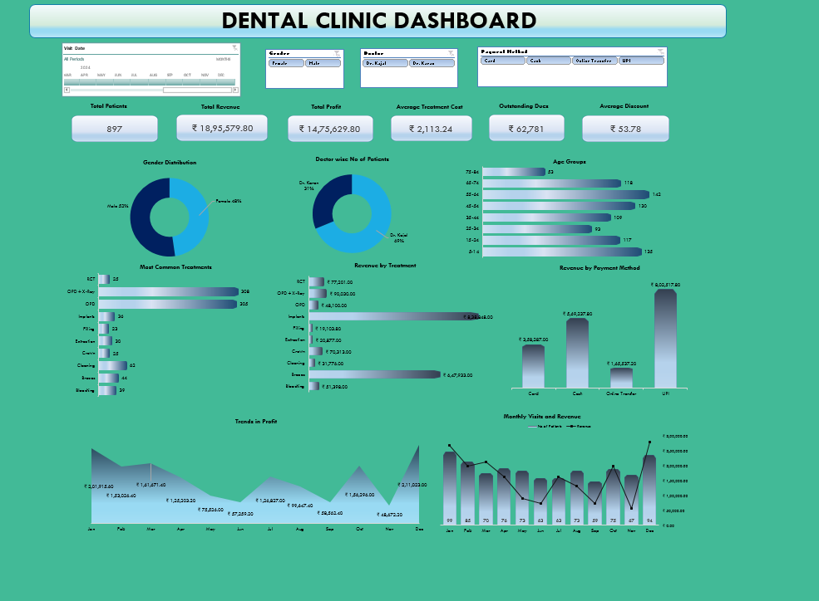

Slide 18
THANK
YOU

